Slide 1





HOW TO BE CONFIDENT
even if you’re not

Slide 2
TABLE OF CONTENT
01
THE RESON WHY I CHOSE THIS TOPIC
03
QUESTIONS
02
THE VOCABULARY AND THE CONTENTS OF THE VIDEO
04
ACTIVITY

Slide 3
01
THE RESON WHY I CHOSE THIS TOPIC

Slide 4
THE RESONS
a
Because I need it.
I don’t have confident.
Even if someone tells me, “You’re fine, so be confident,” I still can’t feel confident and just get nervous.
I stood in front of people many times — yet I was never confident.
But without confidence, it’s hard to be convincing.That’s why
this TED talk feels perfect for me.

Slide 5
02
THE VOCABULARY AND THE CONTENT

Slide 6
VOCABULARY
Authenticity
Being true to who you really are — your values, your feelings, and your identity — instead of pretending to be someone else.
Vulnerability
The willingness to show your emotions, admit your weaknesses, and be open — even when it feels uncomfortable or risky.

Slide 7
CONTENTS
1
Turn up the energy and speak up
2
Pause like a boss
3
Superhero stance
practice with purpose
4
Find your silent sentence
5

Slide 8
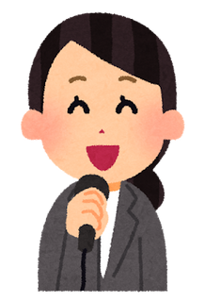
CONTENTS
Turn up the energy and speak up
1
Aim to speak at a level 5 on a 1–10 scale.
Speaking even a little louder helps me appear more confident.
⚠️However, it’s not about simply shouting.

Slide 9
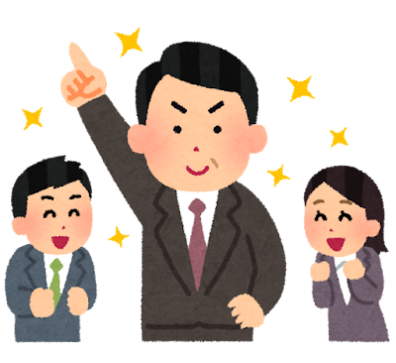
CONTENTS
Pause like a boss
2
People who are nervous tend to speak faster and fill silences with filler words.
Rather than just slowing down, it’s important to use
strategic pauses.

Slide 10
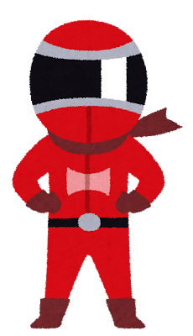
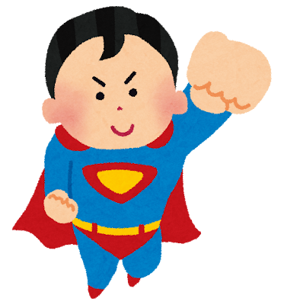
CONTENTS
Superhero stance
3
Stand with good posture—chest up and a smile—and make eye contact.
Just make a shape.
But don’t overdo it!

Slide 11
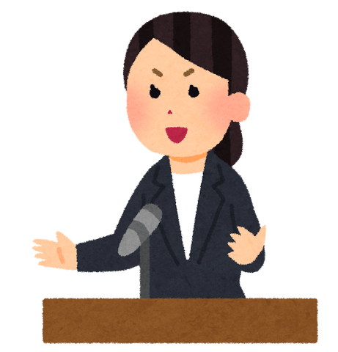
CONTENTS
practice with purpose
4
Set specific goals and practice by achieving them one by one. Consistent short practice sessions are essential.
⚠️Avoid writing a full script.
Use bullet points and speak while thinking on the spot.
Stand up and practice speaking out loud.

Slide 12
CONTENTS
Find your silent sentence
5
Find your silent sentence.
Think about what you want to communicate through your presentation.And use that as the basis for creating your script.

Slide 13
03
QUESTIONS

Slide 14
QUESTIONS
1.What is the difference between real confidence and pretending to be confident?
2.Is vulnerability a strength or a weakness?

Slide 15
MY ANSWER
1.Real confidence comes from accepting who I am. Pretnding to be confident means convincing yourself, even for a moment, that everything you do is right.
2.Vulnerability is not a weakness.
Because it takes courage to show your weaknesses—and having that courage already makes you strong.

Slide 16
04
ACTIVITY

Slide 17
ACTIVITY
PRESENTATION CHECKUP
Let’s start by thinking about your most recent presentation. You’ll see 15 questions.
Add 1 point for “Yes” and 0 points for “No.”

Slide 18
Turn up the energy and speak up
1
Q1. I speak at about a level 5 on a 1–10 scale.
Q2. I shift from my usual way of speaking to a presentation style.
Q3. My speaking style is clear and easy for the audience to follow.

Slide 19
Pause like a boss
2
Q4. I can stay silent without using filler words.
Q5. I’m not speaking too fast.
Q6. I use pauses strategically for emphasis or impact.

Slide 20
Superhero stance
3
Q7. I stand with good posture and an open stance.
Q8. I keep a natural smile and relaxed expression.
Q9. I use eye contact appropriately.

Slide 21
practice with purpose
4
Q10. I practice with clear, specific goals.
Q11. I prepare bullet points instead of a full script.
Q12. I practice standing up and speaking out loud.

Slide 22
Find your silent sentence
5
Q13. I have a mindset that helps me stay calm before speaking.
Q14. I have a clear message for my presentation.
Q15. My main message is built into my script.

Slide 23
ACTIVITY
WHAT IS YOUR SCORE?
3–15 points：You look completely confident.
10–12 points：You look mostly confident.
7–9 points：You’re on the right track.
0–6 points：A great place to start.

Slide 24
REFERENCE
Montana von Fliss
How to be confident (even if you’re not)
https://www.youtube.com/watch?v=eVFzbxmKNUw

Slide 25
THANK
YOU

