Slide 1

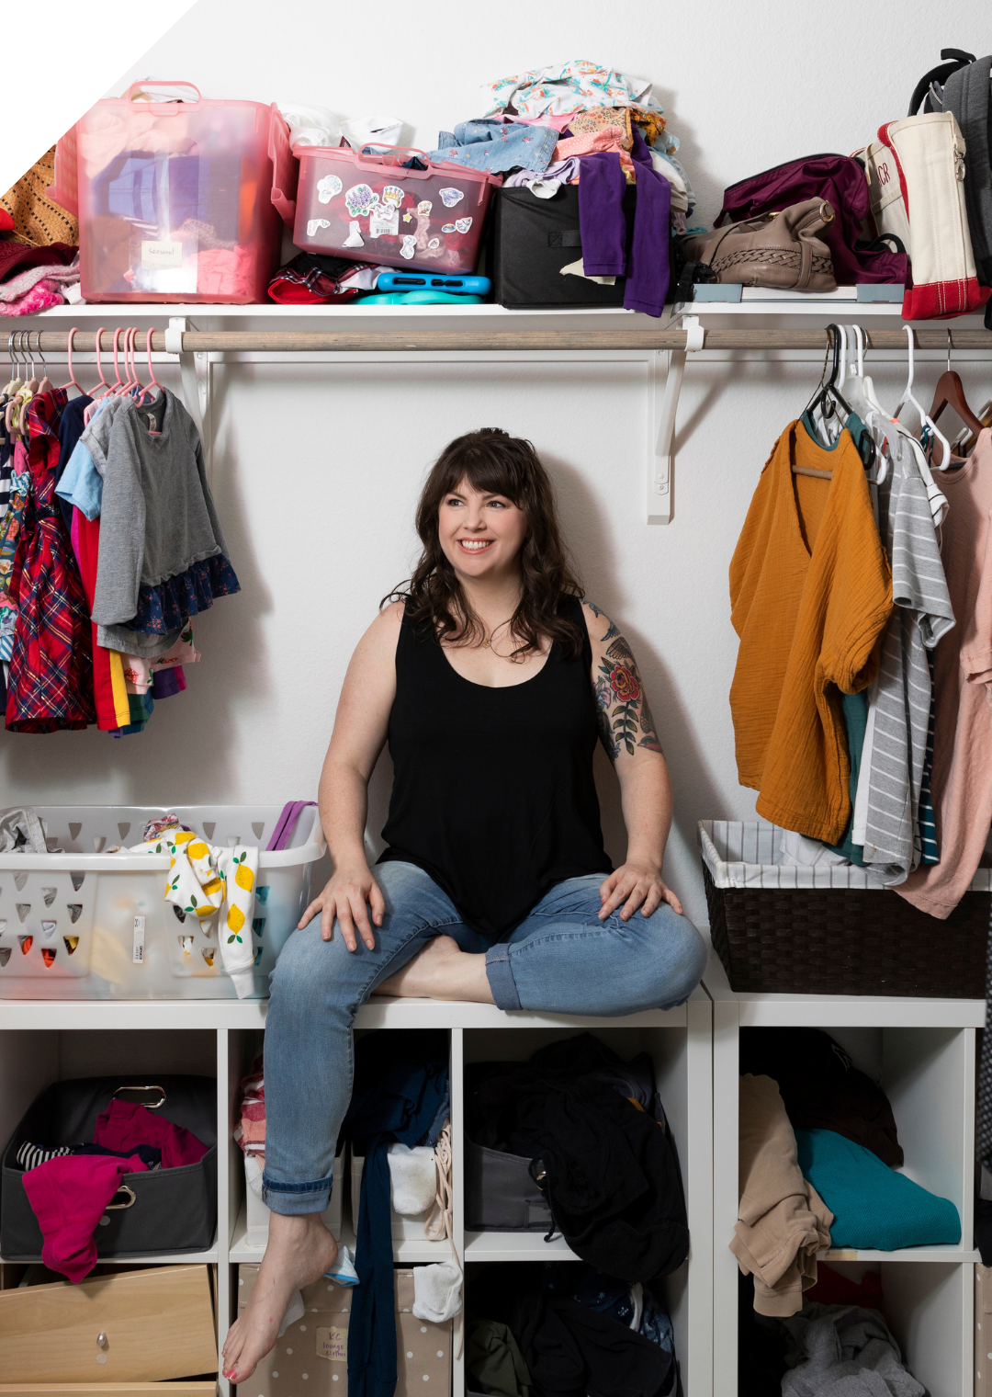
How to do laundry when you’re depressed
KC Davis
・A licensed professional counselor

Slide 2
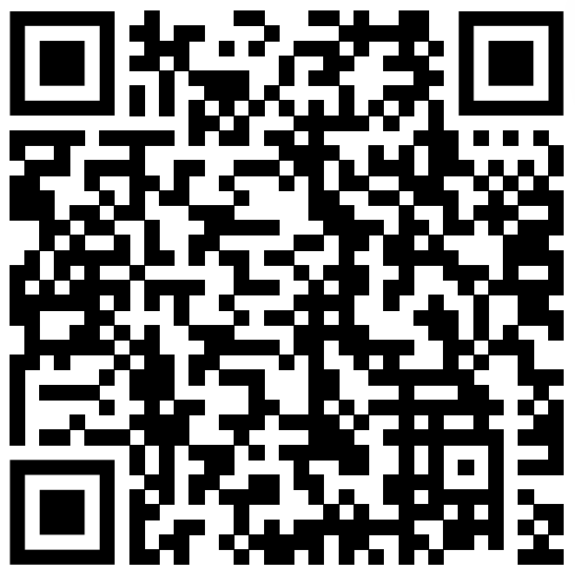
Watch Here
https://www.ted.com/talks/kc_davis_how_to_do_laundry_when_you_re_depressed_jan_2022

Slide 3
Why I chose this TED Talk
I think that simple care tasks can start to feel so stressful as you continue to procrastinate.
I found the presenter’s idea of changing the way you view care tasks very interesting.

Slide 4
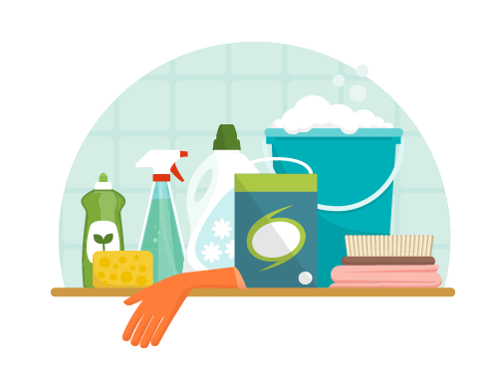
Summary & Vocabulary
Care tasks
: Doing the laundry, washing the dishes, cooking, brushing your teeth…
: For people who are struggling with depression, ADHD, burnout, or enduring hardships, it can be a very difficult task to complete.
Why?
: your incapability of doing care tasks can seem like representations of your failure as a person.

Slide 5
・“Care tasks are morally neutral.”
: it does not make you a good person or a bad person
: your ability to perform care tasks does not define your worth
・Care tasks as a matter of “functionality”
: you can work within the current barriers to improve your life that day
: you can make shortcuts to make it easier for yourself

Slide 6
Quiz
Why did the presenter’s support for taking care of her children disappear one day?
What is unlikely your therapist will ask you about?
What was the question the presenter asked herself when folding a baby onesie?

Slide 7
What is the presenter’s new motto?
When do people exhibit mind-blowing creativity?

Slide 8
Opinion
The presenter introduces a very interesting idea of how to change the way you think about care tasks in order to have more compassion for yourself when you are struggling.
I think the method can be applied to other things by separating your performance or your personal traits from the how you value yourself as a person.

