Slide 1









How to find work you love

Slide 2
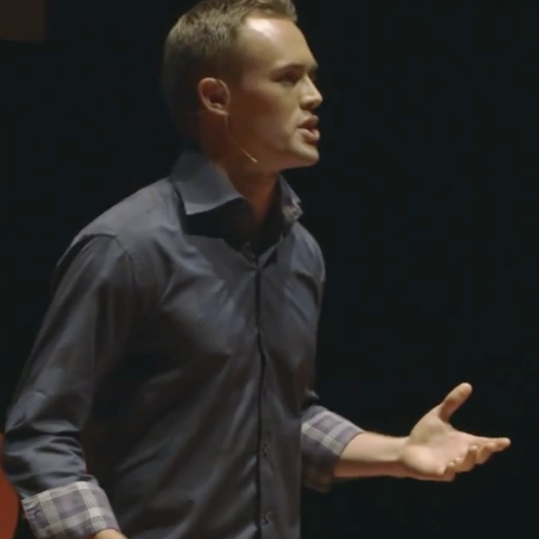
TED
https://www.ted.com/talks/scott_dinsmore_how_to_find_work_you_love?subtitle=ja

Slide 3
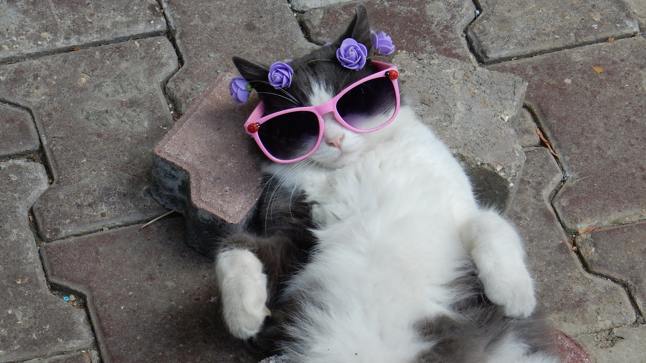
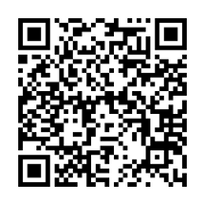
transcription
click me or scan this QR
*after click this cat, you will have a google document of transcription

Slide 4
why i chose this?
It’s always difficult to find a job which is fun ＆ good paid. I have done so many part-time job such as in supermarket, convenience store, teacher, ramen shop etc...
But not all of these job wasn’t something I love. Even though, I really liked the job, the pay was not good enough.
In a part-time job, you can easily change jobs if you don't like them. But full-time jobs cannot be changed so easily. The topic of how to choose a job you like is a very important issue for job-hunting university students.
That is why I chose this TED talk!!

Slide 5
vocabulary&grammar
Credit: Longman Dictionary of Contemporary English Online
・assimilate
to completely understand and begin to use new ideas, information etc
・repository
a place or container in which large quantities of something are stored
・flail
to wave your arms or legs in an uncontrolled way
・limp
not firm or strong
・plop
the sound made by something when it falls or is dropped into liquid
・complacency
a feeling of satisfaction with a situation or with what you have achieved, so that you stop trying to improve or change things – used to show disapproval
・hound
to keep following someone and asking them questions in an annoying or threatening way

Slide 6
engaging Questions
1.
What are the three frameworks mentioned by the speaker for understanding what is important to you?
What does the speaker state is a good place to start in doing the impossible or pushing the limit? And why?
Write here Answer !
2.
Write here Answer !

Slide 7
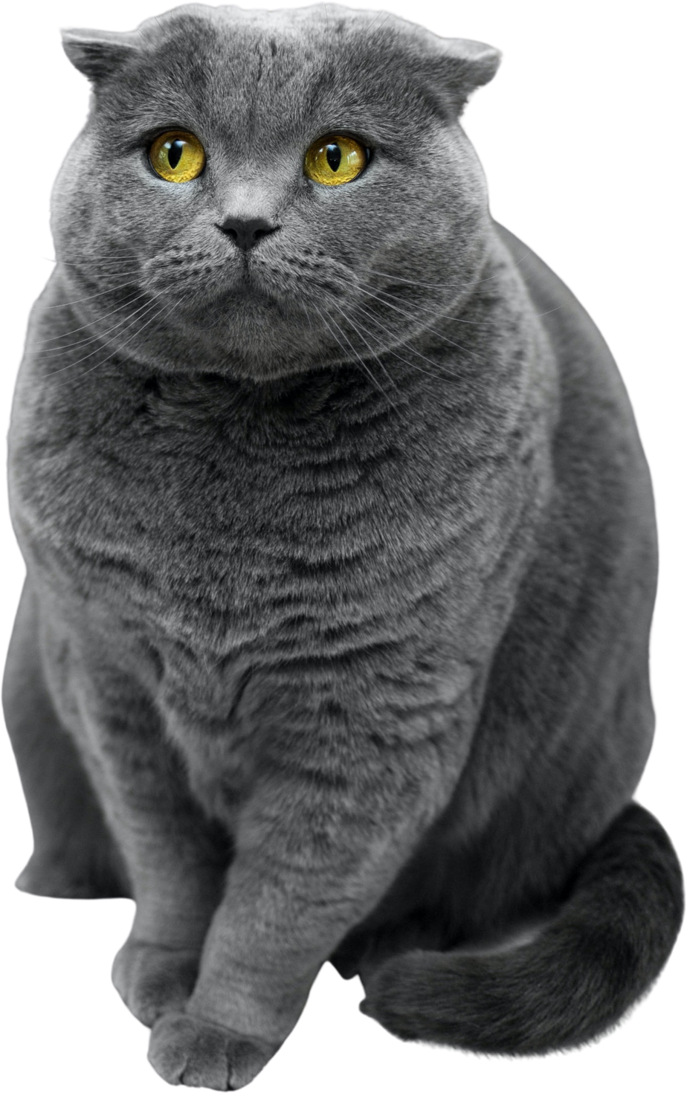

fun activity
3.
Based on the speaker's theory, what is the best job for this cat?

Slide 8

fun activity
3.
Based on the speaker's theory, what is the best job for this cat?
I have always been told that I am observant.
I noticed immediately when a friend's cat was hiding something. I was also physically fit, and when I was a student I often played in clubs until the morning. I would rather have a job that is fun and exciting every day than one that pays well. I am not good at desk jobs.

Slide 9
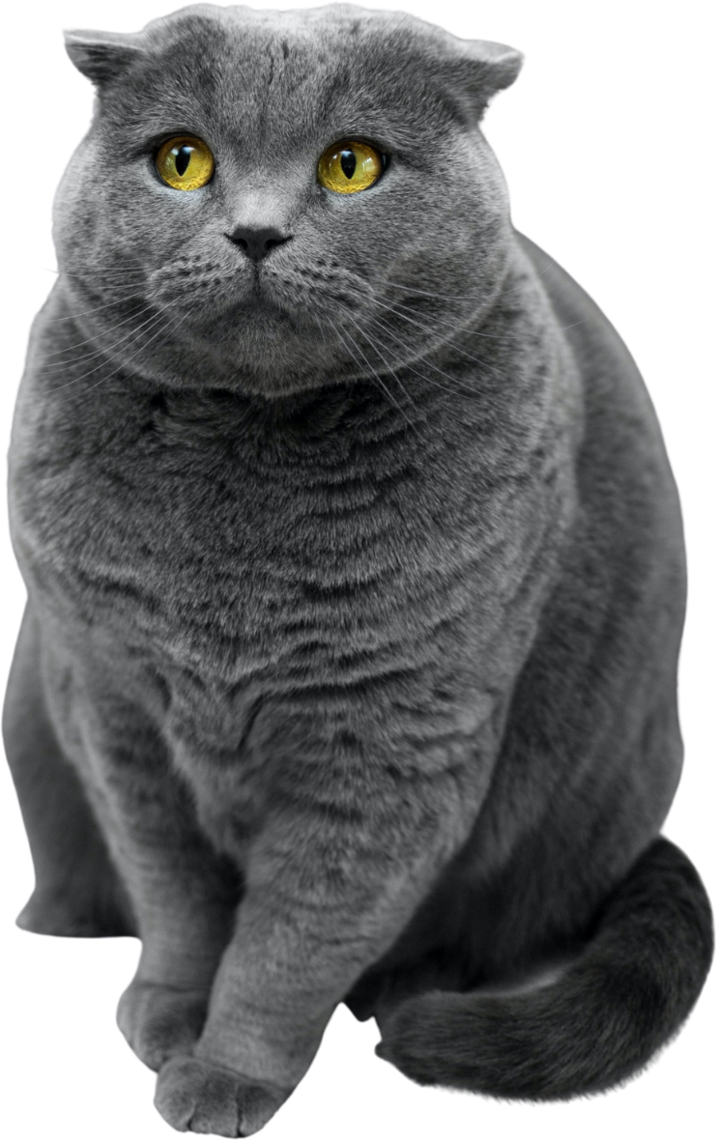
fun activity
3.
Based on the speaker's theory, what is the best job for this cat?
A. Detective
B. Teacher
C. Dancer

Slide 10
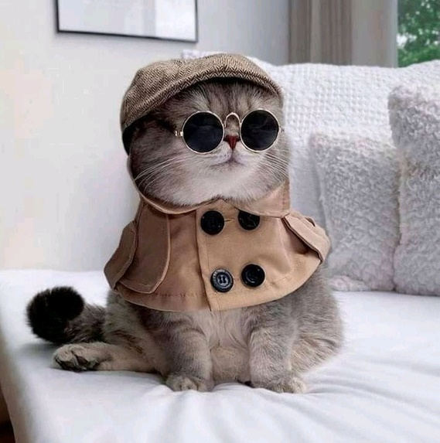
answer
1.
What are the three frameworks mentioned by the speaker for understanding what is important to you?
→Unique Strengths, Values and Experience.
What does the speaker state is a good place to start in doing the impossible or pushing the limit? And why?
→Start with our physical body and fitness, because we can control that.
A) Detective
2.
3.

Slide 11
Thank
You

