Slide 1
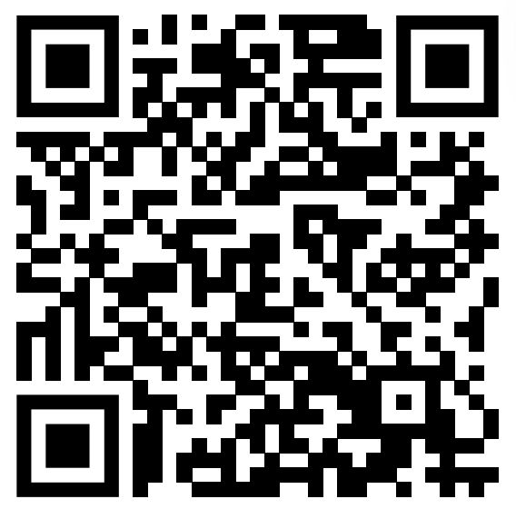
Q. What is “stress” for you?
Harmful? Enjoyable? Something unnecessary for your life?
Your idea towards stress may make stress bad for you.

Slide 2






Kelly Mcgonigal: How to make stress your friend

Slide 3
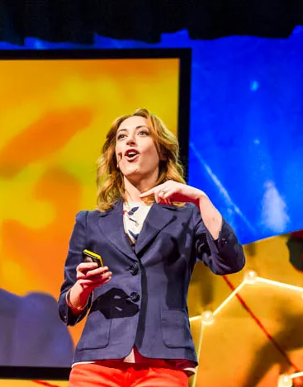
Interesting point
Content is mainly about latest research of “How to deal with stress”.
Idea of the stress resilience reminds me a lot about a book named “On life” by Leo Tolstoy.
How latest research about stress and 130 years old idea of life similar?

Slide 4
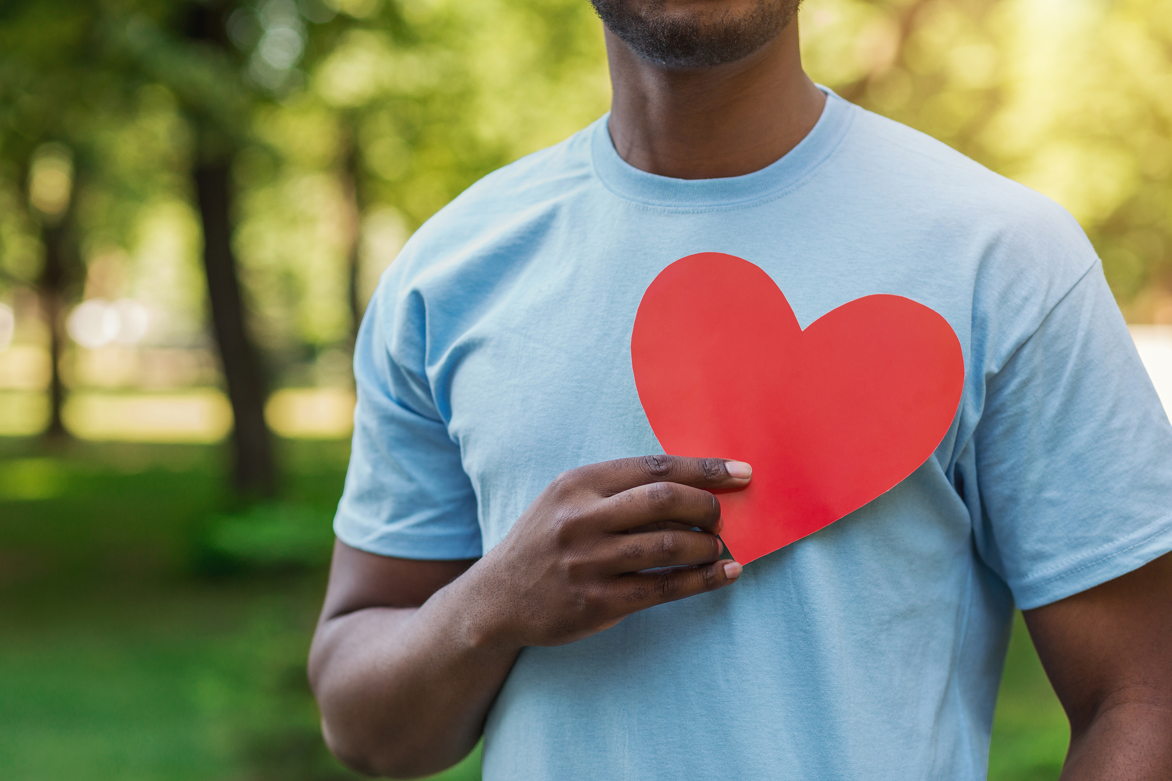
Stresses and our bodies
・Idea of “Stress is harmful” is harmful.
・People who believe stress is harmful have a higher rate of stress-related deaths than those who believe it is harmless.
・To think stress sign as good sign makes body signs change.

Slide 5
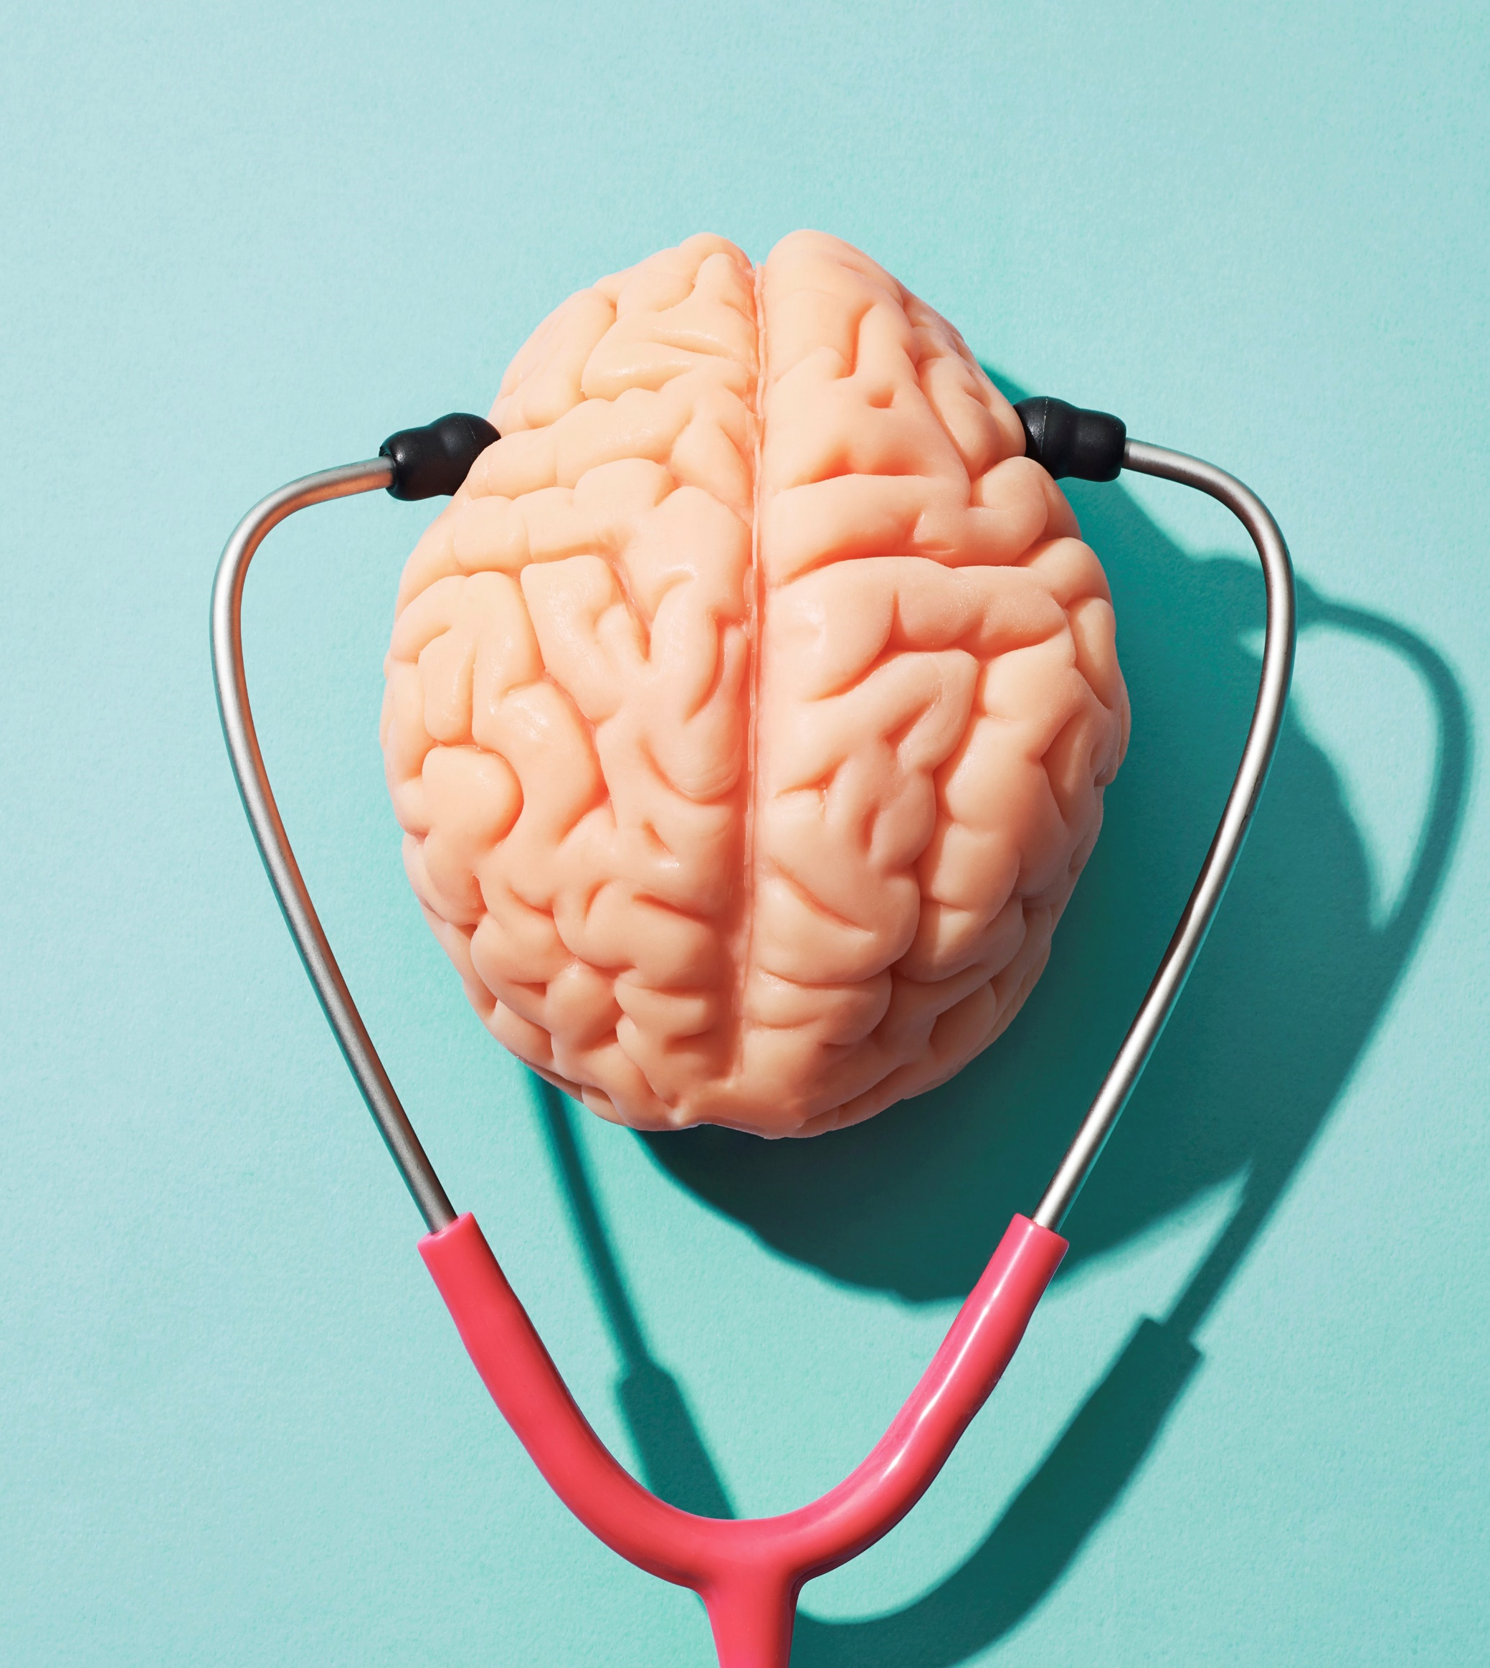
Oxytocin, anti-stress hormone
・Source of stress is adrenalin.
・When adrenalin is released, oxytocin become ready to be released.
・Oxytocin makes our stress resilience.
・When we are cared by someone or care someone, oxytocin is released in our brain.

Slide 6
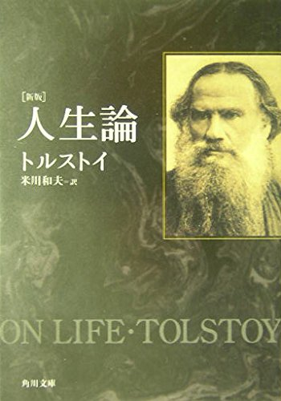
Tolstoy’ｓ “On Life”
Tolstoy says that caring someone is happiness itself for humans.

Slide 7
Conclusion
To change the way of thinking makes you easier to deal with stresses.

Slide 8
Vocabulary list
Cardio vascular
Demoralize
Chronic
Receptor
Resilience

