Slide 1
How to Make Our Presentation More Persuasive

Slide 2
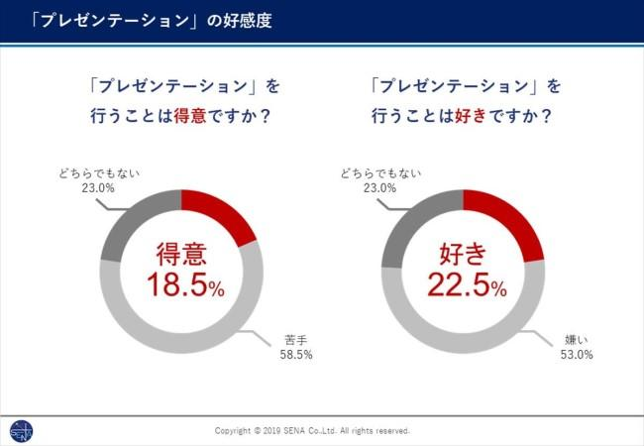
Japanese is struggling with doing Presentation
I discussed on “How To Win An Argument With RuPaul” before

Slide 3

My question
How can we improve our presentation skill and make our presentation more persuasive?

Slide 4

I found one TED talk
How to sound smart in your TEDx Talk | Will Stephen | TEDxNewYork
  He taught many things by talking about“nothing”

Slide 5
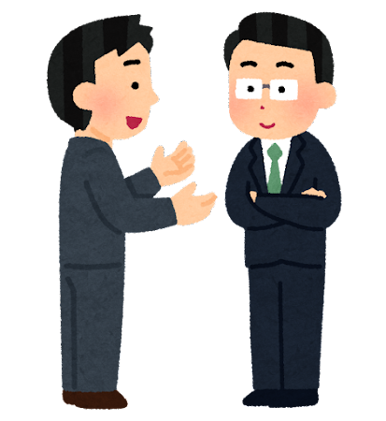
To use non-verbal language
You don’t have to speech everything with your words
  You can use gesture , voice tone or something
Words have only a few percentage on overall communication
  Using non-verbal language makes you look more confident

Slide 6
To involve audience into your presentation
Ask audience some questions
  Asking for a show of hands is also good
Or, talk your personal episode to attract attention
  Something like funny one
Non-verbal language works brilliantly here

Slide 7

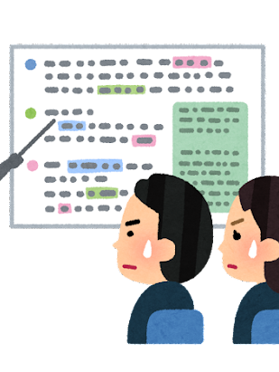
To use images and graphs
Watching only characters is so boring
  Illustration, statistics, and so on
  To show some authorities’ name is effective
Next slide is the example

Slide 8
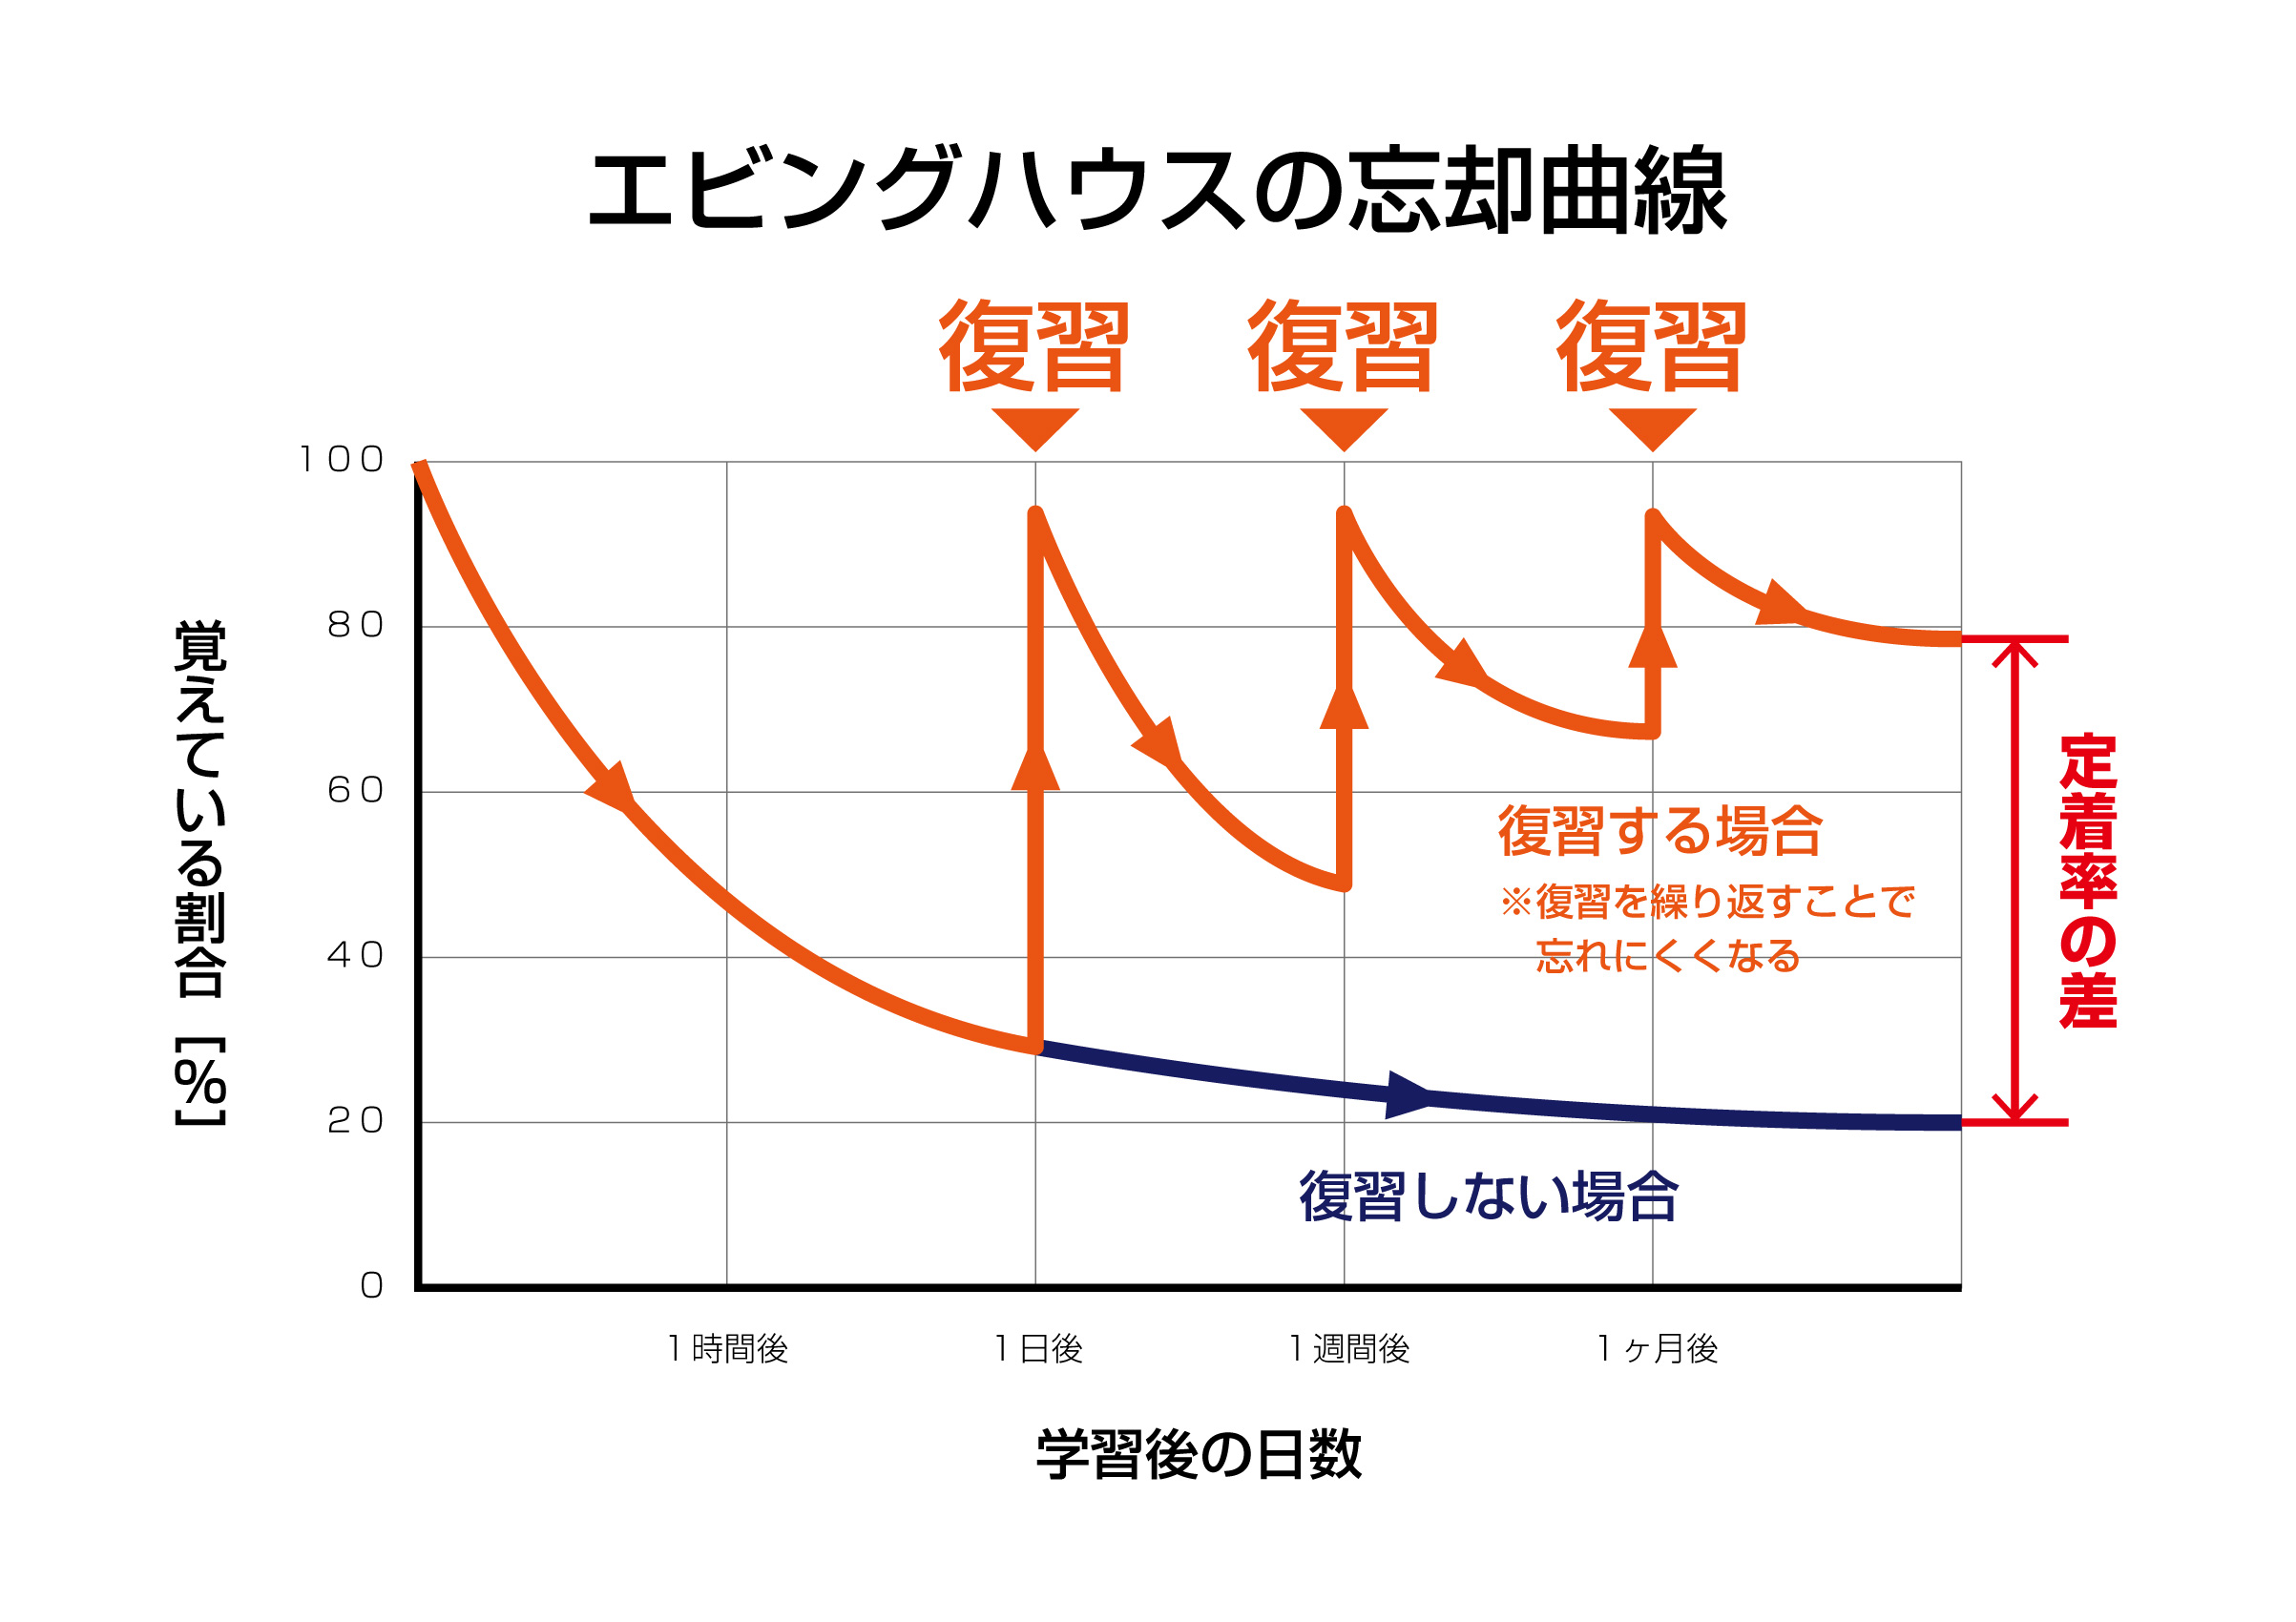

Example:To use effective methods
Making the vocabulary or something into long-term memory is important
Using apps like Mikan,
Anki is easier

Slide 9
Let’s make your presentation!
Make your presentation and maximize influence of your speech
  What material to use…
  How long…
  What is your conclusion…
  etc
Write down on paper, PowerPoint file or something and start practicing now!

Slide 10
My answer to the question
To use non-verbal language
To involve audience into your presentation
To use images and graphs
Finally, be confident!

Slide 11
References
プレゼンテーションが「嫌い」な人は53.0%--「苦手」は58.5% - CANVAS https://mynavi-agent.jp/dainishinsotsu/canvas/2023/03/post-931.html
How to sound smart in your TEDx Talk | Will Stephen | TEDxNewYork
https://www.youtube.com/watch?v=8S0FDjFBj8o

Slide 12
Thank you for listening!

