Slide 1
How to stop languishing and start finding flow

Slide 2
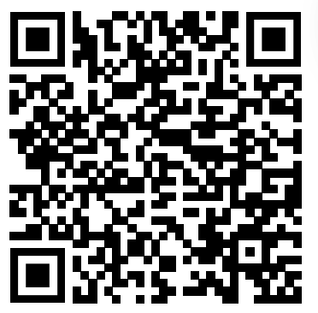
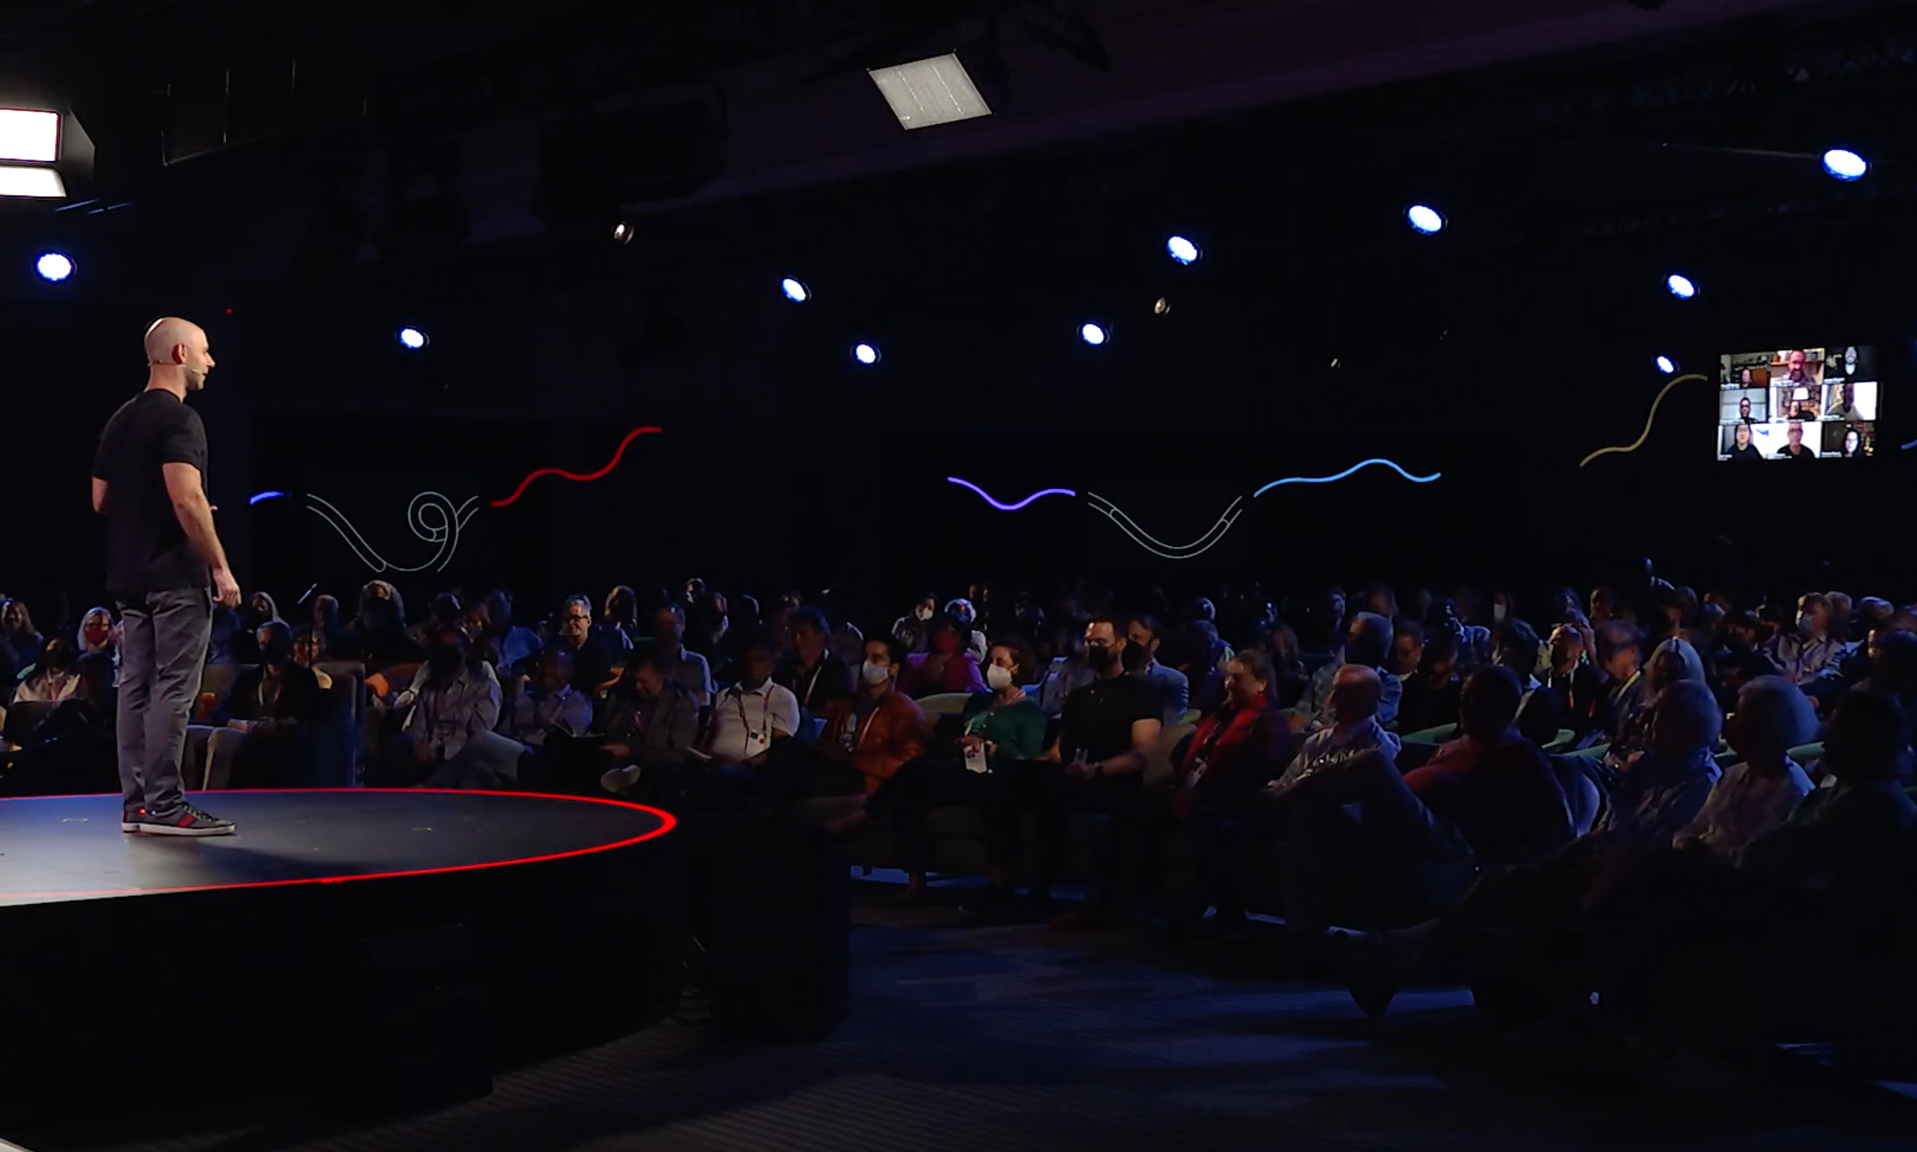
https://www.ted.com/talks/adam_grant_how_to_stop_languishing_and_start_finding_flow

Slide 3
Why I chose this topic
I often felt this way during the pandemic, and still struggle with this emotion sometimes
I want to be able to get out of this mindset and feel better about myself

Slide 4
Vocabulary
Languishing
to exist in an unpleasant or unwanted situation
Isolation
the condition of being alone, especially when this makes you unhappy
Toxic Positivity
the pressure to only display positive emotions, suppressing or avoiding negative emotions
Revenge Bedtime Procrastination
staying up late needlessly in order to feel in control of their life

Slide 5
Question 1
Who was found to be happier, those who could think of more things that made them happy, or less?
①more
②less

Slide 6
Question 2
What is mindfullness?
①focusing on yourself
②thinking about what makes you happy
③focusing your attention on one task

Slide 7
Question 3
Time confetti is an enemy of energy and?
① time
② happiness
③ excellence

Slide 8
Question 4
What three things do we need in order
to find flow?
A. , , ,

Slide 9
Answers
Q.1 less
Q.2 focusing your full attention on one task
Q.3 excellence
Q.4 mastery, mindfulness, and mattering

Slide 10
So…
①The antidote to languish doesn’t have to be productive
as long as it makes you happy!
②Find something that you can enjoy with the people you love!
③Find the flow with mastery, mindfulness, and mattering!

Slide 11
Thank you for reading!!

