Slide 1
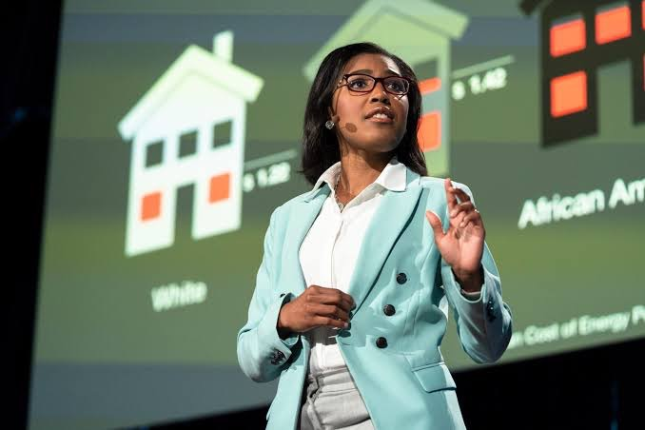

How we can make energy more affordable for low-income families
-DeAndrea Salvador
https://www.ted.com/talks/deandrea_salvador_how_we_can_make_energy_more_affordable_for_low_income_families

Slide 2
Why I chose this TEDTALK
・I was interested in this project because I have seen news reports of needy people in Japan dying from heat stroke in the summer and hypothermia in the winter.
・I decided to look at this Ted Talk because I've found that my own utility costs fluctuate greatly with the seasons when I live alone myself.
・I felt that the people who actually use renewable energy in their daily lives are the wealthy who can afford it, and that it is not reaching the people who originally need it.

Slide 3
Newly learned vocabulary
Burden
a duty, responsibility, etc. that causes worry, difficulty or hard work
Disproportionately
in a way that is too large or too small when compared with something else
Resilient
able to recover quickly after something unpleasant such as shock, injury, etc.
Inequities
something that is unfair; the state of being unfair

Slide 4

Engaging questions
・What else can the government do for those who can't afford to pay their utility bills other than to pay for assistance?
Offer to spend time in large, air-conditioned facilities.
・Is paying assistance to those who cannot pay their utility bills a fundamental solution?
Not really, for fundamental solution,we need to coorporate eath other.
・How much do you think about your utility costs?
It cost about 8000￥

Slide 5
Quiz Activity
１.How many people are estimated to have skipped meals to provide energy costs in 2015
(a)20million (b)25million (c)30million (d)35million
2.How much money does the US spend a year on energy bill payment assistance
(a)1 billion (b)3billion (c)10billion (d)30billion
3. In the Ted Talk she says that she can overcome the supposedly impossible choices?
(a)Truth (b)False
4.What was the name of the nonprofit group she found
(a)RETY (b)RTEI (c)LETI (d)RETI

