Slide 1



BUSINESS & INNOVATION IN AFRICA

Slide 2

How to counter social problems in developing countries?
Poor infrastructure
Lack of access to medical care
Poverty
Education
Climate change & disasters
Natural conservation
And so on...
The problems are interconnected

Slide 3





IS FOREIGN AID THE ONLY SOLUTION?

Slide 4



MAYBE
BUSINESS
COULD
HELP, TOO.
LET US LISTEN TO A TALK
by KELLER RINAUDO ClLIFFTON,
IN WHICH HE DISCRIBES HOW HIS START-UP COMPANY HAS HELPED RWANDAN HEALTH CARE SYSTEM TO SAVE MORE LIVES.

Slide 5
I chose this topic because...
-I am interested in entreneureship
-I thought the following messages could be interesting to my classmates
Business can change the world in a better way
Africa’s immense potential
Significance of not being developed
=leapfrog
1
2
3
In this talk, the speaker discribles how his company, Zipline has brought about a change in terms of medical care in Rwanda, Africa.
Rwanda was the first country to use drones for medical logistics in a national scale. Innovations are starting in Africa!
This talk shows why not being a developed country is an asset in terms of innovation.

Slide 6

Vocab
Transfuse
To transfer blood or its components from one person to another
Following childbirth
Postpartum
To desire to promote the welfare of others, expressed especially by the generous donation of money to good causes
Philanthropy

Slide 7
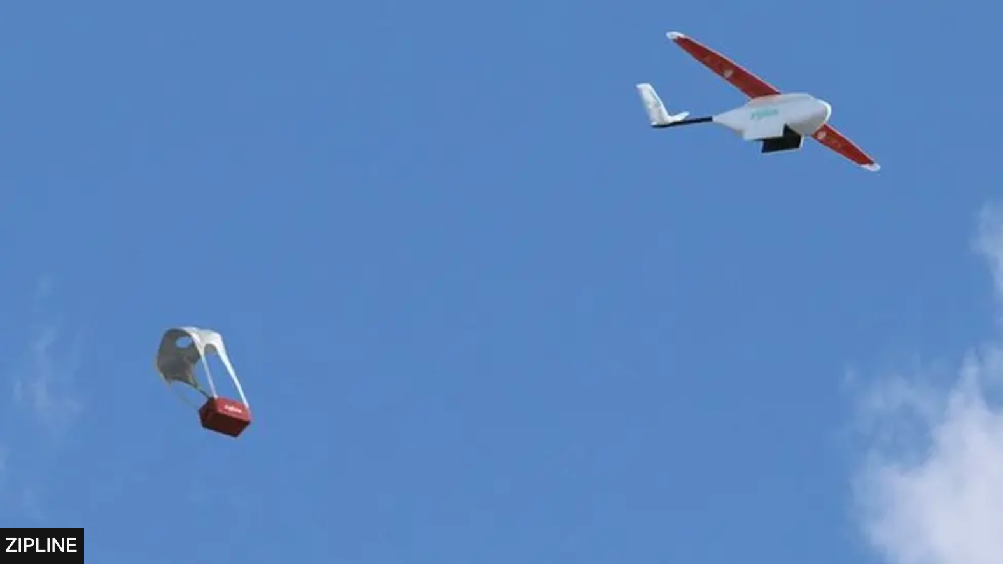
So, what is the talk about?
The talk is about a start-up company called Zipline, which delivers packages of blood to medical institutions using autonomous aircrafts in Rwanda, a small mountainous country in Africa.
They store red blood and its components in operation centers and have been delivering the life-saving packages to hospitals in the remote area. All the 12 health institutions rely 100% of its supply on Zipline’s routine & emergency deliveries.
-How the operation works?
When a doctor needs blood, they send a WhatsApp message to the Zipline operation center. Shortly after, the operator sends the drone to rush to the hospital with a package of blood. The drone can accelerate from 0 to 100km/h within 0.5 second.
-What is the significance?
Blood can be delivered instantly when it is needed for emergency purposes. According to BBC, this feature is valued in Rwanda especially because of the country’s hilly landscape.
Medical institutions don’t have to overstock blood. In this way, they don’t have to throw away expired blood.
3
Photo: BBC https://www.bbc.com/news/technology-37646474

Slide 8
QUIZ TIME!

Slide 9


Guess: According to the talk, what is the definition of “Leapfrog”?
1
An astonishing idea
2
An innovation that goes beyond the next obvious incremental steps and skips beyond a whole phase of change
3
A children’s game in which players in turn vault with parted legs over others who are bending down

Slide 10
ANSWER!

Slide 11
Guess: According to the talk, what is the definition of “Leapfrog”?
2
An innovation that goes beyond the next obvious incremental steps and skips beyond a whole phase of change
Leapfrog innovation is a concept which represent Africa’s high potential in terms of innovation.
Zipline is one example of leapfrog, since Rwanda started using drones to deliver blood, before fully developing its transportation network such as trains or roads.
In the talk, mPESA (mobile money widely used in Kenya) is given as another example. It is considered leapfrog because mobile money became very common in Kenya before bank accounts were barely available to ordinary people.

Slide 12
Thank you!

Slide 13
CITATIONS
*All the images except the one from BBC are from the design application “Canva”, which I used to create the slides.
https://www.canva.com
-Hughes, H. (2004). Oxford Dictionary of English (2nd edition). Reference Reviews, 18(4), 36–37. https://doi.org/10.1108/09504120410535407
-TED TALK « How we're using drones to deliver blood and save lives » by Keller Rinaudo Cliffton
https://www.ted.com/talks/keller_rinaudo_cliffton_how_we_re_using_drones_to_deliver_blood_and_save_lives?subtitle=en
-Simmons, D. (2016, October 14). Rwanda begins Zipline commercial drone deliveries. BBC News. https://www.bbc.com/news/technology-37646474
-Meda, P. (2023, June 9). What is leapfrog innovation and why you should care. Innovation Copilots. https://www.icopilots.com/what-is-leapfrog-innovation-and-hwy-you-should-care/#:~:text=In%20business%2C%20the%20term%20leapfrog,a%20whole%20phase%20of%20change.

