Slide 1

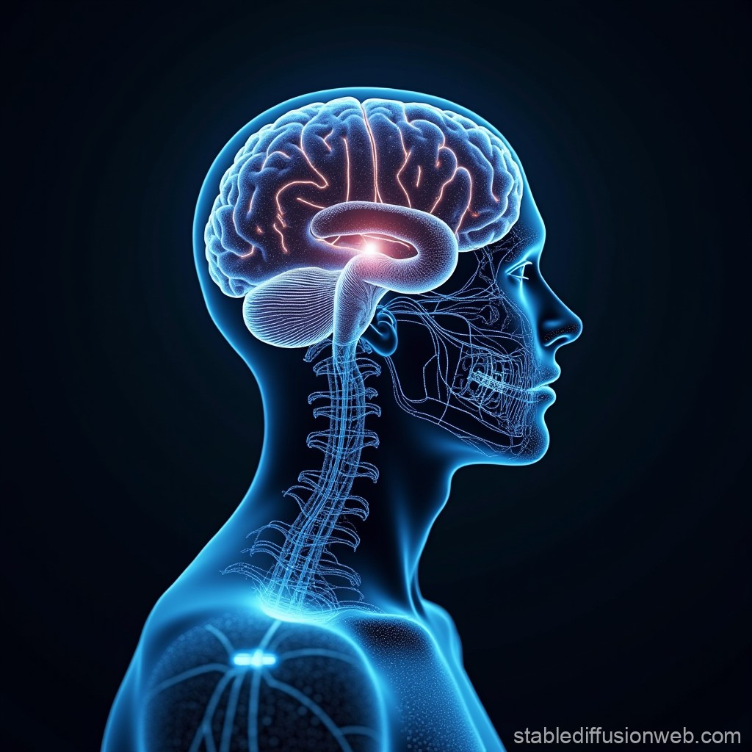
How your brain decides what is beautiful
Anjan Chatterjee
・A neuroscientist

Slide 2
Watch Here
https://www.ted.com/talks/anjan_chatterjee_how_your_brain_decides_what_is_beautiful/transcript?referrer=playlist-craftsmanship&autoplay=true&subtitle=en

Slide 3
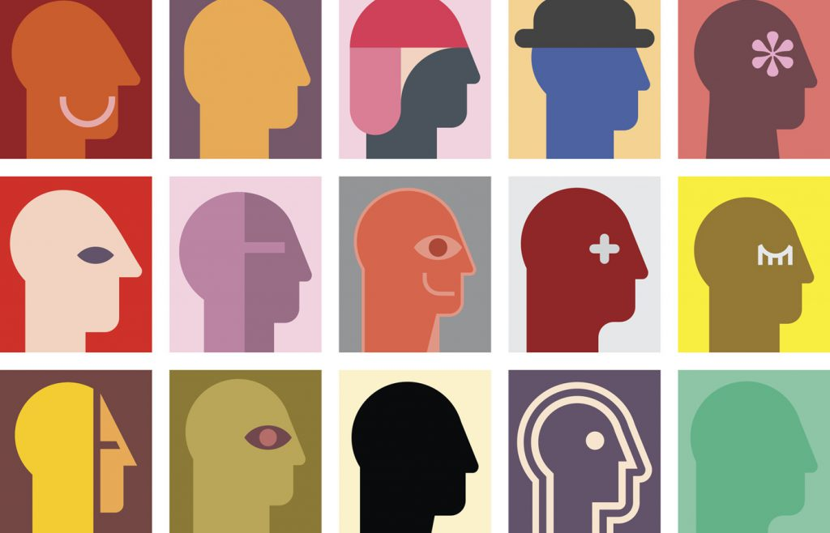
Why I chose this TED Talk
It is fascinating while perceptions vary from person to person, there are common features that many people find attractive in a beautiful face.
I found it interesting to learn how our brains process faces, and to think about ways to overcome biases in society regarding looks.

Slide 4
Vocabulary
・3 basic parameters
.
Averaging : composite faces represent genetic diversity and adaptability
to the environment.
Symmetry : where one half of the face is the mirror image of the other.
→indicator of health
Effects of hormones : estrogen and testosterone
produces features that signal fertility.

Slide 5
・fusiform gyrus : a part of the brain that is activated when seeing a
beautiful person.
・”beauty is good” stereotype : our brains have overlapping neural
activity in response to beauty and good.
→ we automatically associate beauty and good
Message of the presentation
: By understanding these implicit biases,
we can aim for a society which treats people fairly.

Slide 6
Quiz
Who thought that he will discover the face of criminality by combining photographs of violent criminals?
Which 2 academic fields have adressed the question of beauty in the past few decades?
According to the presenter, what is free to drift and become more variable?

Slide 7
Answers
Who thought that he will discover the face of criminality by combining photographs of violent criminals?
Sir. Francis Galton
Which 2 academic fields have adressed the question of beauty in the past few decades?
evolutionary psychology, neuroscience
According to the presenter, what is free to drift and become more variable?
preference and trait combinations

Slide 8
For deeper discission ;
Where do we find the “beauty is good” stereotype causing a negative effect on society?
In what ways do you think modern medicine and technological innovation are affecting our sense of what beauty is ?

