Slide 1

Inside the mind of a master procrastinator
6321116 Nakama Kyoka

Slide 2
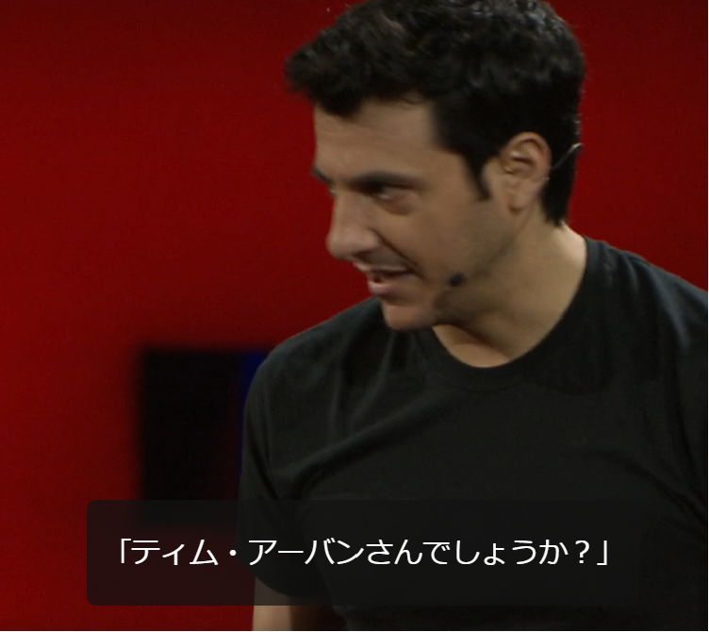
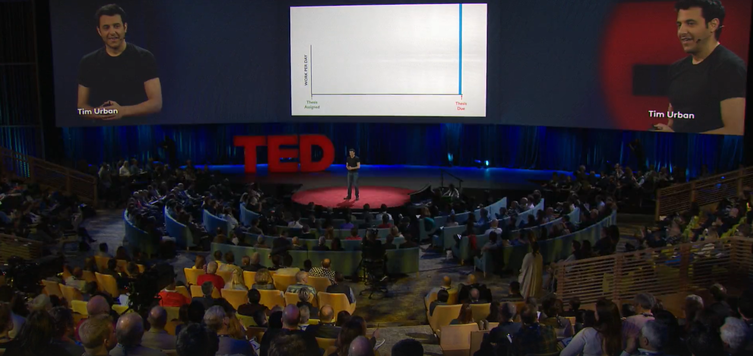
Inside the mind of a master procrastinator
URL:
https://www.ted.com/talks/tim_urban_inside_the_mind_of_a_master_procrastinator

Slide 3
KEYWORD: PROCRASTINATE
Many procrastinators around the world!!!!!
Perhaps you are also…?
We are university students and we have to do a lot of research or homework.
However, sometimes we cannot start doing them until the deadline approaches.
This phenomenon is called PROCRASTINATION,
and many people are suffering from it…

Slide 4
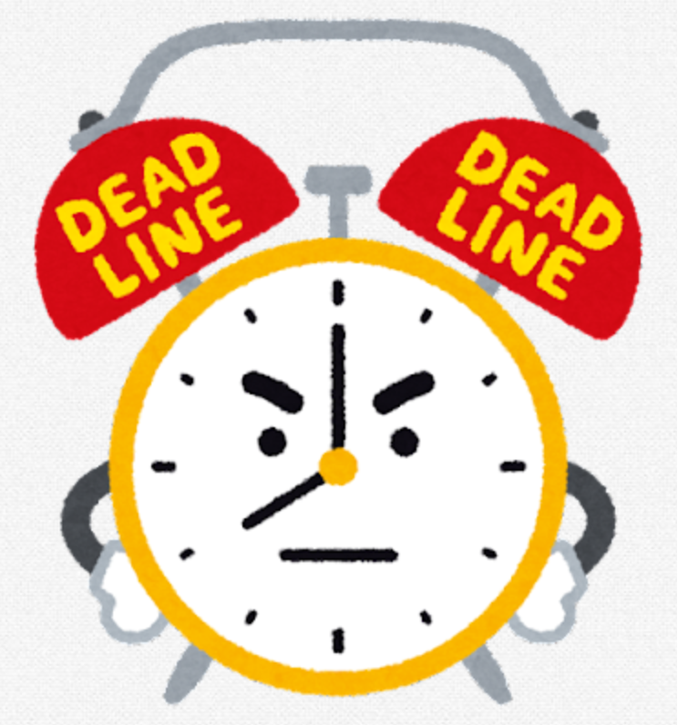
Vocabularies
thesis: a paper or a document that those with an academic degree write to present their research and findings
deadline: the final time you are able to submit something. You are not permitted to submit after this
all-nighter: people who do not sleep and stay awake a night
sprint: run very fast in a short-term
procrastination: putting off things to do

Slide 5

Vocabularies
propagate: make a reproduction
dormant: idle, sleeping
mayhem: big chaos, violent and useless riot
epiphany: sudden inspiration

Slide 6
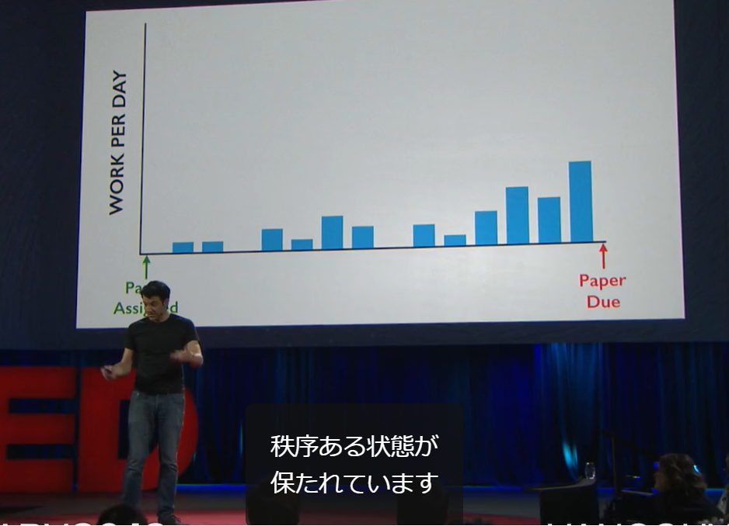
Question 1
How many days did Tim Urban, the speaker of this talk,
spend writing his 90-page senior thesis that was supposed to take a year?
①three months
②three weeks
③three days

Slide 7
Question 2
What is Dark Playground?
①the playground with few sunlight
②place filled with fun and easy things done when we have to do harder and meaningful things
③the parks where only bad children can play

Slide 8
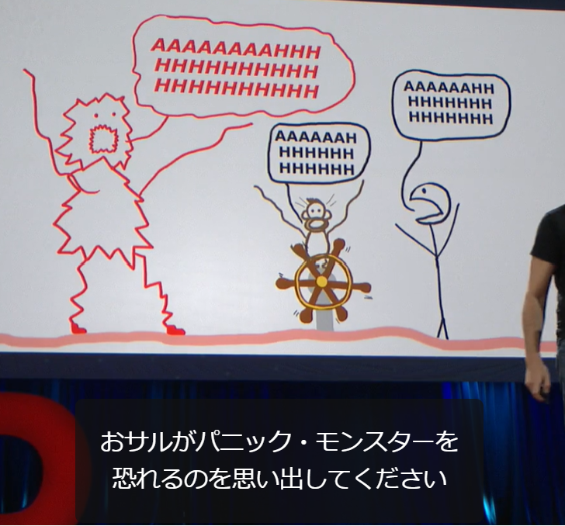
Question 3
Which character in this talk makes the behaviors of procrastinators seem insane for those who are not?
①Rational Decision-Maker
②Instant Gratification Monkey
③Panic Monster
④Instant Gratification Monkey and Panic Monster
⑤None

Slide 9

Trivia
The percentage of those with a habit of procrastination is
surprisingly 95%!
(We are not sure if this sentence is worth believing because this data is from Wikipedia)

Slide 10
Answers to three questions
Question 1: ③
Question 2: ②
Question 3: ④
Did you get the right answers!?

Slide 11
Thank you for watching

