Slide 1
Why do you put off the things that you have to do?

Slide 2

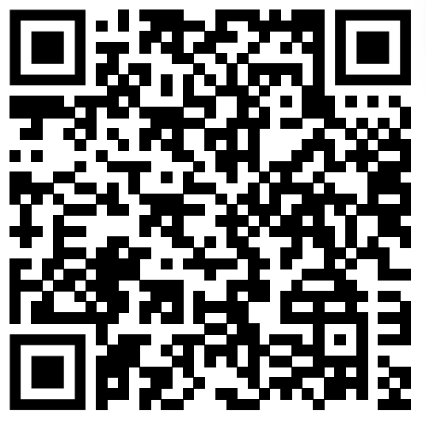
Source
Title: Inside the mind of a master procrastinator
Speaker: Tim Urban
Link: https://www.ted.com/talks/tim_urban_inside_the_mind_of_a_master_procrastinator

Slide 3
Table of Contents
01
03
02
04
The Reasons Why I Chose this Topic
Engazinging Questions
The Vocabulary and the Contents of the Video
Fun Activity

Slide 4

The Reasons Why I Chose the Topic
01

Slide 5
The Reasons
When I saw the title, I thought that this is the best topic for me. It is because I am the person who is a MASTER PROCRASTINATOR!! I tend to put of the things I have to do, and I alsways upset just before the deadline.
Of course I want to do the things as soon as possible, but I cannot do it. Thus, I want to know the inside of my head and improve my situation.

Slide 6
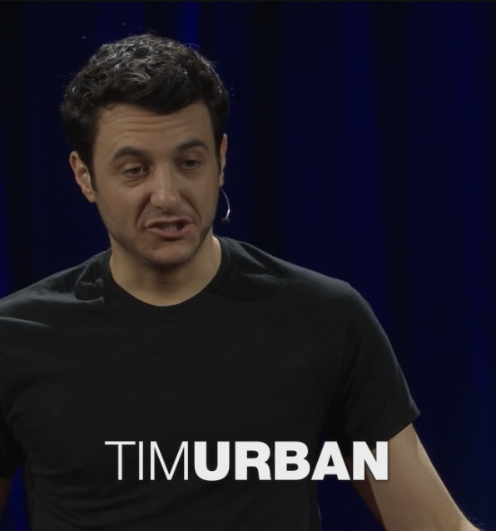
The Vocabulary and the Contents
02
Important Vocabulary
Brief Wrap-up of the Contents

Slide 7
Important Vocabulary
Procrastinator
:someone who keeps delaying things that must be done
Rational Decision-Maker
:something inside us that makes a rational decision
Instant Gratification Monkey
:a monkey inside us that tends to do the lazy or funny things instead of doing the hard things
The Panic Monster
:something inside us that shows up in our mind before the deadline and makes us upset

Slide 8
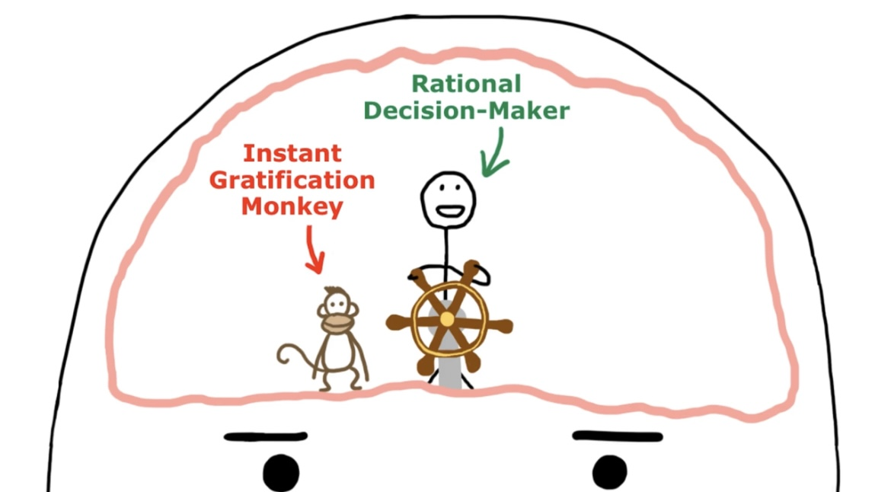
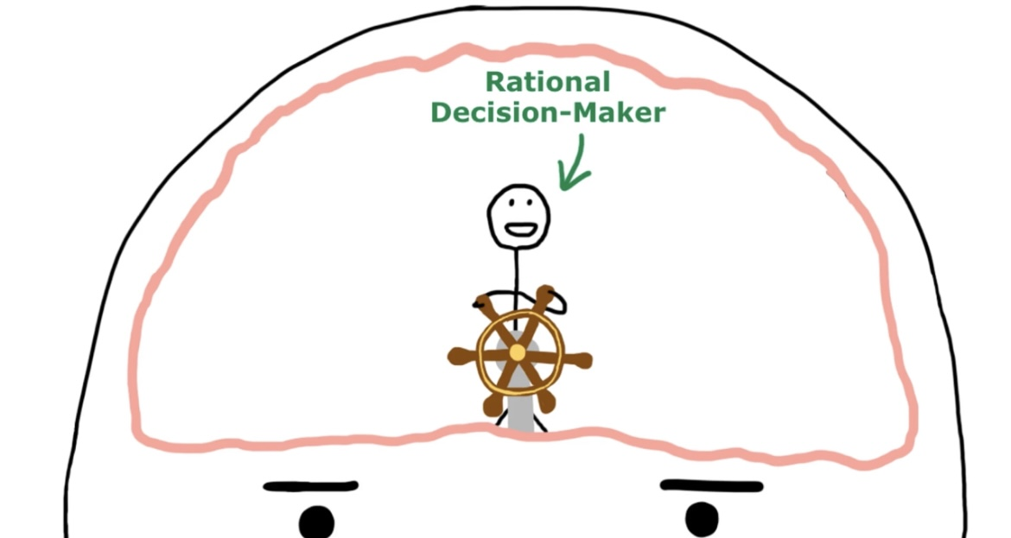
Brief Wrap-up of the Contents
In our brain……
The brain of a non-procrastinator
The brain of the speaker
There is a Instant Gratification Monkey in the procrastinators’ brain.
It always care about just the easy and fun things and get in the way of rational decision-makers’ work.
Rational Decision-Makers are in the all people’s brain.
They make rational correct decision.

Slide 9
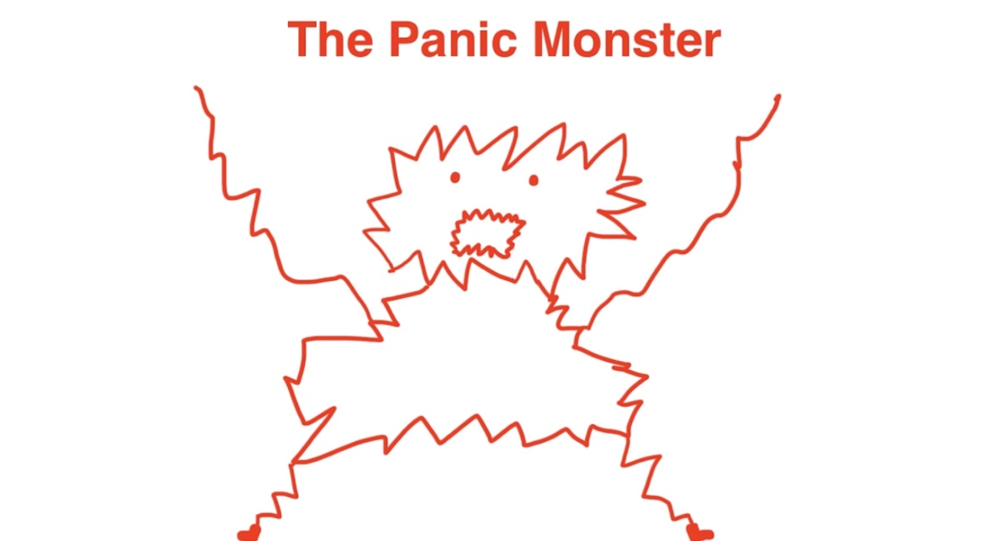
Brief Wrap-up of the Contents
The only thing the Monkey is terrified of is……
The Panic Monster shows up in our brain
just before the deadline or the time when there’s a public rmbarrasment.
Thanks to them, we can manage to finish our tasks.
.

Slide 10
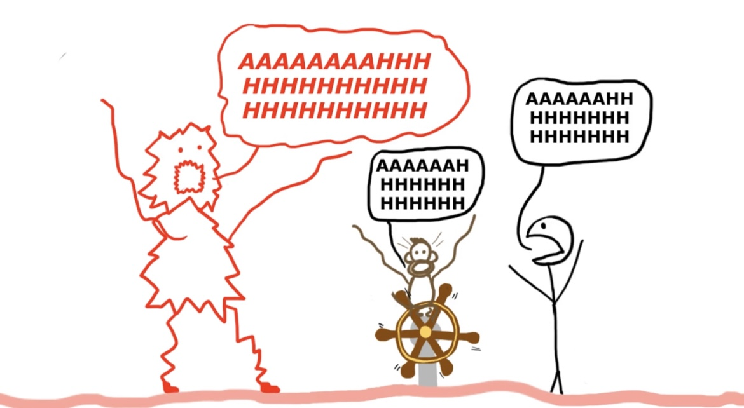

Brief Wrap-up of the Contents
But there is the situation where the Panic Monster wouldn’t show up……
A Panic Monster wouldn’t show up if there is not deadline.
→The time is limited, so let’s start to do the things that you have to do right now!!
.

Slide 11

Engazing Questions
03

Slide 12
Engazing Questions
Q1. Are you procrastinator?
Q2.Do you think what is the cause why you put off the thing that you have to do?
Q3. If you want to improve your situation, what would you do?

Slide 13
My Answer
Q1. I am obviously a procrastinator. I usually put off the things I have to do, and am upset just before the deadline. That’s why I chose this topic.
Q2.For me, the biggest reason is TicTock. I waste a lot of time on watching short video on TikTock. Maybe the Monkey in my brain makes me to do so.
Q3. In my opinion, one of the solution is to set an original deadline for myself. If the actual deadline is Sunday, I set my own deadline on Saturday. By doing so, Panic Monster will show up earlier than usual.

Slide 14

Fun Activity
04

Slide 15
Flowchart
Let’s check your Procrastinative level!!
Do you start to do the tasks just after they are assigned?
Your Level
YES
0%
20%
50%
80%
100%!!
NO
Do you start to do the tasks from more than a week before the deadline?
YES
NO
Do you think about the tasks in a week before the deadline?
YES
NO
YES
Do you usually meat your deadline?
NO

Slide 16
Fun Activity
What was your result?
If your procrastinative level is low, please have confidence on yourselves and keep doing.
If the level is high, please start to think about the limited time and do the tasks as soon as you can.
First of all, try to record your flip grid soon after this class!!

Slide 17
END
Thank you!

