Slide 1
Is the US headed towards another civil war?

Slide 2
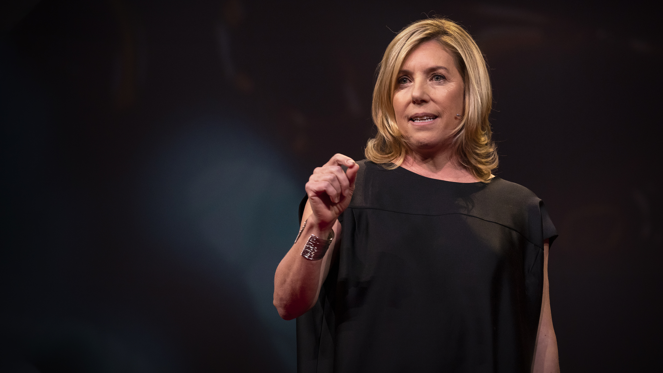
Who is the Speaker?
Barbara F. Walter
She is an American political scientist at the University of California.
Her research focuses on civil wars, violent extremism, and domestic terrorism.
Notes:
https://www.ted.com/talks/barbara_f_walter_is_the_us_headed_towards_another_civil_war/transcript

Slide 3
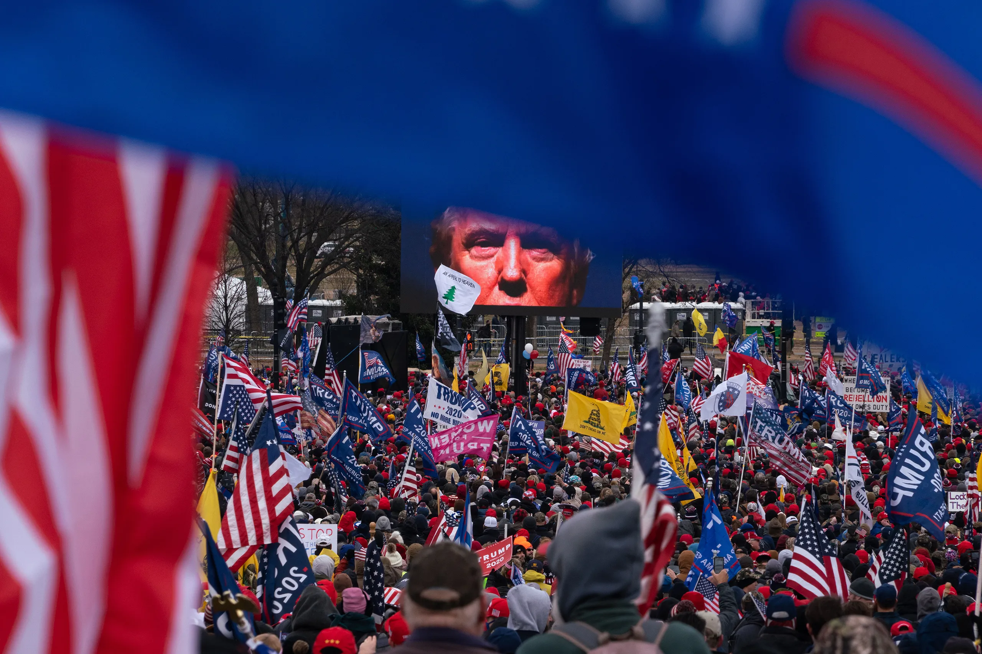
Why I chose this talk
I’ve seen some of her work while I was studying International Relations. I sometimes listen to podcasts made by TED talk, and I heard part of her talk and it sounded so interesting.
Civil war is part of the field that
I have been interested in since
I study about Afghanistan.

Slide 4
Before you listen― these are the words you should know!
Autocratic/Autocracy:
Relating to a ruler who has absolute power, domineering
Demographic:
The structure of populations
Global South:
Grouping of countries based on their characteristics like standard of living, poverty, population growth rates and so on.
Incendiary:
Tending to stir up conflict, provocative
Divisive:
Having a quality that divides or separates
Hatemonger:
People who arouses hatred for others

Slide 5
Quiz Time!

Slide 6
Question No.1
What is true about civil war
Since 1946, over 250 civil wars have broken out but it has been decreasing
Civil war is nothing to be scared of
There are 50% more civil wars than there were in 2001
All of the above

Slide 7
Question No.2
What did she find out when she was working for the CIA?
Military in Zimbabwe was planning coup
How to negotiate with extremists
How to predict a civil war
Ways to escape from interrogation

Slide 8
Question No.3
What does “anocracy” mean?
Government that is neither fully democratic nor fully autocratic
A corrupted government
A country that is poor
None of the above

Slide 9
Question No.4
What is the second factor to predict civil wars that was mentioned in the talk?
People joining parties based on their color
People joining parties based on their religion
People joining parties based on their ethnicity
All of the above

Slide 10
Question No.5
Which statement is true about the current U.S. democracy
If the task force was allowed to study the U.S., it would likely predicted the January 6 insurrection in 2019
The 2016 election was fair but not free
U.S. democracy has been downgraded 4 times
White House has refused to provide information in 2019

Slide 11
Question No.6
Who tends to start civil wars?
People who are most oppressed by the government
People who are politically strong
Just normal people
Group that once had the power but losing it

Slide 12
Question No.7
How can the business help to bring better democracy?
By creating more employment opportunities
By investing in better health care, education
By getting a sanction
By supporting apartheid

Slide 13
Question No.8
Do you think her solution “to regulate social media” is a good idea? Do you agree with it? If so, Why?
Answers here:

