Slide 1
Juice WRLD & Marshmello - Come & Go

Slide 2
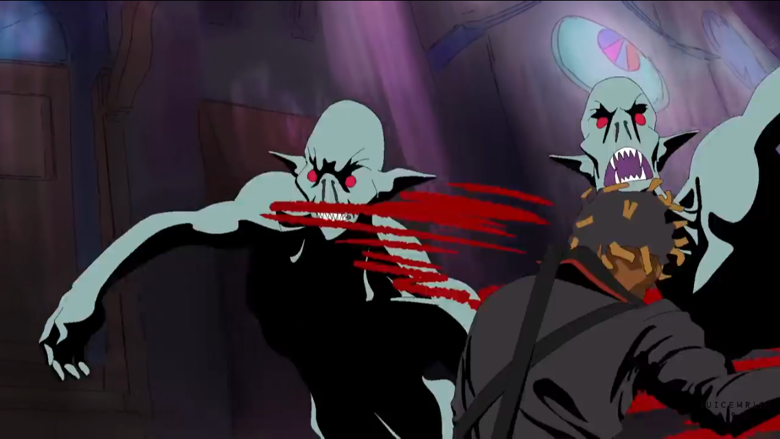

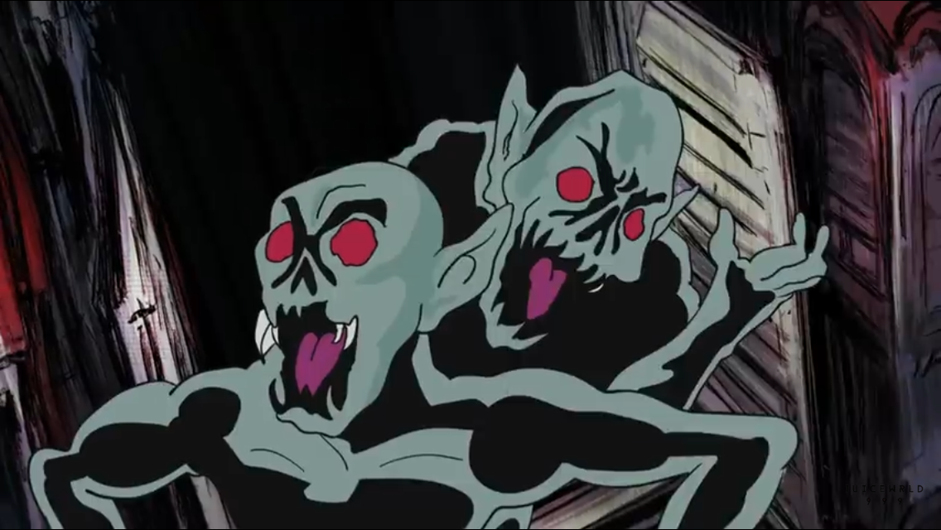
THEME
KINDS OF love song
Genre is EDM and Punk-Rock
Juice WRLD is addicted to DRUGS and ALCOHOL and he wants to keep in touch with his girlfriend and tries to change his addictive situation.
写真

Slide 3


Slide 4
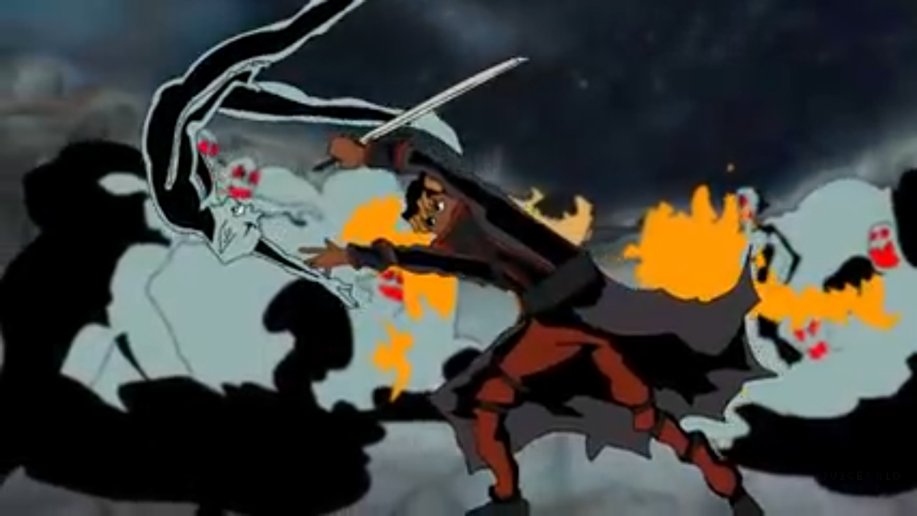
VOCABULARY
・I don’t wanna ruin
・You make me whole

Slide 5

1 everything 2 better man
3 made 4 hell
5 medicine
6 hold
7 alone
8 wipe
9 Head up

Slide 6
On December 8, six days after his 21st birthday, rapper and singer Juice WRLD suffererd an unknown medical emergency shortly after landing at Chicago’s Midway International Airport, and was later pronounced dead at nearby hospital.
Born Jarad Authony Higgins, the Cicago rapper was known for his hit “Lucid Dreams”, which peaked at No.2 on the Billboard Hot 100 and become one of the biggest streaming hits of 2018.

Slide 7
FROM MARSHMELLO TO JUICE WRLD after juice’s death in 2020
Watching you take breaks to do wheelies on your dirt bike and then come back and finish a whole song in one take was normal and to be able to be on this album with you and show the world what we made together means so much to me. You were a great person and I miss you everyday. https://twitter.com/marshmello/status/1281078136537399301

