Slide 1
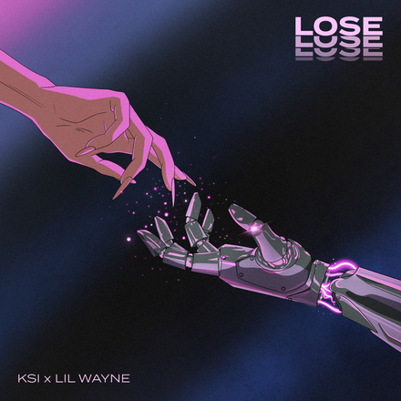

Slide 2


Slide 3
Song
Title : Lose
Genre : Rock, Rap-Rock, Pop-Rock, Hip-Hop
Release date : August 6th, 2021
Single : Lose
About : A love song about losing someone special
Written by : Peter “Pete” Jideonwo, S-X,Benjamin Samama, Charlie Snyder,Ivory Scott, Digital Farm Animals, Lil Wayne & KSI

Slide 4
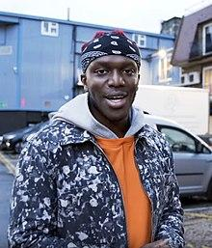
KSI
KSI’s real name is Olajide Olayinka Williams “JJ”.
KSI is a British YouTuber, Rapper, Singer and Boxer.
As a rapper...
https://www.youtube.com/user/KSIOlajidebt
He is great rapper that ranked second by The Sunday Times.
His second studio album, All Over The Place, debuted at number 1.

Slide 5
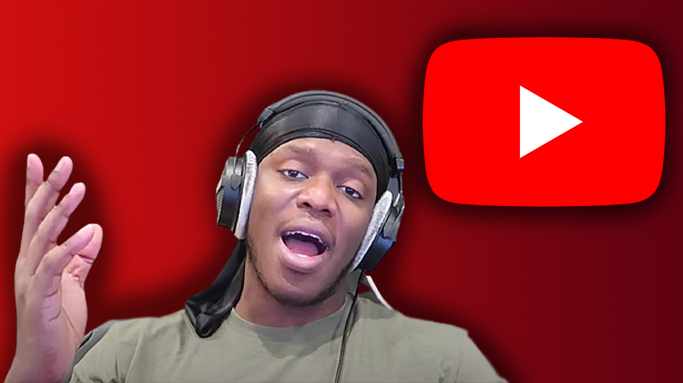
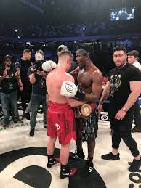
As a YouTuber...
He registered his YouTube account 2009 and now, he has over 14 million subscribers.
As his fan base has grown, his YouTube content has diversified: video game or commentary video.
https://www.youtube.com/user/KSIOlajidebtHD
As a Boxer...
He was the subject of KSI: Can’t Lose.
It is a documentary film, fights against British YouTuber Joe Weller.

Slide 6
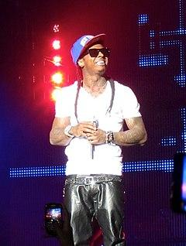
Lil Wayne
Lil Wayne’s real name is Dwayne Michael Carter Jr.
He is an American rapper, singer and songwriter.
His genre is hip hop and regarded as one of the most influential hip hop.

Slide 7
His history...
He has lot of stories; not all stories are fun.
On July 22, 2007, he was arrested because he was discovered smoking marijuana near the bus.
In 2010, “I Am Not A Human Being” was released while he was in jail.
It became No.1 album in America.

Slide 8
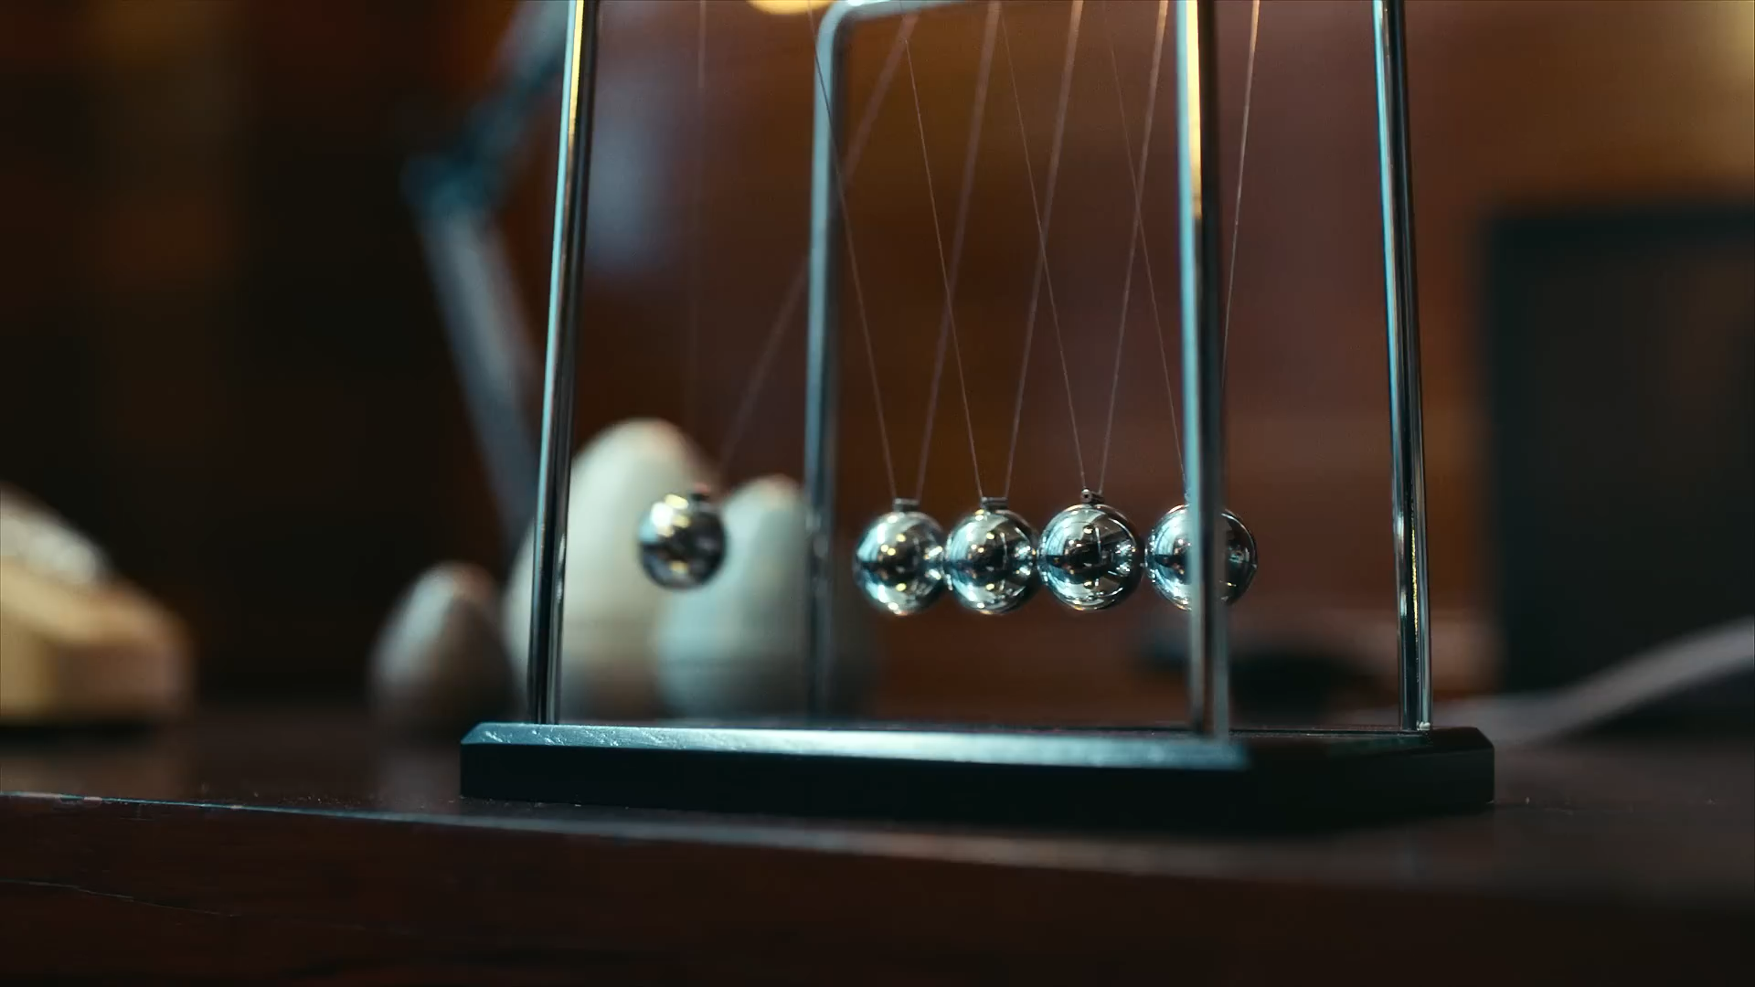

Slide 9
Lyric Breakdown
[Refrain]
I'm gon' need therapy
'Cause you're not here with me
Light me up like amphetamines, yeah
I don't do guarantees
[Pre-Chorus]
I, I, I-I
Wish I could lie
[Chorus]
You got me fallin' thinkin' of you
But that's the one thing I shouldn't do
I, I know the truth
I, I know that you're just one more thing to lose

Slide 10
Lyric Breakdown
[Verse 1: Lil Wayne]
Uh, she loves me, she loves me not, patience, I'm runnin' out
Walkin' all over me, made me her stompin' grounds
Baby, you f****d around, gave me the run-around
Makin' me wonder how crazy and dumb I sound
Takin' me up and down, baby, I'm comin' down
I'ma need some extermination, I'm buggin' out
Stay for another round, maybe she'll come around
She gon' have me turnin' in my grave when I'm underground
Sore loser, I saw you with him, I almost threw up
Don't shoot her, don't talk to her
There's plenty fish in the sea and I'm a shark, just like Mark Cuban
You got me fallin' for you
With no wings on, no parachute
Bring a star back for you
They say love's a lost art
I draw that for you and I fall back for you

Slide 11
Lyric Breakdown
[Verse 2: KSI]
I be actin' odd, I know, I know
When I stare at you, I lose control
And I'm hopin' you're not psychic
Hotter than the devil but you're righteous
I'm addicted to the whole of you
Calling 'cause I needed more
Stalling 'cause you know I fall
My whole demeanour and all, the fact of me losin' you
Comparin' and stuck in a loop
Grow old 'til there's nothin' to do
I'm alone in this space and my story is endin' with you

Slide 12
Thank you so much

