Slide 1
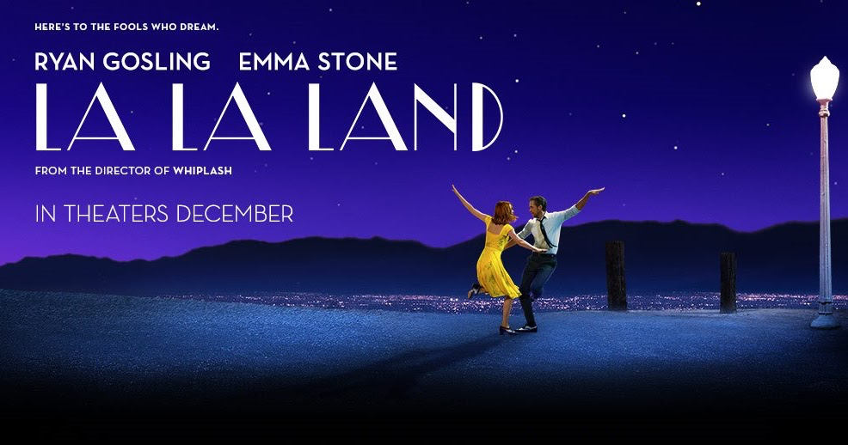


Slide 2
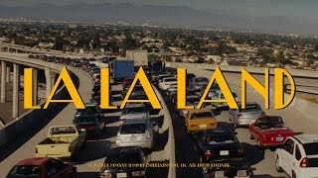
「Another day of Sun」
→The opening song of the movie ”La La Land”

Slide 3
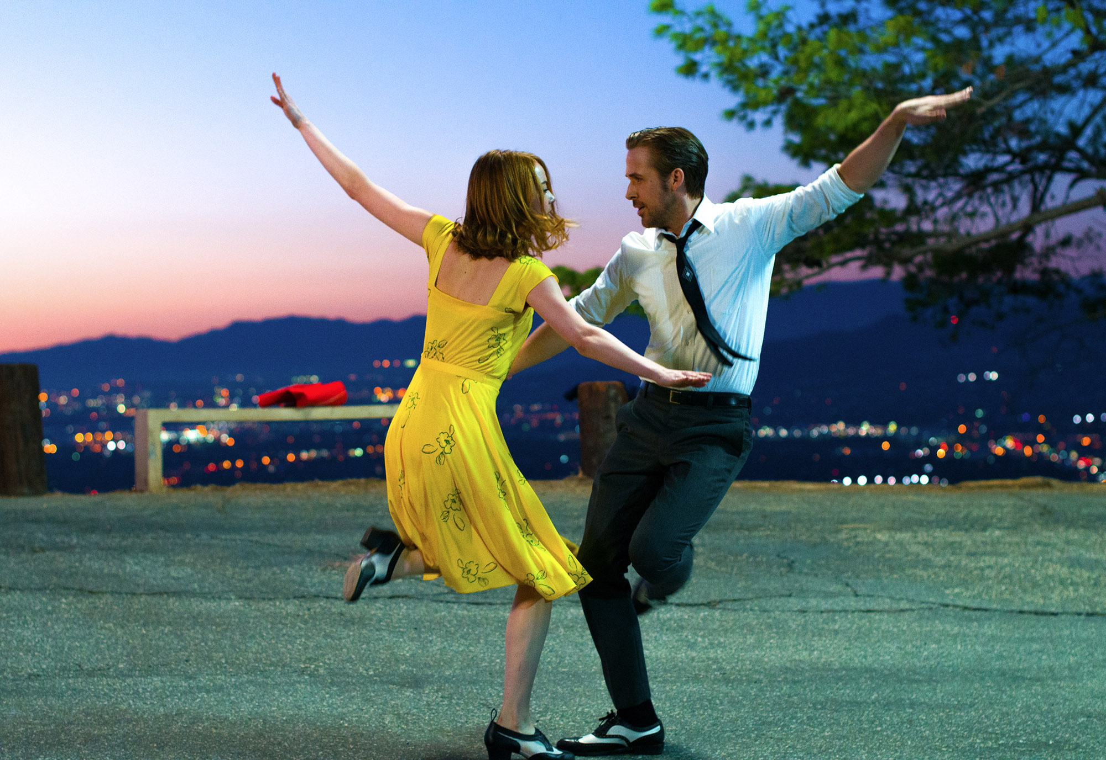
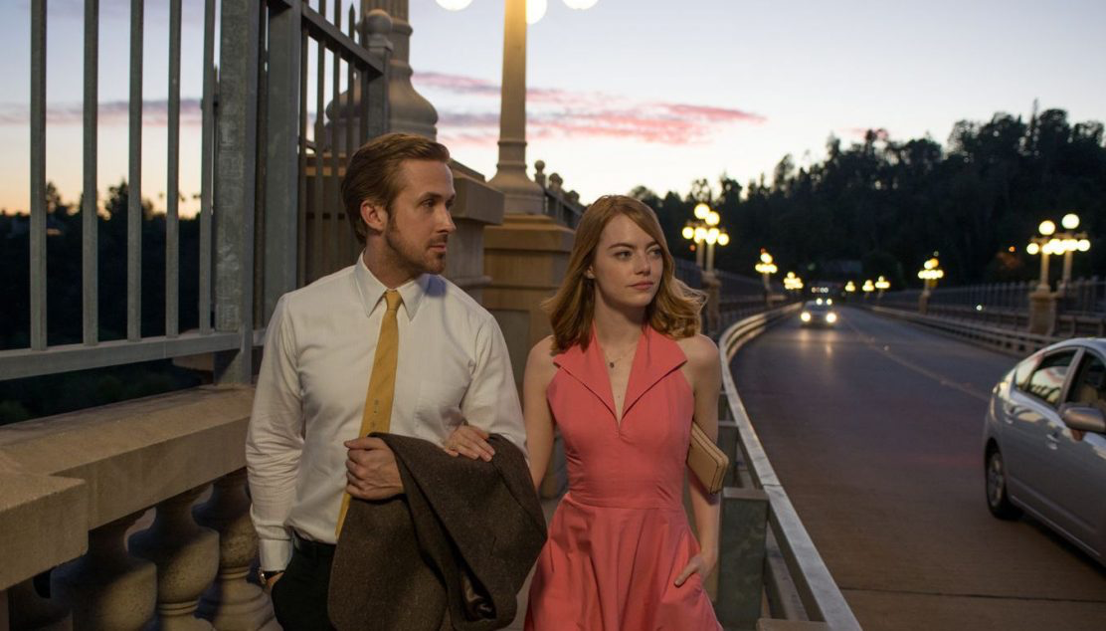
What story lalaland?
In Los Angeles,
many people are pursuing their dreams.
Mia
aspiring actress, constantly auditioning for jobs.
Seb
wants to play jazz to his heart's content in his own bar.
meet,
have an unexpected reunion,
encourage each other to pursue their dreams.

Slide 4
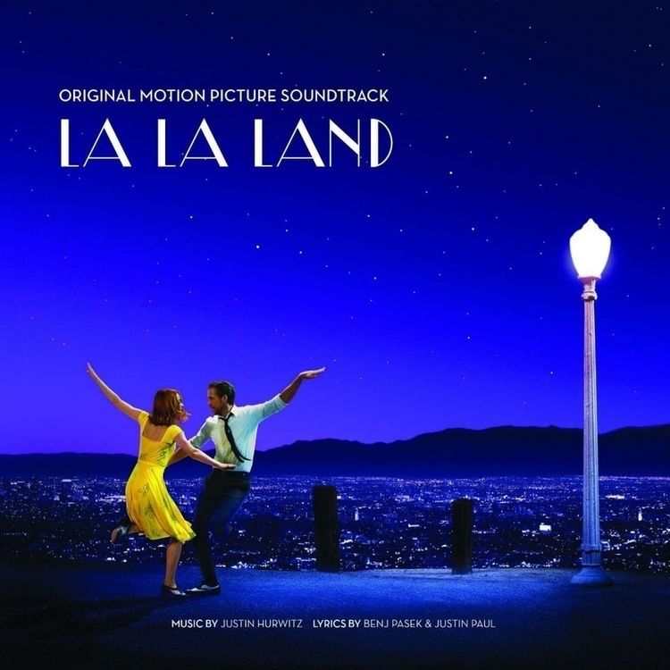
Meaning of titile
Positive
・The sun symbolizes glory and success
→Beginning of a new day.
Negative
・Los Angeles is a place where you can feel the heat 300 days a year.
→the emptiness of knowing that just another day has arrived.

Slide 5
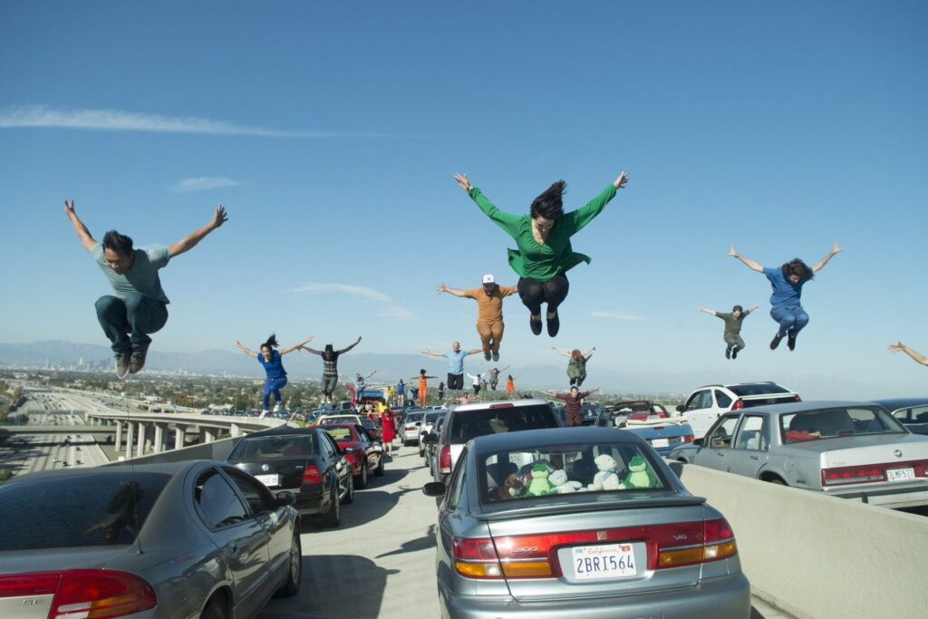

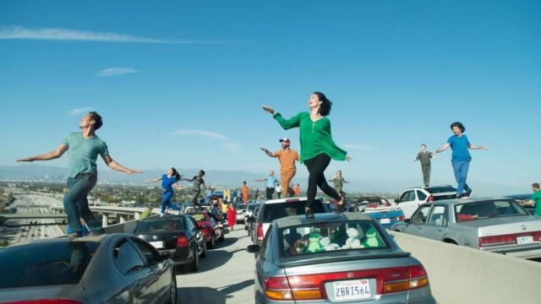
Episode during taking the video
August 2015,on the Los Angeles freeway.
・It took two days
・ 60-car
・Many dancers
The director living in LA.
→The director himself is constantly stuck in LA traffic, and he inspired and fantasized about dancing there.

Slide 6

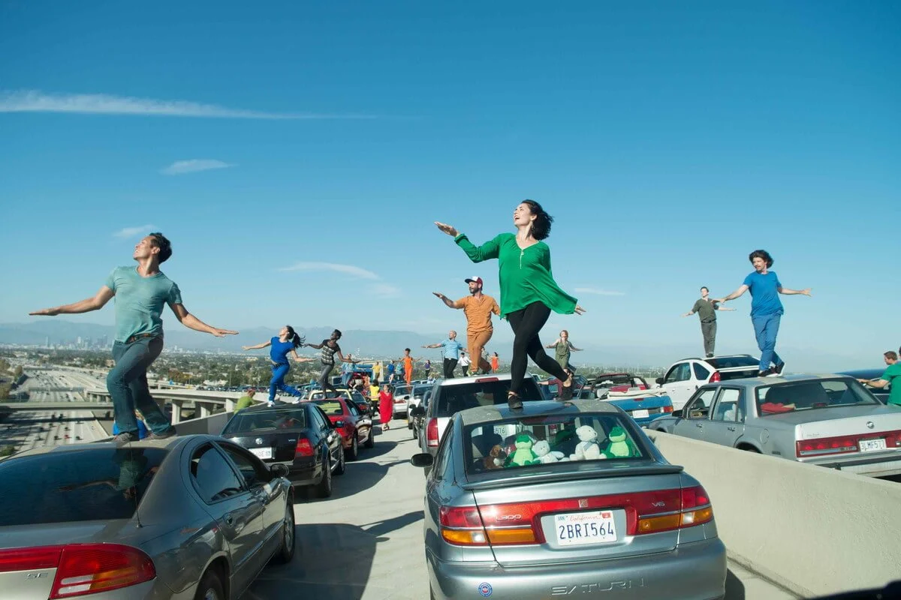
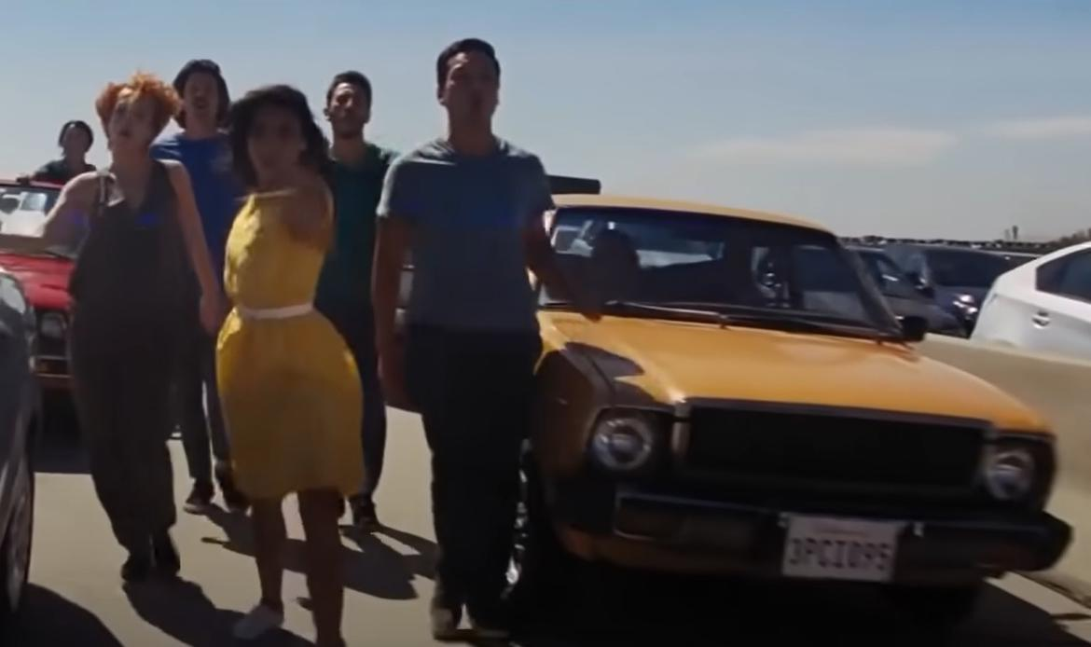
lyric
The meaning of lyrics
[ main of idea ]
The song is about dreams and hope.
It shows the feelings of people who come to Los Angeles.
Even if life is hard, they keep trying.
[ message ]
A part of lyrics, “It’s another day of sun.”
The sun means hope and a new chance.
Every day is a chance to follow your dream.
The last , “It’s another day of sun.” reapets,
showing that hope never ends.

Slide 7
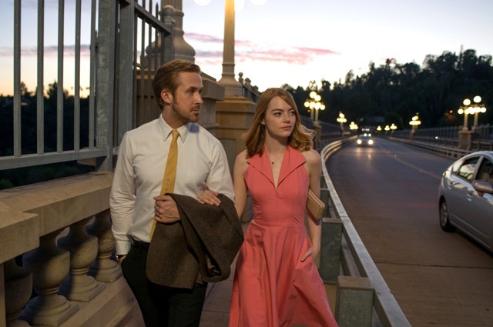
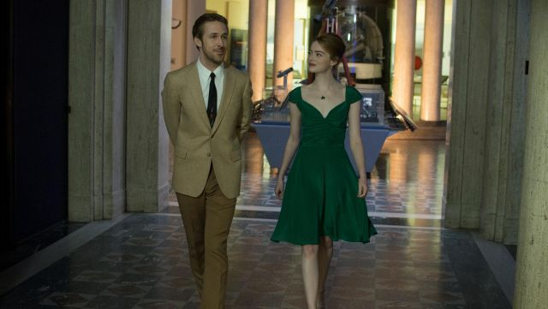
pronounciation
Point1 First line
“I think about that day”
→Stress on think and day ♪Rhythm: I THINK | aBOUT that DAY
Point2 Chorus
“It’s another day of sun”
→Stress on another / day / sun ♪Rhythm: it’s aNÓther | DAY of SUN
Point3 Middle phrase
“Climb these hills, I’m reaching for the heights”
→Stress on climb / hills / reaching / heights
♪Rhythm: CLIMB these HILLS | I’m REACHing for the HEIGHTS

Slide 8




♪Let’s sing !!!
Let's listen to the famous introduction！！
♪I think about that day
I left him at a greyhound station
West of Santa Fé
We were seventeen
But he was sweet and it was true
Still I did what I had to do
‘Cause I just knew

Slide 9


♪Behind these hills
I’m reaching for the heights
And chasing all the lights that shine
And when they let you down
You’ll get up off the ground
As morning rolls around
And it’s another day of sun
Let's listen to the
main part！！

Slide 10

Quiz①
What is this song about ?
a) sad and hopeless
b) optimistic but about unrealized dreams
c) a love song
d) angry and negative about life

Slide 11
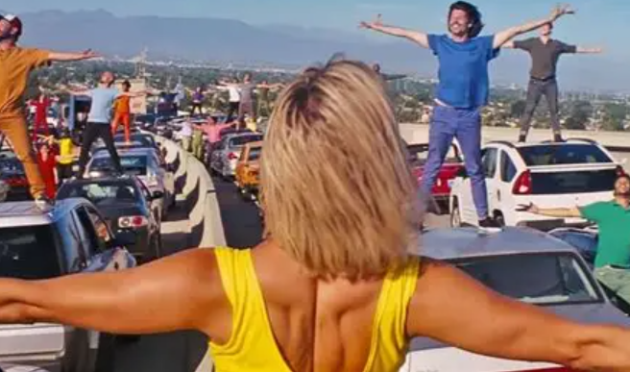
②
In the music video of another day of sun, how many cars are there ?
30
45
60
75

Slide 12
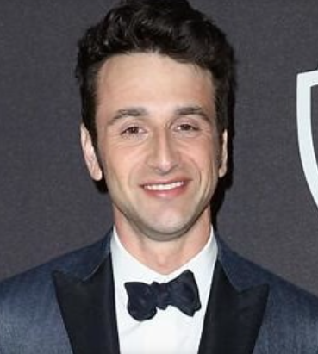
answer
① b
② c
The director , hurwitz ,said about this song ：
「it is optimistic song , but it is also about dreams that have not yet been achieved.」

