Slide 1

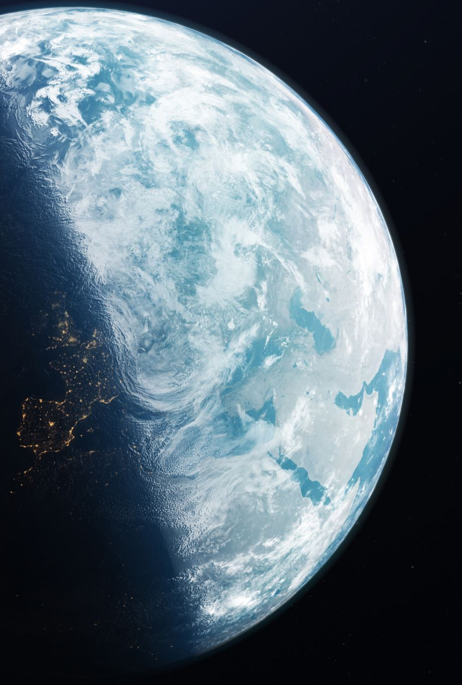
Let’s scan the whole planet with LiDAR

Slide 2
Details of the TED Talk
URL: https://www.ted.com/talks/chris_fisher_let_s_scan_the_whole_planet_with_lidar/transcript?subtitle=en&lng=es
Speaker:
Chris Fisher (Archaeologist and founder of the Earth Archive)
Title:
Let’s scan the whole planet with LiDAR

Slide 3
Why I chose this topic
Because …
I am interested in the culture of Mesoamerica where there are jungles, and it is said that many historical heritages are still hidden
In this video, the speaker is not talking only about how to investigate historical sites more efficiently but also how to protect them from the climate change
This video could make you think of how to conserve what we have now under the climate change as well as how to stop the climate change

Slide 4
Vocabulary
document:
to report on, write about, or make a film about (some historical event)
archaeology:
the scientific study of ancient people and their culture by analyzing their remaining tools, utensils, and other objects
patrimony:
an estate or possessions inherited from one's father or ancestors
painstaking:
taking pains; showing great care and effort
megalopolis:
a very large city
resolution:
the act or capability of distinguishing between nearby or close parts, etc.
deforestation:
the purposeful clearing of forested land
pristine:
having its original purity
bar:
an elevated region of sediment that has been deposited by the flow
brush:
a thick, heavy, dense growth of bushes, shrubs, etc.
sit on one’s hands:
to take no action
mitigate:
to lesson in force or intensity

Slide 5
Quick check of your understanding
Q1. What does LiDAR do?
It shoots a dense (g ) of (l ) (p ) to get high-(r ) scan of the earth’s surface and everything on it.
Q2. How did LiDAR help the speaker?
It made the investigation done much more (q ) and much(b ) and his team could find the (C ) (o ) (t ) (J ).
Q3. What are the three purposes of the Earth Archive?
1) To create a (b ) (r ) of the earth to measure the (c ) (c ). 2) To create a (v ) planet so that scientists can study the earth.
3) To (p ) a record of the earth for the following generations so that they can (r ) and study lost cultural patrimony in the future.

Slide 6
Discussion topics
In this video, the speaker said that we should scan as many sites as possible because we cannot know how they will be used. How could the scan data be used apart from the case of the Notre Dame?
In this video, the speaker said that we should start scanning from more threatened sites. Which site do you think that we should scan first in Japan?
If we had all the scan data of the planet of the previous eras, which site, building, or monument would you reconstruct?

Slide 7
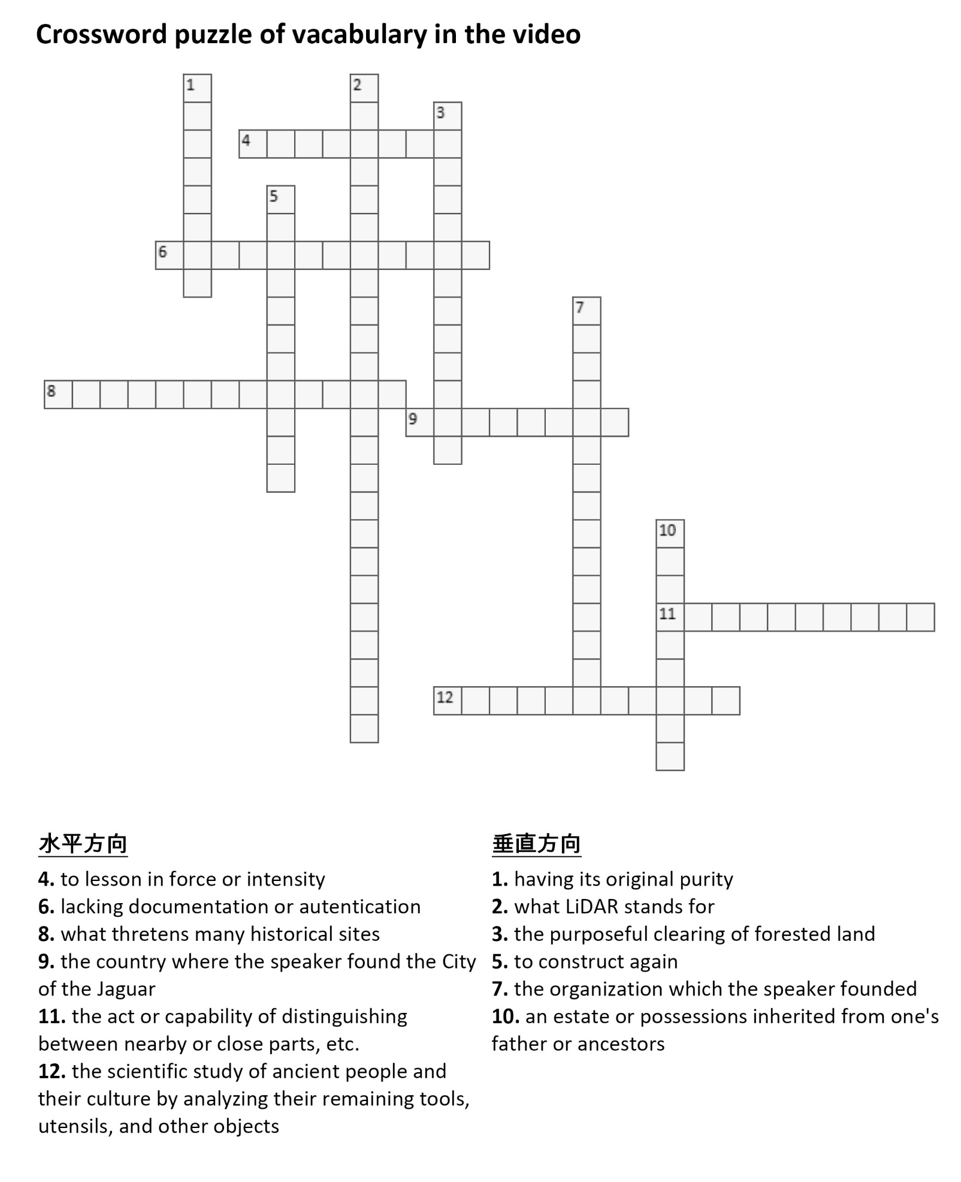
Check your understanding
and vocabulary!!

Slide 8
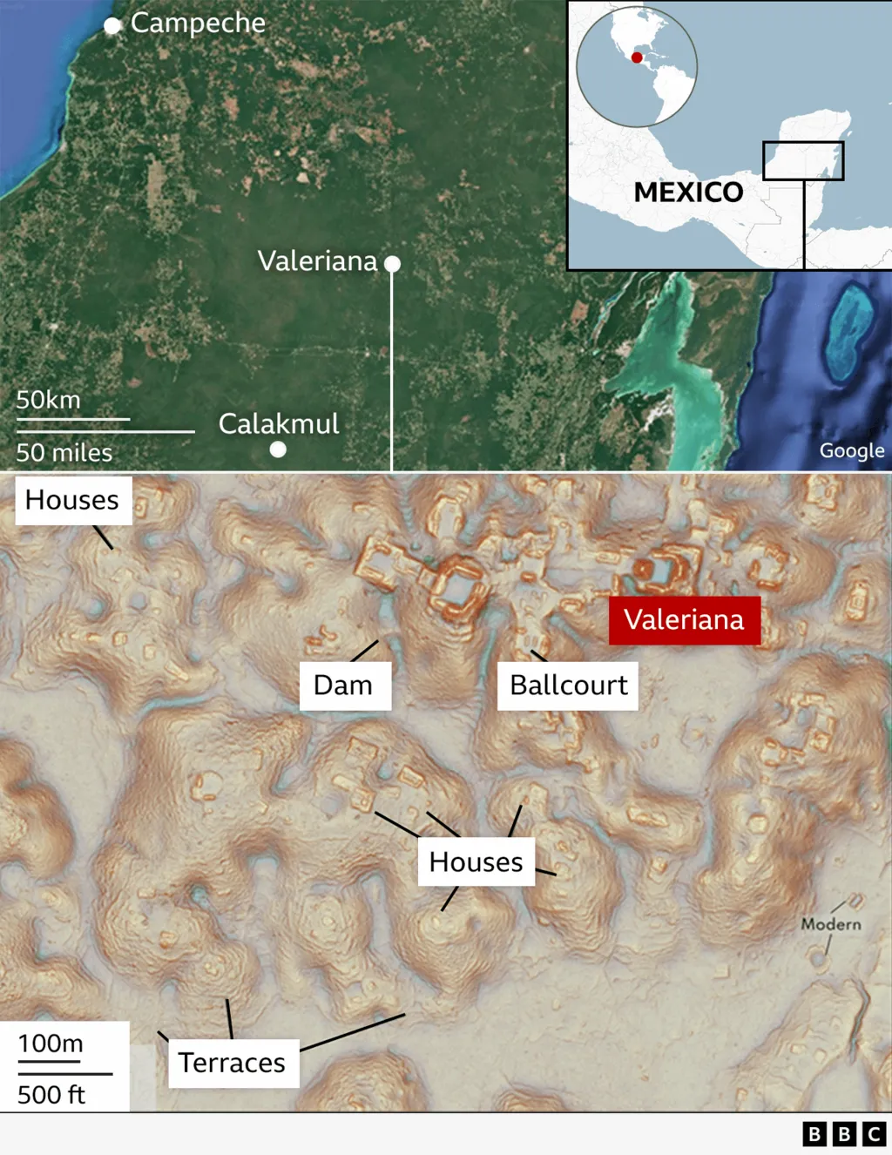
Tip
A few weeks ago, a PhD student at Tulane university in the US discovered a huge lost city hidden under jungle canopy in Mexico by accident using LiDAR.
The scan map
Resource: BBC (2015), https://www.bbc.com/news/articles/crmznzkly3go

Slide 9
Thank you for reading!

Slide 10
The answers to the questions
Q1. What does LiDAR do?
It shoots a dense (grid) of (laser) (pulses) to get high-(resolution) scan of the earth’s surface and everything on it.
Q2. How did LiDAR help the speaker?
It made the investigation done much more (quickly) and much(better) and his team could find the (City) (of) (the) (Jaguar).
Q3. What are the three purposes of the Earth Archive?
1) To create a (baseline) (record) of the earth to measure the (climate) (crisis).
2) To create a (virtual) planet so that scientists can study the earth.
3) To (preserve) a record of the earth for the following generations so that they can (reconstruct) and study lost cultural patrimony in the future.

Slide 11
