Slide 1


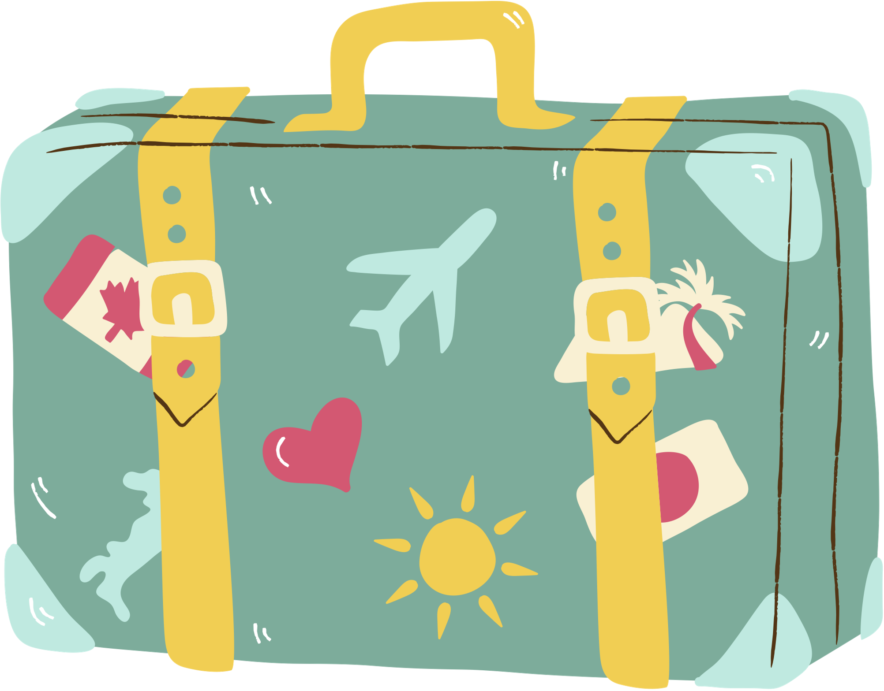
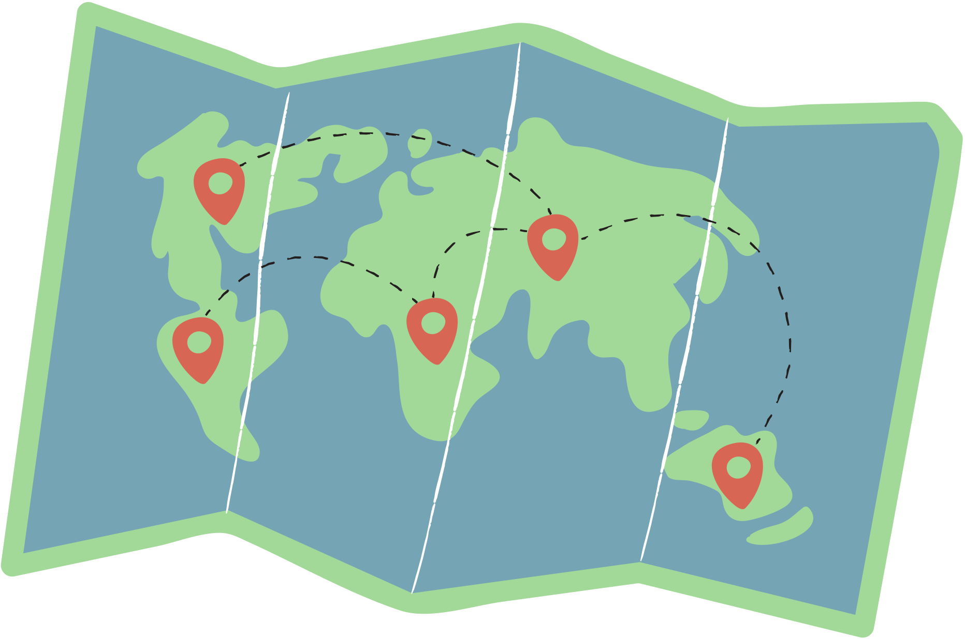




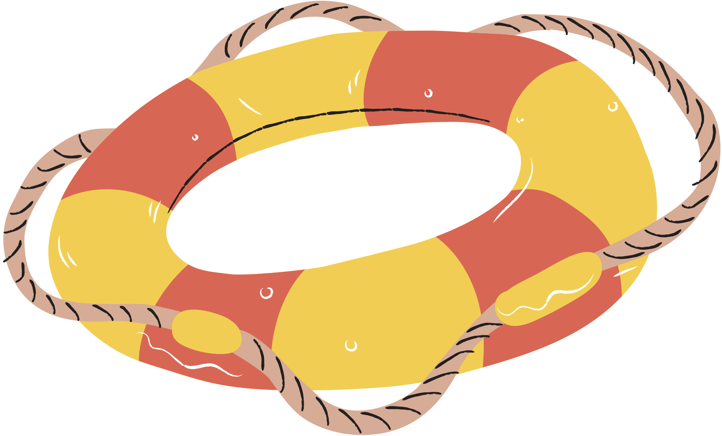
Life Lessons from the Youngest Person to Travel to Every Country

Slide 2




Why I chose this Topic
As someone who loves to travel, I became curious about the value I can gain from going overseas. Although I’ve been taking a lot of international trips recently, I hadn’t really had the chance to find an answer to the question: “what exactly am I learning?” I wanted to explore how traveling overseas can contribute to my personal growth.
Moreover, many TUFS students are passionate about going overseas including myself, so I thought the lessons shared by the speaker would resonate deeply with us.
Lexie Alford, the speaker!

Slide 3


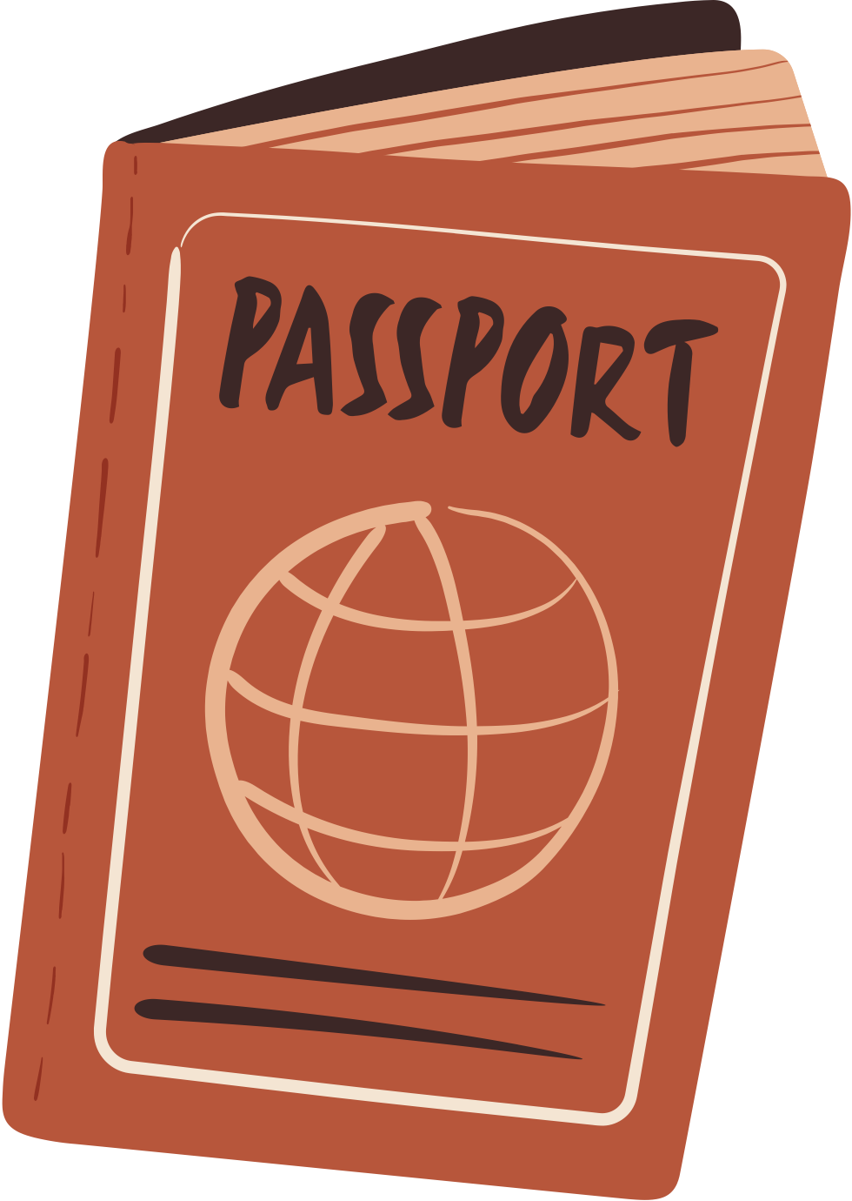

Vocabularies
Congregate
Flash-forward
Gather into a crowd or mass
To whow events that will happen at a later time than the main story
Dawn on (someone)
-There were 50 or so men congregating in the parking lot
-Flash forward two and a half years later, I spent countless hours... traveling with nothing but a backpack.
To become known or obvious to someone, often suddenly
-That’s when it dawned on me。
Euphoria
In retrospect
A feeling or state of intense excitement and happiness
To look back on a past event or situation
-A complete terror turned into utter euphoria.
-In retrospect, I had no idea what I was getting myself into.

Slide 4




Questions
The speaker had already traveled to every country in the world by 22. While this is truly impressive, it’s also very risky for a young woman to travel alone. If you were her, would you have made the same decision? Why or why not?
How do you define your own comfort zone?
Have you ever stepped out of it for the sake of a new experience?
What was that experience like?
Do you have any fears?
How do you think you can overcome them?

Slide 5











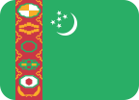

COUNTRY QUIZ
Answer the name of the country and match its flag!
This is a smallest country in the world. It’s entirely surrounded by another county. It plays a very important religious role.
This country is often called “the North Korea of Central Asia”. It is very rich in natural resources like oil and natural gas. Due to strict visa policies, approximately 15,000 visitors are allowed to enter the country annually.
This country is considered one of the poorest countries in the world. It’s in Africa, and coffee is harvested. Its flag resembles a convenience store in Japan.
This country owns a canal that connects Pacific and Atlantic Oceans. It plays a vital role in world’s trades. The canal used to be owned by the United States.

Slide 6

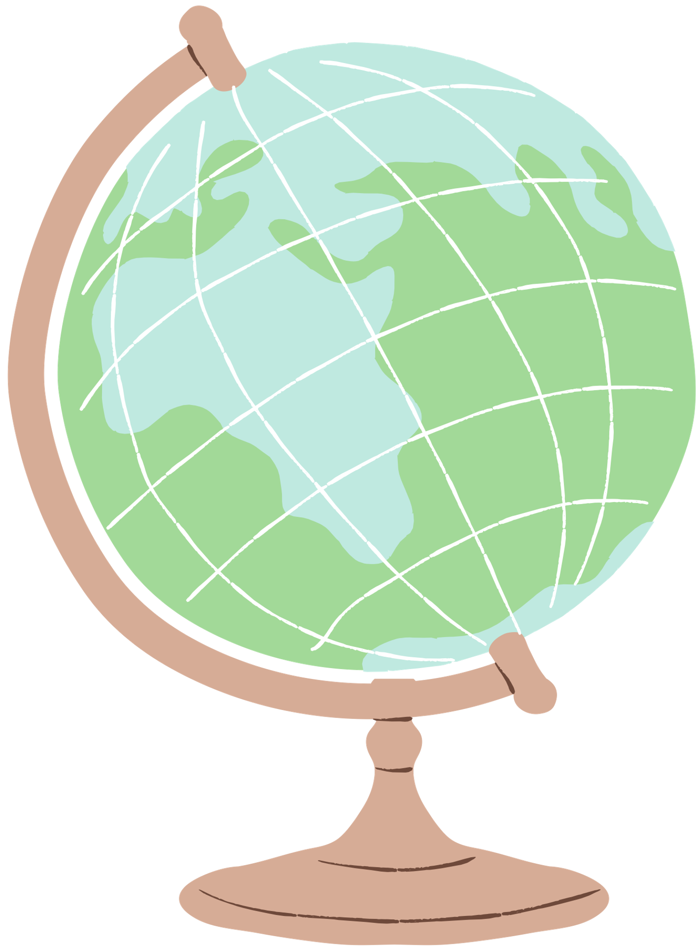

Answers!
Vatican City
Sierra Leone
Turkmenistan
Panama

Slide 7

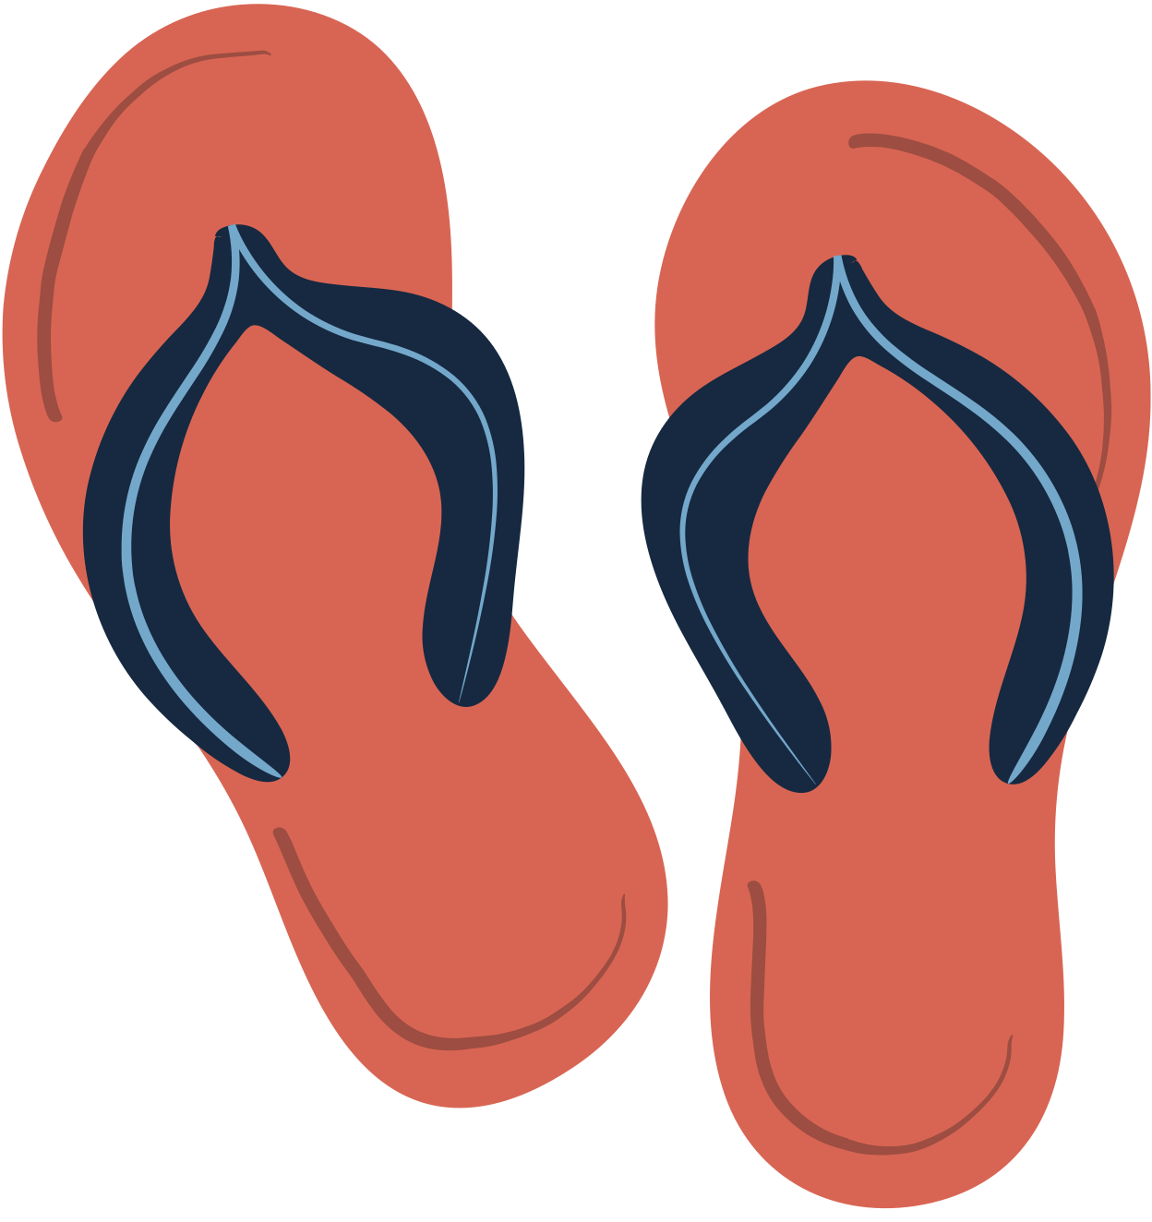
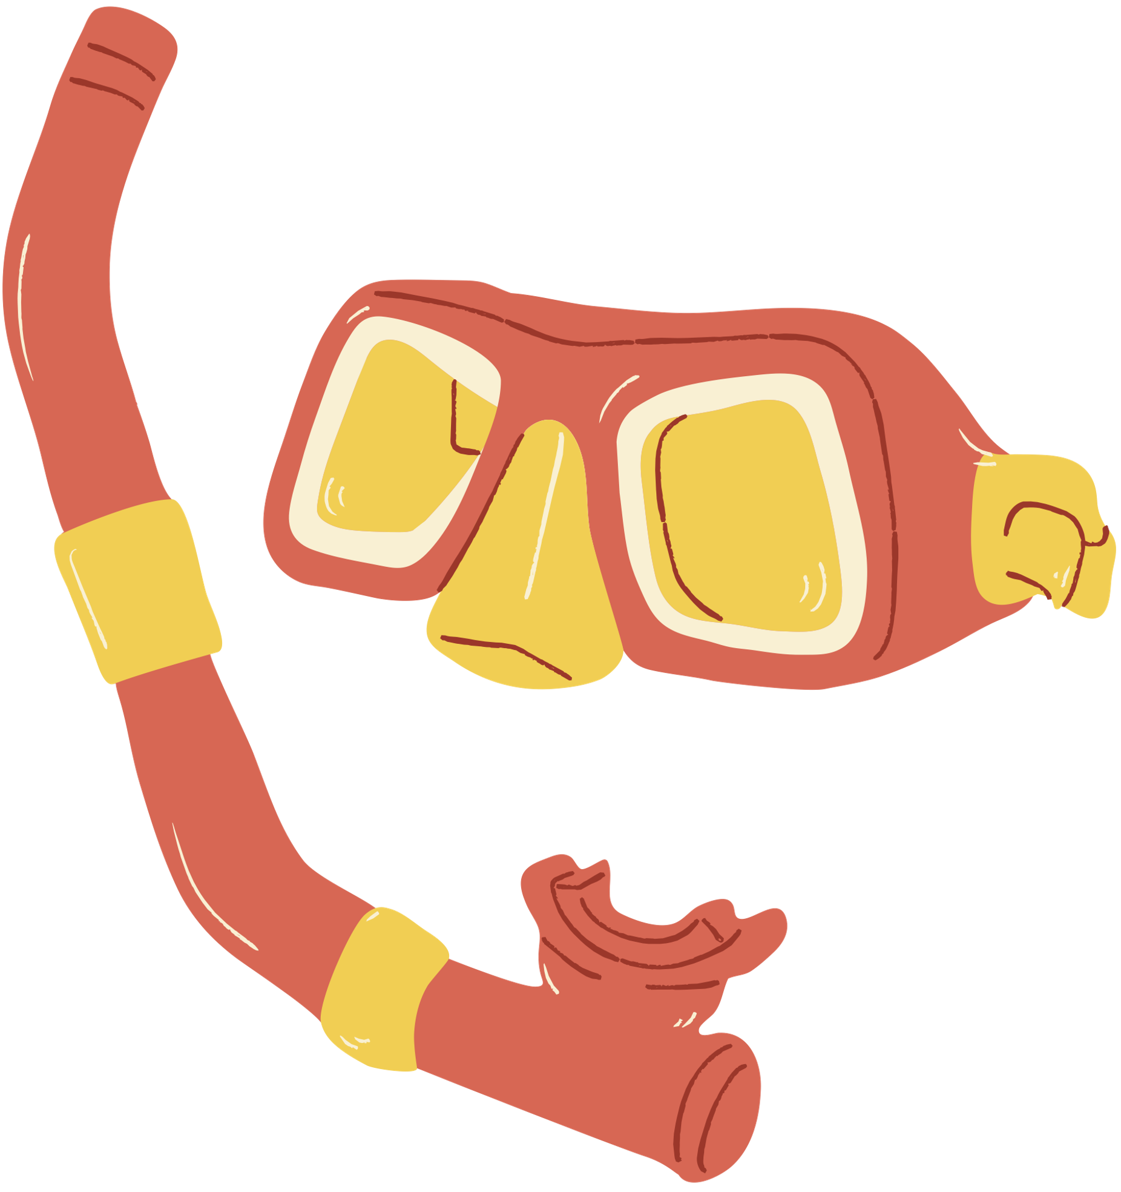
Thank you :)

