Slide 1

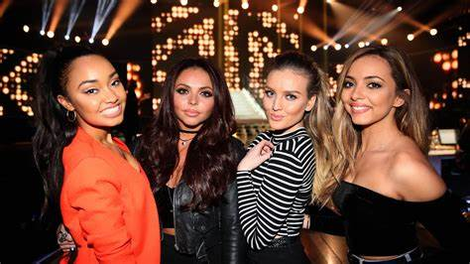





Wings
All Girls
Group1
By Little Mix

Slide 2

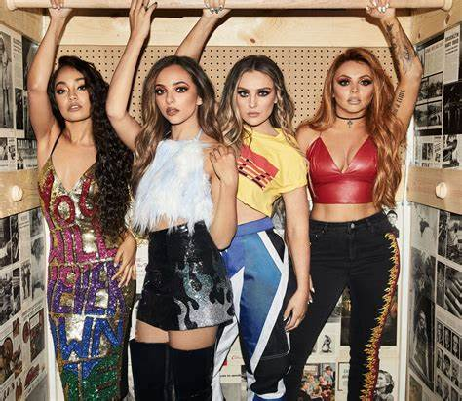

Contents
  1 :About Music
  2:About Artist
  3:Let’s watch the MV together
  4:Important Vocabulary
  5:Gap Fill Quiz
  6:Pronunciation Challenge
  7:Quiz Time
  8:Review Filler

Slide 3
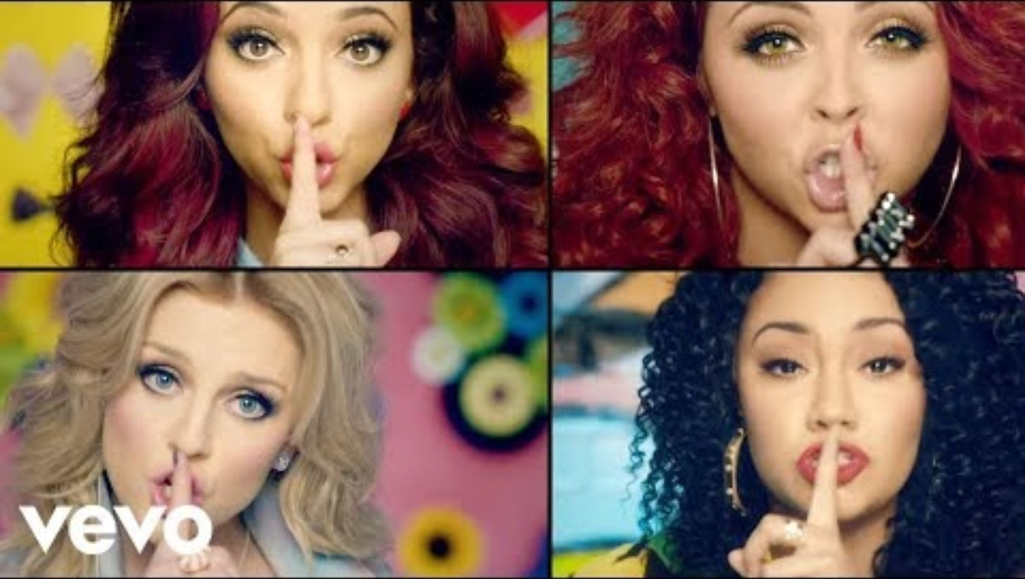
Let's watch the MV without sounds!

Slide 4
This music about
Being yourself
We think there are two things that this song wants to convey.
The first is that you should live your life in your own way, without worrying about what others think.
The second is that you should believe in your own abilities and take on various challenges.
It can be said that it is a song that supports and encourages those who take on challenges.

Slide 5
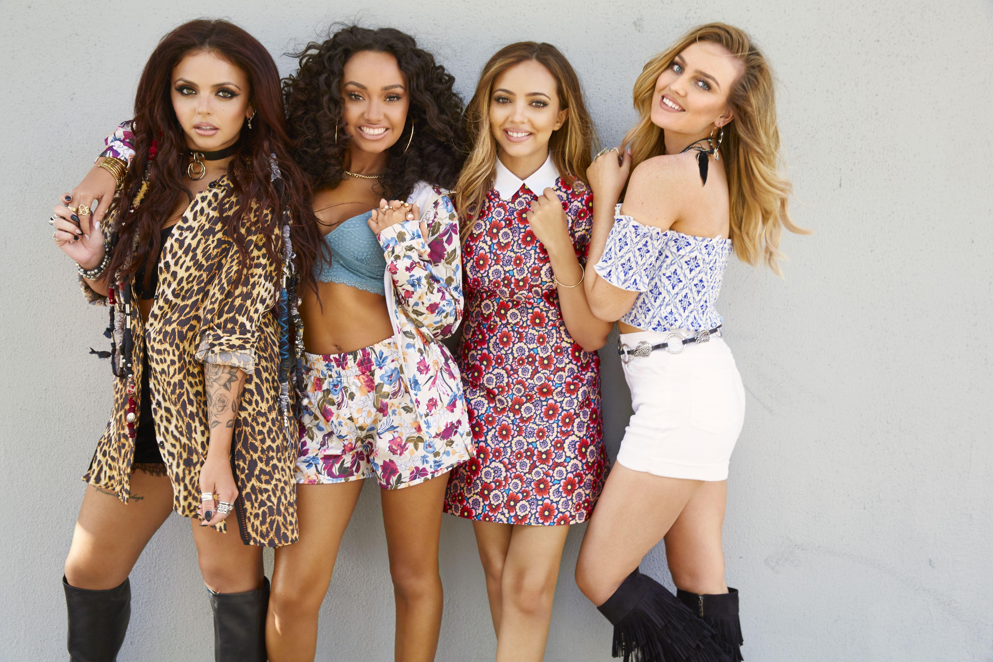
This is a song by…
Little Mix
Winner of the eighth season of “The X Factor,”
the group was formed in 2011.
They are characterized by their powerful singing voices and dance and fashion that match the themes of their songs.
The lineup consisted of Leigh-Anne Pinnock,
Jade Thirlwall, Perrie Edwards, and originally Jesy Nelson, before her departure from the group in 2020.

Slide 6
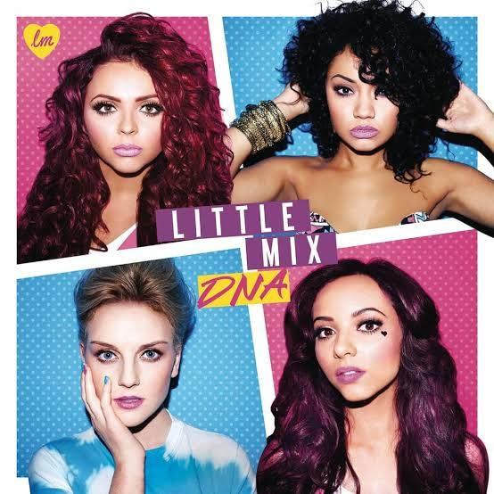
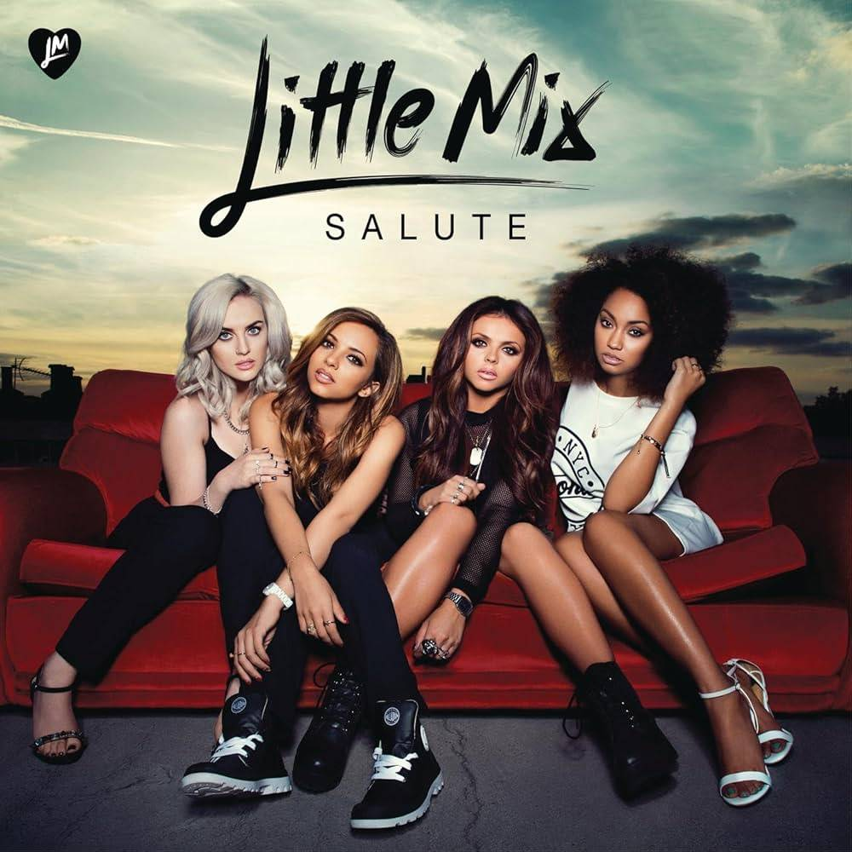
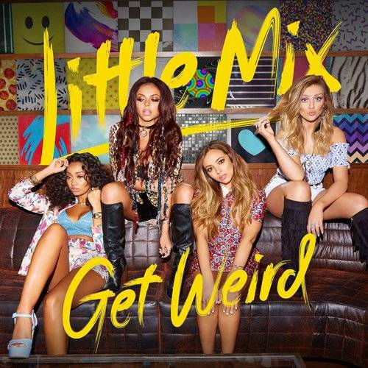


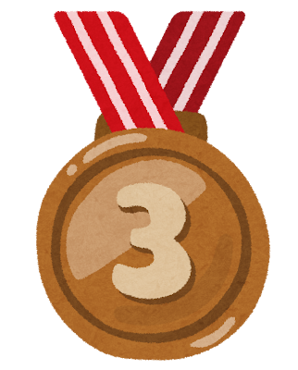
Little Mix's TOP3 Album
DNA
Released November 19, 2012
Salute
Get Weird
Released November 8, 2013
Released November 6, 2015

Slide 7
Let's watch the MV with sounds!

Slide 8
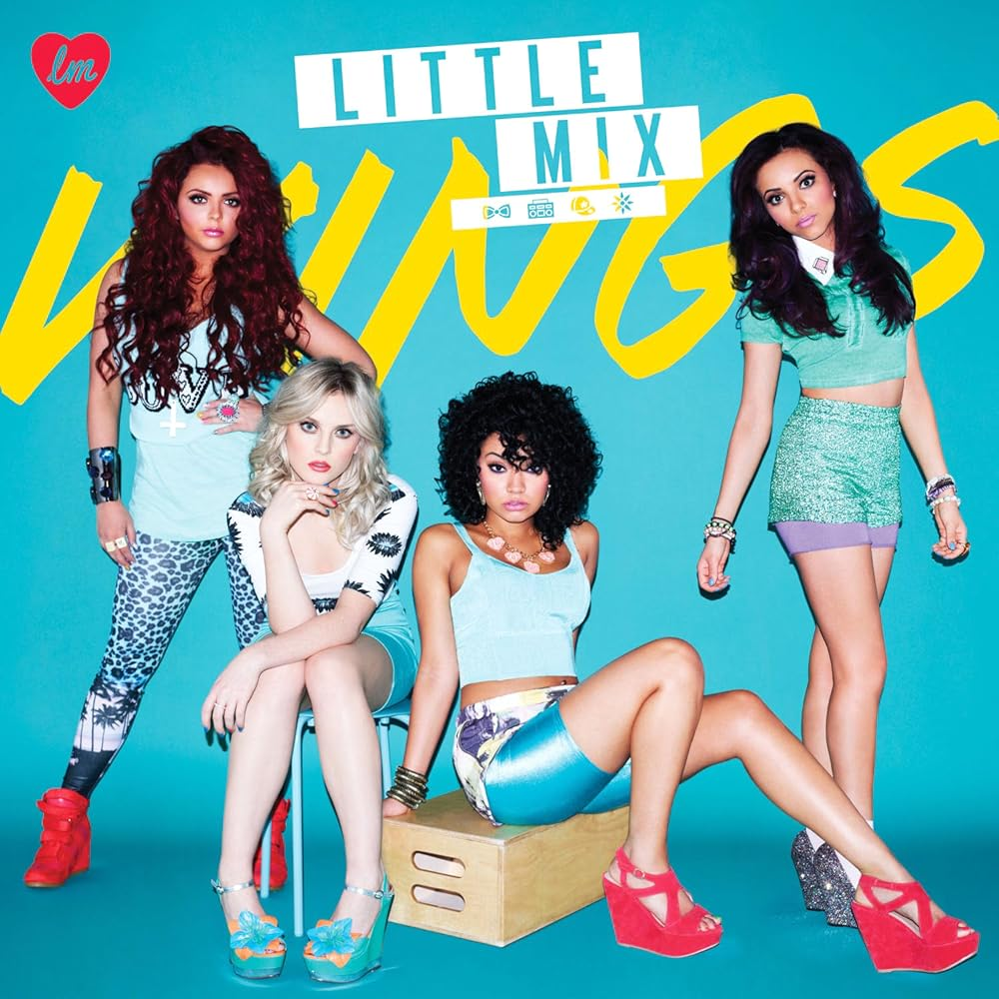
Important Vocabulary
Vocabulary
Important Vocabulary
【Wings・butterfly】
These are important words that appear many times in the song.
These words are metaphors. Butterflies mean children. Spread your wings, I think, implies that we want our children to grow up.

Slide 9
Important lyrics
Vocabulary
Important Vocabulary
【Don't let what they say keep you up at night
And they can't detain you 'cause wings are made to fly
And we don't let nobody bring us down No matter what you say it won't hurt me Don't matter if I fall from the sky These wings are made to fly】
We tought that this lyric was intended for us in today's world, where we tend to be concerned about what people say and do.

Slide 10
Gap fill quiz answer
---
Mama told me not to waste my life (Ah-ooh)
She said, "Spread your wings, my little butterfly(Ah-ooh)
Don't let what they say keep you up at night (Ah-ooh)
And if they give you shh, then they can walk on by"
[Verse 1: Jesy, Jade]
My feet, feet can't touch the ground
And I can't hear a sound
But you just keep on running up your mouth, yeah (Hey, hey, hey, hey)
Walk, walk on over there
'Cause I'm too fly to care, oh, yeah
[Pre-Chorus: Leigh-Anne & Perrie, All]
Your words don't mean a thing
I'm not --------
Keep --------, all I know is
[Chorus: All, Perrie, Jade]
Mama told me not to waste ---- -----
She said, "------- your wings, my little butterfly
Don't let what they say keep you up --- -------
And they can't detain you '------- wings are made to fly"
And we don't let nobody bring us down (Down, down)
No matter what you say, it won't hurt me
------ ------ if I fall from the sky
These wings are made to fly (Hey, hey)
See upcoming ----- -------
Get ----- for your favorite artists
You might also like
Bed Chem
Sabrina Carpenter
Taste
Sabrina Carpenter
Good Graces
Sabrina Carpenter
[Verse 2: Perrie, Leigh-Anne]
I'm ------ --- on that runway
I know we're gonna get there someday
But we don't need no ready steady go, no
Talk, talk turns into ----
And I don't even care, oh, yeah
[Pre-Chorus: Leigh-Anne & Perrie, All]
Your words don't mean a thing
I'm not listening
Keep talking, all I know is
[Chorus: All, Perrie]
Mama told me not to waste my life
She said, "Spread your wings, my ------ butterfly
Don't let what they say keep you up at night
And they can't detain you 'cause wings are made to fly"
(Let 'em fly, let 'em fly, fly)
And we don't let nobody bring us down
(Down, down; Let 'em fly, let 'em fly, fly)
No matter ----- ----- ------, it won't hurt me
(Let 'em fly, let 'em fly, fly)
Don't matter if I ----- from the sky
(Let 'em fly, let 'em fly, fly)
These wings are made to fly
[Bridge: Leigh-Anne, All]
I don't need no one sayin', "Hey, hey, hey, hey"
I don't hear no one sayin', "Hey, hey, hey, hey, hey, hey, hey, hey"
You'd better keep on walkin'
I don't wanna hear your talking, boy'd
You'd better keep on walkin'
I don't wanna hear your talking, boy'd
[Pre-Chorus: Perrie, All]
Your words don't mean a thing (Don't mean a thing)
I'm not listening (Not listening)
They're just like ------ ----- my wings
[Chorus: All, Perrie]
Mama told me not to waste my life (Ooh, woah)
She said, "Spread your wings, my little butterfly (My little butterfly)
Don't let what they say ------ ----- --- at night
And they can't detain you (They can't detain you)
'Cause wings are made to fly" (Let 'em fly, let 'em fly, fly)
And we don't let nobody bring us down
(Down, down; Let 'em fly, let 'em fly, fly)
--- ------- what you say, it won't hurt me
(Let 'em fly, let 'em fly, fly; Oh, woah)
Don't matter if I fall from the sky
(Let 'em fly, let 'em fly, fly; Oh, woah)
These wings are made to fly
[Outro: All, Perrie]
And we don't let ------ bring us down (Down, down)
No matter what you say, it won't ----- ---
Don't matter if I fall from the sky
These wings are ----- --- fly

Slide 11
Gap fill quiz answer
[Pre-Chorus: Leigh-Anne & Perrie, All]
Your words don't mean a thing
I'm not listening
Keep talking, all I know is
[Chorus: All, Perrie, Jade]
Mama told me not to waste my life
She said, "spread your wings, my little butterfly
Don't let what they say keep you up at night
And they can't detain you 'cause wings are made to fly"
And we don't let nobody bring us down (Down, down)
No matter what you say, it won't hurt me
Don't matter if I fall from the sky
These wings are made to fly (Hey, hey)
[Verse 2: Perrie, Leigh-Anne]
I'm ------ --- on that runway
I know we're gonna get there someday
But we don't need no ready steady go, no
Talk, talk turns into ----
And I don't even care, oh, yeah
[Pre-Chorus: Leigh-Anne & Perrie, All]
Your words don't mean a thing
I'm not listening
Keep talking, all I know is
[Chorus: All, Perrie]
Mama told me not to waste my life
She said, "Spread your wings, my ------ butterfly
Don't let what they say keep you up at night
And they can't detain you 'cause wings are made to fly"
(Let 'em fly, let 'em fly, fly)
And we don't let nobody bring us down
(Down, down; Let 'em fly, let 'em fly, fly)
No matter ----- ----- ------, it won't hurt me
(Let 'em fly, let 'em fly, fly)
Don't matter if I ----- from the sky
(Let 'em fly, let 'em fly, fly)
These wings are made to fly
[Bridge: Leigh-Anne, All]
I don't need no one sayin', "Hey, hey, hey, hey"
I don't hear no one sayin', "Hey, hey, hey, hey, hey, hey, hey, hey"
You'd better keep on walkin'
I don't wanna hear your talking, boy'd
You'd better keep on walkin'
I don't wanna hear your talking, boy'd
[Pre-Chorus: Perrie, All]
Your words don't mean a thing (Don't mean a thing)
I'm not listening (Not listening)
They're just like ------ ----- my wings
[Chorus: All, Perrie]
Mama told me not to waste my life (Ooh, woah)
She said, "Spread your wings, my little butterfly (My little butterfly)
Don't let what they say ------ ----- --- at night
And they can't detain you (They can't detain you)
'Cause wings are made to fly" (Let 'em fly, let 'em fly, fly)
And we don't let nobody bring us down
(Down, down; Let 'em fly, let 'em fly, fly)
--- ------- what you say, it won't hurt me
(Let 'em fly, let 'em fly, fly; Oh, woah)
Don't matter if I fall from the sky
(Let 'em fly, let 'em fly, fly; Oh, woah)
These wings are made to fly
[Outro: All, Perrie]
And we don't let ------ bring us down (Down, down)
No matter what you say, it won't ----- ---
Don't matter if I fall from the sky
These wings are ----- --- fly

Slide 12
Gap fill quiz answer
[Verse 2: Perrie, Leigh-Anne]
I'm firing up on that runway
I know we're gonna get there someday
But we don't need no ready steady go, no
Talk, talk turns into air
And I don't even care, oh, yeah
[Pre-Chorus: Leigh-Anne & Perrie, All]
Your words don't mean a thing
I'm not listening
Keep talking, all I know is
[Chorus: All, Perrie]
Mama told me not to waste my life
She said, "Spread your wings, my ------ butterfly
Don't let what they say keep you up at night
And they can't detain you 'cause wings are made to fly"
(Let 'em fly, let 'em fly, fly)
And we don't let nobody bring us down
(Down, down; Let 'em fly, let 'em fly, fly)
No matter ----- ----- ------, it won't hurt me
(Let 'em fly, let 'em fly, fly)
Don't matter if I ----- from the sky
(Let 'em fly, let 'em fly, fly)
These wings are made to fly
[Bridge: Leigh-Anne, All]
I don't need no one sayin', "Hey, hey, hey, hey"
I don't hear no one sayin', "Hey, hey, hey, hey, hey, hey, hey, hey"
You'd better keep on walkin'
I don't wanna hear your talking, boy'd
You'd better keep on walkin'
I don't wanna hear your talking, boy'd
[Pre-Chorus: Perrie, All]
Your words don't mean a thing (Don't mean a thing)
I'm not listening (Not listening)
They're just like ------ ----- my wings
[Chorus: All, Perrie]
Mama told me not to waste my life (Ooh, woah)
She said, "Spread your wings, my little butterfly (My little butterfly)
Don't let what they say ------ ----- --- at night
And they can't detain you (They can't detain you)
'Cause wings are made to fly" (Let 'em fly, let 'em fly, fly)
And we don't let nobody bring us down
(Down, down; Let 'em fly, let 'em fly, fly)
--- ------- what you say, it won't hurt me
(Let 'em fly, let 'em fly, fly; Oh, woah)
Don't matter if I fall from the sky
(Let 'em fly, let 'em fly, fly; Oh, woah)
These wings are made to fly
[Outro: All, Perrie]
And we don't let ------ bring us down (Down, down)
No matter what you say, it won't ----- ---
Don't matter if I fall from the sky
These wings are ----- --- fly

Slide 13
Gap fill quiz answer
Chorus: All, Perrie]
Mama told me not to waste my life
She said, "Spread your wings, my little butterfly
Don't let what they say keep you up at night
And they can't detain you 'cause wings are made to fly"
(Let 'em fly, let 'em fly, fly)
And we don't let nobody bring us down
(Down, down; Let 'em fly, let 'em fly, fly)
No matter what you say, it won't hurt me
(Let 'em fly, let 'em fly, fly)
Don't matter if I fall from the sky
(Let 'em fly, let 'em fly, fly)
These wings are made to fly
[Bridge: Leigh-Anne, All]
I don't need no one sayin', "Hey, hey, hey, hey"
I don't hear no one sayin', "Hey, hey, hey, hey, hey, hey, hey, hey"
You'd better keep on walkin'
I don't wanna hear your talking, boy'd
You'd better keep on walkin'
I don't wanna hear your talking, boy'd
[Pre-Chorus: Perrie, All]
Your words don't mean a thing (Don't mean a thing)
I'm not listening (Not listening)
They're just like ------ ----- my wings
[Chorus: All, Perrie]
Mama told me not to waste my life (Ooh, woah)
She said, "Spread your wings, my little butterfly (My little butterfly)
Don't let what they say ------ ----- --- at night
And they can't detain you (They can't detain you)
'Cause wings are made to fly" (Let 'em fly, let 'em fly, fly)
And we don't let nobody bring us down
(Down, down; Let 'em fly, let 'em fly, fly)
--- ------- what you say, it won't hurt me
(Let 'em fly, let 'em fly, fly; Oh, woah)
Don't matter if I fall from the sky
(Let 'em fly, let 'em fly, fly; Oh, woah)
These wings are made to fly
[Outro: All, Perrie]
And we don't let ------ bring us down (Down, down)
No matter what you say, it won't ----- ---
Don't matter if I fall from the sky
These wings are ----- --- fly

Slide 14
[Bridge: Leigh-Anne, All]
I don't need no one sayin', "Hey, hey, hey, hey"
I don't hear no one sayin', "Hey, hey, hey, hey, hey, hey, hey, hey"
You'd better keep on walkin'
I don't wanna hear your talking, boy'd
You'd better keep on walkin'
I don't wanna hear your talking, boy'd
[Pre-Chorus: Perrie, All]
Your words don't mean a thing (Don't mean a thing)
I'm not listening (Not listening)
They're just like water off my wings
[Chorus: All, Perrie]
Mama told me not to waste my life (Ooh, woah)
She said, "Spread your wings, my little butterfly (My little butterfly)
Don't let what they say ------ ----- --- at night
And they can't detain you (They can't detain you)
'Cause wings are made to fly" (Let 'em fly, let 'em fly, fly)
And we don't let nobody bring us down
(Down, down; Let 'em fly, let 'em fly, fly)
--- ------- what you say, it won't hurt me
(Let 'em fly, let 'em fly, fly; Oh, woah)
Don't matter if I fall from the sky
(Let 'em fly, let 'em fly, fly; Oh, woah)
These wings are made to fly
[Outro: All, Perrie]
And we don't let ------ bring us down (Down, down)
No matter what you say, it won't ----- ---
Don't matter if I fall from the sky
These wings are ----- --- fly
Gap fill quiz answer

Slide 15
[Chorus: All, Perrie]
Mama told me not to waste my life (Ooh, woah)
She said, "Spread your wings, my little butterfly (My little butterfly)
Don't let what they say keep you up at night
And they can't detain you (They can't detain you)
'Cause wings are made to fly" (Let 'em fly, let 'em fly, fly)
And we don't let nobody bring us down
(Down, down; Let 'em fly, let 'em fly, fly)
No matter what you say, it won't hurt me
(Let 'em fly, let 'em fly, fly; Oh, woah)
Don't matter if I fall from the sky
(Let 'em fly, let 'em fly, fly; Oh, woah)
These wings are made to fly
[Outro: All, Perrie]
And we don't let ------ bring us down (Down, down)
No matter what you say, it won't ----- ---
Don't matter if I fall from the sky
These wings are ----- --- fly
Gap fill quiz answer

Slide 16
Gap fill quiz answer
[Outro: All, Perrie]
And we don't let nobody bring us down (Down, down)
No matter what you say, it won't hurt me
Don't matter if I fall from the sky
These wings are made to fly

Slide 17
Pronunciation challenge
Mama told me not to waste my life
She said ' Spread your wings , my little butterfly
Don't let what they say keep you up at night
And if they give you sh... then they can walk on by'
による ThePhoto は CCYYSA の下でライセンスされています。

Slide 18
Quiz 1：
What does this song want to convey?
1
Love is the most important things
Being selfish
2
Being yourself
3
Money is the most important things
4

Slide 19
Quiz 1：
What does this song want to convey?
1
Love is the most important things
Being selfish
2
Being yourself
3
Money is the most important things
4

Slide 20

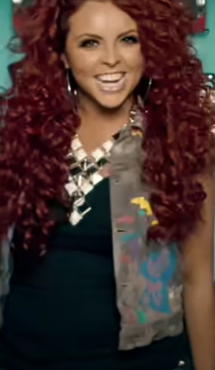
Quiz 2：
What is displayed behind the member Jesy in the MV?
1
Radios
2
Bows
3
Flowers
Paintings
4

Slide 21

Quiz 2：
What is displayed behind the member Jesy in the MV?
1
Radios
2
Bows
3
Flowers
Paintings
4

Slide 22
Quiz 3：Who is encourage you in the lyrics?
1
Friends
Mom
2
Lover
3
God
4

Slide 23
Quiz 3：Who is encourage you in the lyrics?
1
Friends
Mom
2
Lover
3
God
4

Slide 24
Quiz 4：What kind of creature does Mom compare to me?
1
Butterfly
Cat
2
Bird
3
Lion
4

Slide 25
Quiz 4：What kind of creature does Mom compare to me?
1
Butterfly
Cat
2
Bird
3
Lion
4

Slide 26
Quiz 5：
On which reality music audition show did Little Mix win?
fast
1
The X Factor
2
Britain's Got Talent
3
Pop Idol
facts
4
Love Island

Slide 27
Quiz 5：
On which reality music audition show did Little Mix win?
1
The X Factor
2
Britain's Got Talent
3
Pop Idol
4
Love Island
By Little Mix

Slide 28
Quiz 6：
How many members were in the group when it was formed?
1
3
2
4
3
5
4
By Little Mix
6

Slide 29
Quiz 6：
How many members were in the group when it was formed?
1
3
2
4
3
5
4
6
By Little Mix

Slide 30
Review Filler
We give the song.....
★★★★★
We really like the meaning of the lyrics and the powerful music.
Listening to this music makes us feel excited.
We think this song is perfect for college students who are struggling with their careers. If you are hesitant about failing, please listen to this song and take a step forward.

Slide 31


Thank you for listening!

