Slide 1
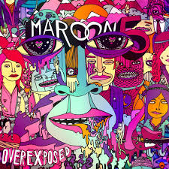

Meiji's Mainstream Music: Maroon 5 - "Daylight"
Let's explore one of Maroon 5's most emotional songs together! We'll dive into vocabulary, meaning, and activities that will help you understand this beautiful song about saying goodbye.
Today we'll discover:
What makes this song special
Key vocabulary to understand the lyrics
The deeper meaning behind the music
Notes:
"Hello everyone. Today, I'd like to introduce a great song from one of my favorite bands. This is Meiji's Mainstream Music, and we're going to explore "Daylight" by Maroon 5.
First, I have a couple of questions for you. What do you do when you have to say goodbye to someone important? It‘s a sad moment, right? Also, have you ever heard of Maroon 5? They are a world famous pop-rock band.
This song, "Daylight," is brilliant because it has a beautiful melody and lyrics that many people can relate to. It’s all about cherishing the last moment with someone special.Let's dive in."

Slide 2

About the Song
Released in 2012 as part of their album "Overexposed," "Daylight" quickly became one of Maroon 5's most beloved songs.
What makes it special?
Unique Voice
Universal Theme
Adam Levine's distinctive vocals carry the emotional weight of saying goodbye
The bittersweet experience of cherishing final moments with someone special
Powerful Melody
A memorable tune that perfectly complements the emotional lyrics
Adam Levine, lead vocalist

Slide 3
Vocabulary Bank: Key Words
Before we listen to the song, let's learn some important vocabulary that will help you understand the lyrics better.
1
2
Daylight
Slip away
The natural light of the day
To leave quietly without being noticed
In the song, it symbolizes the time of separation
In the song, the singer has to slip away when morning comes
3
4
Glance
Hold close
A quick look
To embrace someone tightly
In the song, it could mean the singer's last look at the person he loves
In the song, it expresses the desire to cherish final moments together
Notes:
"Okay, are you ready to listen to the song? Let's try a listening activity!
(Play the song or give students time to listen)

Slide 4


Slide 5
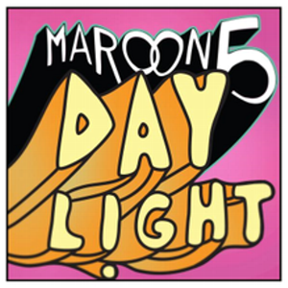
Listening Activity: Fill in the Blanks!
Let's test your listening skills! As you listen to the song, fill in the missing words in these lines from the chorus:
"But tonight, I'm ____ hold you so close.
'Cause in the daylight we'll be .
tonight, I need to hold you so close"

Slide 6

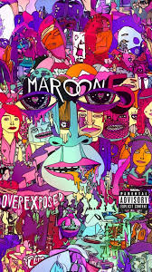



Let's Check the Answers!
How many did you get right?
First
gonna
Second
on our own
Thirfd
But

Slide 7

The Story & Symbolism
What is this song truly about?
At its heart, "Daylight" captures the feeling of a painful goodbye. The singer must leave someone he loves when the morning comes.
Key Symbolism:
Night: Represents togetherness, intimacy, and precious moments
Daylight: Symbolizes inevitable separation and the end of time together
This contrast creates the emotional tension that makes the song so powerful and relatable.

Slide 8

"The Daylight Project" Music Video
What makes the music video for "Daylight" special is that it's not just about the band - it's about everyone's stories.
A Global Invitation
Universal Message
The band invited fans from all over the world to share their own personal video clips and stories
The final video is a compilation of these fan submissions, showing how the song's theme connects with people everywhere
Emotional Impact
By featuring real people and real emotions, the video amplifies the song's message about cherishing precious moments

Slide 9
Quiz Time: Check Your Understanding!
Question 1
Question 2
Question 3
What is the name of the lead vocalist of Maroon 5?
The music video for "Daylight" was created with videos submitted by whom?
In the song, what does "daylight" symbolize?
Adam Lambert
Adam Levine
Adam Sandler
Professional actors
The band members' families
Their fans
A new beginning
The time to say goodbye
A happy memory
How many did you get right?
Notes:
"Okay, let's have a quick quiz to check your understanding so far. There are three questions.
Question 1: What is the name of the lead vocalist of Maroon 5? ... The answer is B) Adam Levine.
Question 2: The music video for 'Daylight' was created with videos submitted by whom? ... The answer is C) Their fans.
Question 3: In the song, what does 'daylight' symbolize? ... The answer is B) The time to say goodbye.
I hope you all got them right!"

Slide 10
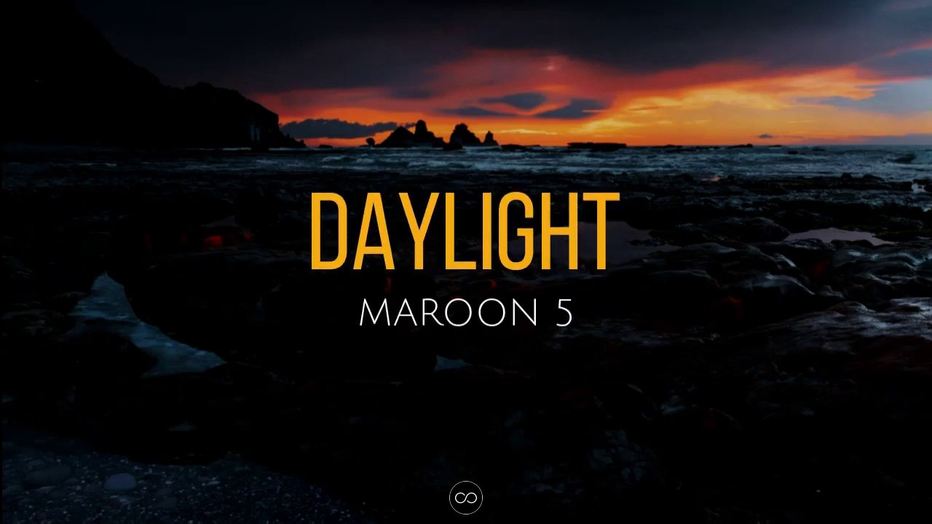
Pronunciation Challenge: Sound Like a Native!
Natural spoken English uses special techniques that make words flow together. Let's practice with lines from the song!
Elision (音が消える)
Linking (音が繋がる)
"But" → /bə/ (The final "t" sound becomes very weak)
"tonight I" → /tənaɪt‿aɪ/
"on our" → /ɒn‿aʊər/
"'Cause" (from Because) → /kəz/
The Schwa (弱い音)
Try it yourself! Practice these techniques to make your English sound more natural.
"gonna" → /ˈgənə/
This weak "uh" sound is very common in natural English

Slide 11
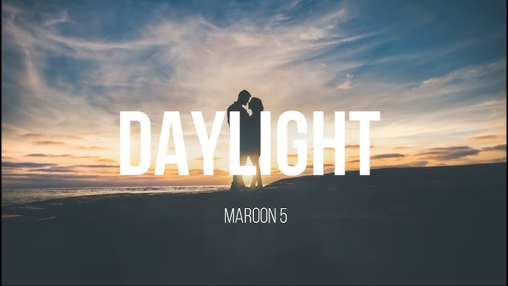
Activity: Let's Change the Lyrics!
The original chorus line is:
"And when the daylight comes I'll have to go"
Let's change this line to fit new situations:
Examples:
Finishing a fun party
"And when the morning comes I'll have to go home"
Last day of summer vacation
Now, your turn!
"And when September comes I'll have to go to school"
Think of a situation and create your own lyric to share with the class!
Thank you for exploring Maroon 5's "Daylight" with us today!
Notes:
"That's all for my presentation. Today, we explored the world of Maroon 5's 'Daylight,' from its vocabulary and lyrics to its special meaning. I hope you enjoyed it and understand more about the magic of this song.
Thank you for your participation and for listening.

