Slide 1
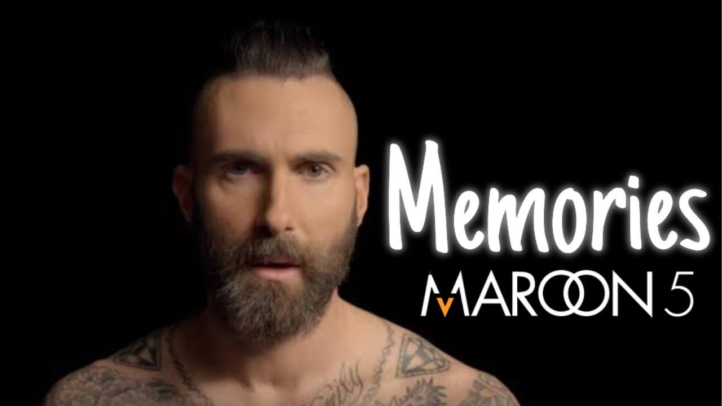
Notes:
Hello guys we gonna
talking about “Memories “ by Maroon 5.

Slide 2
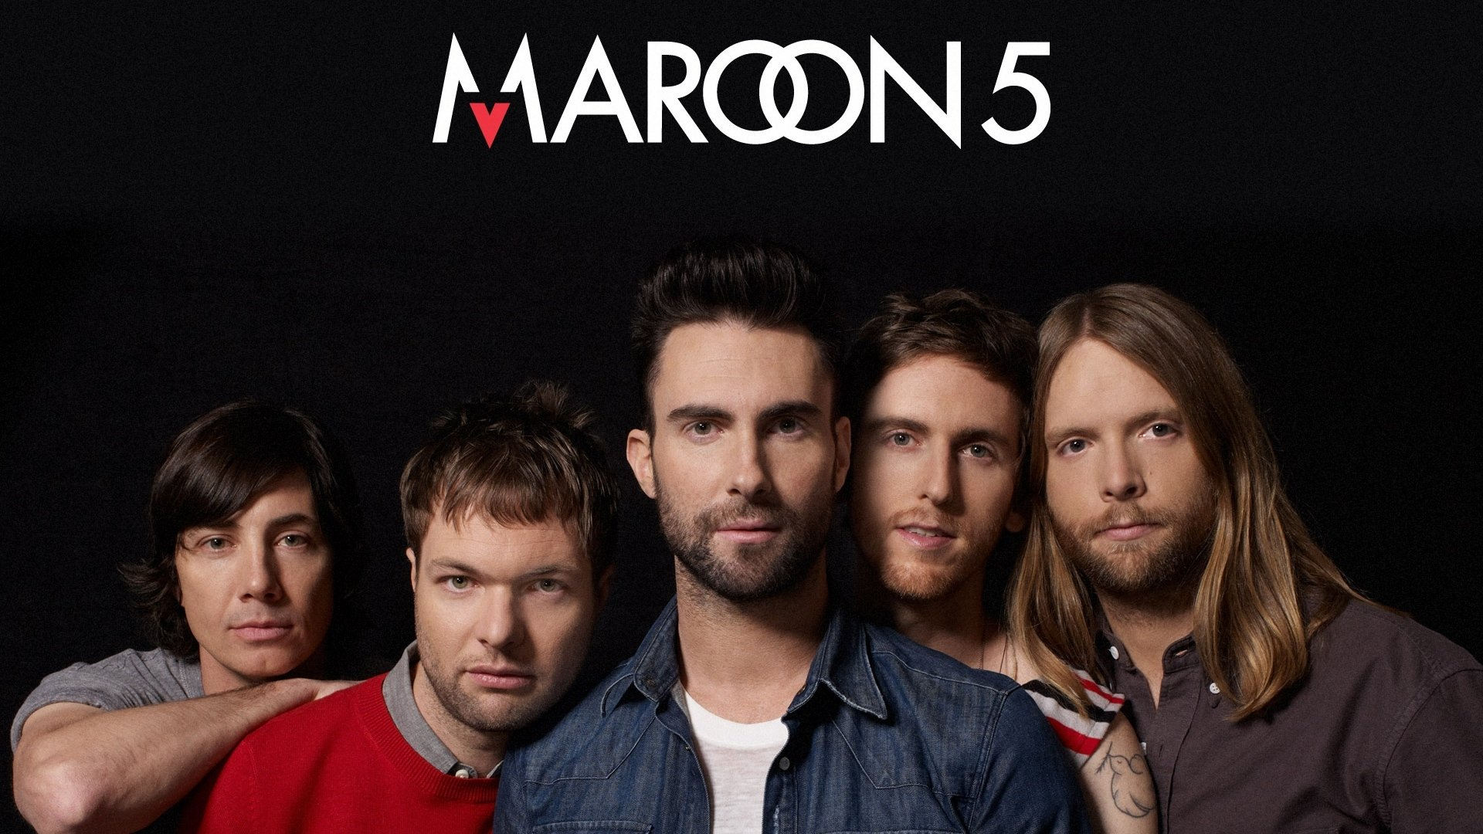
ABOUT
They regrouped in 2001, added James Valentine.
American boy pop rock band.
Moves Like Jagger is one of the UK’s best-selling single of all time.
They were originally formed in 1994 as Kara’s Flowers.
Notes:
Maroon5 is American boy pop rock band. They were originally formed in 1994 as “Kara’s Flowers”.
They regrouped in 2001, and added member jame

Slide 3

MEMORIES IS……
Requiem
for Jordan Feldstein.

Slide 4

Who is Jordan Feldstein?
He supported Maroon5 for long time as their manager.
He passed away in 2017.
He died without seeing Mroon5’s great success.
Notes:
And then you’re

Slide 5
PLAY THE SONG
https://www.youtube.com/watch?v=SlPhMPnQ58k

Slide 6


Slide 7
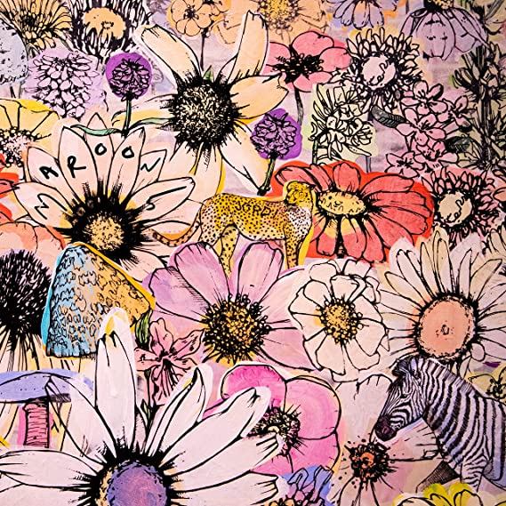
MEANINGFUL LYRLICS
Very simple, but touching lyrics
“Cheers to the wish you were here, but you’re not”
“ ‘Cause the drinks bring back all the memories”
“Memories bring back, memories bring back you”
Notes:
Next, we tal

Slide 8
CHECK THE ANSWER
[1]cheers
[5]December
[2]Toast
[6]lighting up
[3]pain
[7]torches
[4]heart

Slide 9
THANK YOU FOR WATCHING

