Slide 1
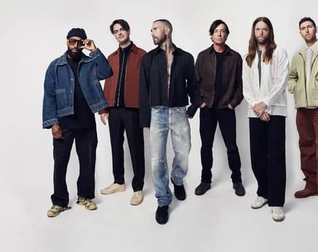

Katsumi Kumagaye
Jingyao Wu
Sweet Success:
The Story Behind Maroon 5
—Sugar

Slide 2

Discussion Time

Slide 3

Over view
1. Artist Introduction
2. Main vocabulary
3. Song Overview
4. Watch the video with gap fills
5. Pronunciation challenge
6. Quiz time
7. Lyrics scramble

Slide 4
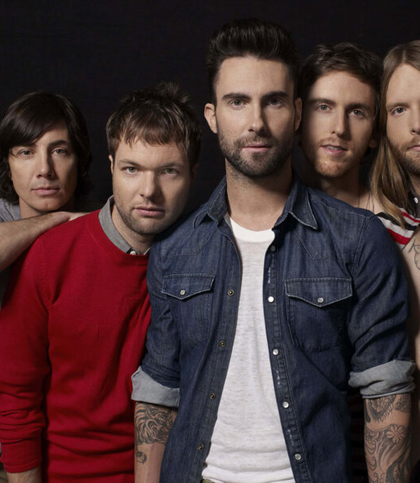
Artist Introduction
Artist Name: Maroon 5
Formation Year: 1994 (originally as Kara's Flowers)
Origin: Los Angeles, California, USA
Music Genres: Pop Rock, R&B, Electronic Music
Vocal Features: Adam Levine’s distinctive falsetto
Style Evolution: From traditional rock to incorporating electronic music
Concerts: Highly successful world tours
Fan Base: A diverse and widespread global audience
Social Influence: Strong presence in music videos and social media

Slide 5
Main vocabulary
Love:
The song revolves around a deep and enduring love, expressing the protagonist's strong desire and dependence on their partner. The lyrics frequently emphasize the yearning for the loved one to return, highlighting the importance of love in the protagonist's life.
“Love” represents a profound emotional connection, conveying the strong need for love and the commitment to maintaining the relationship.
Sweetness:
“Sweetness” symbolizes the delightful experiences and joyful feelings that love brings. It goes beyond the literal meaning of sweetness, serving as a metaphor for the warmth, happiness, and positive emotions that come with being in love.
The song uses sweet melodies and lyrics to create a tender atmosphere, allowing listeners to feel the warmth and comfort that love provides.

Slide 6
Song Overview
The lyrics of "Sugar" primarily revolve around themes of love and desire. In the song, the protagonist uses "sugar" as a metaphor to express his intense longing for love and affection.
He pleads for his lover to return, emphasizing that love and warmth are as essential and irresistible as sugar.
In the chorus, the repeated line "Sugar, yes, please" conveys the protagonist's urgent need to be loved and cared for. He compares love to sweet sugar, hoping that this sweetness will heal his loneliness and pain.
The lyrics are simple yet direct, using the metaphor of sweetness to portray the dependency on love and the pursuit of happiness.
The song, with its upbeat melody and warm lyrics, captures the sweetness and longing of love, creating a feeling that is both joyful and comforting.

Slide 7
Watch the video with gap fills
Fill in the missing words from the lyrics of "As long as you love me"
[Verse 1]
I'm hurtin', baby, I'm broken down
I need your lovin', lovin', I need it now
When I'm without you, I'm somethin' weak
You got me beggin', beggin', I'm on my knees
[Pre-Chorus]
I don't wanna be needin' your love
I just wanna be (2 word)＿＿＿ your love
And it's killin' me when you're away
Ooh, baby
'Cause I really don't care where you are
I just wanna be there where you are
And I gotta get one little taste
The song’s URL: https://www.youtube.com/watch?v=09R8_2nJtjg
[Chorus]
Your sugar, yes, please
Won't you come and (3 words) ________ on me?
I'm right here, 'cause I need
Little love, a little sympathy
Yeah, you show me good lovin', make it alright
Need a little sweetness in my life
Your sugar, yes, please
Won't you come and put it down on me?

Slide 8
[Chorus]
Sugar, yes, please
Won't you come and put it down on me?
I'm right here, 'cause I need
Little love, a little sympathy
Yeah, you show me good lovin', make it alright
Need a little sweetness in my life
Your sugar, yes, please (Your sugar, yes, please)
Won't you come and put it down on me?
[Bridge]
Yeah
I want that (2 words) _______, I want that sugar sweet
Don't let nobody touch it unless that somebody's me
I gotta be a man, there ain't no other way
'Cause, girl, you're (1 words) ______than a Southern California day
And I wanna play no games, you don't gotta be afraid
Don't give me all that shy shit
No makeup on, that's my sugar
[Verse 2]
Babe,(3 words) ______, you pick them up
Don't leave me hangin', hangin', come give me some
When I'm without you, I'm so (1 word) ______.
You are the one thing, one thing I'm livin' for
[Pre-Chorus]
I don't wanna be needin' your love
I just wanna be deep in your love
And it's killin' me when you're away
Ooh, baby
'Cause I really don't care where you are
I just wanna be there where you are
And I gotta get one little taste

Slide 9
[Chorus]
Sugar, yes, please (Please)
Won't you come and put it down on me? (Down on me)
I'm right here, 'cause I need (I'm right here, 'cause I need)
Little love, a little sympathy
Yeah, you show me good lovin', make it alright
Need a little sweetness in my life (Yeah)
Your sugar, yes, please (Your sugar, yes, please)
Won't you come and put it down on me? (Down on me)
Sugar, yes, please
Won't you come and put it down on me? (Down on me)
I'm right here, 'cause I need (I'm right here, 'cause I need)
Little love, a little sympathy
Yeah, you show me good lovin', (3 words) _______.
Need a little sweetness in my life
Your sugar, yes, please (Your sugar, yes, please)
Won't you come and put it down on me?
(Down on me, down on me, ooh)

Slide 10
1.deep in
2.put it down
3.My broken pieces
4.insecure
5.red velvet
6.Hotter
7.make it alright
Answer

Slide 11
Pronunciation challenge
1. Linking Sounds: "Sugar, Yes Please"
• Phrase: "Sugar, yes please"
• Added Sound: When Adam Levine sings "Sugar, yes please," you can hear a slight linking sound between "sugar" and "yes." The ending "r" sound in "sugar" is almost merged with the start of "yes," creating a smooth transition: "sugar-r-yes." This makes the phrase flow naturally without a break, which helps maintain the song's rhythm and melody.
2. Insertion of "Y" Sound: "I Need"
• Phrase: "I need"
• Added Sound: Between "I" and "need," Adam Levine slightly inserts a "y" sound, making it sound like "I-yi-need." This insertion makes the transition between the words smoother, especially when singing quickly or with emphasis, and gives the phrase a more flowing, melodic quality.
3."W" Sound Linking: "When I'm Without You"
• Phrase: "When I'm without you"
• Added Sound: Between "I'm" and "without," there's a subtle "w" sound linking them, making it sound like "I'm-w-without." This linking helps create a seamless connection between the words, enhancing the rhythm of the line.

Slide 12
Quiz question 1
What metaphor does the protagonist use in "Sugar" to express his longing for love and affection?
a) Honey
b) Sugar
c) Chocolate
d) Flowers

Slide 13

Answer
b) Sugar

Slide 14
Quiz question 2
What emotion is primarily conveyed through the repeated line "Sugar, yes, please" in the song?
  a) Anger
  b) Joy
  c) Urgent need for love and care
  d) Indifference

Slide 15
Answer
  c) Urgent need for love and care

Slide 16
Quiz question 3
In "Sugar," what does the protagonist hope to achieve by receiving the "sweetness" of love?
a) To feel more powerful
b) To heal his loneliness and pain
c) To become famous
d) To gain wealth

Slide 17
b) To heal his loneliness and pain
Answer

Slide 18
Lyrics scramble
Q1.(a little/my/life/sweetness/in)
Q2.(come and put/you/me/down/won’t/on)
Q3.(where/are/care/cause/really/I/you/don’t)

Slide 19
Answer
A1.Need a little sweetness in my life
A2.Won't you come and put it down on me?
A3.Cause I really don't care where you are

Slide 20

Thank you for listening!

