Slide 1
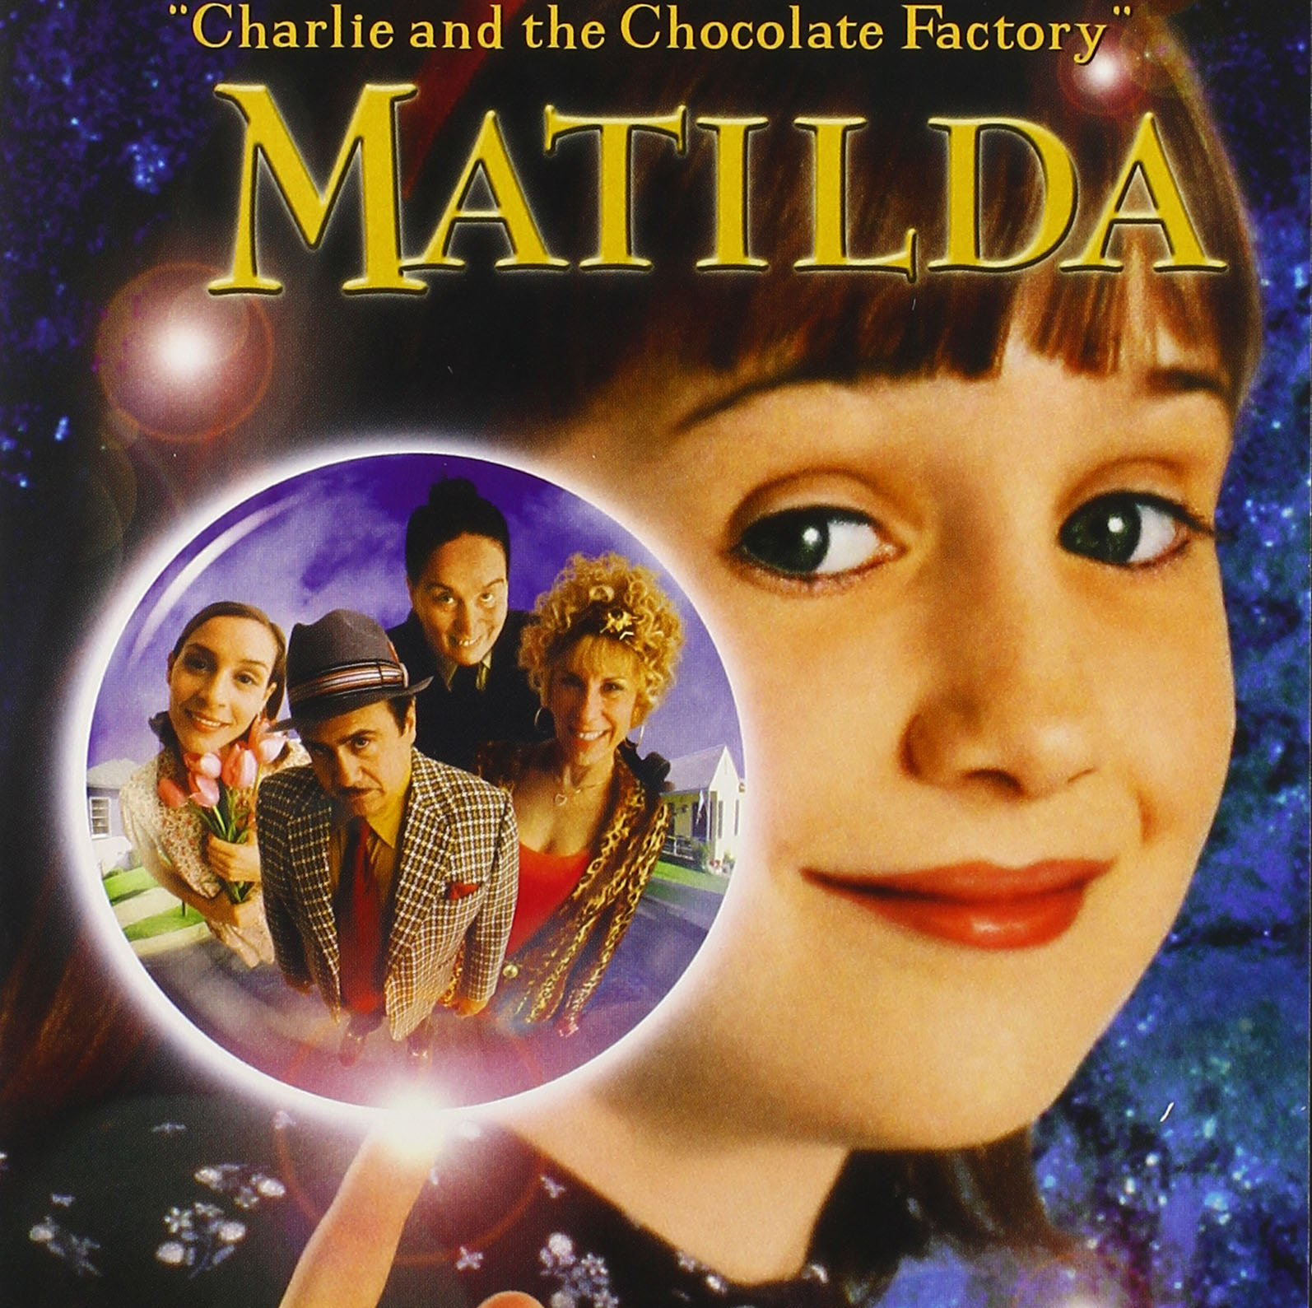
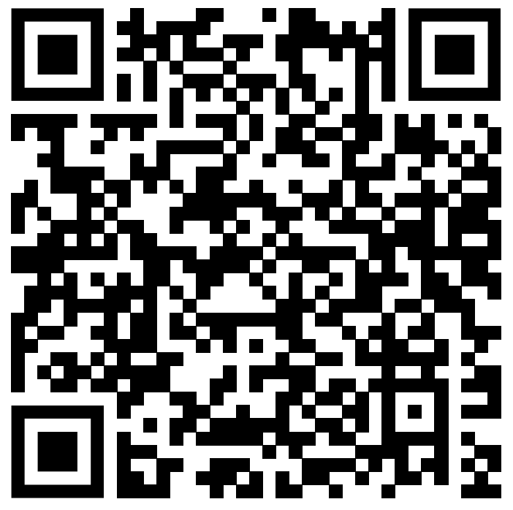
Matilda(1996)
https://www.youtube.com/watch?v=WoN5cCs0l2M&list=PLZbXA4lyCtqr3h4ICO8t79LAkbSIoJVQg&index=2
(0:00-1:37)

Slide 2

Why did I choose this movie and scene?
I like the works of Roald Dahl, but I haven’t read some of his works, including “Matilda”.
I’m not good at listening to fast spoken English, so it is challenging for me to choose this scene.
↓
I chose this movie and scene.

Slide 3

Plot of “Matilda”
Matilda is a very clever little girl.
By the time she was 4 years old, she was reading difficult literature and solving mathematical problems.
However, her parents were not interested in her and even treat her as a nuisance.
Matilda is treated unfairly by her parents, but each time she uses her intelligence to play tricks on them and never gives up confronting them.

Slide 4
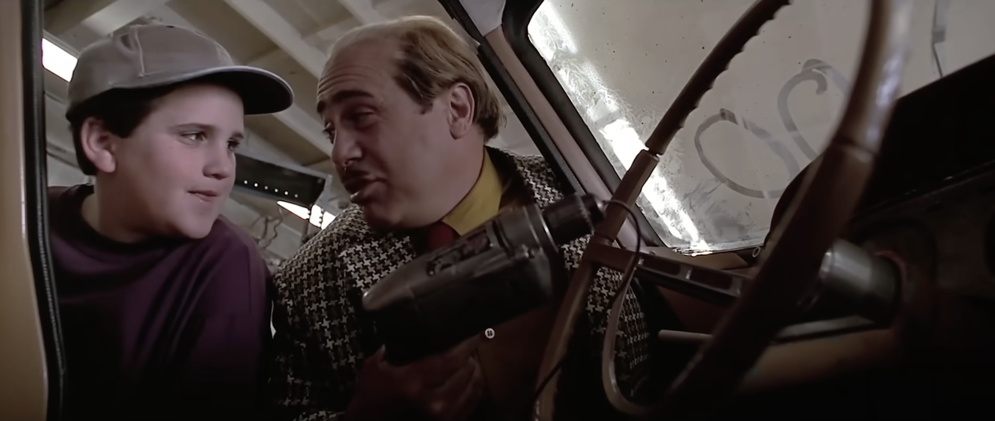
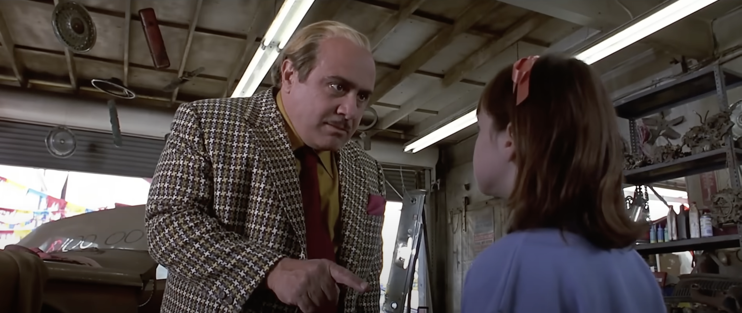
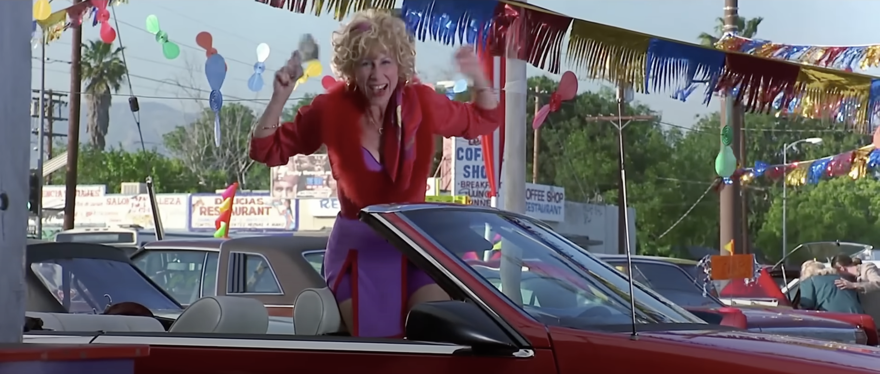
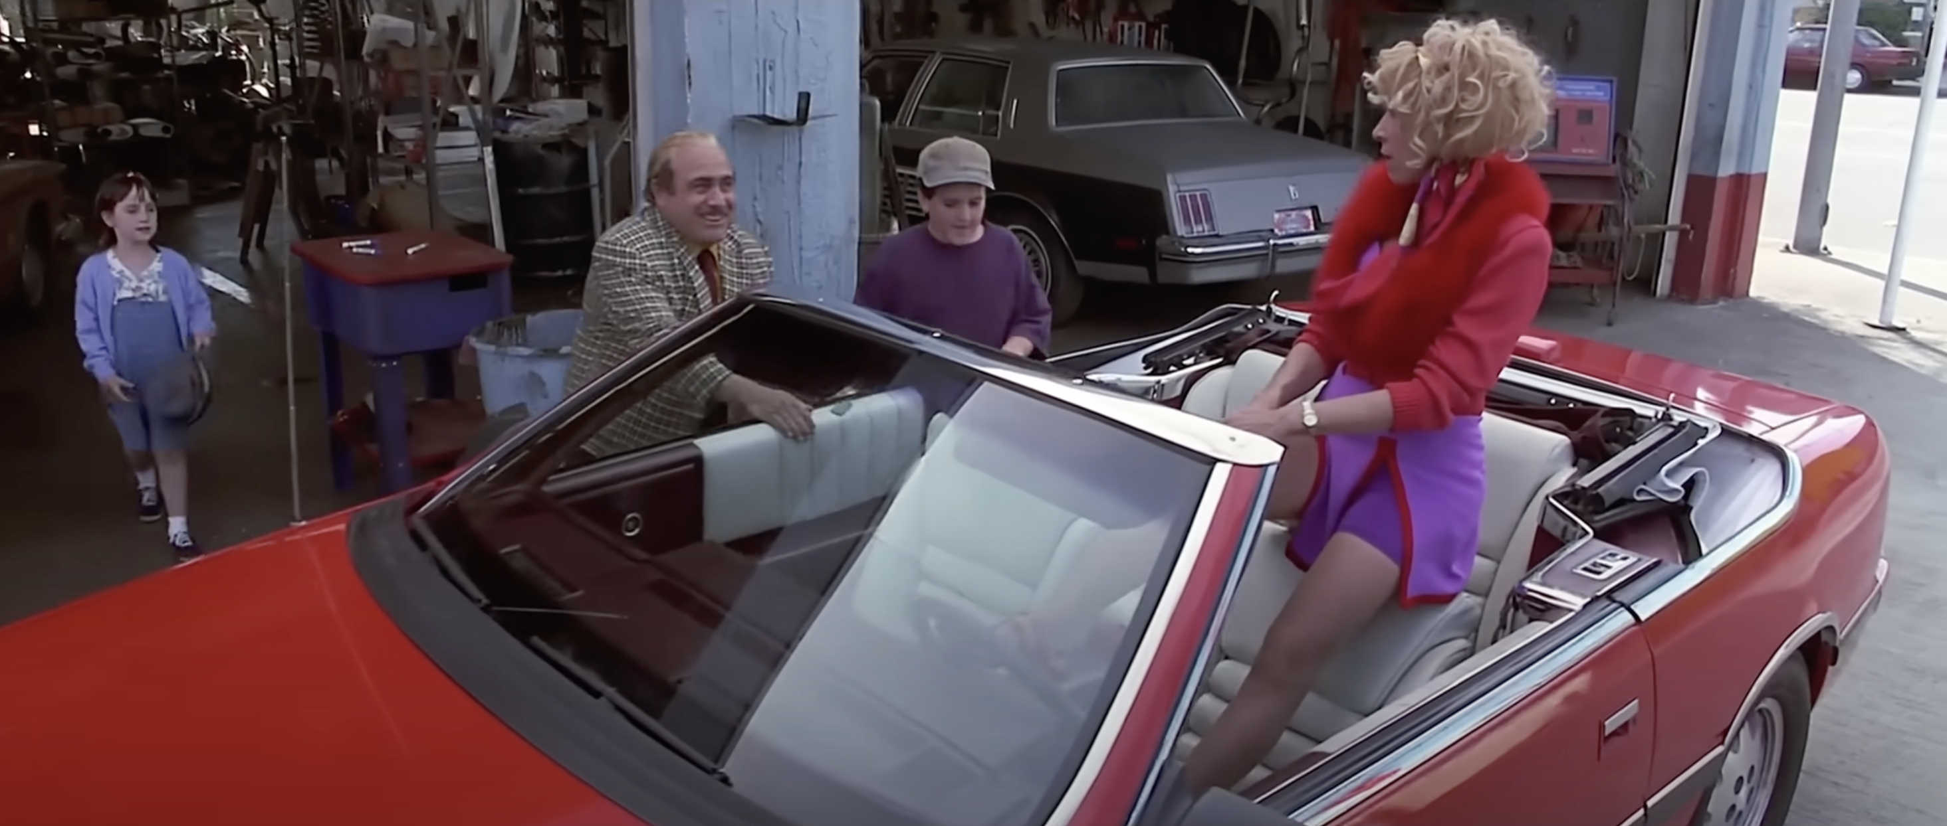
About this scene
Matilda's father works as a used car salesman.
He always uses tricks to make used cars look new and sells them for more money.
Matilda criticizes her father for this, but he won't listen to her.
Matilda's mother loves bingo, and she goes to play bingo, leaving the children to look after themselves.
When she wins the bingo, the four of them go out to eat at a cafe.

Slide 5
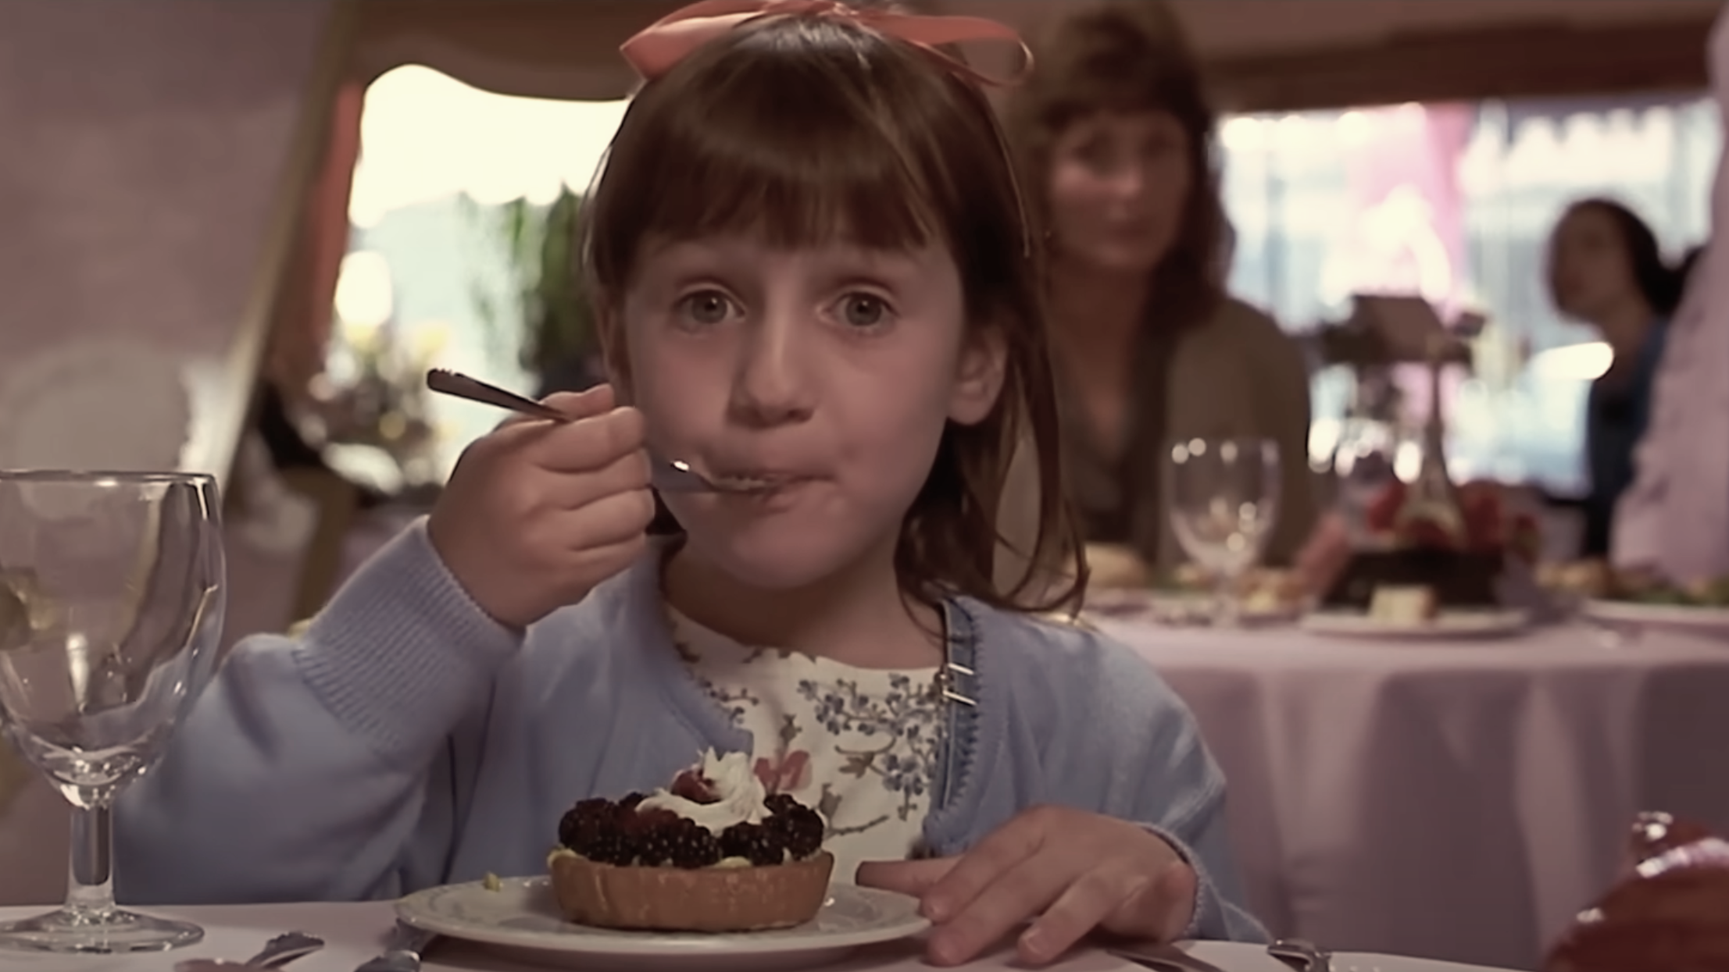
Script
Father: Twenty years ago, we could turn the numbers back by hand, but, here, take my hat! But the feds like to test the ingenuity of the American businessman. Two directional drill. If you run it backwards, the numbers go down.
Michael: Cool!
Matilda: Daddy, you’re a crook.
Father: What?
Matilda: This is illegal.
Father: Keep drilling. Do you make money? Do you have a job?
Matilda: No. But don’t people need good cars? Can’t you sell some good cars, dad?
Father: Listen, you little wiseacre. I'm smart; you're dumb. I'm big; you're little. I'm right; you're wrong. And there's nothing you can do about it.
Mother: Harry! I won! I won! I hit the double bingo! Come on, everybody. I'm takin’ you all to Café Le Ritz.
Father: Let me see the money.
Mother: Never mind.
Father: Double bingo, huh? Ooh.
Mother: God, your hair looks awful. I hope they let you in.
Father: They let me in.
Matilda: Here’s your hat, daddy.
Father: Get in the car. Go on, get in. How much?
Mother: It’s for me to know, and you to find out.

Slide 6
Vocabulary
Feds…federal officers or officials
Ingenuity…someone’s ability to think of clever new ways of doing something
Crook…a very dishonest person, especially a criminal or a cheat
Wiseacre…one who feigns knowledge or cleverness
It’s/That’s for me to know, and you to find out…a phrase used to reply to a question whose answer the speaker doesn’t want to reveal

Slide 7
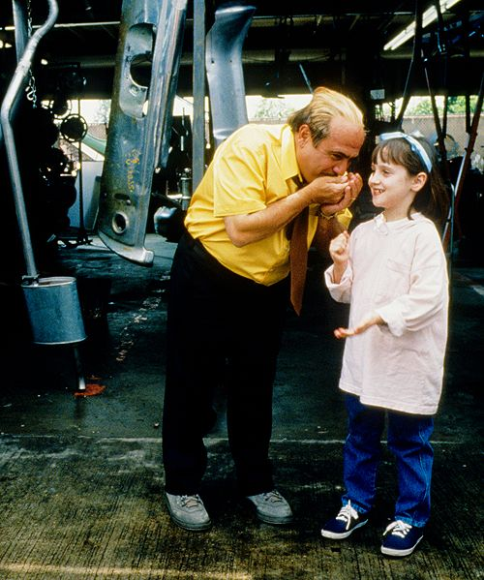

Question provided
Matilda has …
1. father and mother/ 2. father, mother and brother/ 3. father, mother and sister
When Matilda criticized her father, he…
1. was upset and tried to hide the fraud/ 2. angrily blamed Matilda/ 3. reflected on his action and changed his ways
After Matilda‘s father blamed her, Matilda…
1. cried in fear of him/ 2. got angry and criticized him even more/ 3. put glue on his hat

Slide 8
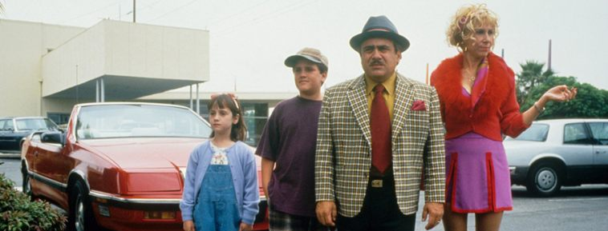
Discussion questions
As a parent, what do you think is the appropriate way to interact with your children?
When pointing out someone's mistake, what do you think is necessary to consider?
What do you think is necessary to clearly convey your opinion to an overbearing person like Matilda’s father?

Slide 9
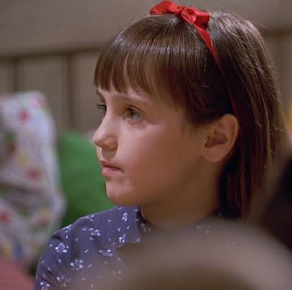
What did I learn from this scene?
Cultural differences
・In Japan “cafe” means the place where people mainly order some drink and prices are cheap, on the other hand in some countries “cafe” means the place in which people eat some foods. So, it might be hard for some students to understand why Matilda’s mother brings her family to the café when she won the bingo game.
・People in Japan play the bingo game only when they attend to any party and rarely get the money. But in US, the bingo game is famous and popular game, like the lottery in Japan.
Miscommunication
・”Feds like to test the ingenuity of the American businessman” is ironical words. It means that cheaters try what is prohibited by the feds. But if some students accept this words positively, it will give them wrong impression.
Vocabulary
・ The phrase ”It’s for me to know, and you to find out” is used when someone doesn’t want to answer the question. But if some students take this phrase literally, they will not be able to understand speaker’s true feelings.
・The word “wiseacre” has a negative meaning, but if some students don’t know this word, they might have the positive image for this word because it includes the word “wise”.
Cultural difference about the action
・When Matilda’s father blamed Matilda, he pointed his forefinger at her. It is so rude action in Japan, so it might confuse some students.

Slide 10
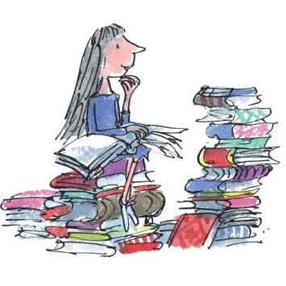
Thank you for reading!

