Slide 1
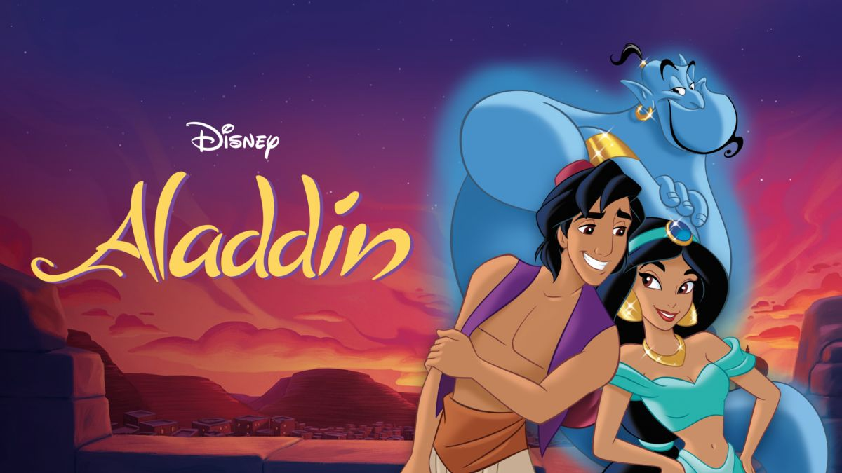

A whole new world
A whole new world

Slide 2

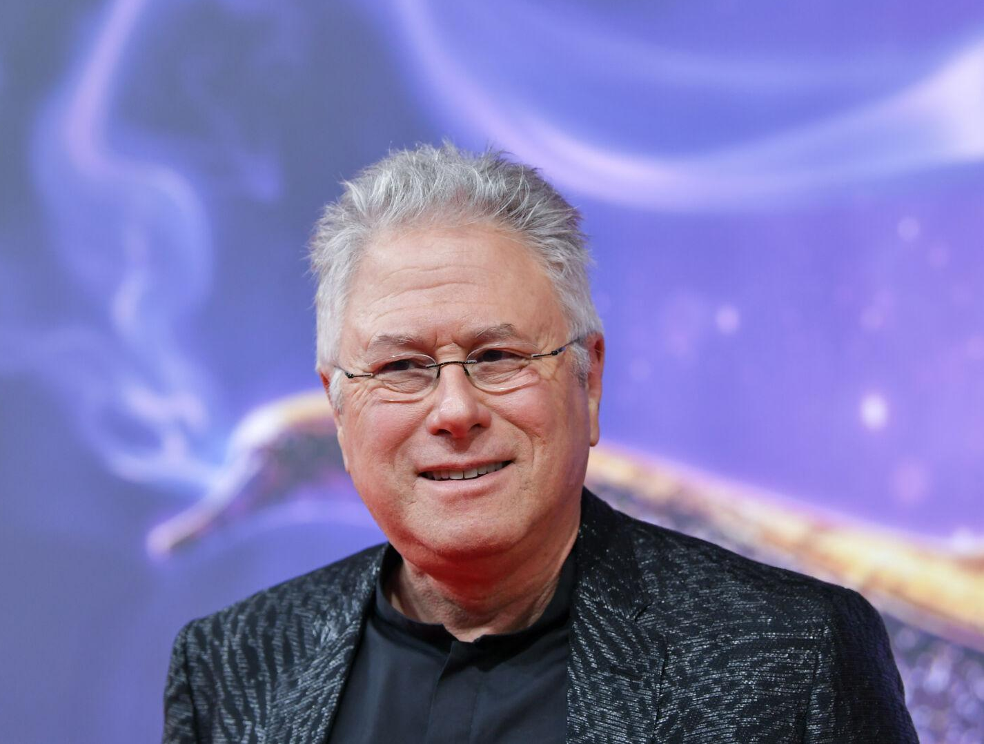

★music by Alan Menken ★lyilics by Tim Rice

Slide 3
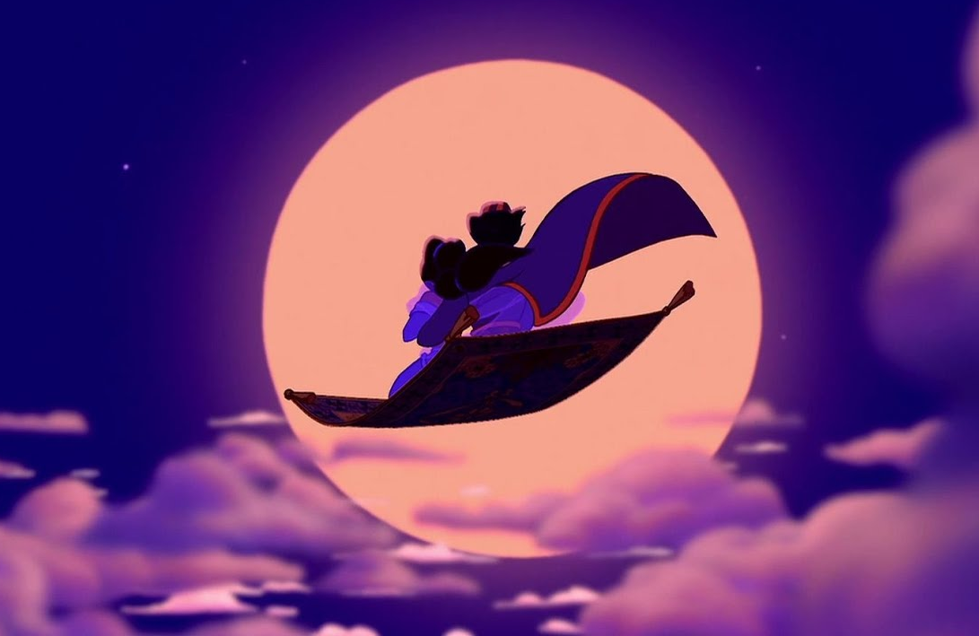
★signature song from Disney's 1992 animated feature
film『Aladdin』
It is sung when Aladdin, disguised as a prince, goes to see the world on a magic carpet with Jasmine.

Slide 4
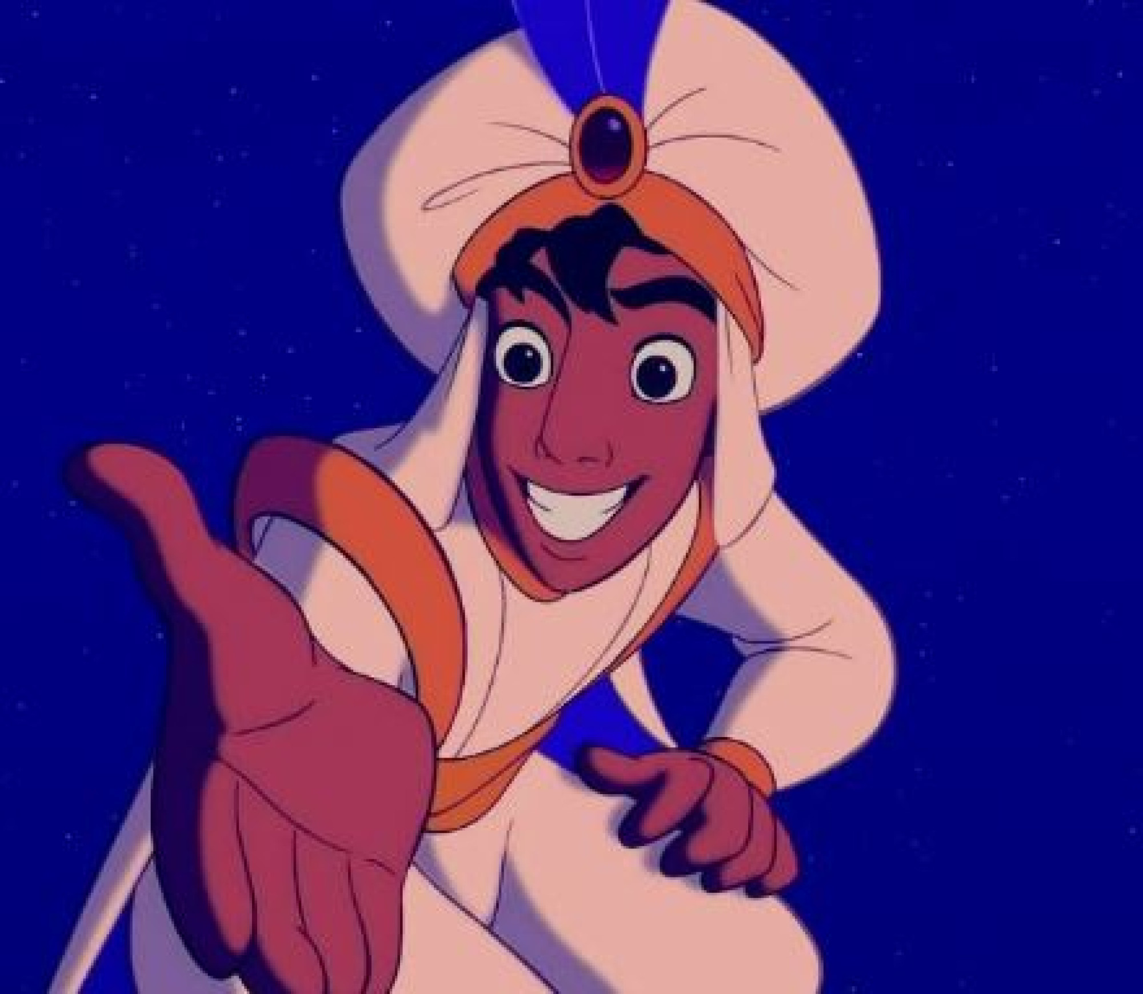
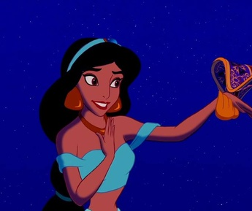
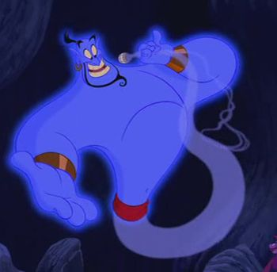
Story of Aladdin
This is the story of Aladdin, who is poor but has a pure heart,
trying to change his life through encounters with
Jasmine, who seeks freedom in the world outside the royal palace,
and Genie, the genie of the lamp.

Slide 5

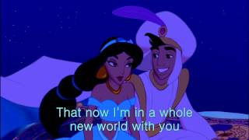
Now please listen to the music. ♪

Slide 6
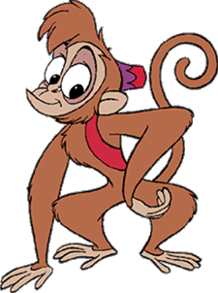
Gap fill 1
Let’s check answer!!
I can show you the world over, sideways and under
shining shimmering splendid on a magic carpet ride
tell me, princess now when did
you last let your heart decide? A whole new world
a new fantastic point of view
I can open your eyes No one to tell us no
Take you wonder by wonder or where to go
or say we’re only dreaming

Slide 7
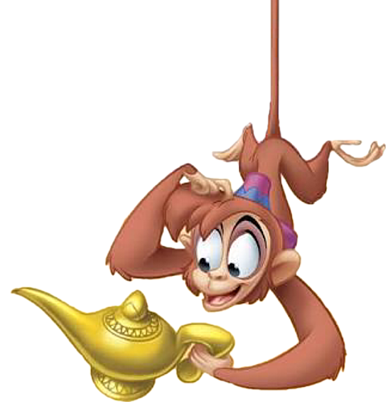
Gap fill 2
A whole new world Unbelievable sights
a dazzling place I never knew indescribable feeling
But when I’m way up here soaring tumbling freewheeling
It’s crystal clear through endless diamond sky
That now I’m in a whole new world
with you
Now I’m in a whole new world with you
Let’s continue!!

Slide 8
Gap fill3
Can you answer the questions right?
A whole new world
(Every turn a surprise)
With new horizons to pursue
（Every moment,red letter)

Slide 9
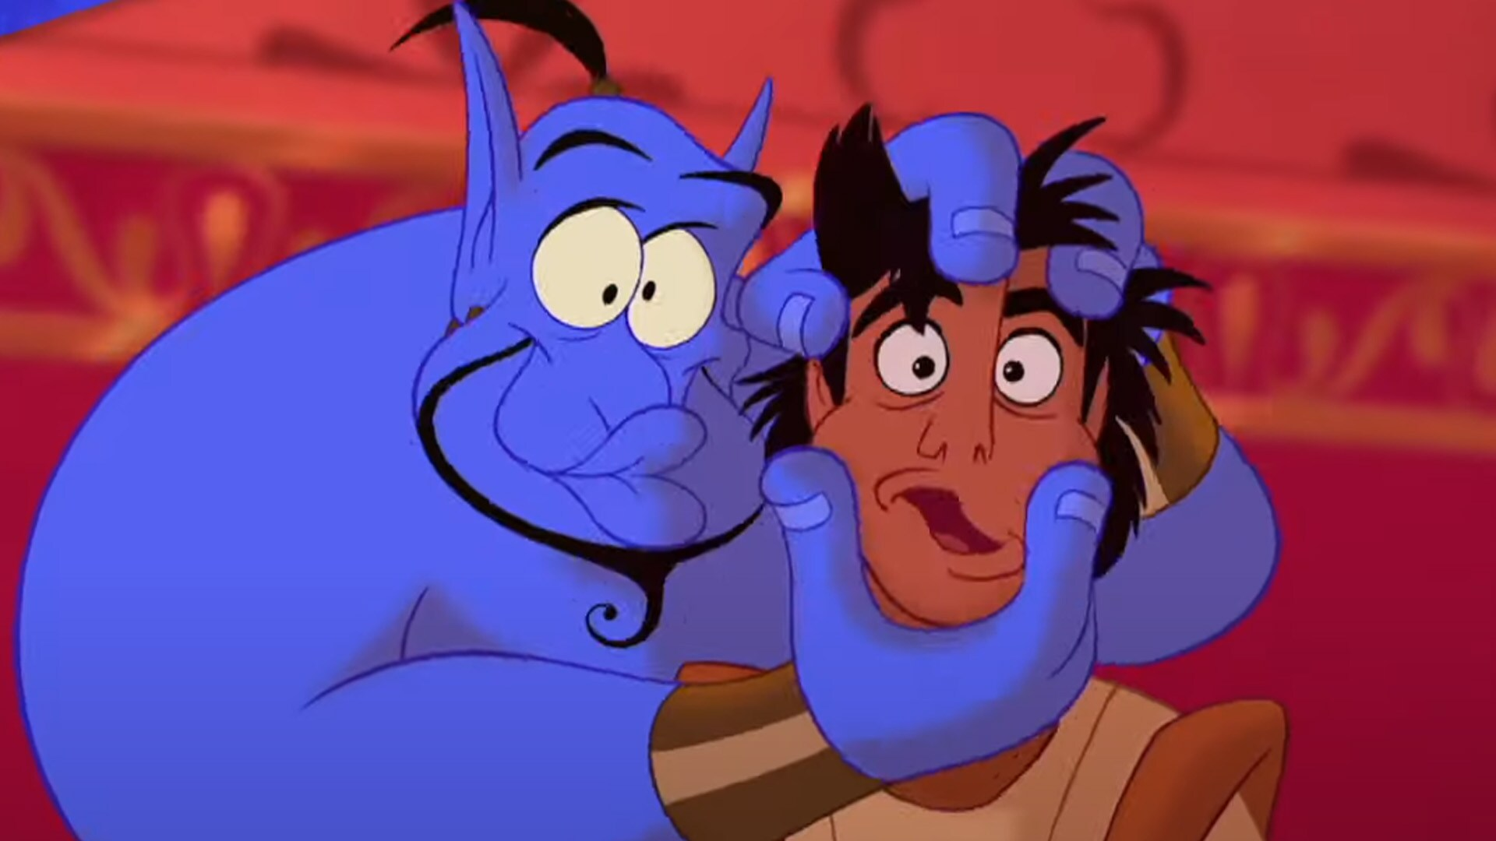
Vocabulary
simmering : to shine with a soft light e.g. give off shimmering reflection
splendid : excellent e.g. a splendid idea
wonder by wonder : from splendid place to splendid place
dazzling : brilliantly or showily blight e.g. dazzling sunlight
crystal clear : very very clear e.g. the outcome is crystal clear
soaring : to fly at a great height e.g. a soaring eagle
tumbling : to spin or turn around e.g. tumble in the bed laughing out loud
freewheeling : free and loose in form or manner e.g. lead a freewheeling life
red letter : a date that is special to celebrate e.g. tomorrow is a red-letter day

Slide 10
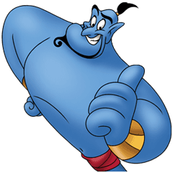
You can go Kahoot!!
https://create.kahoot.it/share/let-s-queiz/3f6fdfc7-2b95-4547-aded-965a7f3df41e

