Slide 1


A whole new world
in Aladdin
Lea Salonga and Bradley Caleb kane

Slide 2
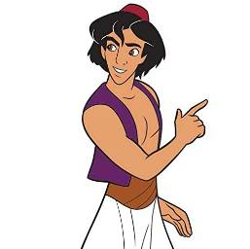
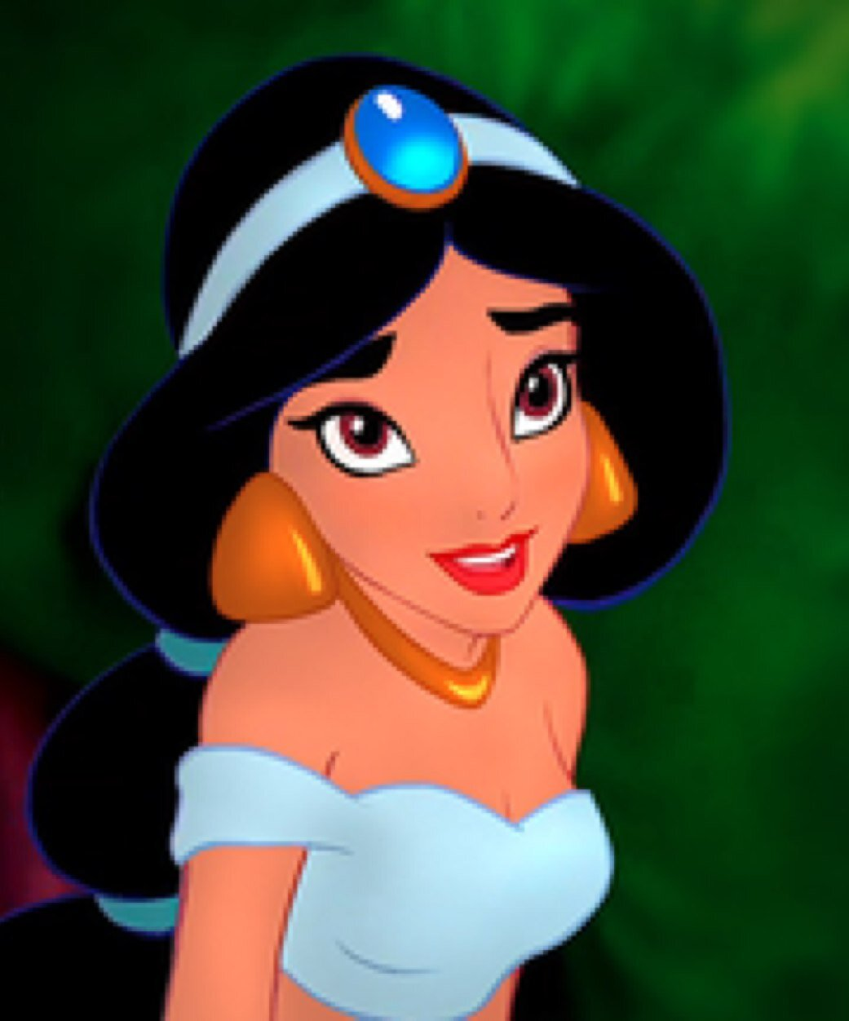
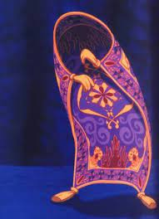
Basic Information about the Aladdin
Introduce characters
Aladdin Jasmine magic carpet
Notes:
kyoka kana
introduce characters
explain whole story

Slide 3
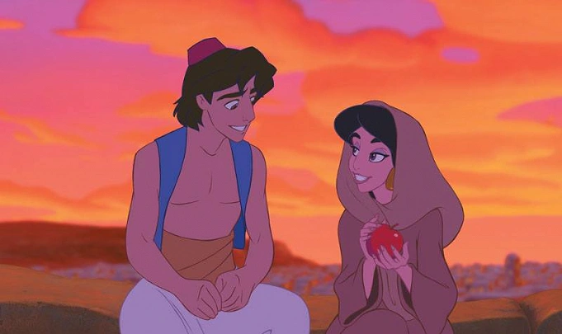
Basic Information about the Aladdin
Explanation of whole story
Aladdin fall in love with Jasmine!!
Notes:
kyoka kana
introduce characters
explain whole story

Slide 4
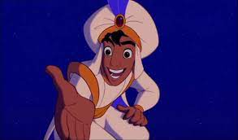
Basic Information about the Aladdin
the scene of the song is this!!
Would you like to travel on a magic carpet?
Notes:
kyoka kana
introduce characters
explain whole story

Slide 5
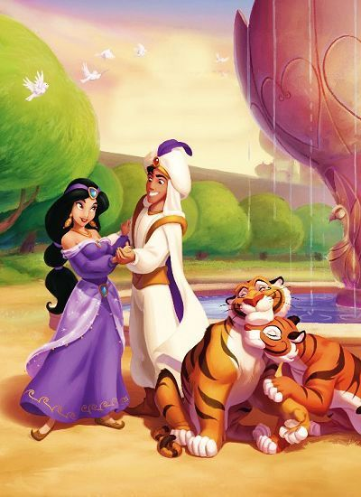
Basic Information about the Aladdin
Aladdin and Jasmine got married!!
Notes:
kyoka kana
introduce characters
explain whole story

Slide 6
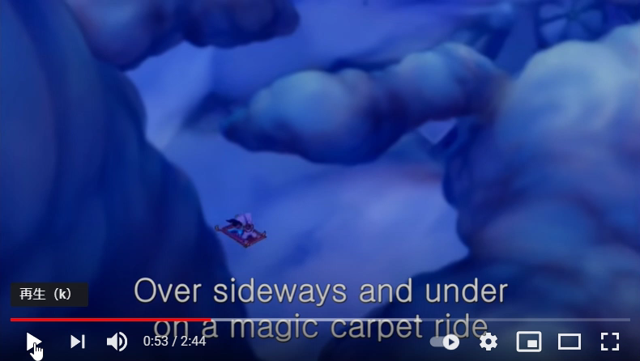
Notes:
the scene the character sing this song
54 ~

Slide 7
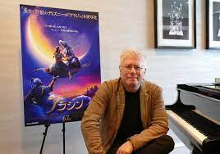
The episode about A Whole New World
Alan Menken is a famous composer who made a lot of Disney music such as Little Mermaid, Beauty and the Beast and The Hunchback of Notre Dame.
He made this song with Tim Rice.
“The world that my feet”
“A Whole New World”
Alan Menken

Slide 8
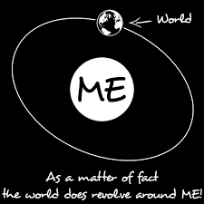

Is Jasmine a selfish woman?
In the second part of this song, Jasmine almost sings.
Aladdin
Don’t you dare close your eyes
Hold your breath, it gets better
Jasmine
A whole new world
A hundred thousand things to see
I’m like a shooting star
I’ve come so far
I can’t go back to where I used to be
Advice to Jasmine
Impressions of the scenery she saw

Slide 9
Thank you for listening！

