Slide 1
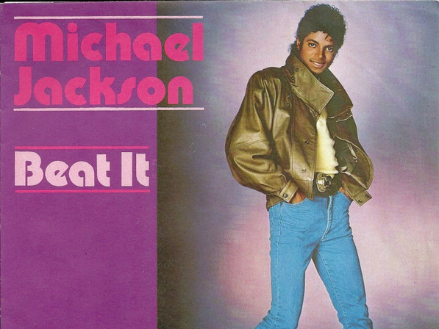

Beat it
Michel Jackson

Slide 2
Agenda
Michael Jackson
Background of this song
New vocabulary
Fill the gap
Pronunciation challenge
Quiz

Slide 3
Michel Jackson
He is USA's artist. He is called "King of pop" and he joined in ”The Jackson 5” in 70's.
He awarded Grammy 13 times. It is said that he can sing about 4 octaves.
His dance stayle is inspired by Fred Astaire who is Hollywood musical dancer.

Slide 4

Background of "Beat It"
･This song is from the album ”Thriller”
･This song released by 1983
･This song’s MV was created based on “West Side Story”.
･This song was created for children to enjoy Rock music.

Slide 5
New Vocabulary
Beat it
Go away or leave
On the battle field beating the drum means retreat.
Beat the drum→beat it
True or dare
If you choose True, you must reveal your secret.
If you choose Dare, you must do what you are ordered.
This is kind of party game.

Slide 6
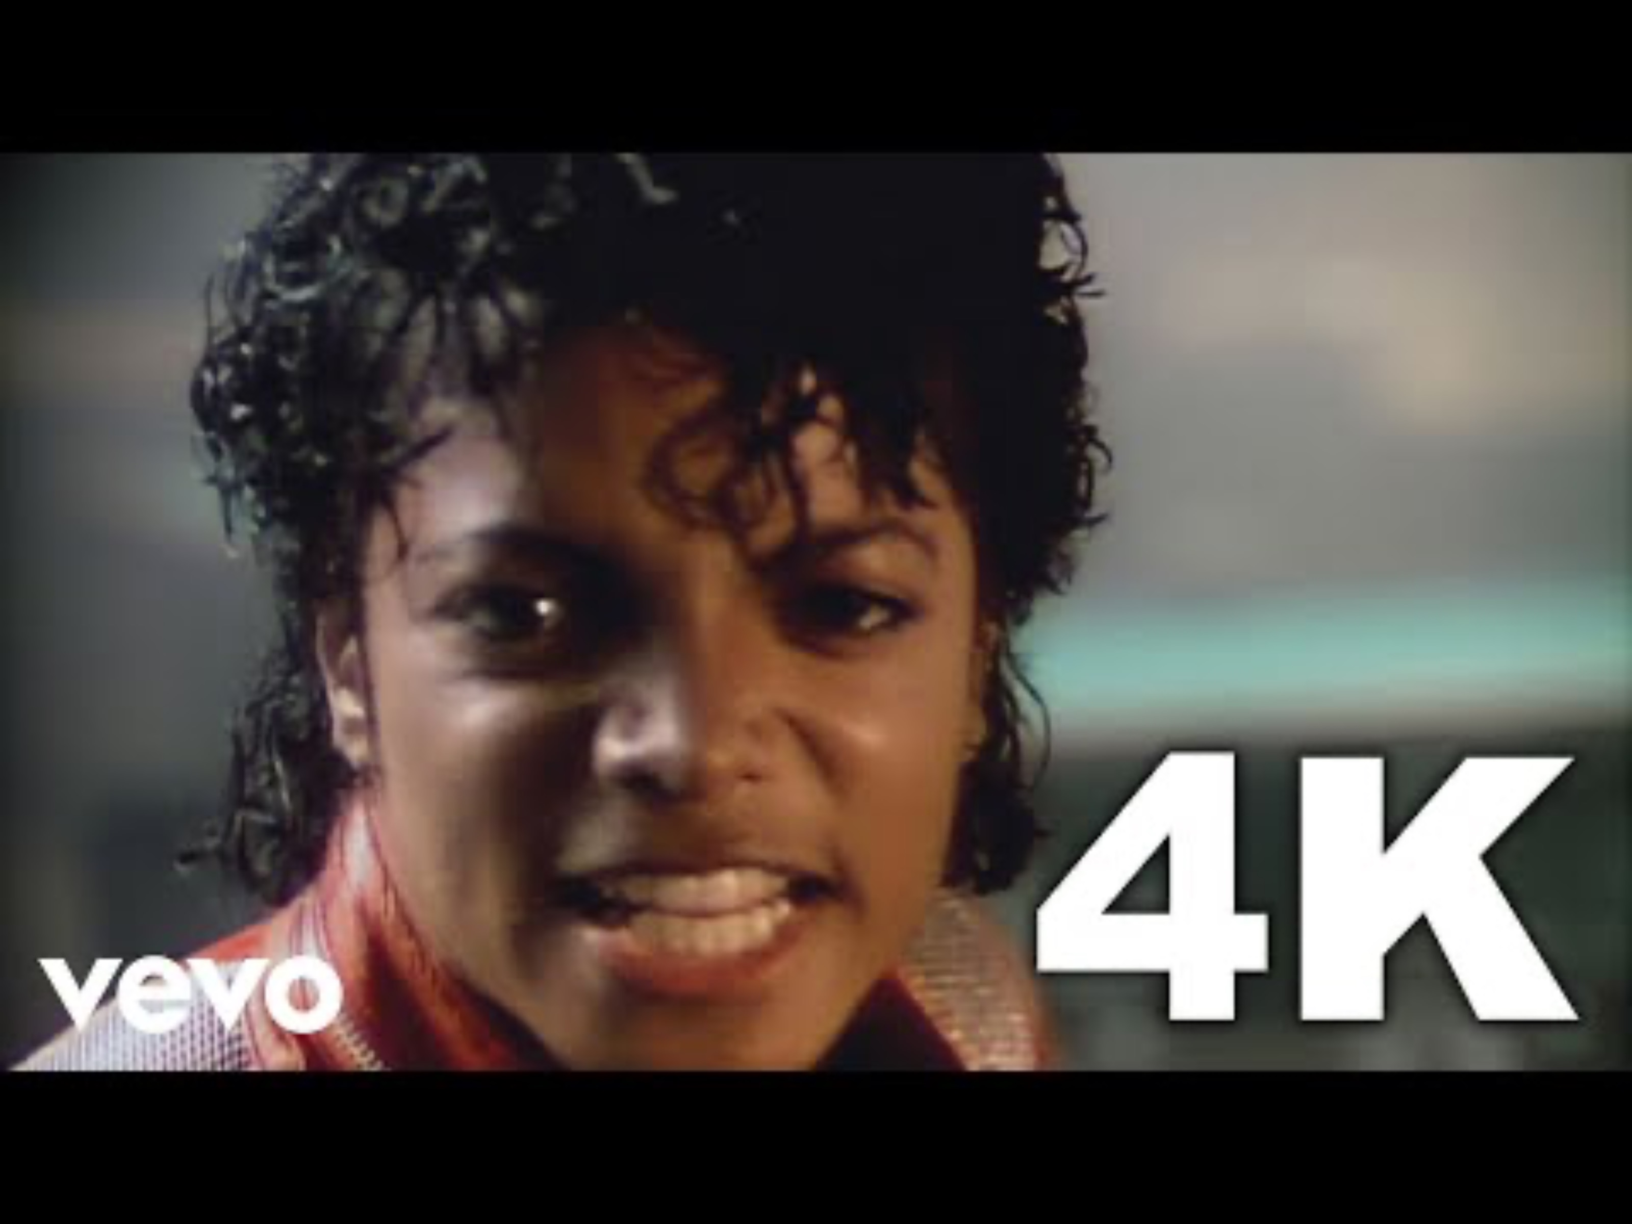
Fill the gap

Slide 7
Pronunciation Challenge
They told him “Don’t you ever come around here”
“told” and “him”→ “toldim”
”Don’t" and "you" → "Donchyou"
"come" and "around" → "comwround”
Assimilation
Intrution

Slide 8
Pronunciation Challenge
They told him don’t you ever come around here

Slide 9

Quiz1
1, What is called about Michel Jackson?
A, King of pop
B, King of USA
C, Master of pop
D, Master of puppets

Slide 10
Answer
A, King of pop

Slide 11

Quiz 2
2,How many times he awarded Grammy?
A, 18
B, 8
C, 6
D, 13

Slide 12
Answer
D, 13

Slide 13
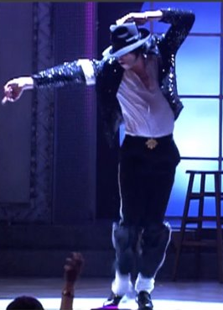
Quiz 3
3, Who inspired his dance?
A, Fred Astaire
B, Randy Menson
C, Fleetwood Mac
D, Marty Friedman
↑
Today's Article - The Moonwalk - Quizmaster Trivia: Drink While YouThink...

Slide 14
Answer
A, Fred Astaire

Slide 15
Thank you for listening!!!!!

