Slide 1

Smooth Criminal
by Michael Jackson
Presented by Jackson 2

Slide 2
01
SONG INFORMATIONS

Slide 3
Smooth Criminal
1987
Bad
By himself
Weird Song
Violence

Slide 4

The meaning of the titles
Smooth
Criminal
Doing sth without problems or difficulties
A person who has committed a crime
Very clever criminal

Slide 5


Slide 6

The song about domestic violence
Click here to listen the lyrics from official video
He left the bloodstains on the carpet
she ran underneath the table
…
She was struck down, it was her doom
A man comes to a woman's house and she is beaten. She tried to escape, but was finally killed.

Slide 7
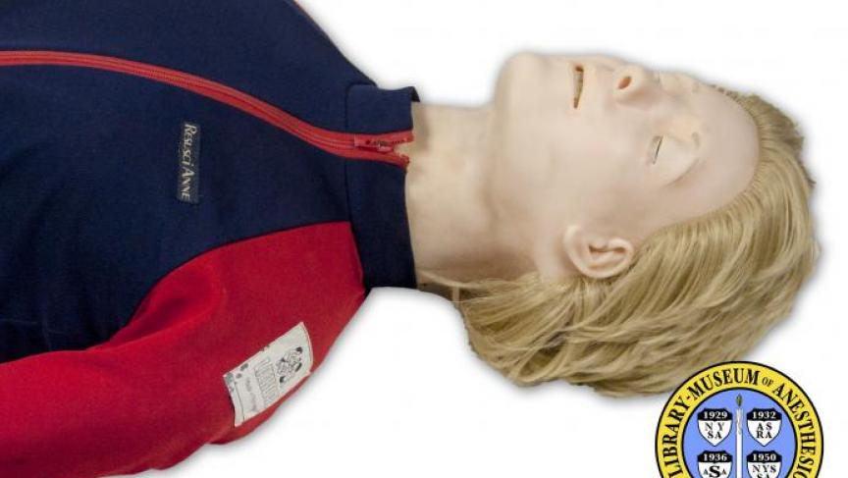
Annie - the victim named after the doll
Click here to listen the lyrics from official video
Annie, are you okay?
So, Annie, are you okay? Are you okay, Annie?
The woman's name was Annie, and that was the name of the CPR doll
The model's lifelessness may represent the powerlessness of women
Annie -- CPR training doll

Slide 8
02
Learn lyrics
True or false

Slide 9
[Verse 1]
As he came into the window
Was a _______of a crescendo
He _________her apartment
He left the ________on the carpet
She ran ________the table
He could see she was unable
So she ran into the __________
She was ____down, it was her doom
Listen to the song and fill in the blanks!

Slide 10
[Verse 1]
As he came into the window
Was a sound of a crescendo
He came into her apartment
He left the bloodstains on the carpet
She ran underneath the table
He could see she was unable
So she ran into the bedroom
She was struck down, it was her doom
How many did you get?

Slide 11
03
Vocabulary

Slide 12
Guess the word’s meaning with your group
Crescendo
Stains
Underneath
Struck down

Slide 13
The point when you sing this song
Focus on the rhyme!
Window / Crescendo
Table / Unable
Out way / Black day
Resuscitation / Intimidation

Slide 14
Thanks for your time

