Slide 1
Thriller
Presented by Jackson 4

Slide 2
01
Who is
Michael Jackson?

Slide 3
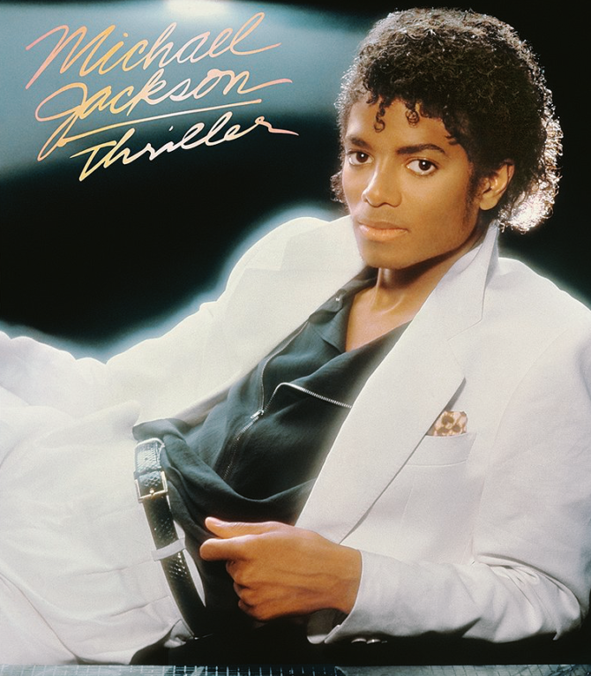
Who is Michael Jackson?
- Singer-songwriter
- Dancer
- The most successful entertainer of all time
- "King of Pop"
- One of the most influential figures in popular music since the 20th century

Slide 4
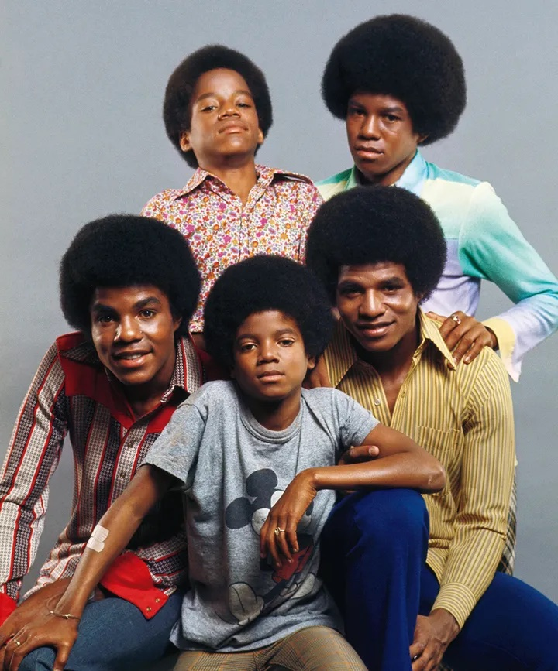
Before became "Michael Jackson"
Jackson 5
- formed in the 1960s
- the forerunners of the "boy bands" represented by the Backstreet Boys and One Direction
- first black idols to gain popularity among whites
- After Michael left the band in late 1980, the band's activities stopped

Slide 5
The Mystery Behind Michael Jackson
His Death
He died of cardiac arrest (heart stopped beating) in 2009.
This is because he had insomnia (a disease that prevents you from sleeping) and
the doctors gave him too much medicine at Jackson's request.
He has a different skin color than he did in Jackson 5. He says this is a skin color loss disease.
His skin

Slide 6
02
SONG INFORMATIOINS

Slide 7
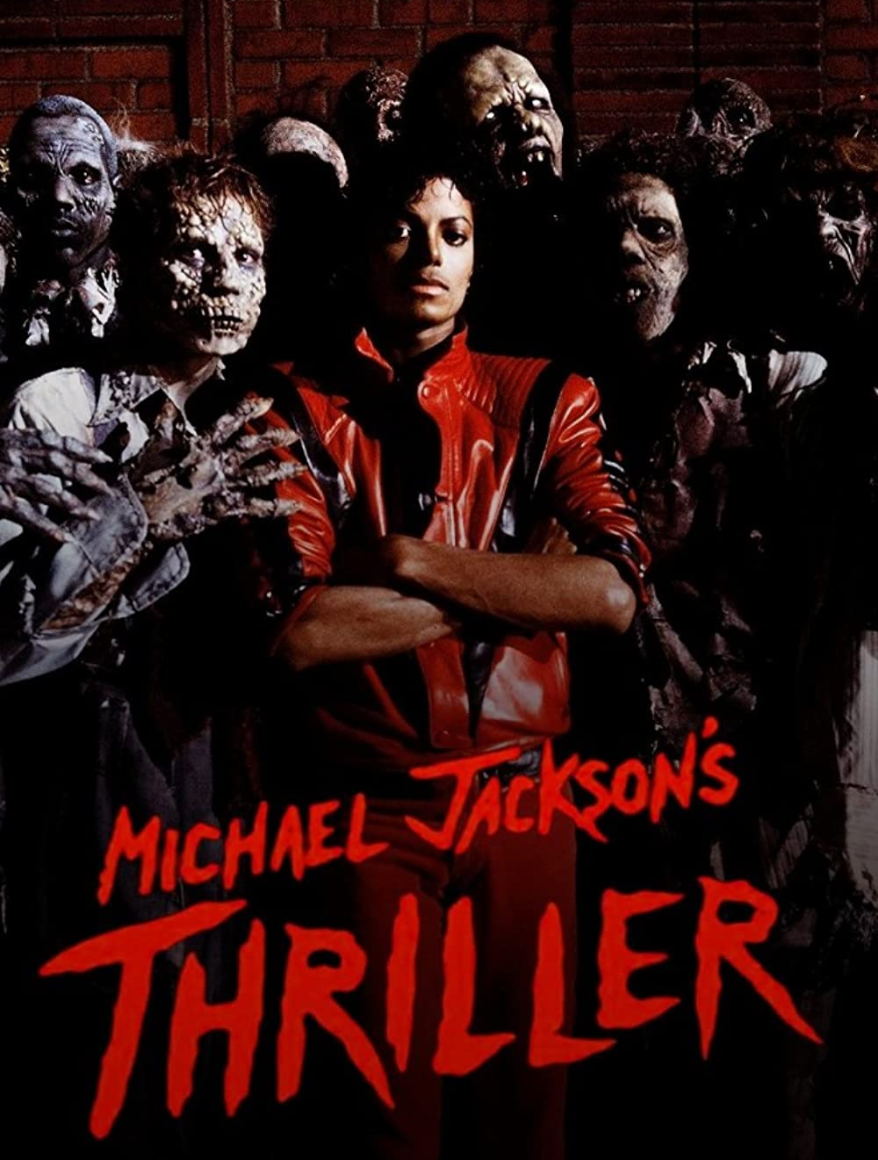
THRILLER
Released
November 1983 (U.K)
January 23, 1984 (U.S)
*Recorded in 1982
Genre
Disco, Funk

Slide 8
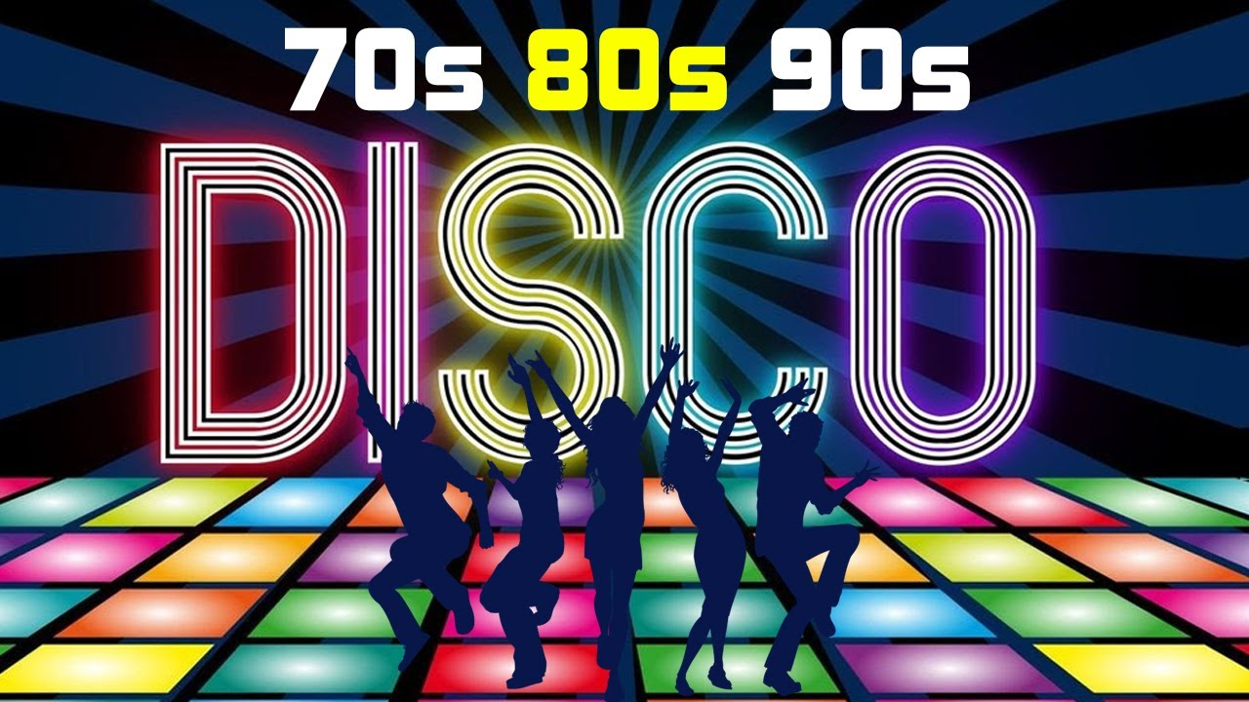

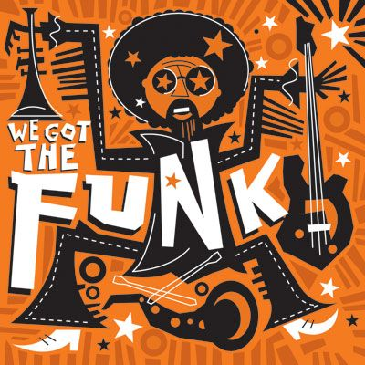
GENRE
40% Male
DISCO
FUNK
Disco is a genre of dance music and a subculture that emerged in the 1970s from the United States' urban nightlife scene. Its sound is typified by four-on-the-floor beats, syncopated basslines, string sections, horns, electric piano, synthesizers, and electric rhythm guitars.
Funk is a music genre that originated in African American communities in the mid-1960s when musicians created a rhythmic, danceable new form of music through a mixture of soul, jazz, and rhythm and blues (R&B).

Slide 9
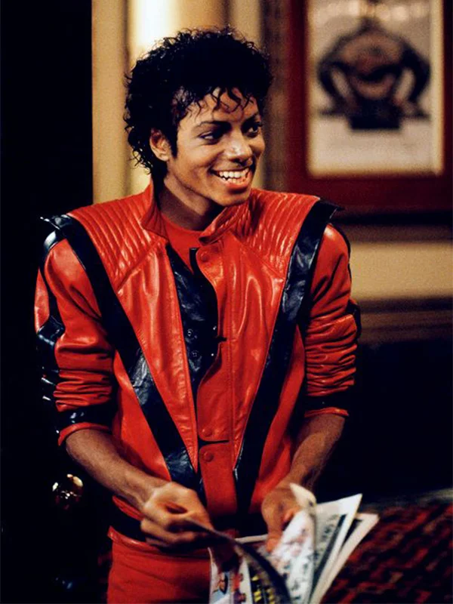
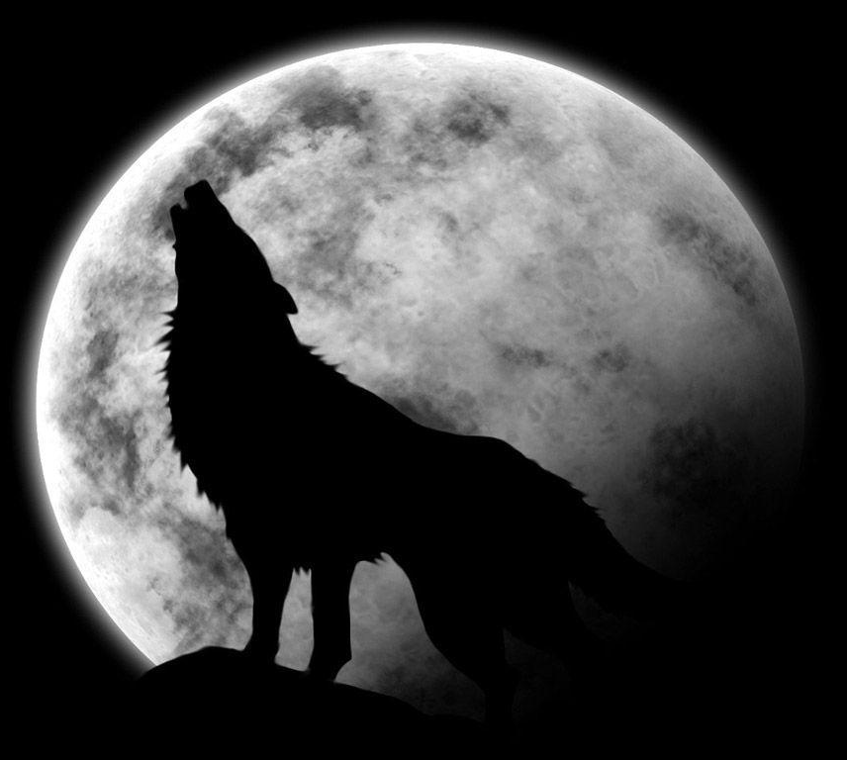
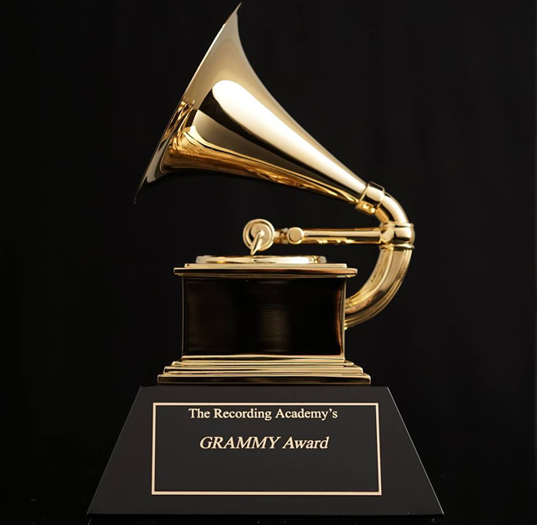
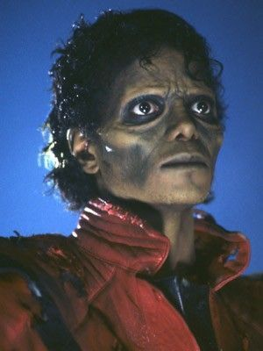
Thriller jacket
Sound effects
is the red jacket worn by Michael Jackson in the 1983 "Thriller" music video.
The jacket became the "hottest outerwear fad of the mid-1980s" and was widely emulated.
The music and lyrics evoke horror films, with sound effects such as thunder, footsteps and wind. It ends with a spoken-word sequence performed by horror actor Vincent Price.
Grammy Award
Music video
"Thriller" won a Grammy Award and received positive reviews and became the album's seventh top-ten single on the Billboard Hot 100, peaking at number four.
It has been named the greatest video of all time by various publications and readers' polls.

Slide 10
03
True or false
True or false

Slide 11
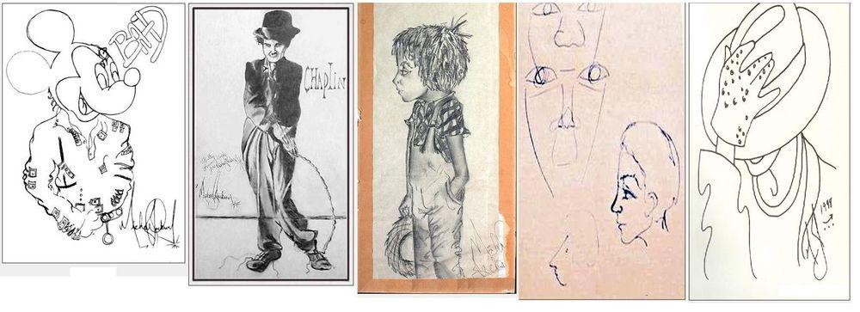
Michael Jackson is also a good painter T/F

Slide 12

Michael Jackson’s favorite food is Sushi T/F

Slide 13
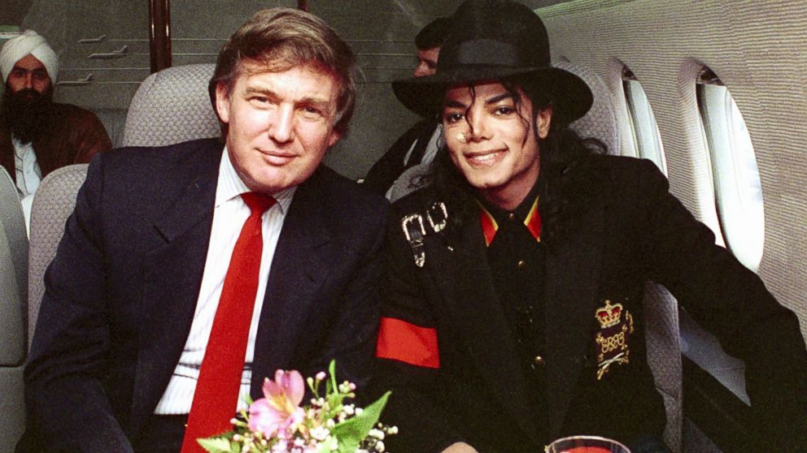
Michael Jackson and Donald trump were good friends T/F

Slide 14
04
Learn lyrics

Slide 15
Let’s Find the Word of Dark
There is some words means some dark image.
Fill the blanks and find dark words from lyrics.

Slide 16
Listen and fill the Lyrics
It’s close to midnight.
Something evil’s lurking in the dark
Under the __________
You see a sight that almost stops your heart
You try to scream
But terror take the sound before you _______ _______
You start to freeze
As horror looks you _______ _________ the eyes
You’re _________

Slide 17
Listen and fill the Lyrics
It’s close to midnight.
Something evil’s lurking in the dark
Under the __________
You see a sight that almost stops your heart
You try to scream
But terror take the sound before you _______ _______
You start to freeze
As horror looks you _________ _________ the eyes
You’re _________
moonlight
Make it
Right between
paralyzed

Slide 18


Slide 19
Can you find dark and scary image of words?
Midnight
Evil
Dark
Moonlight
Scream
Terror
Freeze
paralyze

Slide 20
Thank You for Listening Our Presentation

