Slide 1
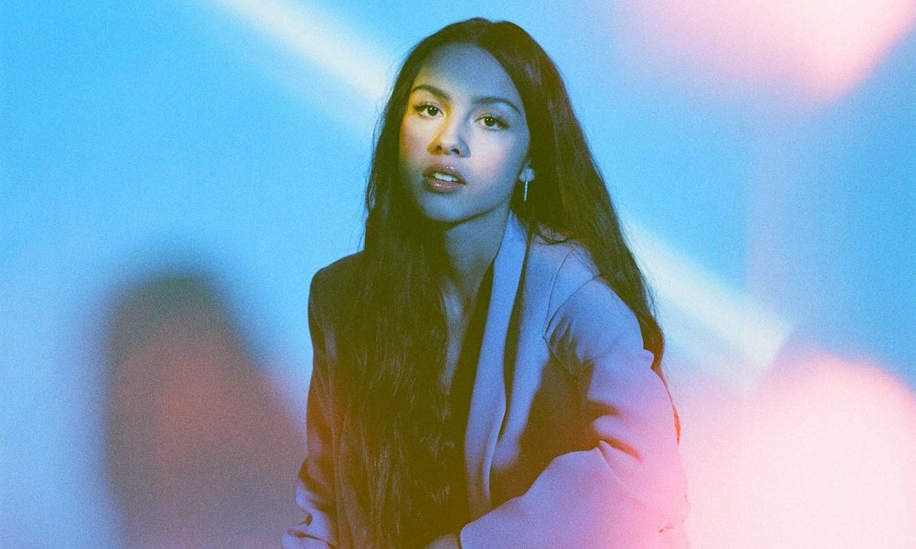
drivers license
Olivia rodrigo

Slide 2
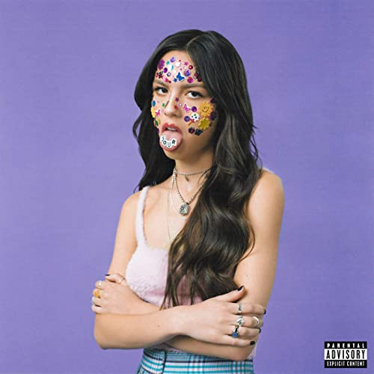
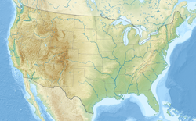
Who is she?
Olivia Isabel Rodrigo
February 20, 2003 (age 18)
Murrieta, California, U.S.
Singer-songwriter / actress

Slide 3

Singer-songwriter , Actress
Bizaardvark(TV Series ) | Paige Olvera
High School Musical: The Musical – The Series | Nina “Nini” Salazar-Roberts
An American Girl: Grace Stirs Up Success | Grace Thomas
Olivia kickstarted her singing career with the hit song “All I Want,” from the High School Musical: The Musical – The Series soundtrack.

Slide 4
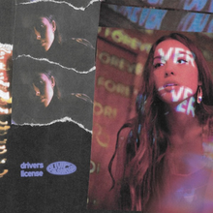

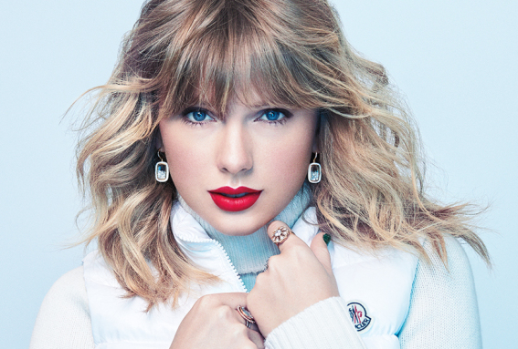
On January 8, 2021, she proceeded to release her debut single “drivers license”, the lead single from her debut album.
After getting unexpectedly massive success, because of its popularity on TikTok and several co-signs from major artists like Taylor Swift.

Slide 5
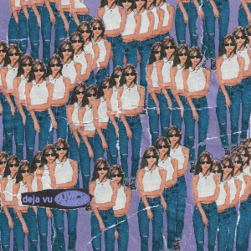
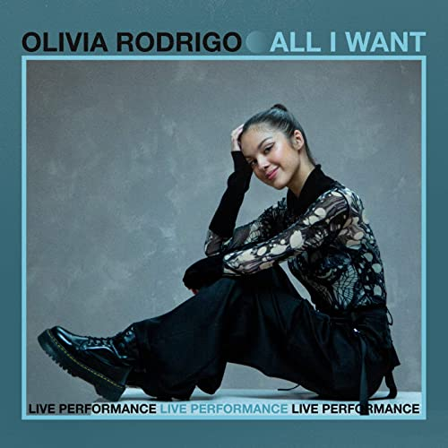
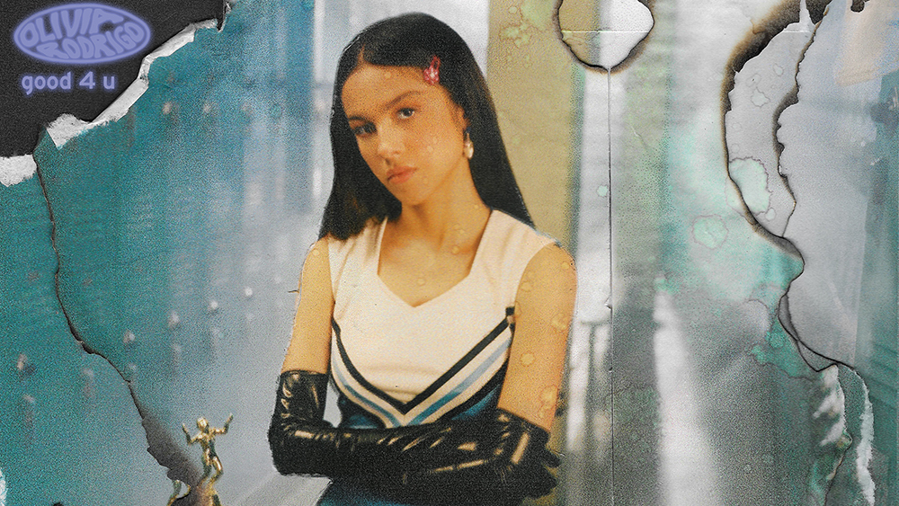
Popular songs
・driver’s license 3.5M
・deja vu 2.4M
・good 4 u 2.3M
・All I Want 1.2M
・happier 1.1M

Slide 6


The meaning of this song is…
The song documents the "multifaceted" emotions Rodrigo endured after a heartbreak.

Slide 7
The genre of this song is…
Bedroom pop
loosely describes a musical genre or aesthetic in which bands record at home, rather than at traditional recording spaces. It also has the connotation of DIY.
Indie pop
is a music genre and subculture that combines guitar pop with DIY ethic in opposition to the style and tone of mainstream pop music.
Power pop
a style of pop music characterized by a strong melody line, heavy use of guitars, and simple rhythm.

Slide 8
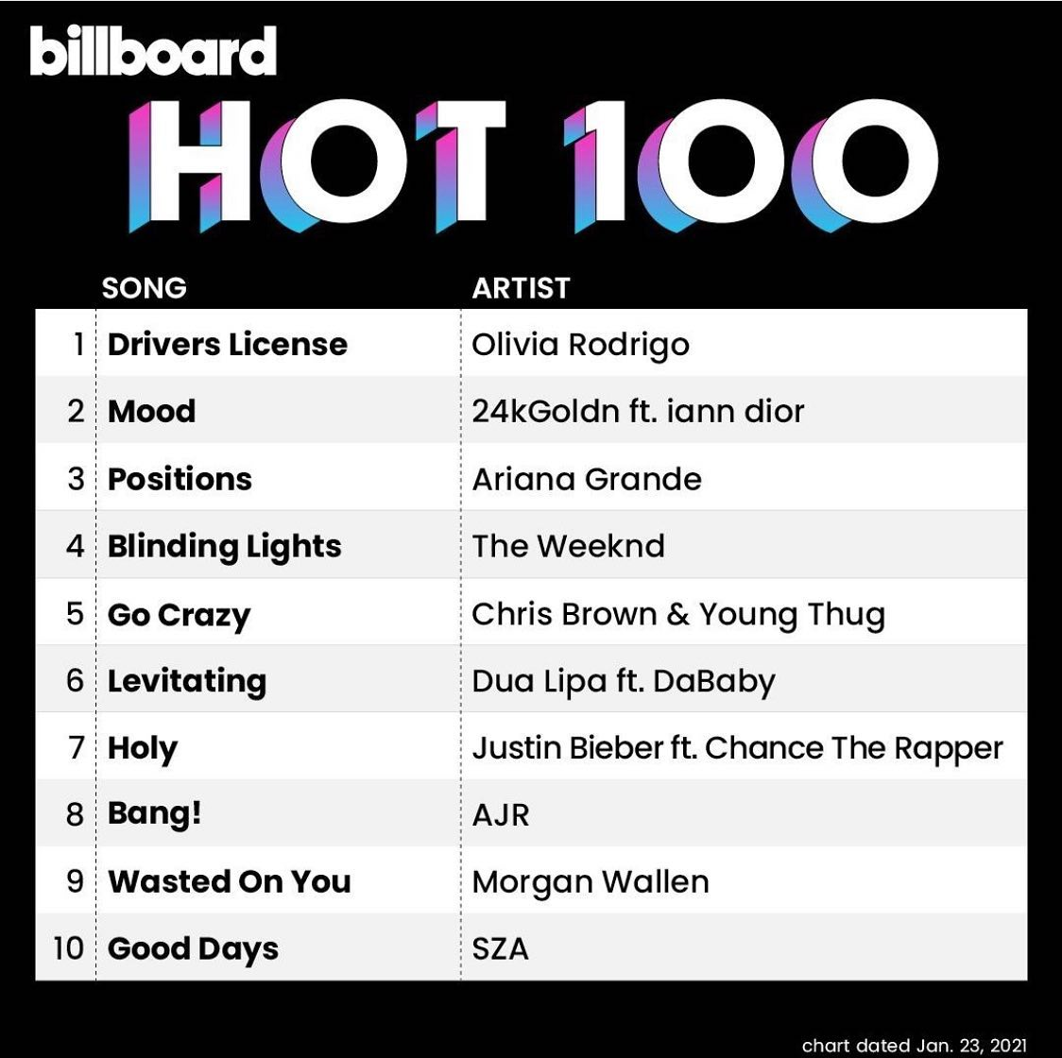
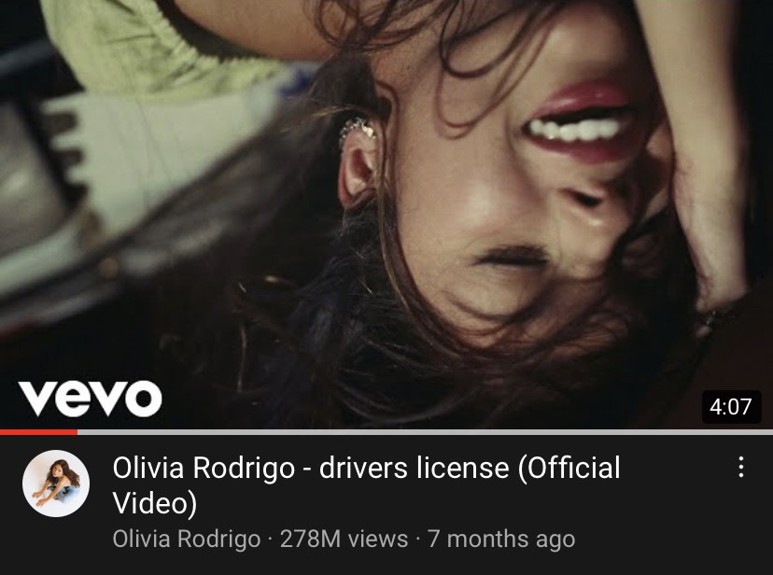
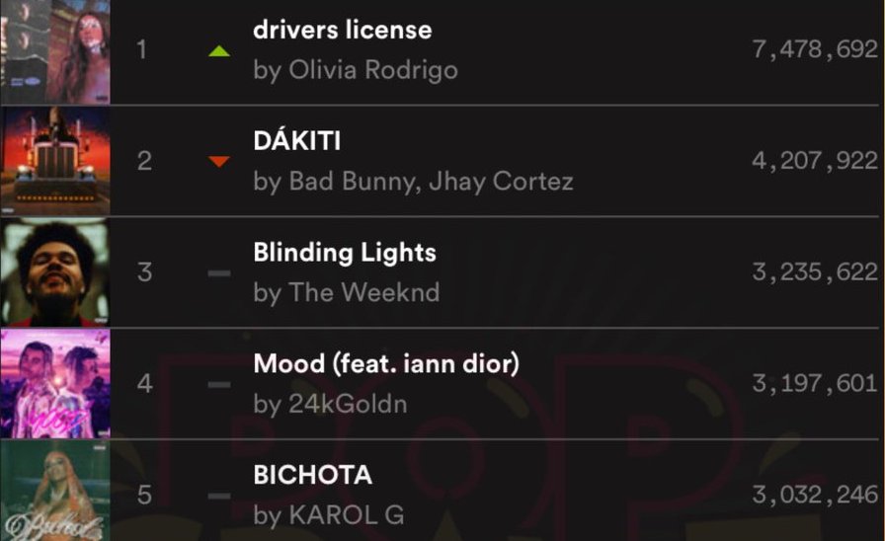

The song eventually represented the best start Olivia could ever imagine for her career,
establishing a new streaming record twice on Spotify and climbing directly to No. 1 on the Billboard Hot 100 chart.

Slide 9

Gossips the lyrics…
I got my driver's license last week
Just like we always talked about
'Cause you were so excited for me
To finally drive up to your house
But today, I drove through the suburbs
Crying 'cause you weren't around
It’s rumored that Olivia and Joshua Bassett, began dating while filming the show in 2019, and called it quits in early 2020.
He once taught her how to drive, and the lyrics remind her of that.

Slide 10
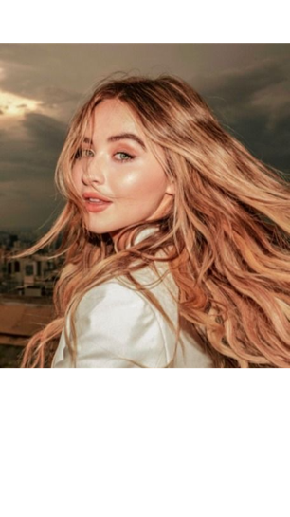
Gossips the lyrics…
And you're probably with that blonde girl
Who always made me doubt
She's so much older than me
She's everything I'm insecure about
In June 2020, Joshua and Sabrina Carpenter were dating.
Sabrina has blonde hair and is four years older than Olivia.

Slide 11
And I know we weren't perfect
But I've never felt this way for no one
In this part, Olivia used the word ‘no one’, not ‘anyone’.
This is her saying that, though she might have felt this way before, everyone that she’s fallen in love with has been someone important to her, and never a “no one”.

Slide 12
Quiz!!
1. Where is she from?
-from Murrieta, California, U.S.
2. What is her debut single?/what song is the most popular song?
-drivers license
3. What great achievement did drivers license accomplish?
-establishing a new streaming record twice on Spotify and climbing directly to No. 1 on the Billboard Hot 100 chart

Slide 13
6. What does this song talk about?
Heartbreak
7. Which of the following is not a genre of “drivers license”?
- ①Bedroom pop ②Electropop‎ ③Indie pop ④Power pop
Q. Guess the right lyrics for the blank.
8. I got my _____________ _____________ last week Just like we always talked about.
And you're probably with that _____________ _________. Who always made me doubt
And I know we weren't perfect. But I've never felt this way for ______ _______.
driver’s license
blonde girl
no one

