Slide 1
good 4 u
Haruka Ichimura, Karen Negishi,
Makoto Seki, Honoka Shin
https://www.youtube.com/watch?v=gNi_6U5Pm_o

Slide 2


Slide 3

The Birth Story of This Album
This album shows my thinkings deeply.
I interpret teenagers’ complexed feelings like sudden sad emotions and not theoretical angers.

Slide 4

I made these songs based on my feelings.
Sour sings reality of teenagers.
I’m sure to succeed in this album!!!!!
Reference:Intrview of sour

Slide 5


This song is about a heartbreak
She :hasn’t changed her mind yet.
Her ex: has already moved on.
but…
Singing powerful with drums and guitars
Not moody, sentimental, painful

Slide 6

Sing about her ex’s attitude sarcastically(ironically)
what the fuck is up with that?
You moved on really easily!
You look happy and healthy, not me!
You’re do in’ great out there without me!
You’re so unaffected, I really don’t get it!t
Hun?
screw that, and screw you
like a damn sociopath
good for you!!!! ×14 times

Slide 7


Her true feelings...
Why you are so Ok now?
Am I just a little thing to you?
Why are you moving on so quickly?
Don’t you have any regrets about our breaking up?
You don’t care about me, do you?

Slide 8

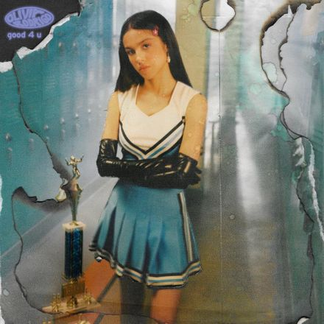
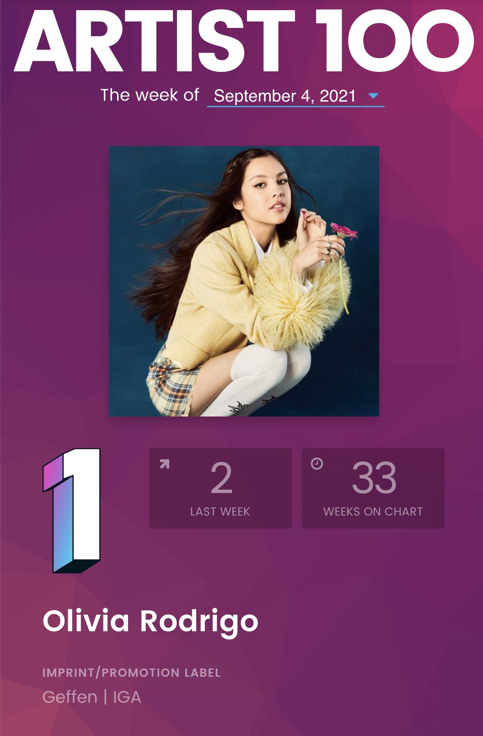

About Artist
Olivia Isabel Rodrigo
age 18
Murrieta, California, U.S.
Singer-songwriter actress
Notes:
I wanna introduce about artist of this song.artist name is Olivia, she is 18 old. she is a singer songwriter and actress,
as an actress she is famous for Nina from Highschool musical.
Now she is in the first place of artist 100 chart by bilboard

Slide 9

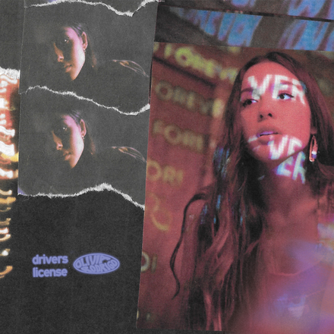

Career
All I WANT
Nov 27, 2019
Driver’s license
January 8, 2021
(Her debut single)
SOUR
May 21, 2021
Let’s click these photos. You can look more information of songs!
Notes:
Next, I introduce her career. Her popular song is here.
All I want is her kickstarted song of her singer’s career.
Driver’s license is her debut single and most popular song.
SOUR is the album. It includes many popular somg for example driver7Slicense ,good 4 u dejavu and so on
If you click these photos ,you can get more information of the songs

Slide 10

Words information from lyrics
lose one's mind
: to become mentally ill : to go insane
salt in/into the wound
: to make a difficult situation even worse for someone
sociopath
:Individuals with antisocial personality disorder.
They are known for having shallow emotions, manipulating others, behaving impulsively and not caring about the feelings of others.
Notes:
Next I explain words information
I picked up 3 words from lyrics
the word sociopath is used to express a heartless exboyfriend.
other 2 words please check it later.

Slide 11


Slide 12

How to sing well this song?
Points
1. Using pronunciation rule such as linking, reduction and assimilation.
ex) good for you → goofor you
2. Taking one rest (■) before you sing one phrase
3. Rising and falling of tone like emphasis or not…. Keep the rhythm
4. If the same letter is followed by a letter, pronounce it together.
ex) could do→ couldo
5. Pronunciation focus ex) hand-drum, to work on the beats and practice
6. When you find some same or similar pronunciation, you try to keep the rhythm
reference: the article of room1

Slide 13

[Verse 1]
Well, good for you, I guess you moved on really easily
You found a new girl and it only took a couple weeks
Remember when you said that you wanted to give me the world?
(World)
And good for you, I guess that you’ve been workin’ on
yourself
I guess that therapist I found for you, she really helped
Now you can be a better man for your brand new girl
(Girl)
[Chorus]
Well, good for you
You look happy and healthy, not me
If you ever cared to ask
Good for you
You’re doin’ great out there without me, baby
God, I wish that I could do that
I’ve lost my mind, I’ve spent the night
Cryin’ on the floor of my bathroom
But you’re so unaffected, I really don’t get it
But I guess good for you
[Verse 2]
Well, good for you, I guess you're gettin' everything you want (Ah)
You bought a new car and your career’s really takin’ off (Ah)
It’s like we never even happened
Baby, what the fuck ■ is up ■ with that?(Ah)
And good for you, it's like you never even met me
Remember when you swore to God I was the only
Person who ever got you? Well, screw that, and screw you
You will never have to hurt the way you know that I do
[Chorus]
[Break]
(Ah-ah-ah-ah)
(Ah-ah-ah-ah)

Slide 14
[Bridge] ・Pronunciation focus
Maybe I’m too emotional
But your apathy’s like a wound in salt
Maybe I’m too emotional
Or maybe you never cared at all
Maybe I’m too emotional
Your apathy is like a wound in salt
Maybe I’m too emotional
Or maybe you never cared at all
[Chorus]
Well, good for you
You look happy and healthy, not me
If you ever cared to ask
Good for you
You're doin' great out there without me, baby
Like a damn sociopath
I've lost my mind, I've spent the night
Cryin' on the floor of my bathroom
But you're so unaffected, I really don't get it
But I guess good for you
[Outro]
Well, good for you, I guess you moved on really easily

