Slide 1


Live while we're young
ONE DIRECTION

Slide 2

Song

Slide 3

Theme of the song

Slide 4
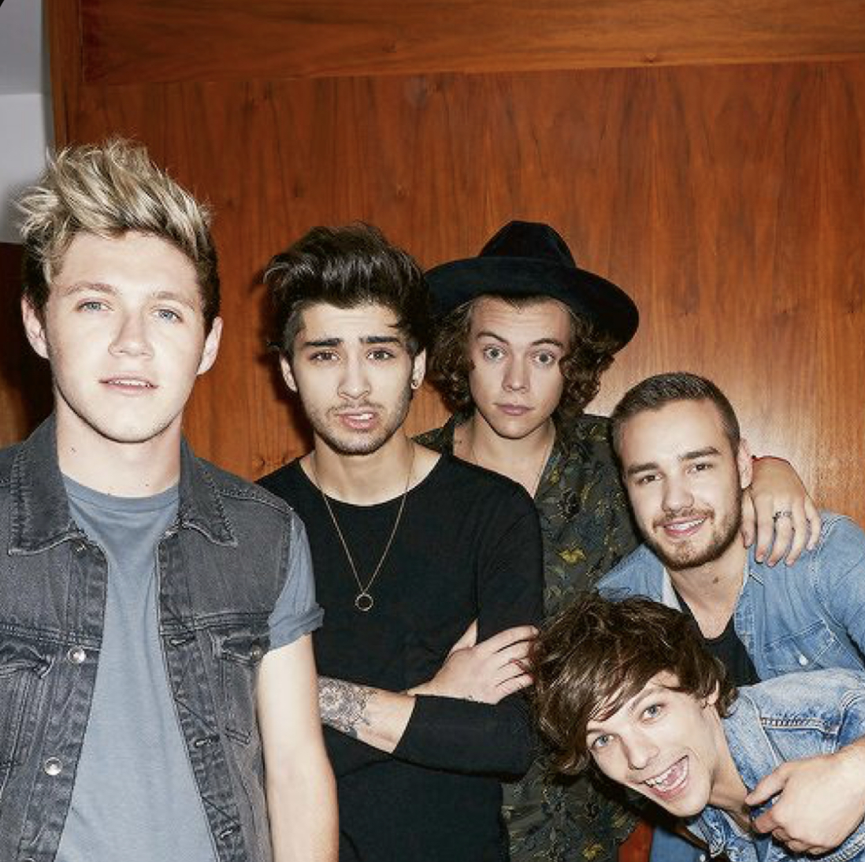
What is One direction (1D)
One direction, often , shortened to 1D, are English and Irish pop boy band formed in London in 2010.
They auditioned as solo candidates for the 2010 series of the British singing competition The X factor .

Slide 5

Why they are 4 members now…
Zayn Malik left the group in 2015.
After that, they continued to be active and released "Drag Me Down", which sung by 4 members , won 1 billion views on YouTube.
The group was suspended in 2016, and the members began to do solo activities.

Slide 6
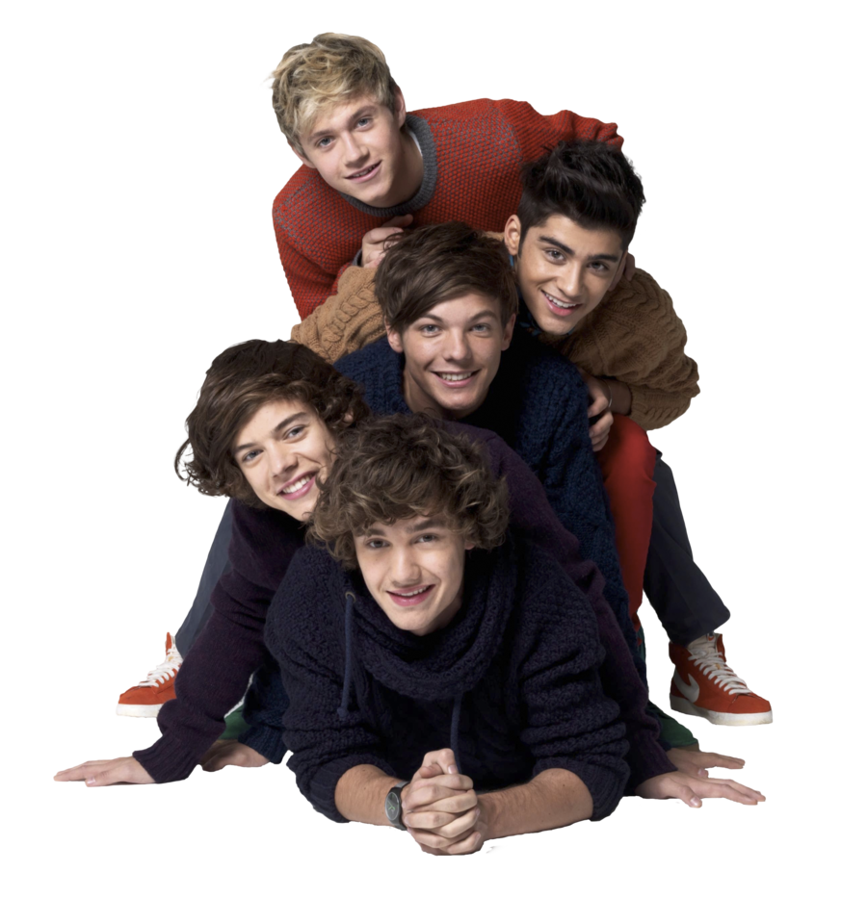
Lyrics : Live While We’re Young
Yeah, we‘ll be doing （ ）
Just pretending that we're cool and we know it too
Yeah, we‘ll keep doing （ ）
Just pretending that we're cool, so tonight
Let‘s go ( , , )'til we see the sun
I know we only met, but let's pretend it's love
And （ , , ) stop for anyone
Tonight, let's get some
And live while we're young
(Oh-oh-oh-oh-oh-oh-oh)
(Oh-oh-oh-oh-oh-oh-oh)
And live while we're young (Oh-oh-oh-oh-oh-oh-oh)
Tonight, let's get some
And live while we're young

Slide 7

Answer
Yeah, we'll be doing what we do
Just pretending that we're cool and we know it too
Yeah, we'll keep doing what we do
Just pretending that we're cool, so tonight
Let's go crazy, crazy, crazy 'til we see the sun
I know we only met, but let's pretend it's love
And never, never, never stop for anyone
Tonight, let's get some
And live while we're young
(Oh-oh-oh-oh-oh-oh-oh)
(Oh-oh-oh-oh-oh-oh-oh)
And live while we're young (Oh-oh-oh-oh-oh-oh-oh)
Tonight, let's get some
And live while we're young

Slide 8
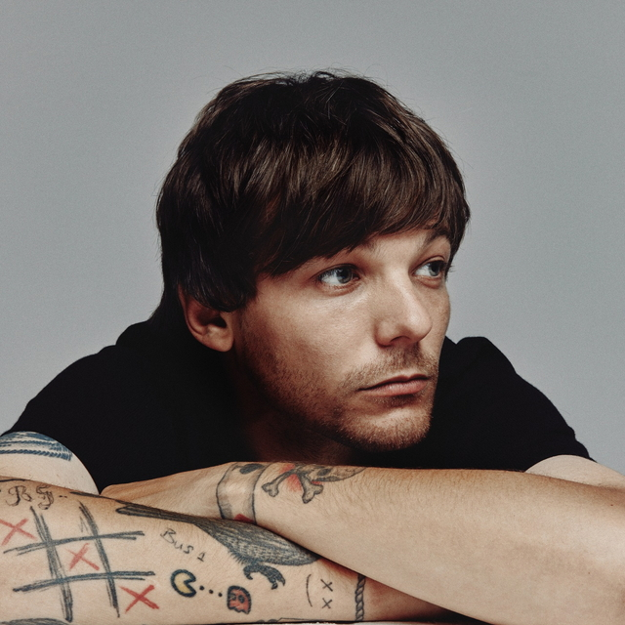
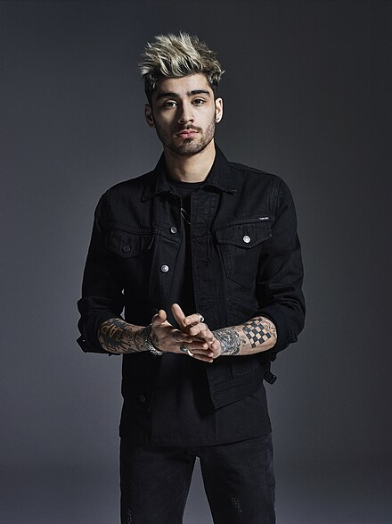
Member Introduction
Louis Tomlinson
(1991~)
Now....32
Blue eyes
Zein Malik
(1993~)
Now...30
Hgh-pitched voice

Slide 9
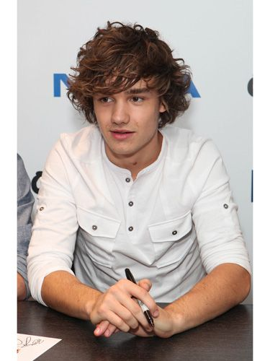
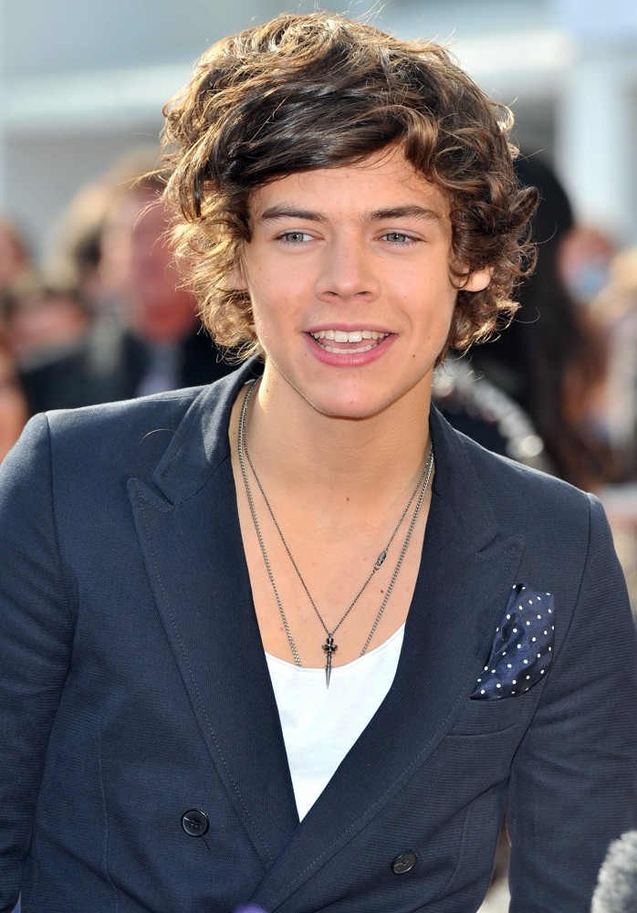
Liam payne
(1993~)
Now...30
Mood maker
Harry Styles
（1994~)
Now...29
Sweet looks & sexy voice

Slide 10

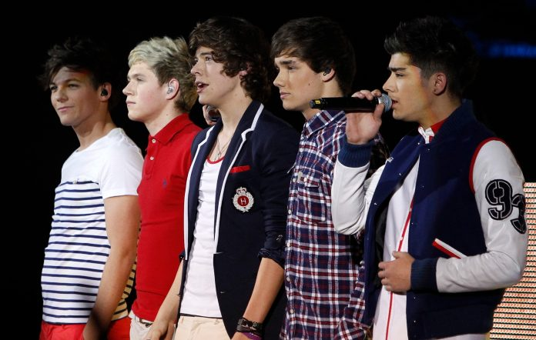
Niall Horan
(1993~)
Now...29
Cute smile

Slide 11
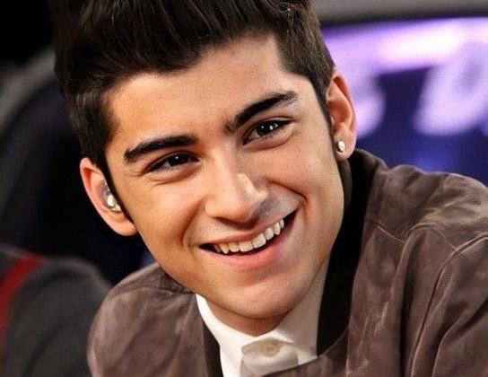
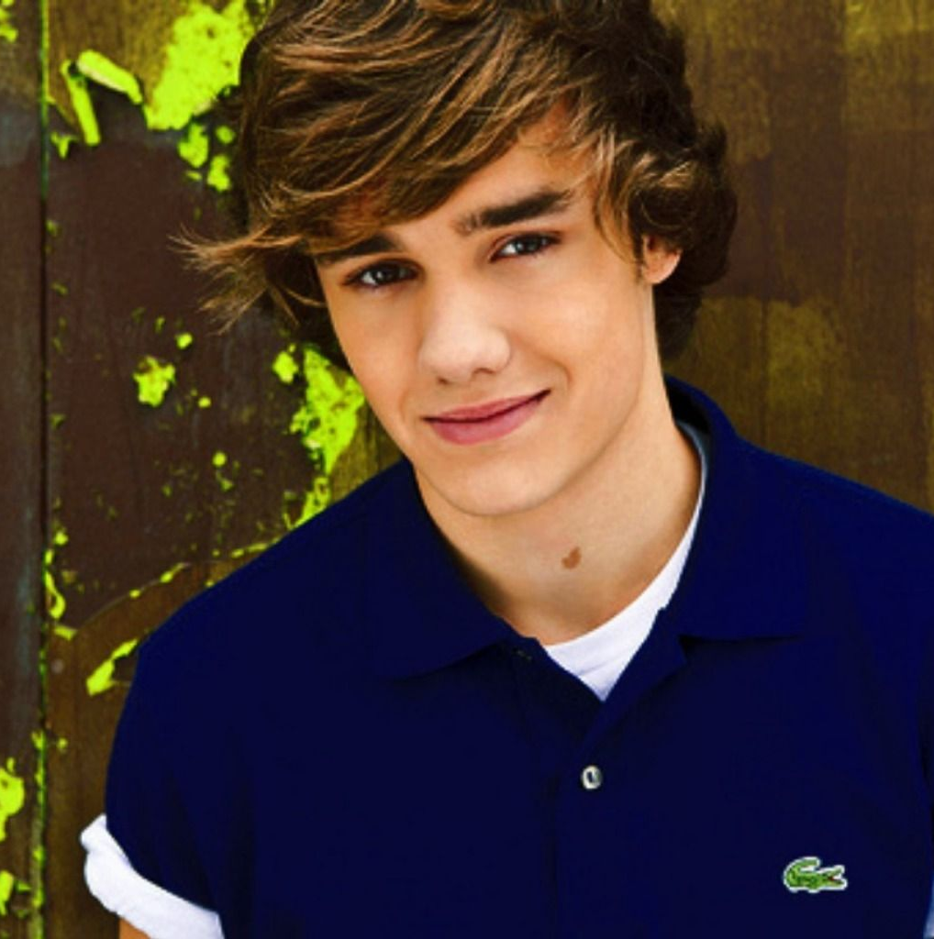

Quiz
They are banded in UK,
But which member is not from UK?
Zayn
Liam
Niall

Slide 12

The answer is...
C. Niall
He is Irish.

Slide 13
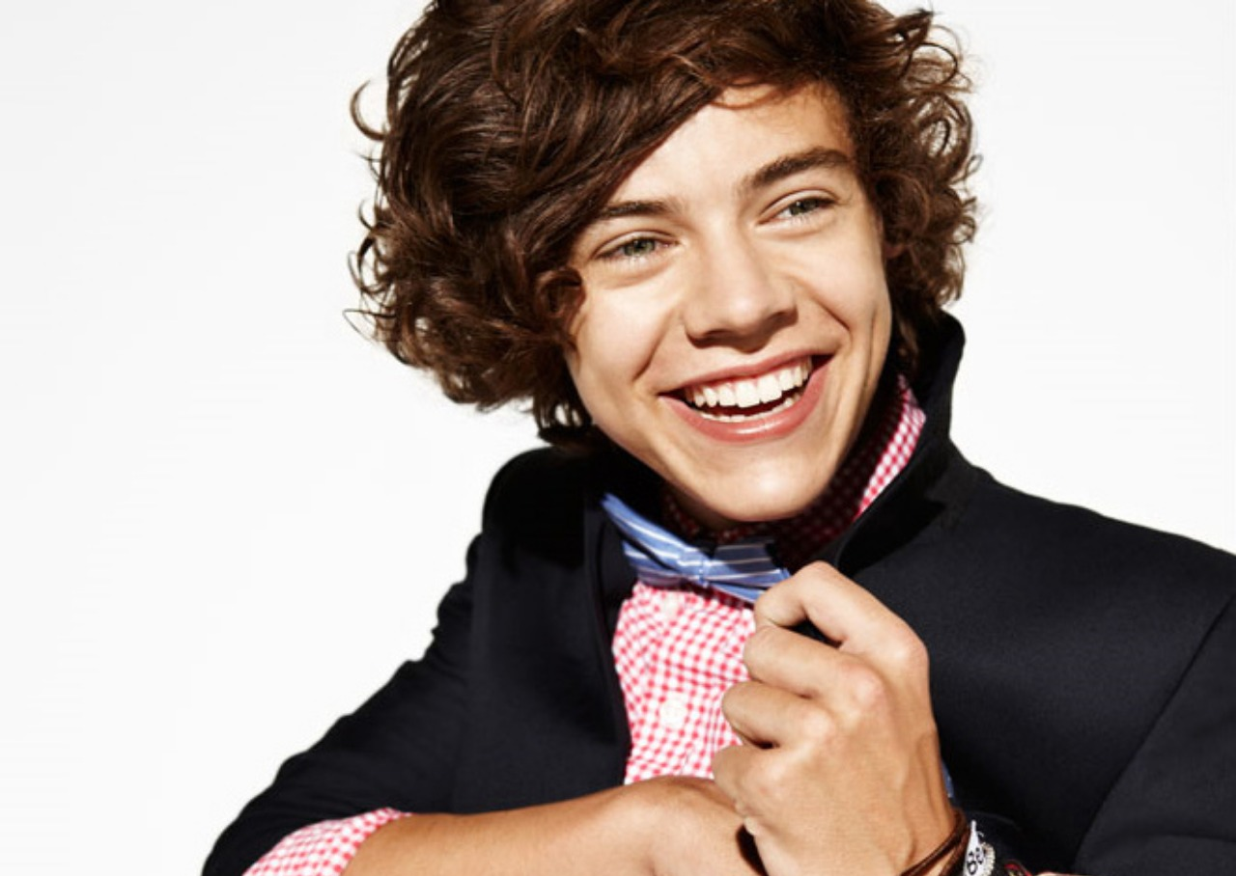
2. Harry, one of the member of One Direction, had a part-time job before debut.
Which job is the correct?;)
Flower shop
Bakery
Ninja

Slide 14

The answer is...
B. Bakery.

Slide 15

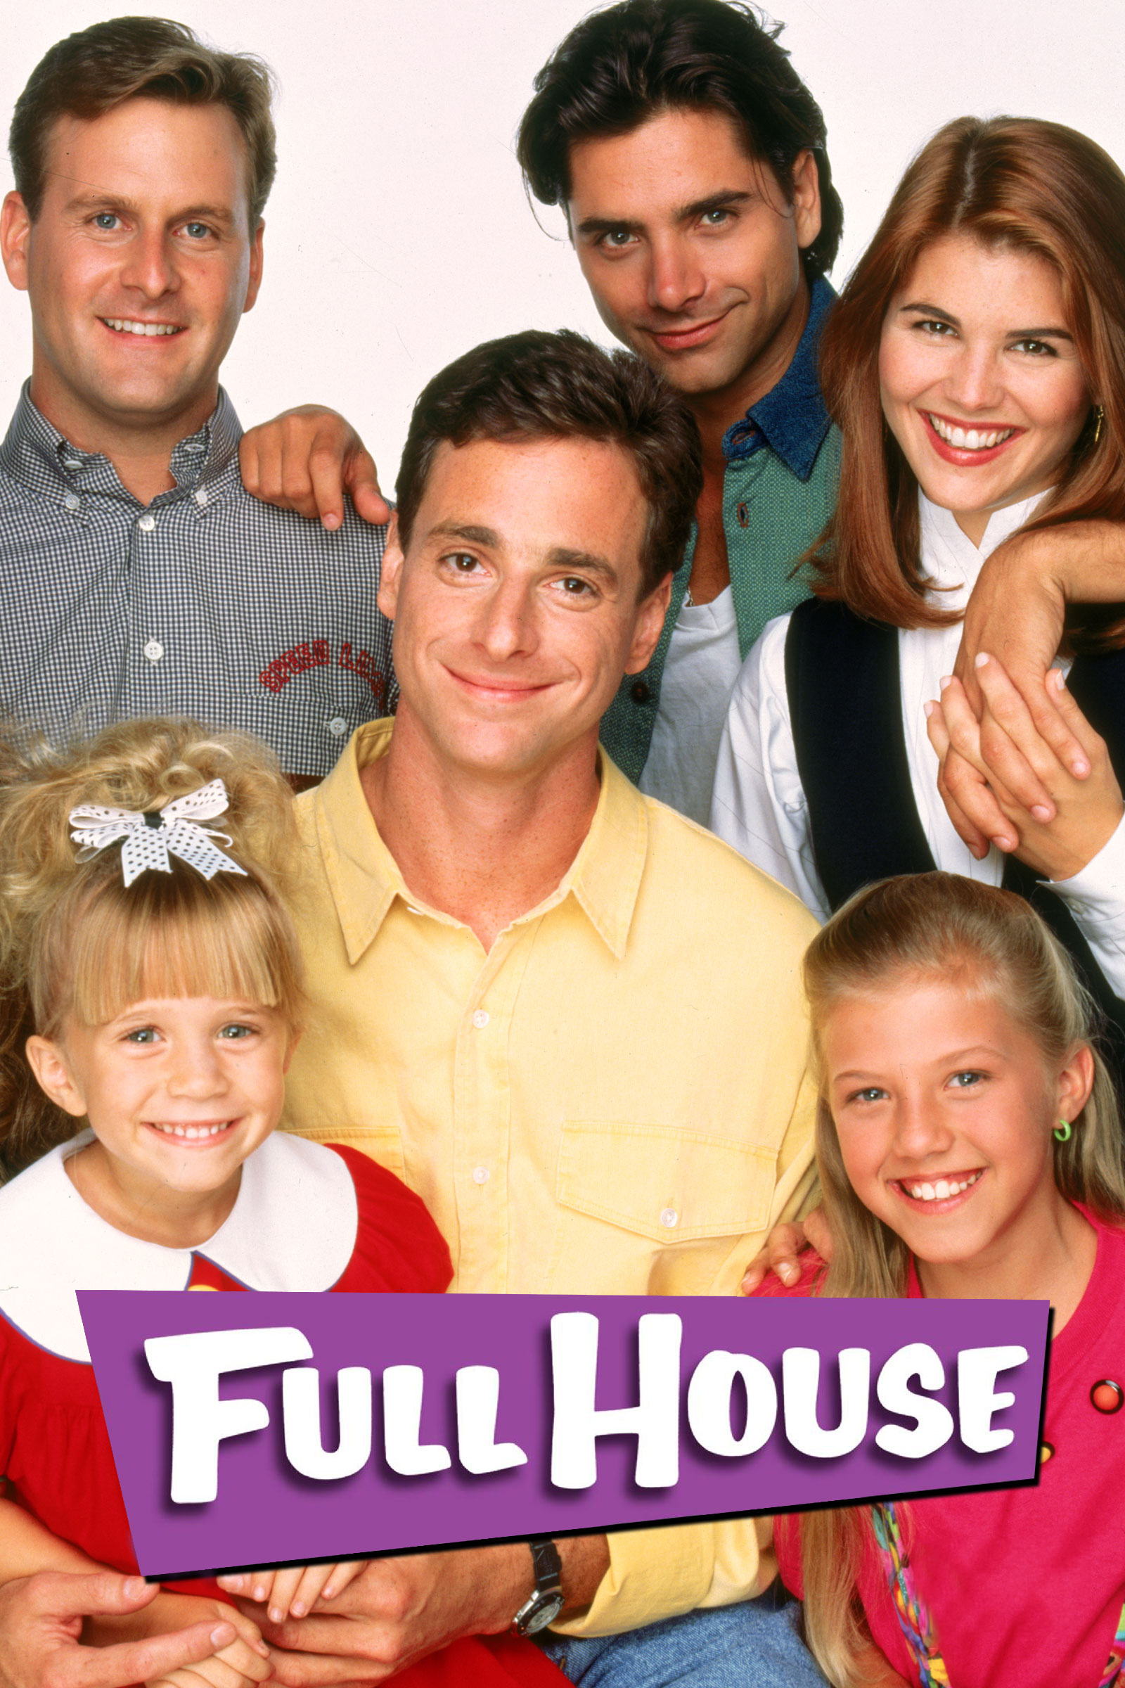

3. Which drama they were in?
iCarly
Full house
glee

Slide 16
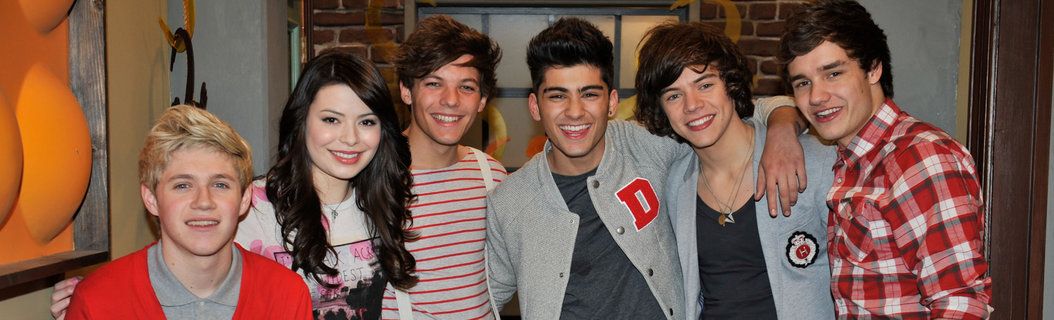
The answer is...
iCarly

Slide 17
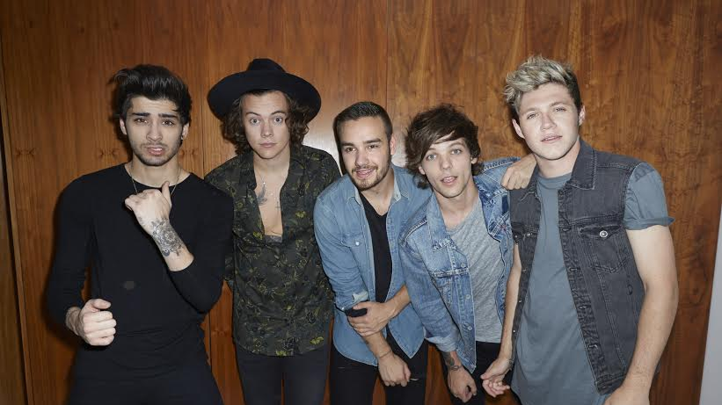

If you become interested in them...
You should check this video！ it is really popular:)

