Slide 1


One Way Or Another
By One Direction

Slide 2

The meaning of the title “One way or another”
It means “in any way that is possible.”
For example...
I‘m gonna live London one way or another
One way or another I will get that dress

Slide 3
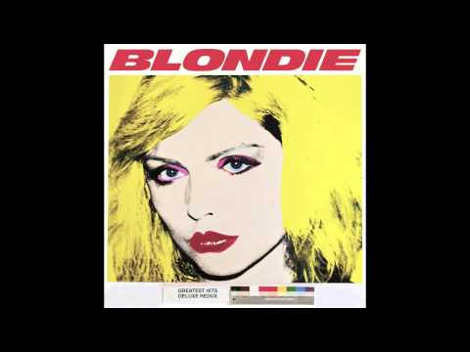
Interesting facts you should know
・This song is not their own song
The original song was written in more than
40 years ago, by Blondie,
famous punk band in UK.
In original version, they sing about ‘’Stalker‘’
Like one way or another , I am gonna find ya...

Slide 4

Interesting facts you should know II
This song is charity song.
So people in the music video, and of course One Direction released this song for no gurantee
・ in the music video, they visit many countries, including Japan.
And also, you can see a certain famous person there.
Let‘s guess who is that, and the answer is in quiz section.

Slide 5

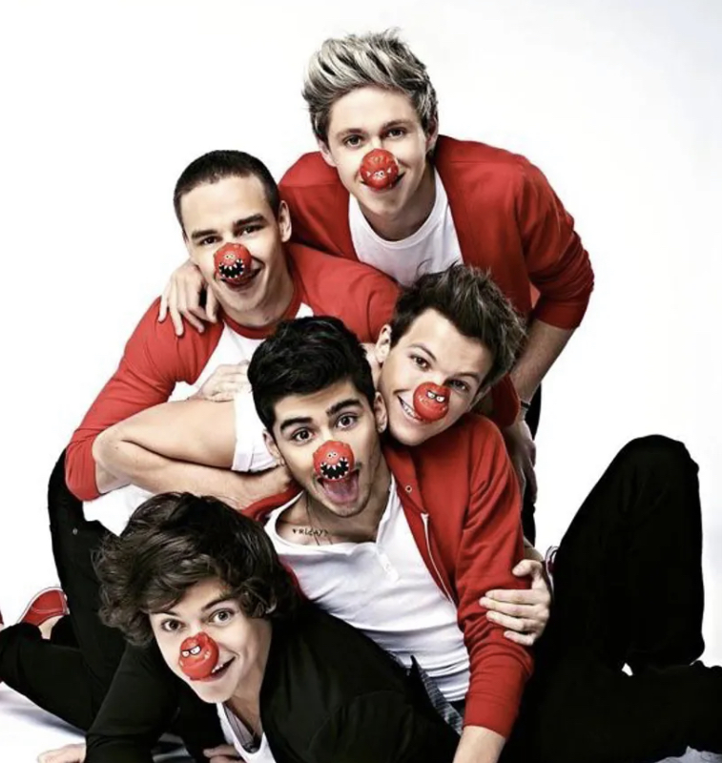
What is “Red Nose Day” ?
Red Nose Day is an annual campaign that raises life-changing funds to help end the cycle of poverty and ensure children are safe, healthy, educated and empowered across the U.S. and around the world.Through the power of entertainment , they raise money.

Slide 6
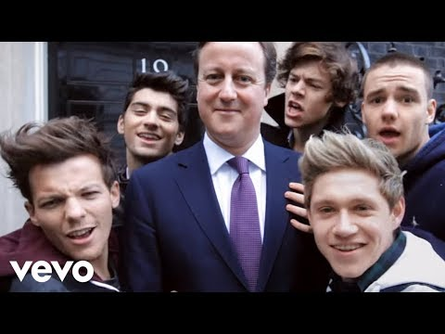
Let‘s listen to it and sing it🎤

Slide 7
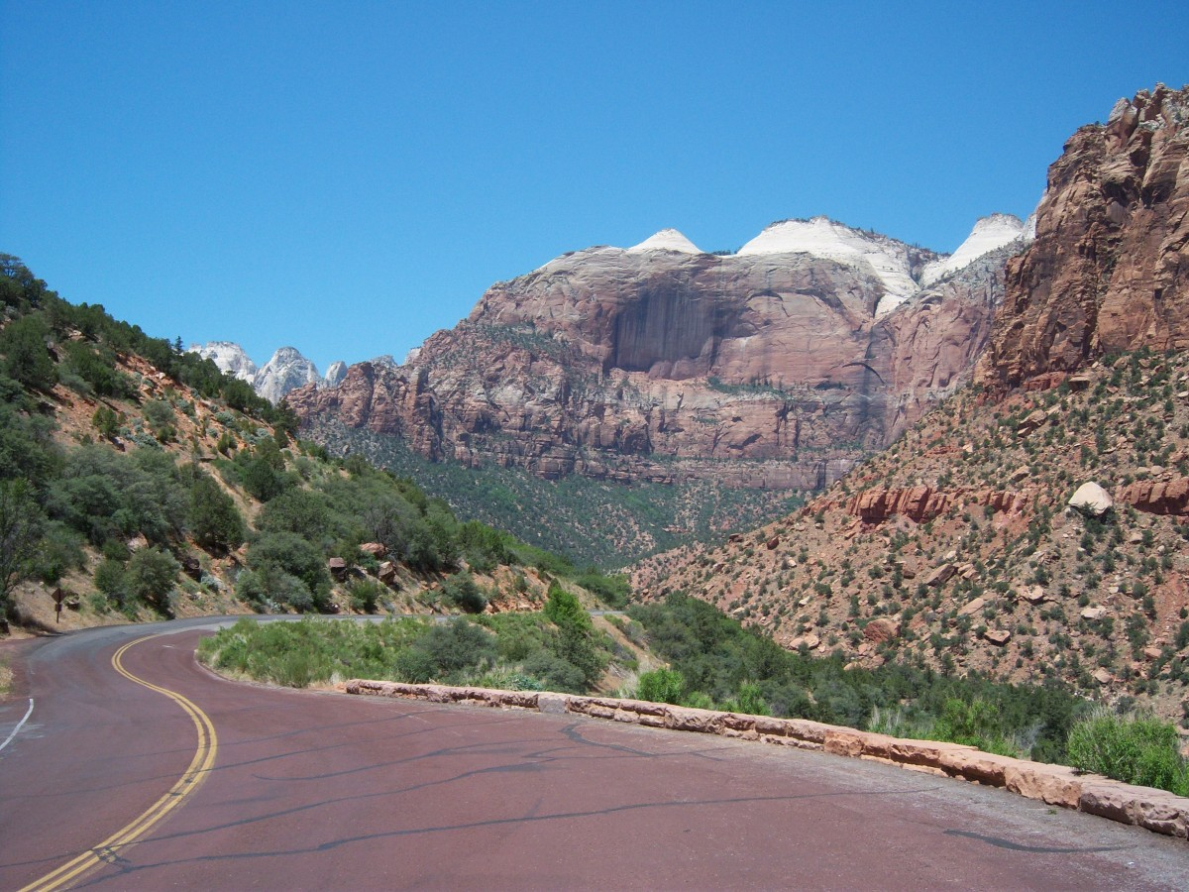
Lyrics : One Way Or Another
One way, or another, I'm gonna find ya
I'm gonna get ya, get ya, get ya, get ya
One way, or another, I'm gonna win ya
I'm gonna get ya, get ya, get ya, get ya
One way, or another, I'm gonna see ya
I'm gonna meet ya, meet ya, meet ya, meet ya
One day, maybe next week
I'm gonna meet ya, I'm gonna meet ya, I'll meet ya
I will drive past your house
And if the lights are all down
I‘ll see who’s around ,,,

Slide 8

Pronunciation
1, getcha
get you
2, metcha
meet you
3, fainju
find you
4,holju
hold you

Slide 9


Let's dancing!
It's funny dance!
Everyone stand up please!
Let's dancing and singing like this movie!!
💓💓💓

Slide 10

Let’s try some quiz!!!

Slide 11
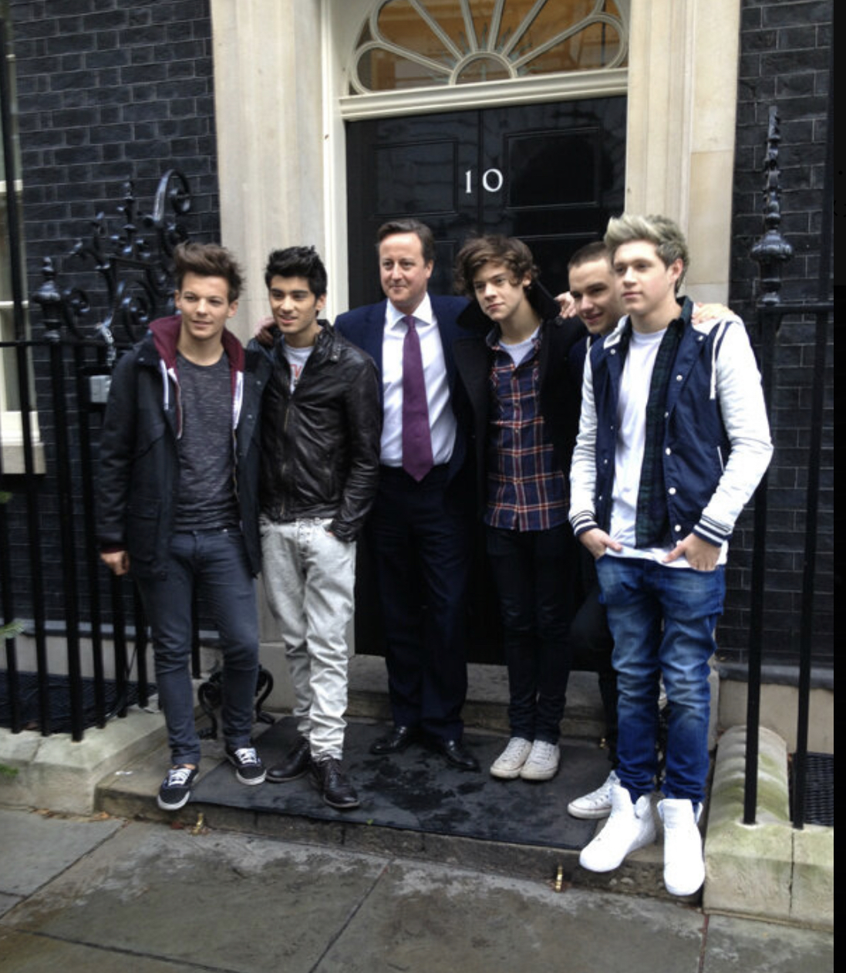
Quiz
1, What is the occupation of this men in the music video ?
①Prime Minister
②Bakery
③Singer

Slide 12
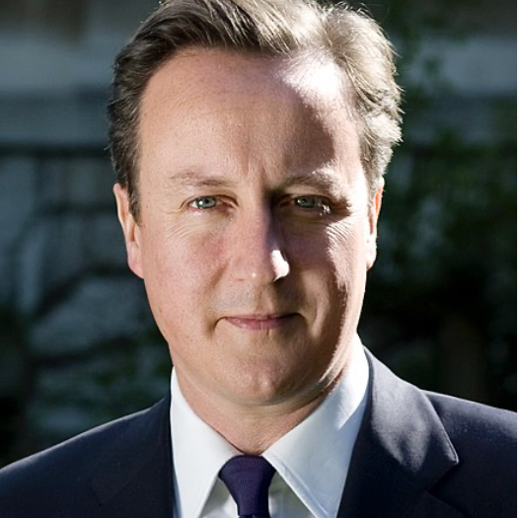
Answer is,,,
①Prime Minister of the United Kingdom from 2010 to2016.
David William Donald Cameron（born 9 October 1966 ）

Slide 13
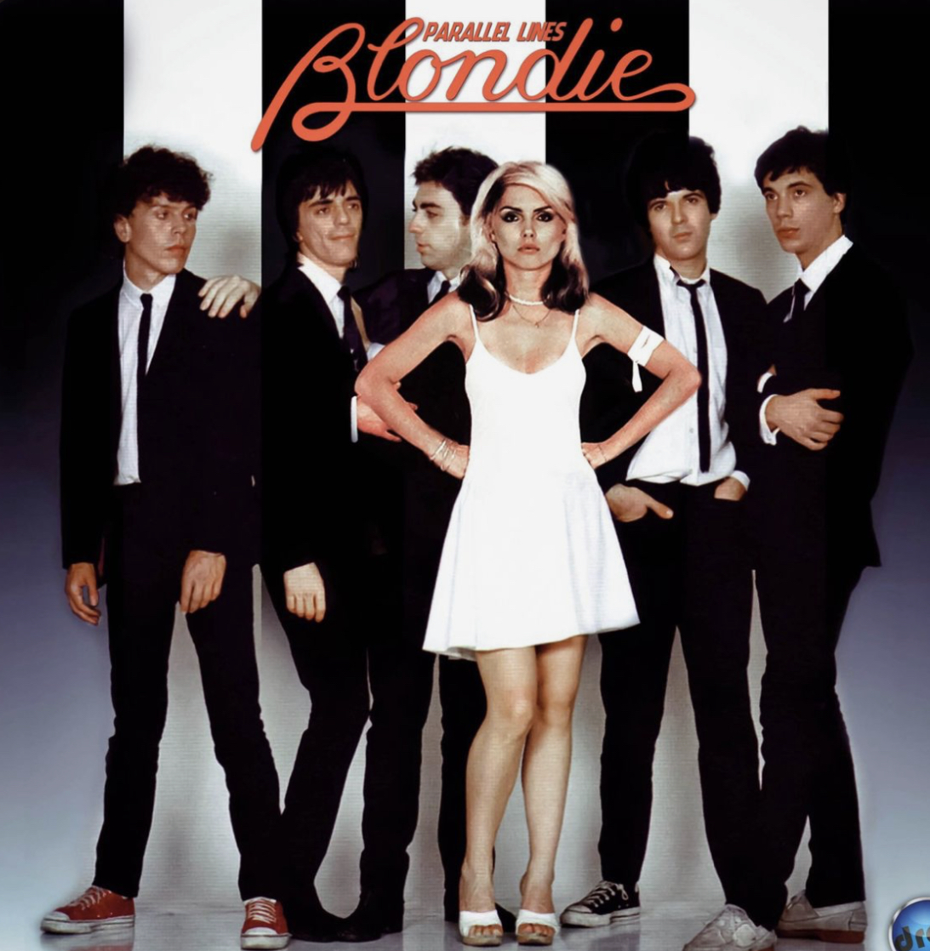
Quiz
2, When is this song written by Blondie ?
①1960
②1979
③2013

Slide 14
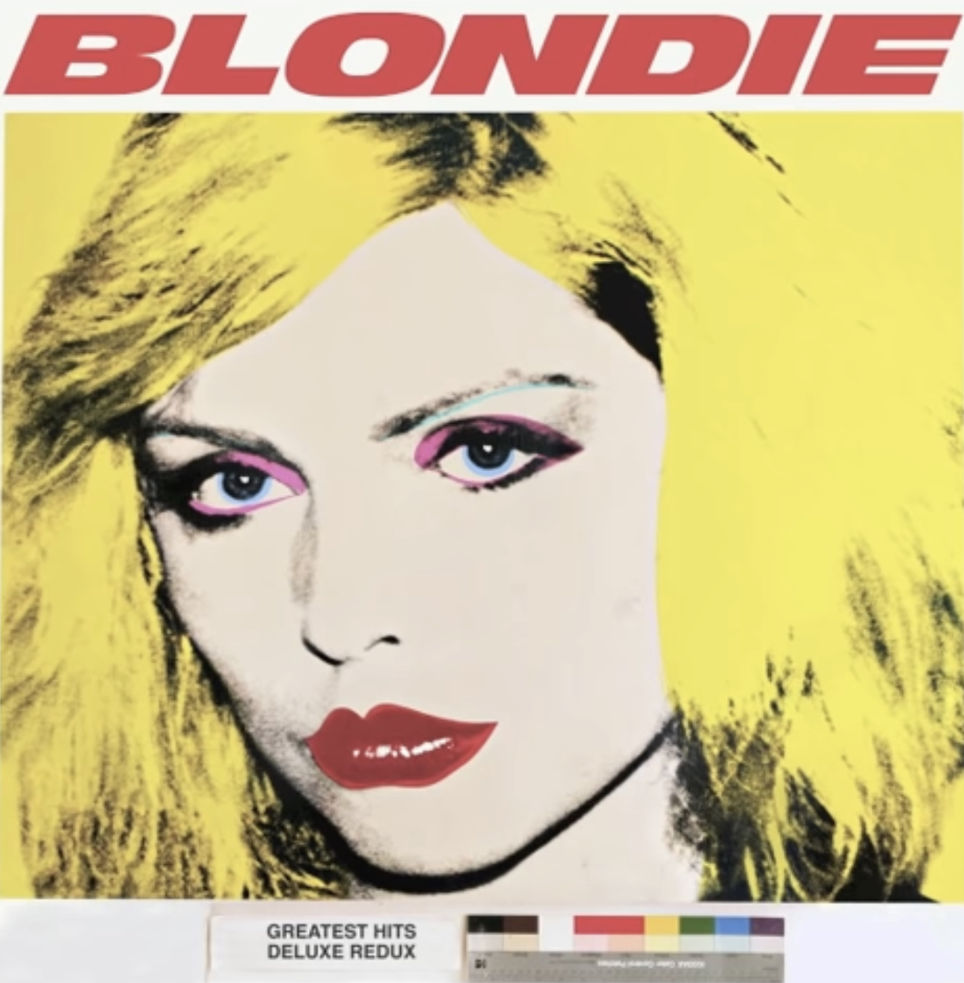
Answer is ,,,
②1979
This song was covered by One direction in 2013.

Slide 15

Quiz
3, Which country doesn’t appear in the music video?
①Japan
②Ghana
③India

Slide 16
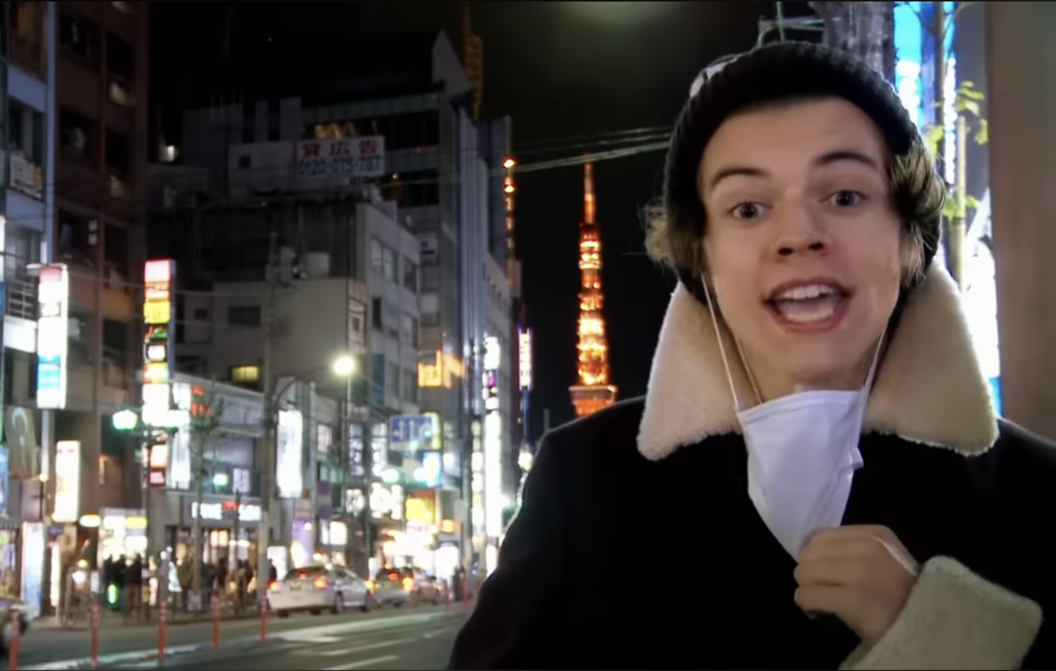

Answer is ,,,
③India
Japan
Ghana

Slide 17

~Thank you for watching ~

