Slide 1


80’s rock
Every breath you take

Slide 2
WHAT IS 80S ROCK?
Synthesizers & New Tech: Electronic sounds became characteristic of the era.
The Rise of MTV: Music videos turned musicians into visual superstars.
Diverse Subgenres: From Glam Metal and New Wave to Hard Rock

Slide 3
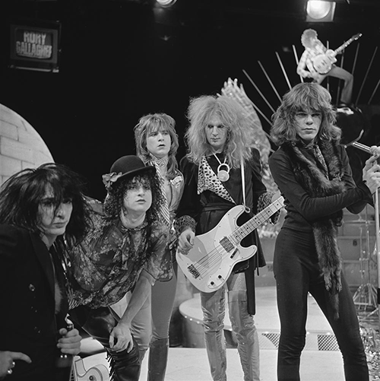
Glam Metal
This genre emphasized a flamboyant image with big hair, makeup, and flashy clothes.
The music was loud, fun, and catchy melody
and powerful guitar solo.
Bands: Bon Jovi, Mötley Crüe, Poison

Slide 4
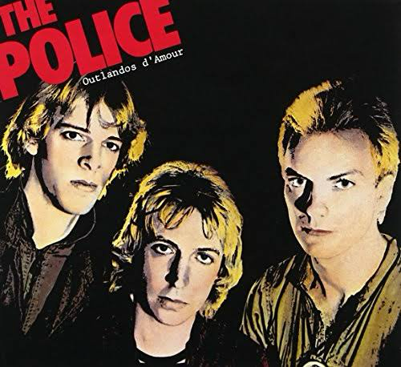
New Wave
New Wave fused rock with pop, punk, and electronic music.
It was characterized by the heavy use of synthesizers, drum machines.
Bonds: The Police, Duran Duran, Talking Heads

Slide 5

Hard Rock
Building on the foundations of the 70s, 80s hard rock delivered a more polished sound.
It was defined by powerful vocals and massive, sing-along choruses
Bonds: Guns N' Roses, Def Leppard, AC/DC

Slide 6
Every breath you take
"Every Breath You Take" is a song by the British rock band The Police, released in 1983.
It became one of the biggest hits of the year, reaching #1 on the Billboard Hot 100 in the U.S. for eight weeks and in the UK for four weeks
The song sounds like a beautiful and romantic ballad. However, the lyrics tell a much darker story.

Slide 7
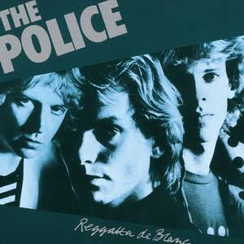
The Police
The Police blended the energy of punk with complex reggae rhythms and sophisticated pop hooks.
This power trio became one of the biggest bands in the world.
Key Members: Sting, Andy Summers, Stewart Copeland
Iconic Sound: Reggae basslines, atmospheric guitar, and polyrhythmic drumming.
(polyrhythmic : a rhythm which use different rhythms simultaneously )
Famous Hits: "Roxanne", "Message in a Bottle", "Every Breath You Take"

Slide 8

Fill in the blanks
https://youtu.be/OMOGaugKpzs
{Intro}
Every ( ) you take
And every ( ) you make
Every ( )( ) break
Every ( )( ) take
I’ll be watching you
Every single day

Slide 9
And every word you say
Every ( ) ( ) play
Every ( ) ( ) stay
I'll be watching you

Slide 10
Oh, can’t you see you belong to me?
How my ( )( )( )
( ) ( ) step you take?

Slide 11
Every move you make
And every ( ) you break
Every smile you ( )
Every claim you ( )
I’ll be watching you

Slide 12
Since you’ve ( ), I’ve been lost ( )( )( )
I dream at night, I can only see your face
I ( ) around, but it’s you I can’t replace
I feel so cold, and I ( ) for your embrace
I keep ( ) baby, baby, please

Slide 13
Oh, can’t you see you belong to me?
How my ( )( )( )
With every step you take

Slide 14
Every move you make
And every ( ) you break
Every smile you ( )
Every claim you ( )
I’ll be watching you
Every move you make
Every step you take
I’ll be watching you

Slide 15
I’ll be watching you
(Every breath you take)
(Every move you make)
(Every bond you break)
(Every step you take)
I’ll be watching you
(Every single day)
(Every word you say)
(Every game you play)
(Every night you stay)

Slide 16
I’ll be watching you
(Every move you make)
(Every vow you break)
(Every smile you fake)
(Every claim you stake)
I’ll be watching you
(Every single day)
(Every word you say)
(Every game you play)
(Every night you stay)
（×２）
I’ll be watching you…

Slide 17
Vocabulary
You belong to me: you are mine.
long for: desire , yearn for

Slide 18
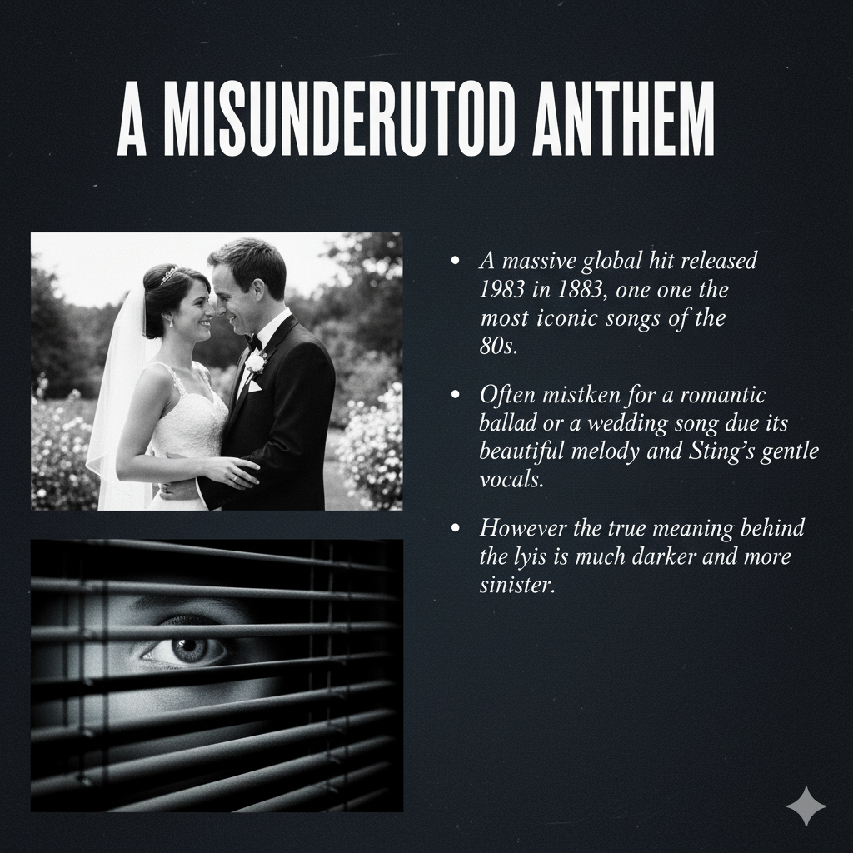
A MISUNDERSTAND ANTHEM
this song is often mistaken for a romantic ballad or a wedding song due its beautiful melody and Sting’s gentle voice
HOWEVER….

Slide 19
the true meaning behind the lyric is much darker and sinister

Slide 20
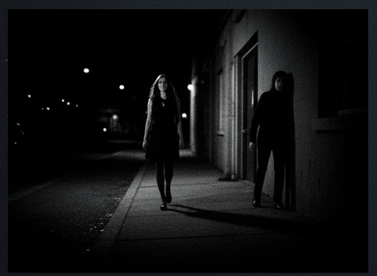
A CLOSER LOOK
“Every breath you take, every move make…I’ll watching you”
The Phrase “I’ll watching you” is not about caring for someone from the distance.
It implies constant, invasive surveillance.
The song is not a declaration of love, but a tale of obsession.

Slide 21
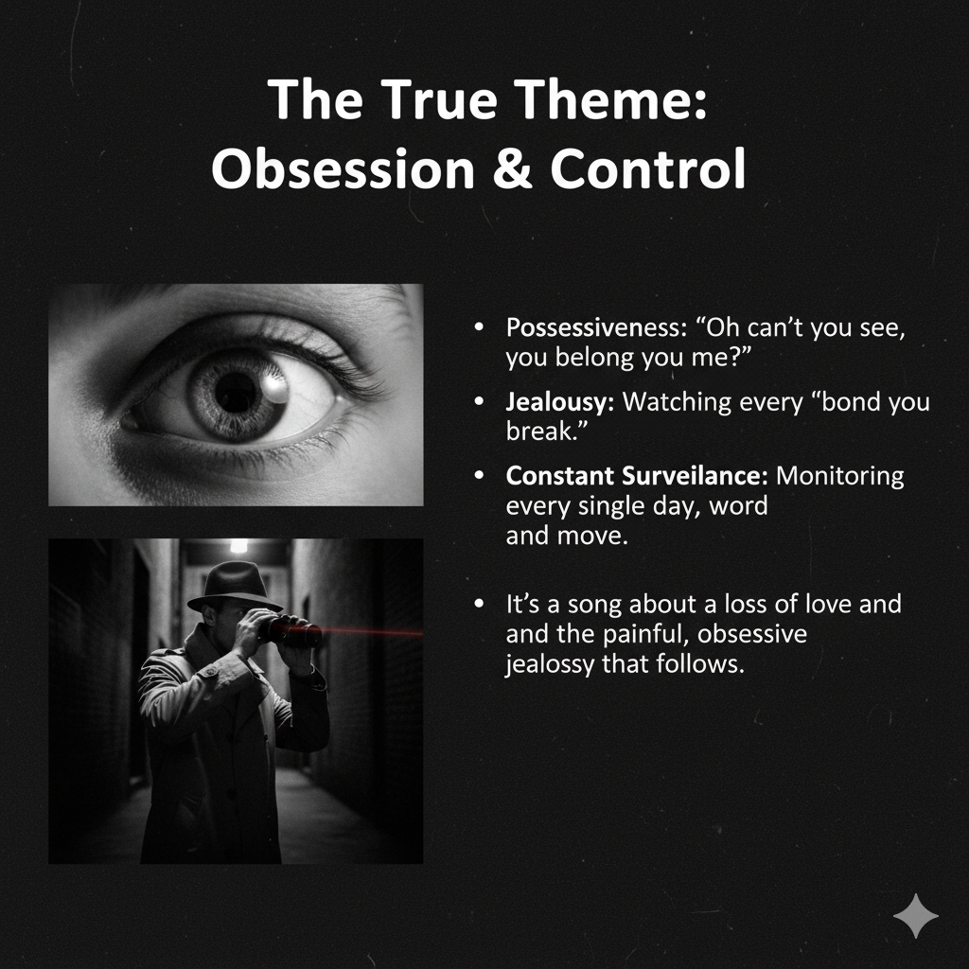
The true Theme : Obsession and Control
The lyrics describe the mind of stalker
Possessiveness: "Oh can't you see, you belong to me?"
Jealousy: Watching every "bond you break."
Constant Surveillance: Monitoring every single day, word, and move.
It’s a song about a loss of love and the painful, obsessive jealousy that follows.

Slide 22

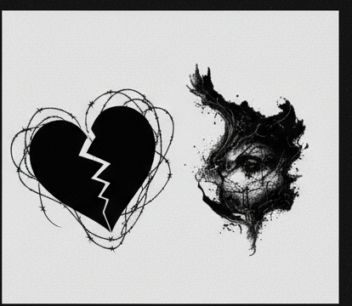
WHY STING WROTE THIS LYRIC
Written by Sting during a difficult personal period.
He was going through a painful divorce and separation from his first wife.
Sting himself has said the song reflects his own feelings of jealousy and a desire for control at that time.

Slide 23

Quiz
Ⅰ What is this song about?
① heartbreak
② To tell someone you love them directly
③ To secretly observe someone you like.
Ⅱ From the following choices, select the band that is not classified as an '80s band.
① Guns N’Roses
② Nirvana
③ Metallica
Notes:
here we can see the quiz
this quiz is very EASY
So let’s do it
Next
Do you understand?

Slide 24
Quiz
Ⅰ What is this song about?
① heartbreak
② To tell someone you love them directly
③ To secretly observe someone you like.
Ⅱ From the following choices, select the band that is not classified as an '80s band.
① Guns N’Roses
② Nirvana
③ Metallica
Notes:
This is answer
Did you get it right?

Slide 25
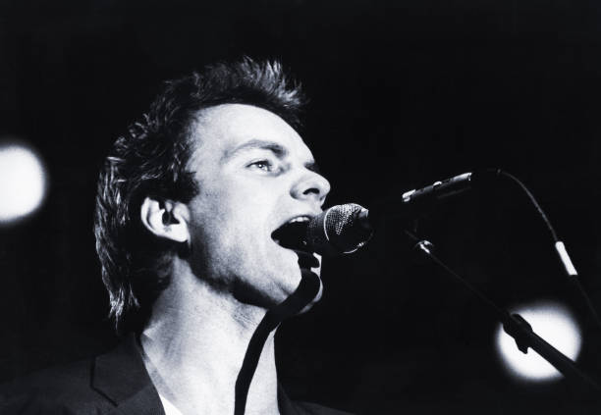
Pronunciation Challenge
Pronunciation Challenge
1 [Every breath you take]
→ evri brethiu teic
2 [Every bond you break, every step you take]
→ evri bóndju breic, evri stepiu teic
3[ I'll be watching you]
→ ael bi uótching iu
4 [and every word you say]
→ enevri uərdju sei
Notes:
Finally, Pronunciation Challenge

Slide 26
Thank you for listening !

