Slide 1
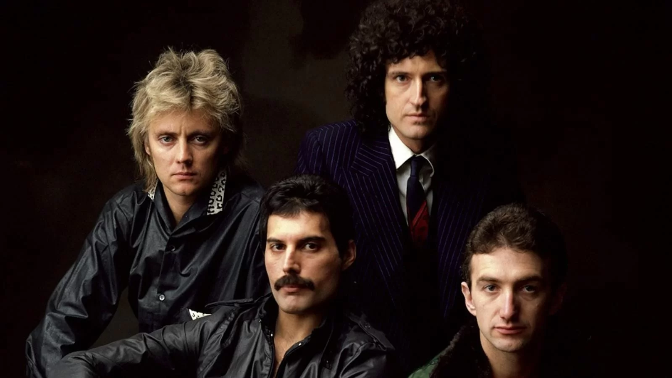
Queen
Okada, naganami

Slide 2
Band’s detail
Country: England
Genre: Rock
Member:
Vo. Freddie Mercury
Gt. Brian May
Ba. John Deacon
Dr. Roger Taylor

Slide 3
Another one bites the dust
・Song’s lyrics
Steve is scared of someone terrible and narrator talks his feeling of tension.
・Background of the song
This song is contained in “The Game” which was released in 1980. The song is written by bassist, John Deacon. In the first, he thought its riff is so stupid and it was only played in live, not contained album. However, when Michel Jackson saw their live, he said that you should single cut this song, and finally be single cutted.

Slide 4
pronunciation
How do you think I'm going to get along?
Without you, when you're gone.
You took me for everything that I had
And kicked me out on my own.

Slide 5
pronunciation
O O O O
How do you think I'm gonna get along?
without you when you’re gone.
You took me for every-----------thing that I had
And kicked me out on my own.

Slide 6
Quiz
"I'm gonna get you, too"
What's does "get you" mean in the above sentence?
a. It means to defeat you.
b. It means to make you do.
c. It means to obtain you.
d. It means to become you.

Slide 7
Quiz
"I'm gonna get you, too"
What's does "get you" mean in the above sentence?
The answer
a. It means to defeat you.

Slide 8
Quiz
Brian May and Roger Taylor are alive.
How old is Brian May?
a. He is 67 years old.
b. He is 77 years old.
c. He is 87 years old.
d. He is 97 years old.

Slide 9
Quiz
Brian May and Roger Taylor are alive.
How old is Brian May?
The answer
b. He is 77 years old.

Slide 10
Quiz
"Another one bites the dust."
What does the above sentence mean?
a. It means someone dies.
b. It means someone eats the dust.
c. It means someone makes things easier.
d. It means someone turns back time.

Slide 11
Quiz
"Another one bites the dust."
What does the above sentence mean?
The answer
a. It means someone dies.

