Slide 1


Slide 2
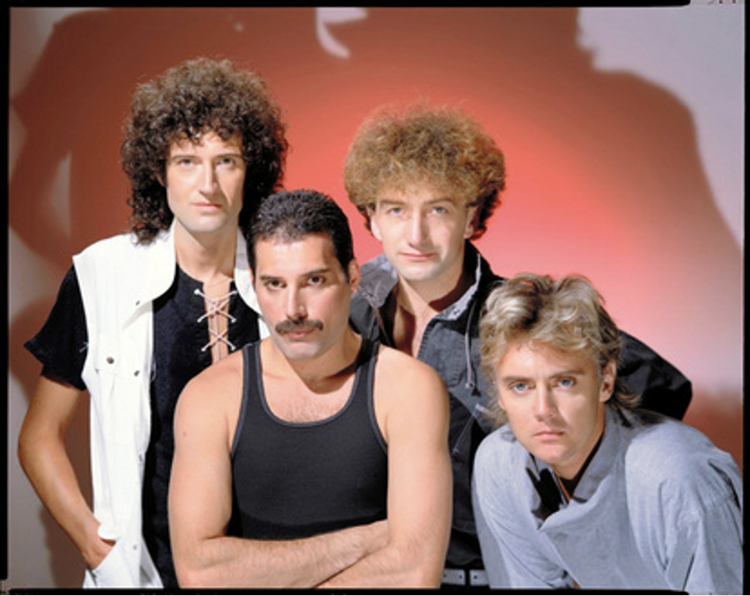
Do you know Queen?

Slide 3
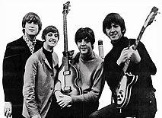
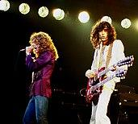

Queen are a British rock band formed in London in 1970.
Another British rock is...
The Beatles
Led Zeppelin
Elton John

Slide 4
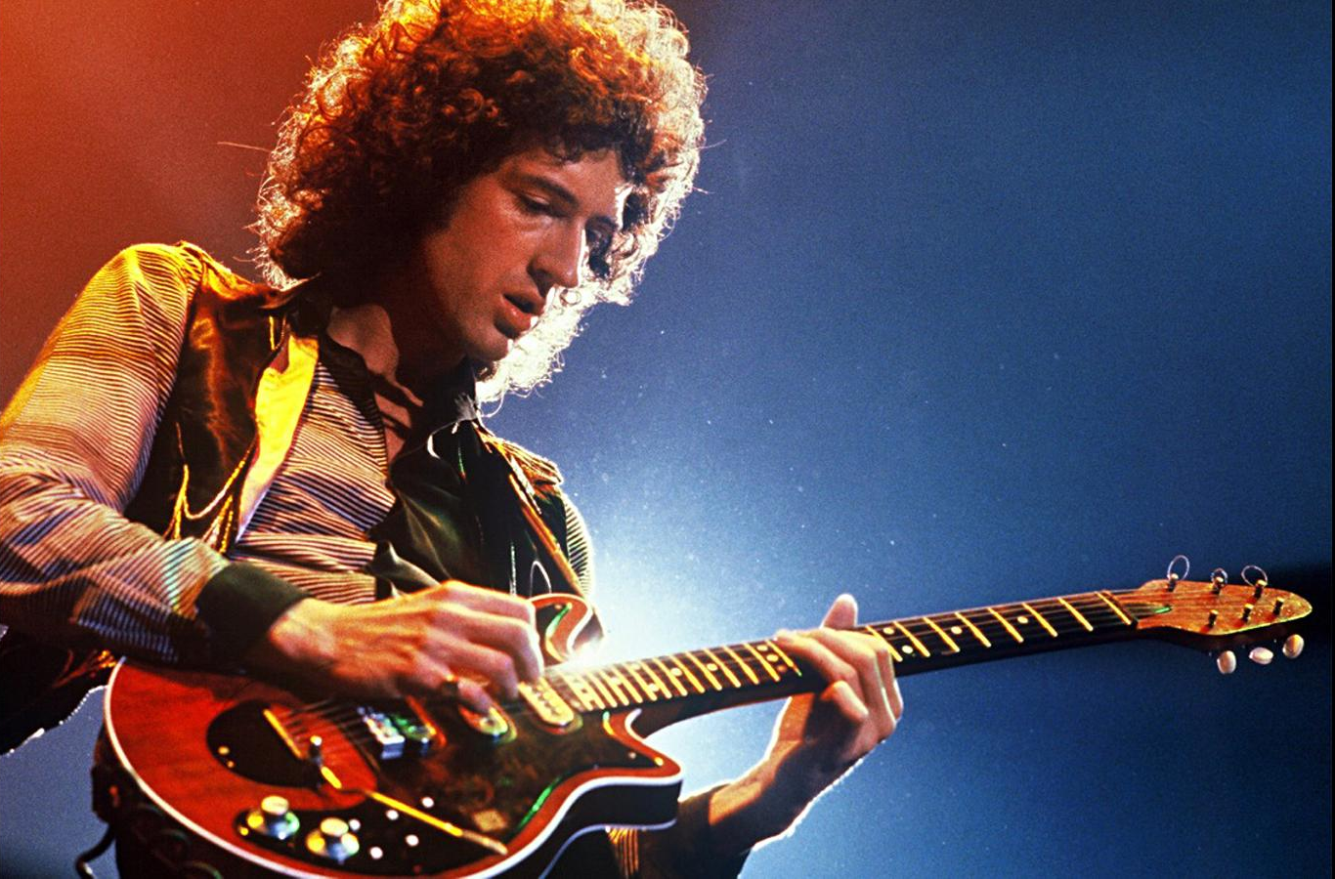

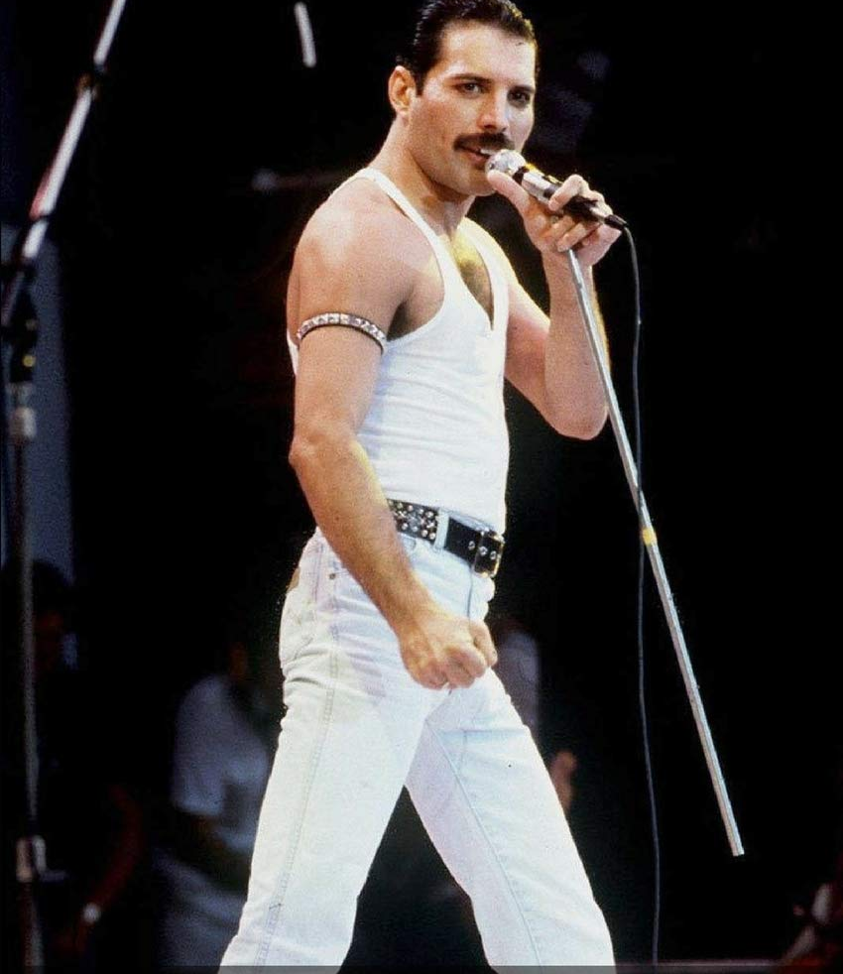
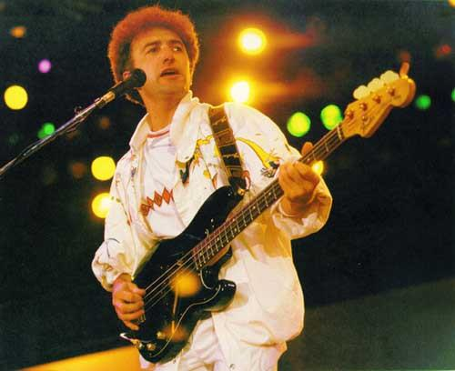
The role of the band
Brian May | Guitar
Roger Taylor | Drums
Freddie Mercury | Vocal & Piano
John Deacon | Bass

Slide 5
Some Questions !
I want you to choose these sentence is correct or false.
❌
Queen have been a member of 4 people from the time of formation.
✅
Two more members of Queen have passed away.
❌
Now, Queen is disbanded.
All the members of Queen can play the guitar and keyboard.
✅
❌
Queen is a rock artist so it was only rock songs.

Slide 6
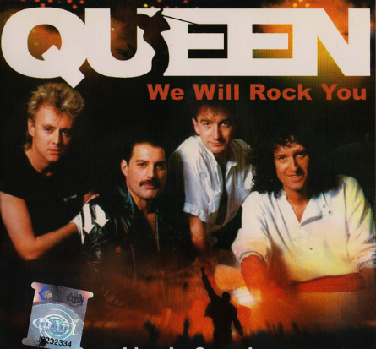
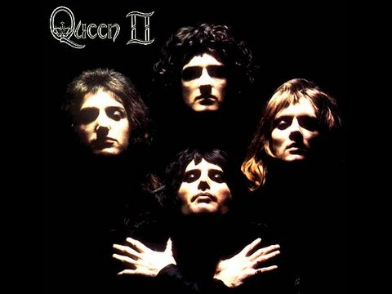
Queen’s famous song is...
Bohemian Rhapsody
We will rock you
https://www.youtube.com/watch?v=fJ9rUzIMcZQ
https://www.youtube.com/watch?v=-tJYN-eG1zk

Slide 7


Queen’s famous song is...
Under Pressure
We are the champion
https://www.youtube.com/watch?v=a01QQZyl-_I
https://www.youtube.com/watch?v=04854XqcfCY

Slide 8
Music Video with Lyrics !
“Don’t Stop Me Now”

Slide 9


Slide 10

Lyrics Breakdown and Facts !
[Verse 1]
I'm a shooting star leaping through the sky
Like a tiger defying the laws of gravity
I'm a racing car passing by like Lady Godiva
I'm gonna go go go there's no stopping me
Tigers have been recorded to jump as high as 15-16 feet
Lady Godiva is an English noblewoman know for riding a horse through the streets of Coventry stark naked

Slide 11
Lyrics Breakdown !
Freddie Mercury moves so fast and hot that he’s like a shooting star.
200 hundred degrees is pretty hot and Fahrenheit can also be taken as a joke, because of its pronunciation of “heit” as “height”, referring to the measurement of two hundred degrees.
[Pre-Chorus]
I'm burning through the sky yeah
200 degrees that's why they call me Mr. Fahrenheit
I'm travelling at the speed of light
I wanna make a supersonic man out of you
Freddie is a player and he cannot be held down, He is “traveling at the speed of light” and if you are with him, you will end up traveling at a fraction of his speed (supersonic). This is a reference to the fact that he was bisexual.

Slide 12
Lyrics Breakdown !
[Chorus]
(Don't stop me now)
I'm having such a good time
I'm having a ball
(Don't stop me now)
If you wanna have a good time
Just give me a call
(Don't stop me now)
'Cause I'm having a good time
(Don't stop me now)
Yes, I'm having a good time
I don't wanna stop at all, yeah
At the time Freddie Mercury the lead singer of Queen was in his prime. They were releasing several hit songs, his only request then was that it would never, ever stop.

Slide 13
Lyrics Breakdown !
[Verse 2]
I'm a rocket ship on my way to Mars on a collision course
I am a satellite, I'm out of control
I'm a sex machine ready to reload like an atom bomb
About to oh, oh, oh, oh, oh, explode
At the time, he was just going higher and higher. But, everything has to come to an end, or in this case a ‘collision course’ which would later see Freddie Mercury being diagnosed of HIV/AIDS.
Mercury is using the explosion of an atom bomb as a euphemism for male ejaculation.

Slide 14
Thanks for tuning in !

