Slide 1


Ayaka, Narumi, Koyuki

Slide 2
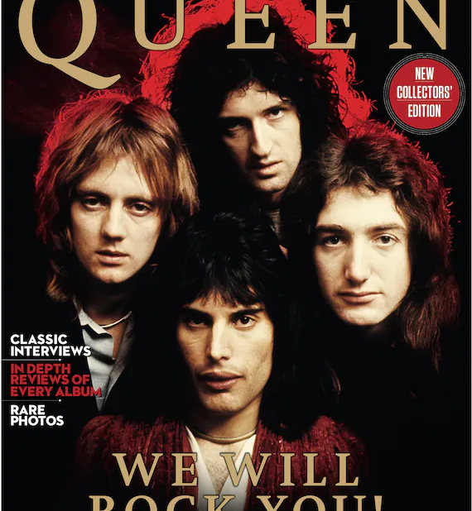
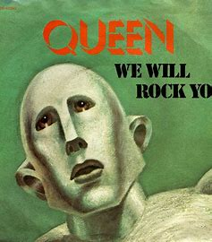

Slide 3

Please listen to it and fill in the blanks!!
https://www.youtube.com/watch?v=-tJYN-eG1zk

Slide 4
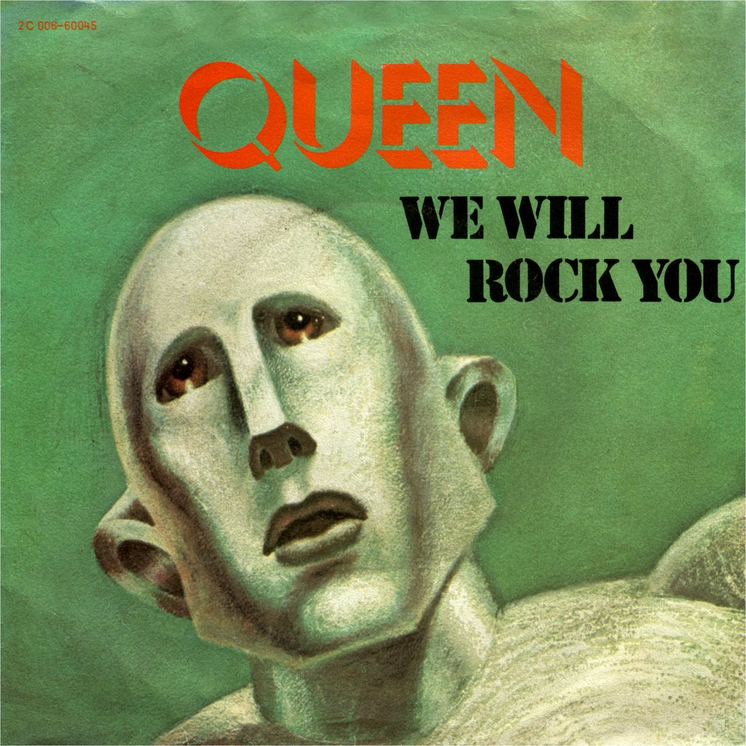
We Will Rock You
[Verse 1]
Buddy, you're a boy, make a big noise
Playing in the street
Gonna be a man someday
You got mud on your face
You big disgrace
Kicking your can
All over the place, singing
[Chorus]
We will, we will rock you
We will, we will rock you

Slide 5
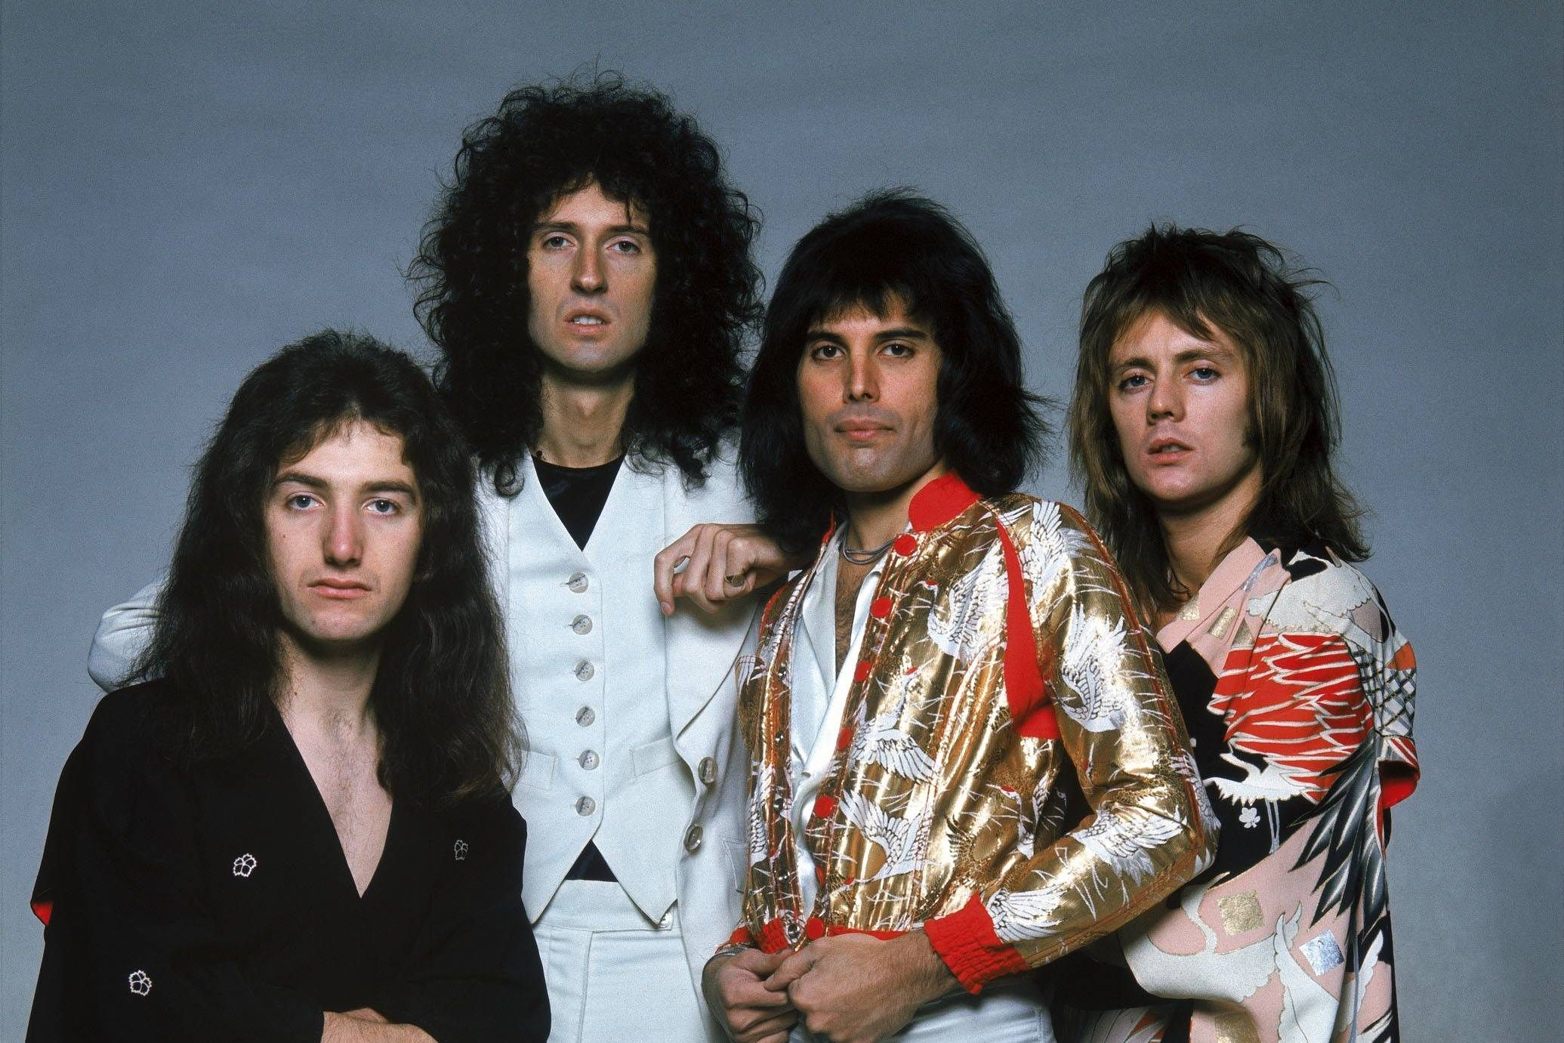
[Verse 2]
Buddy, you're a young man, hard man
Shouting in the street
Gonna take on the world someday
You got blood on your face
You big disgrace
Waving your banner
All over the place
[Chorus]
We will, we will rock you (Sing it out)
We will, we will rock you

Slide 6

[Verse 3]
Buddy, you're an old man, poor man
Pleading with your eyes
Gonna make you some peace someday
You got mud on your face
Big disgrace
Somebody better put you back
Into your place
[Chorus]
We will, we will rock you, sing it
We will, we will rock you, everybody
We will, we will rock you, hmm
We will, we will rock you, alright
Thank you for trying！！

Slide 7
Let’s ride a beat and
enjoy singing!!
Stomp on your right foot
Stomp on your left foot
Clap your hands
Are you ready???
Click here and enjoy!
https://www.youtube.com/watch?v=-tJYN-eG1zk

Slide 8

Quiz Time

Slide 9

What is the message of “We Will Rock You”?
Amaze people
Give people shock
Tell strong encouragement
Sing the rock music

Slide 10
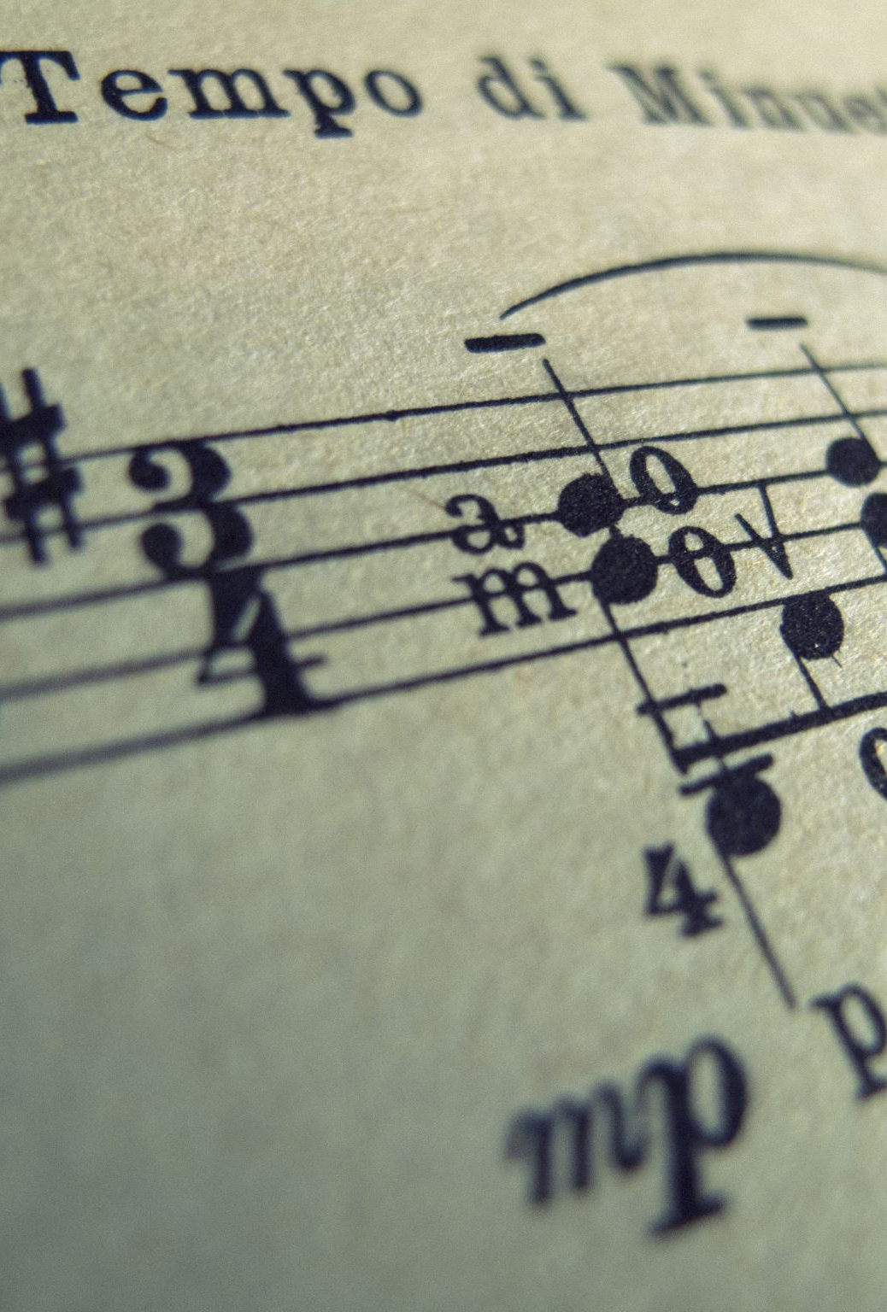
When was “We Will Rock You” released?
a.2002
b.1977
c.1982
d.1999

Slide 11
What sound is in the beginning of this song?
Breath
Wind
Crying
Stomp and Clap

Slide 12
How many people are in “Queen”?
3
4
5
6

Slide 13
Is “Queen” still active?
Yes
or
No

Slide 14
Thank you for listening!!

