Slide 1


Red Hot Chili Peppers

Slide 2

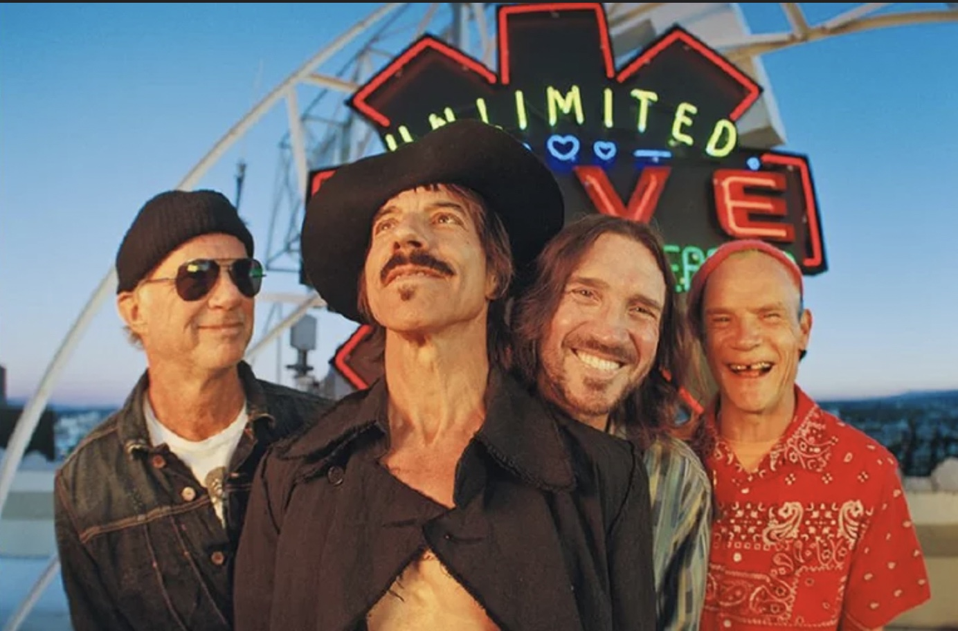






Red Hot Chili Peppers
Red Hot Chili Peppers are an American rock band formed in Los Angeles in 1983.
They sold more than 120 million pieces they are regarded as one of the most selling band of all time. And they got 3 Grammy awards.
They are successful band in Funk Rock, also incorporate various genres such as Punk, hard Rock, Psychedelic rock, Hip-hop.

Slide 3








Red Hot Chili Peppers- Snow ( Hey Oh)
Snow (Hey Oh) was released in 2006.
Vocalist Anthony Kiedis states that the track is about surviving, starting fresh.
This song contains the album named “Stadium Arcadium”, which this group’s 9th album.
So this song says about drug and liken drug to snow.
The song can be interpreted as roughly two stories. One is about wanting to get away from drugs.
The other is it’s for people who want to make
a fresh start.

Slide 4


Fill in the blanks while listening to music!!
CLICK THIS VIDEO

Slide 5





Lyrics
Check out the answer
[Verse1]
Come to decide that the things that I tried
Were in my life just to get high on
When I sit alone
Come get a little known
But I need more than myself this time
Step from the road to the sea to the sky
And I do believe that we rely on
When I lay it on
Come get to play it on
All my life to sacrifice
Trying to move forward
Getting high
Depend on
offer

Slide 6




[REFRAIN]
Hey oh
Listen what I say, oh
I got your hey oh
Now listen what I say, oh
When will I know that I really can't go
To the well once more time to decide on?
When it's killing me
When will I really see
All that I need to look inside
Come to believe that I better not leave
Before I get my chance to ride
[VERSE2]
Give it a try

Slide 7
When it's killing me, what do I really need
All that I need to look inside?
Hey, oh
Listen what I say, oh
Come back and hey, oh
Look at what I say, oh
The more I see, the less I know
The more I like to let it go
Hey oh, whoa-whoa
[REFRAIN]
[Pre-Chorus]

Slide 8




[CHORUS]
Deep beneath the cover of another perfect wonder
Where it's so white as snow
Privately divided by a world so undecided
And there's nowhere to go
In between the cover of another perfect wonder
And it's so white as snow
Running through the field where all my tracks will be concealed
And there's nowhere to go
Ho!
Innocence

Slide 9



[VERSE 3]
When to descend to amend for a friend
All the channels that have broken down
Now you bring it up, I'm gonna ring it up
Just to hear you sing it out
Step from the road to the sea to the sky
And I do believe what we rely on
When I lay it on, come get to play it on
All my life to sacrifice
Means, way
[Refrain] [Pre-Chorus] [Chorus] [Bridge] [Chorus]

Slide 10

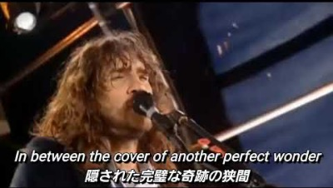



[Outro]
I said hey, oh yeah (Ooh)
Oh yeah, tell my love now (Ooh)
Hey, hey yeah, oh yeah (Ooh-ooh-ooh)
Ooh-ooh
Ooh-ooh

Slide 11

QUIZ TIIME
🙌🏻Number 2 and 3 have multiple answers.
1. Where is this band from?
1. New York 2. New Orleans 3.Wales 4. Los Angeles 5. Sheffield
2. What is the interpretation of this song? (2)
1. Fresh start 2. wanting to get away from drug 3. Just snow 4.Nothing
3. What does “ to get high on” mean? (2)
1.Let’s be the best 2.Be difficult to achieve 3. Trying to move forward 4. Getting high

Slide 12



Thanks

