Slide 1
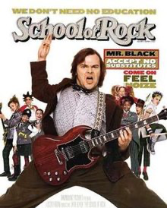

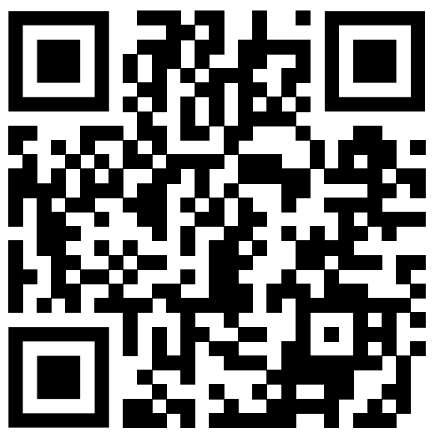
School of Rock

Slide 2


Why I chose this movie
I like Jack Black, the lead actor in this movie.
I was choosing between Gulliver's Travels and School of Rock, but I picked School of Rock because it has fun scenes.
The movie takes place in an elementary school, so the words and expressions are easy.
Most of all, it’s really fun.

Slide 3
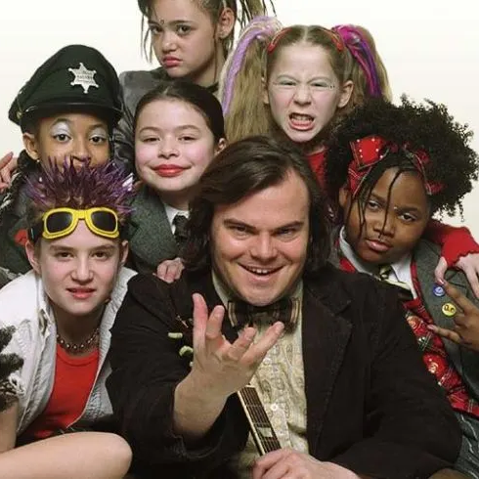
Situation context
Dewey Finn(teacher) takes charge of his students and assigns them roles for their upcoming "School of Rock" band project.
He uses humor, nicknames, and creativity to motivate the students and make them feel excited about their roles.
https://www.youtube.com/watch?v=_Tf_smu76T0

Slide 4
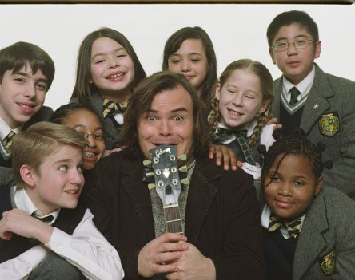
Why I chose this scene
You can motivate your team by talking about unimportant tasks as if they are important.
It helps them stay positive and motivated, making them put effort into their given roles with interest.

Slide 5
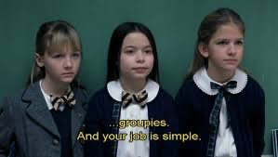
Script(1)
Dewey Finn: Lead guitar Zack Attack. Take a seat.
On bass, Posh Spice. On keyboards, Mr. Cool.
And on drums, Spazzy McGee.
OK, Blondie, Brace Face, you're singing backup.
All right, Tough Guy, Shortstop, Fancy Pants, get over here.
You guys on security detail.
Your job is to Make sure no one outside this room knows what we're doing in here
The future of band depends on you
OK, your first mission, soundproofing this room. Get on it.
Billy: Can I be the band stylist instead?

Slide 6
Script(2)
Dewey Finn: Of course you can, Fancy Pants.
OK. Carrot Top, Roadrunner, Turkey Sub, we are gonna have a lot of equipment.
We're talking amps, electric guitars, maybe even lasers and smoke machines.
Now your job is to master the transportation and operation of this technology.
Seriously Without a first-rate roadie crew, we’ll never have a psychedelic show,
and I can't live with that, ok? I'm counting on you. Get going. Go.
All right. You three. groupies. And job is simple. Just worship the band.
And you're gonna be making hats, you’re gonna be making T-shirts, all kinds of merchandise.
Which leads me to your first assignment. Naming the band.
Student: Yes.
Dewey Finn: All right. Sit down.

Slide 7
vocabulary
Instead: In place of something else; as an alternative.
Transportation: The act of moving people or things from one place to another.
I'm counting on you: A phrase meaning "I trust or depend on you to do something.”
Worship: To show deep respect or admiration, often with devotion.
Assignment: A specific task or duty given to someone to complete.
First-rate: Of the highest quality or excellence.
Roadie crew: A group of people who manage and operate equipment for concerts or performances.

Slide 8

questions
(1) What is the first mission given to the security detail?
1. Cleaning the room.
2. Soundproofing the room.
3. Decorating the room.
(2) What task does Dewey give the groupies as their first assignment?
1. Designing posters.
  2. Cleaning the instruments.
  3. Naming the band.

Slide 9
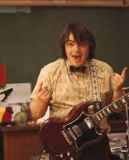
What did I learn from this scene?
Leadership Skills / Motivation Techniques
  Dewey demonstrates how to assign roles effectively, ensuring everyone feels included and valued.
  Even seemingly small tasks are presented as important, encouraging the team's motivation.
Teamwork
  Every member of the group is given a role that contributes to the overall success of the band.
  Emphasizes that every role, no matter how minor, plays important part to achieving a shared goal.

Slide 10
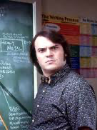
Discussion Questions
Do you think Dewey’s leadership style is effective in boosting team morale?
What ways to motivate team members have you seen or used?

Slide 11
Correct answer
(1) What is the first mission given to the security detail?
  -2. Soundproofing the room.
  (2) What task does Dewey give the groupies as their first assignment?
  -3. Naming the band.

