Slide 1


Who Says by Selena Gomez
Team POP
Haruka, Arim, Momoe, Riono

Slide 2
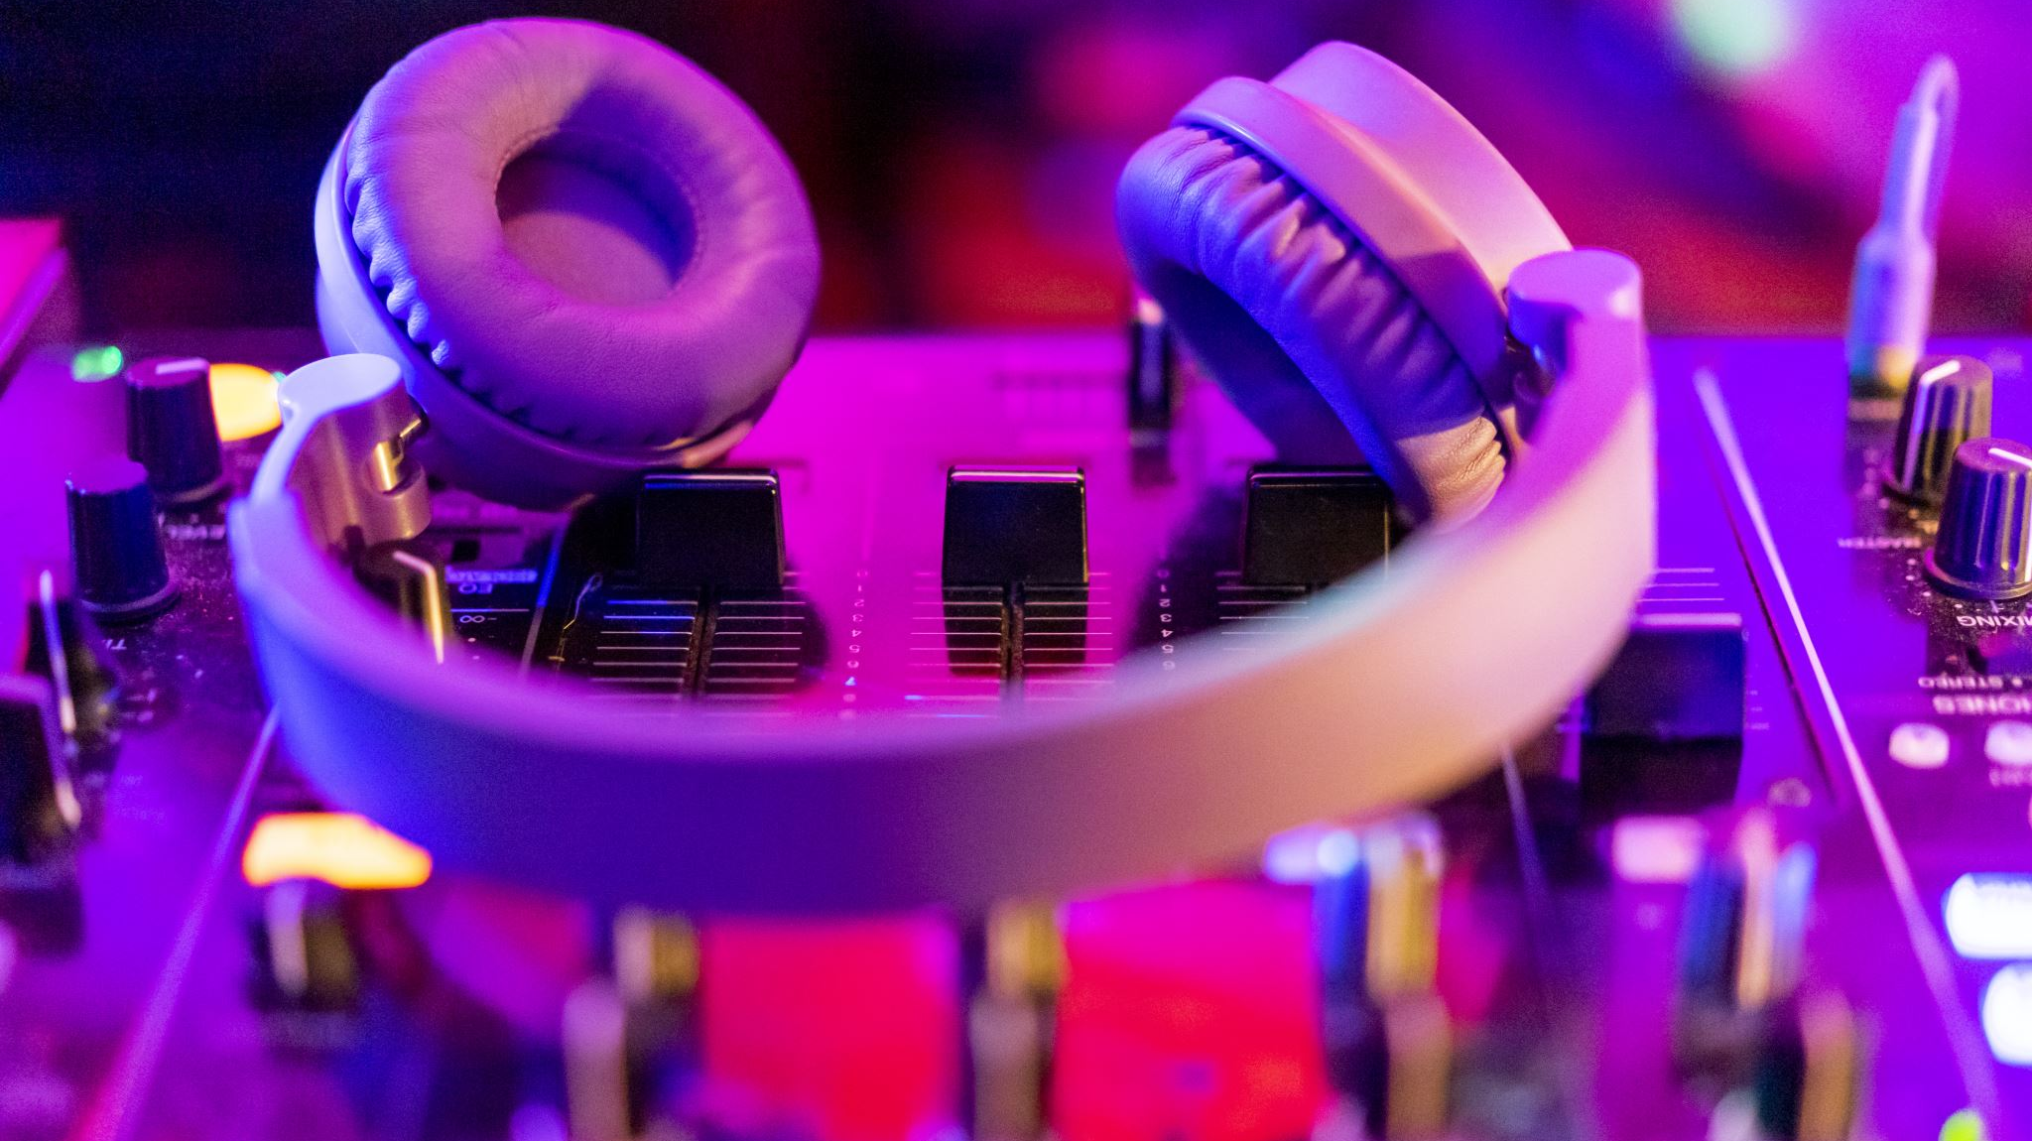

Music Video

Slide 3
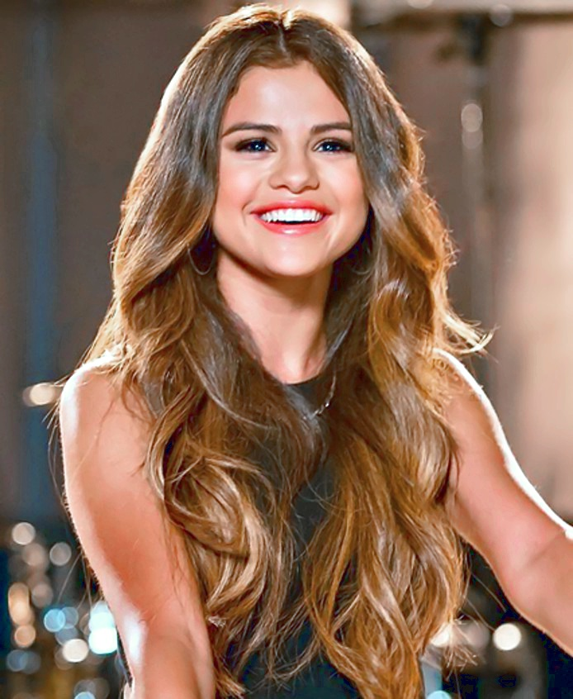
Who is Selena Gomez?
Job
➤Actress
➤Singer
➤Dancer
➤Designer
From
➤Texas
Genre
➤Dance Pop
➤R＆B
➤Hip hop
Age
➤31 years old
(She was born in 1992)

Slide 4

About
“Who Says”
Performed by American band Serena Gomez & the Scene
The lead single from the band’s third album
Released in March 2011
Intended to inspire people, and fire back at the “haters”, particularly those involved in cyberbullying
Notes:
I’ll introduce the song “Who Says.” The song was performed by American band Serena Gomez & the Scene and released in March 2011. This is the lead single from the band’s third album. According to Selena, “Who Says” was intended to inspire people, and fire back at the “haters”, particularly those involved in cyberbullying. Cyberbullying is to harm or frighten another person on the Internet.

Slide 5

Lyrics
[Chorus:]
Who says, who says you're not perfect?
Who says you're not worth it?
Who says you're the only one that's hurtin'?
Trust me, that's the price of beauty
Who says you're not pretty?
Who says you're not beautiful?
Who says?
♫ repeat "who says you're~"
♫ pass over the negative attention and "be confident".

Slide 6
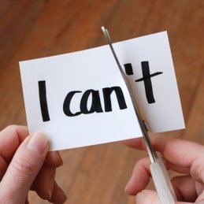
Lyrics
[Bridge:]
Who says you're not star potential?
Who says you're not presidential?
Who says you can't be in movies?
Listen to me, listen to me
Who says you don't pass the test?
Who says you can't be the best?
Who said, who said?
Would you tell me who said that?
Yeah, who said?
♫ repeat "who says you~"

Slide 7
Confidence
ー”I’m just beautiful me”
You decide your worth
Self-doubt
ーCare what others think about me too much:-(
Notes:
If you have plenty of confidence in yourself, its great. No need to hear this song, and my talk anymore.
But if you have no confidence, this song will screw up your courage.
You care about your looks? Status? English speaking skill?
You might feel satisfied with yourself and positive at these topics regardless of the facts, if you have great confidence.
But the reality is, many of you don’t have very much confidence, including me.
So

Slide 8
Confidence
ー”I’m just beautiful me”
You decide your worth
Don’t care what people say about you!
Self-doubt
ーCare what others think about me too much:-(
Notes:
No need to pay attention such a thing. All of them doesn’t decide your value. They doesn’t assure your worth. You can decide your oun value.
If you have no confidence in yourself, start with trying not to mind what people think about you.
A slogan is, “Who says that!?”

Slide 9

Try Quiz!!
https://create.kahoot.it/share/who-says-you-can-t-be-campion/92665474-0b08-4ba4-9585-c819ba9df2bb

