Slide 1
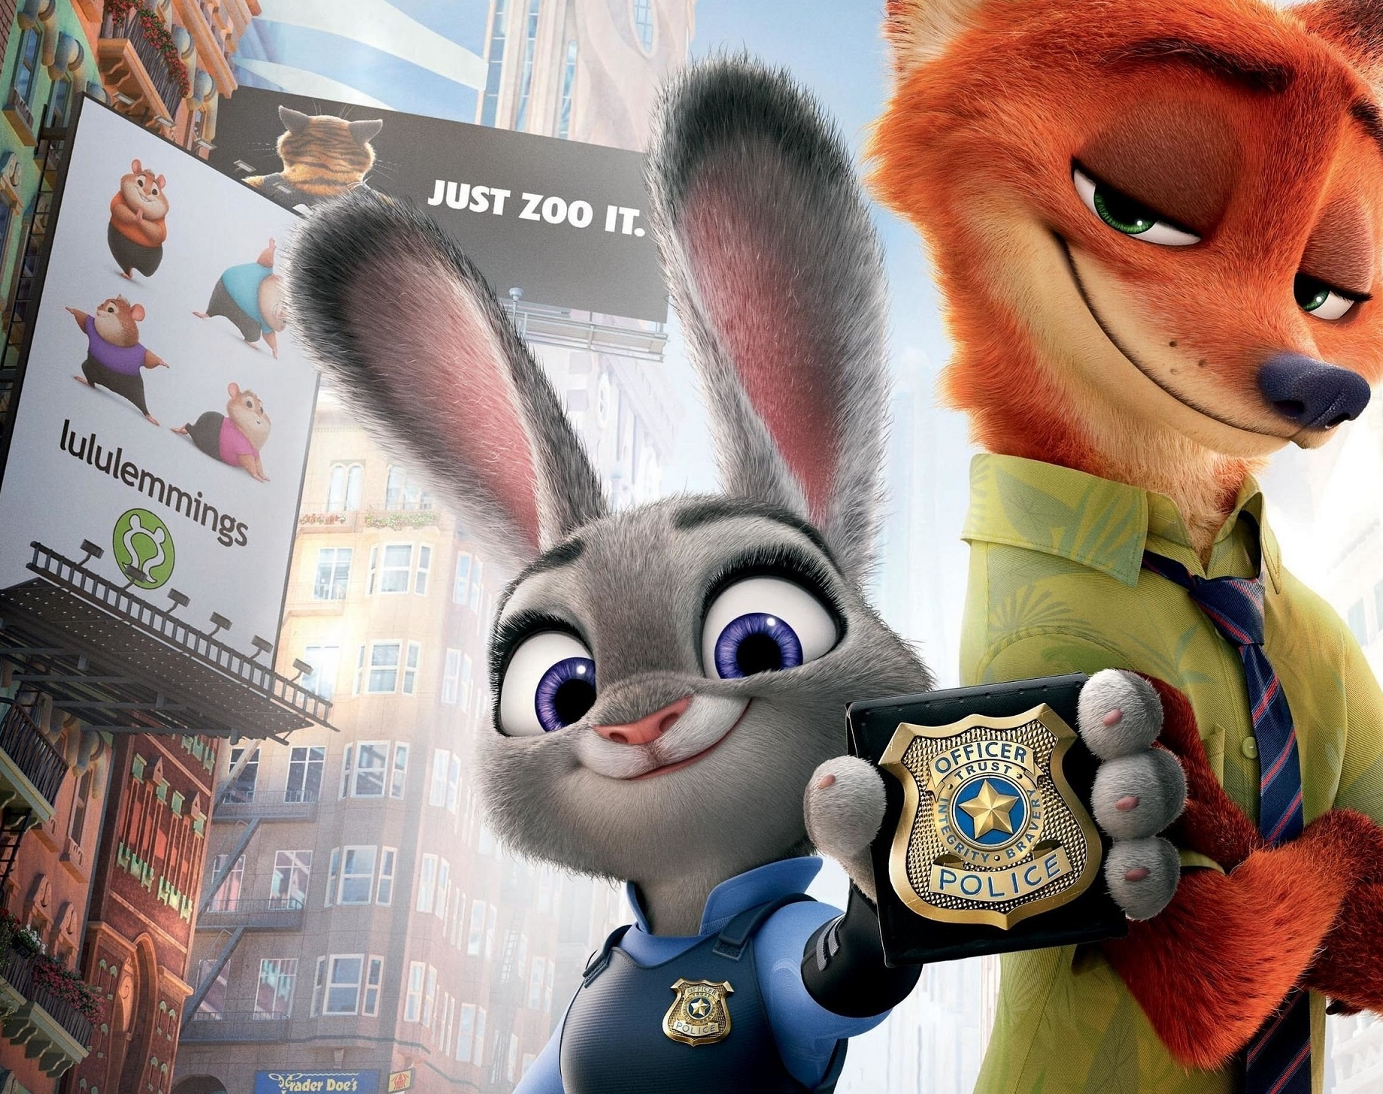

Try
Try
Everything
Everything
By Group of Disney
Nodoka, Siyao, Tomohiro, Saki

Slide 2
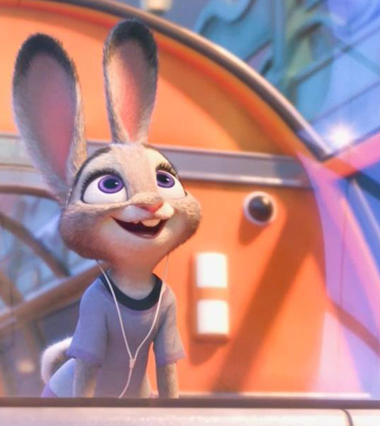
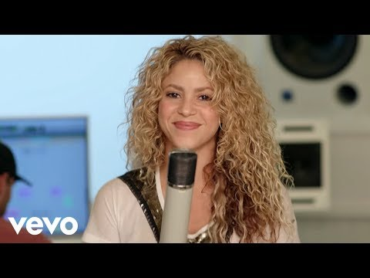
Please listen ♪↓

Slide 3
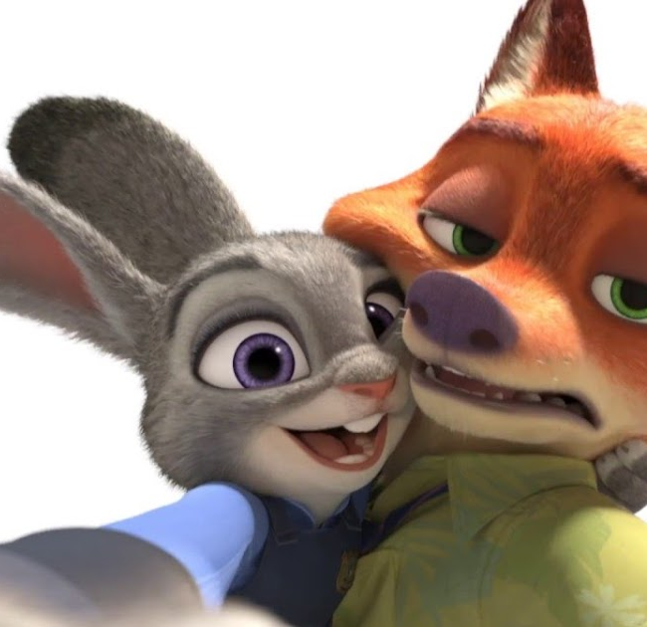
This song is…
the theme song of the movie
Zootopia!!

Slide 4
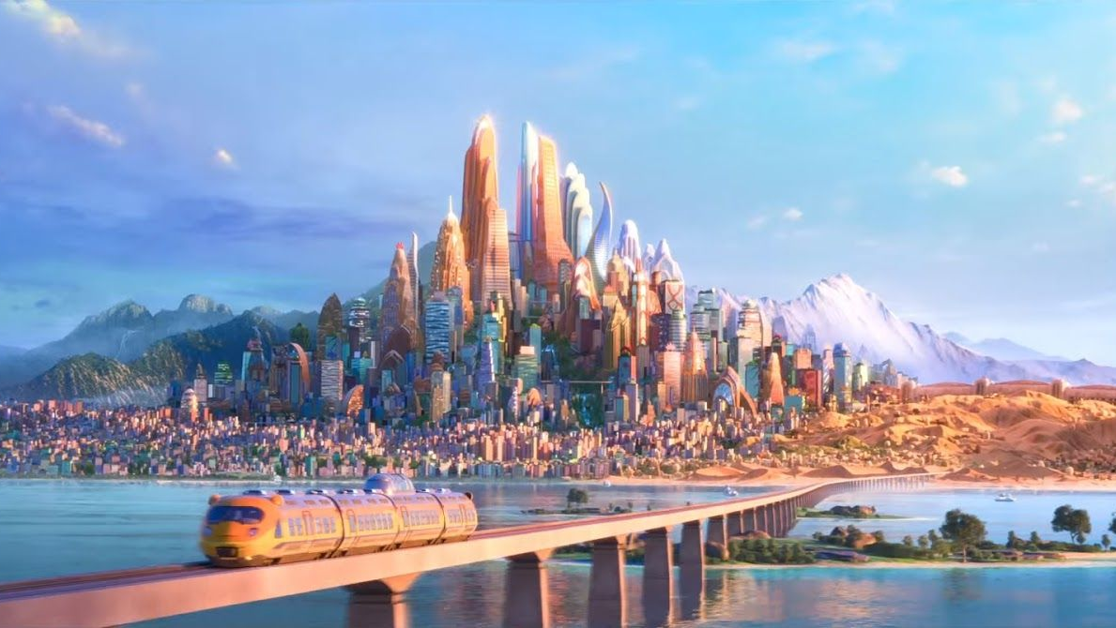
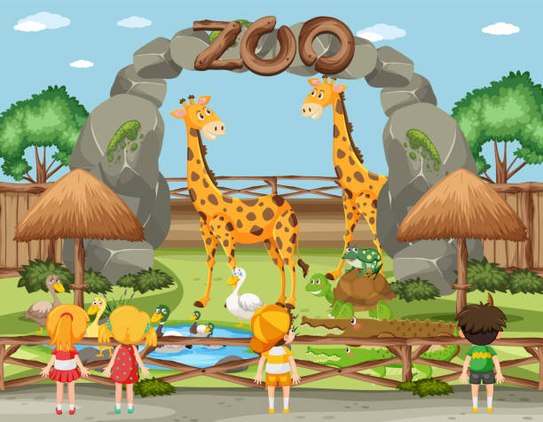
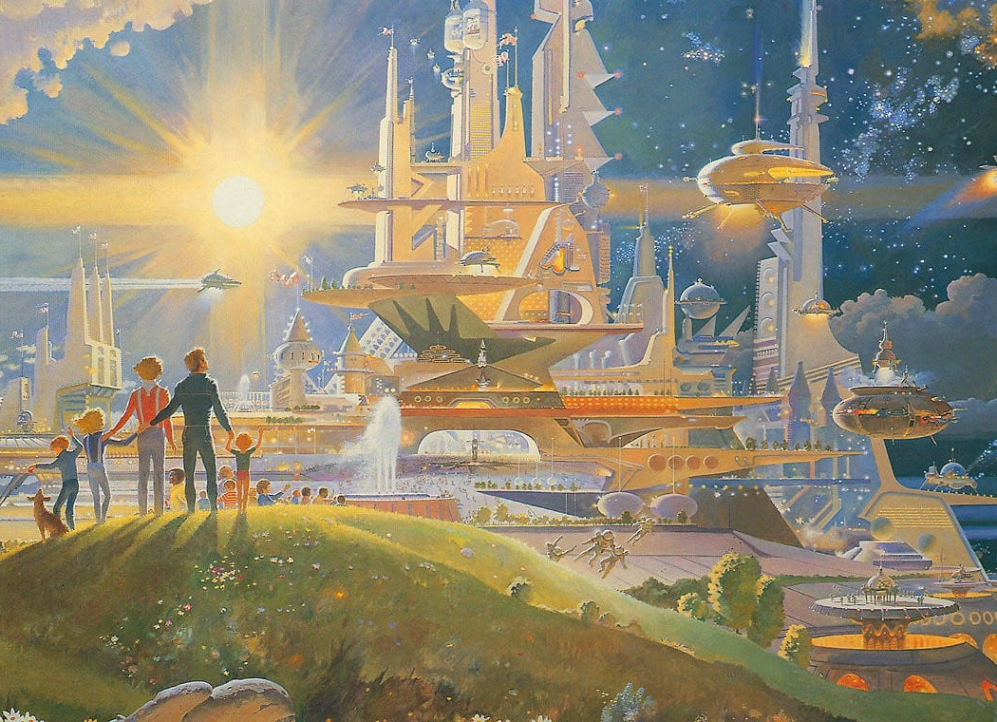
Zootopia
＝
Zoo
＋
utopia

Slide 5
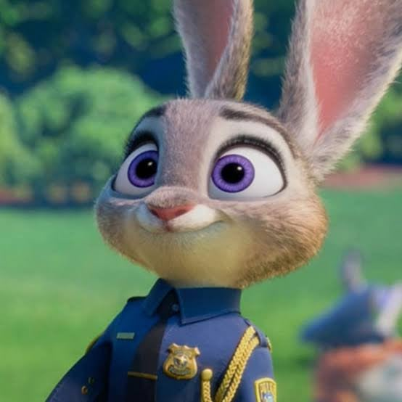
Zootopia is Disney movie
that follows the story of
Judy Hopps
a rabbit who becomes a police officer
and works to overcome prejudice
in the city of Zootopia.

Slide 6


Singer: Shakira (Isabel Mebarak Ripoll)
・Columbian Latin pop singer-songwriter
・Born in February 2, 1977
・Known for hit songs such as "Whenever, Whenever"
・She has been writing lyrics and composing music since she was 8!!
In the film, it is featured as a song recorded by a singer named Gazelle (voiced by Shakira)

Slide 7
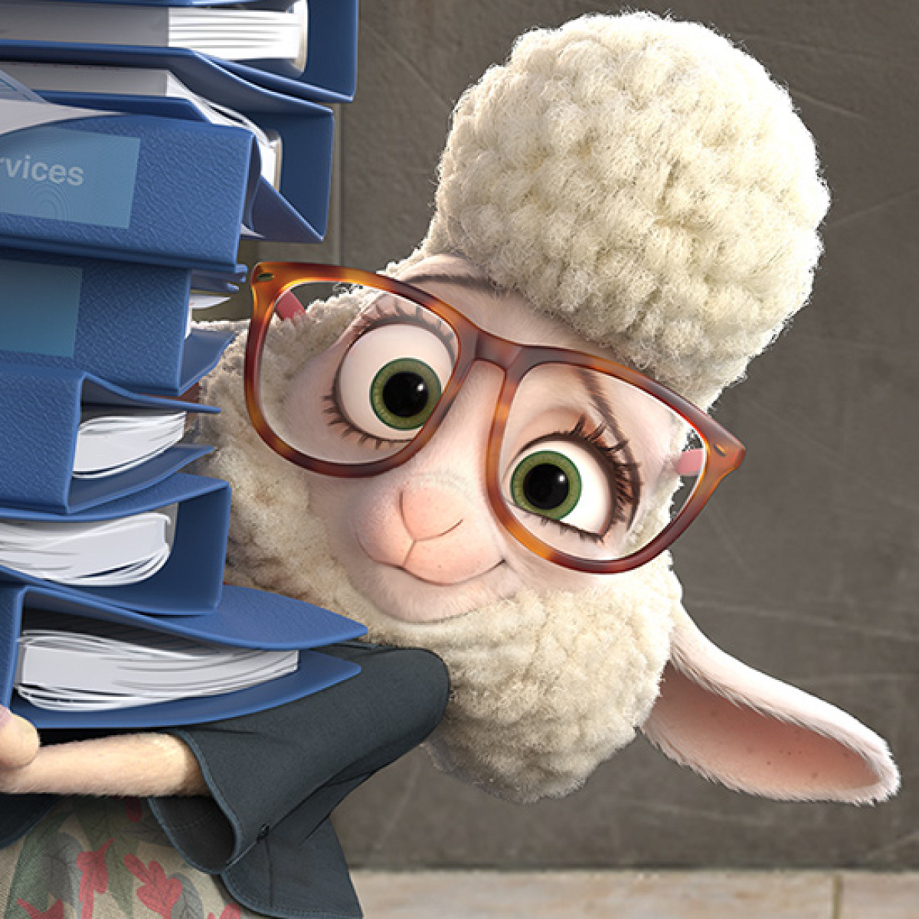
Words from Lyrics
Mess up ・・・to spoil or damage something, or to do something wrong or badly
Gettin' ・・・getting.
Wanna ・・・ want to
'Til ・・・until
Let’s check some difficult words!!

Slide 8
Give up? Give in?
What is the difference between “give up” and “give in”?
Give up
to stop doing something before you have finished it, usually because it is too difficult
Give in
to accept that you have been defeated and agree to stop competingor fighting

Slide 9
This is our favorite sentence!
Don't beat yourself up
No need to run so fast
Sometimes we come last
But we did our best

Slide 10
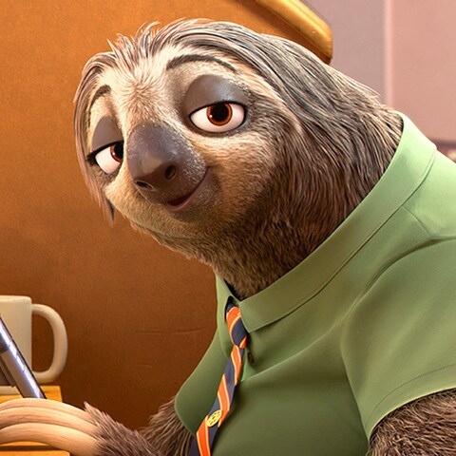
Le〜t's si〜ng wi〜th u〜s!!

Slide 11
Quiz!!!
①What the meaning is"zootopia"?
A.zoo+topia
B.zo+otopia
C.zoo+utopia
D.zo+outopia.
Answer : C

Slide 12
②which is the name of the singer right?
A.shiken
B.shalira
C.shlaol
D.shakira
Answer : D

Slide 13
③ Please fill the blank : Some time we ( ) last
A.go
B.come
C.realize
D.reach
Answer : B

Slide 14
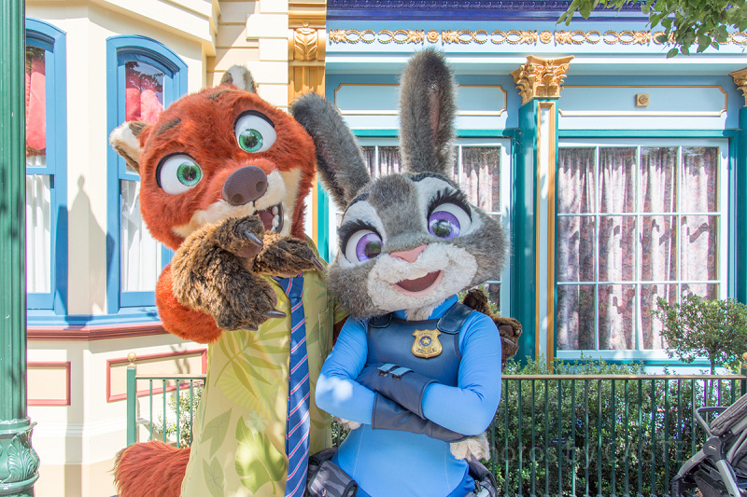
Thank you for listening !!

