Slide 1
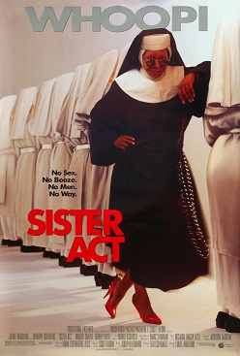

Sister Act

Slide 2
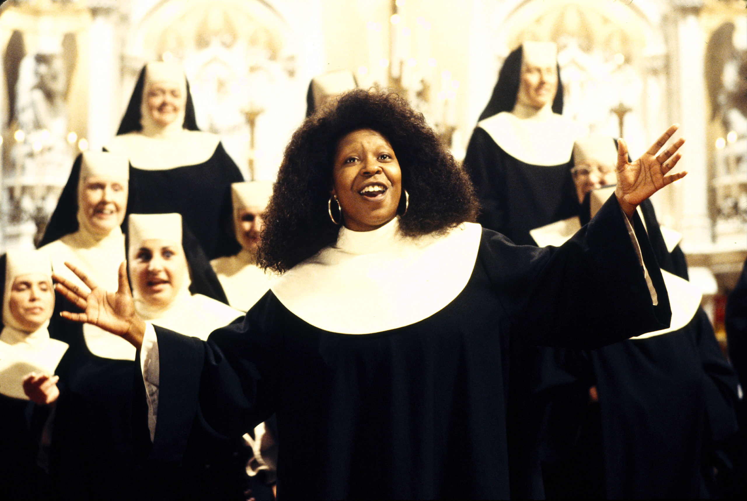
Why sister act?
This is because it is one of my favorite films. This is a musical comedy film which will make you happy. This film has many songs, and they are very beautiful and enjoyable. If you become interested in this film after reading this material, you should watch the full version.

Slide 3
Characters and Background
Sister Mary Clarence (Deloris)
Main Character of this film. She was a lounge singer, but after she witnessed her boyfriend committing murder, police told her to disguise herself as a nun to hide from him. It was difficult for her to adapt to the life in the monastery where there are many strict rules. However, she succeeded in reviving the church’s popularity by improving the choir’s performance and doing many other innovative things.

Slide 4
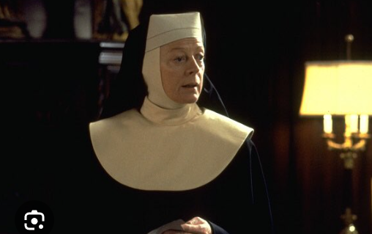
Characters and Background
Reverend Mother
Head nun of St. Katherine’s, the monastery where Deloris lives as a nun. She is very strict and prefers traditional ways. Therefore, she is at odds with Deloris, who is vulgar and adopts innovative ways.

Slide 5
About the scene
The choir did a great and innovative performance thanks to Sister Mary Clarence (Deloris), and many people started coming to the church to listen to the performance. All nuns were excited, and they liked how Sister Mary Clarence changed the church. They started going out the monastery and interacting with neighbors to make their town better. However, only Reverend Mother, who values tradition, opposes Sister Mary Clarence. One day, Sister Mary Clarence told by the police that she could go home, and she visited Reverend Mother’s room.

Slide 6

Why did I choose this scene?
Reverend Mother is a very strict and strong person. However, she first tells her worries and the lack of confidence in the conversation with Sister Mary Clarence. These two characters are always in conflict, but in this scene, Sister Mary Clarence is trying to encourage Reverend Mother. That is why I like this scene.
Here is the clip
https://www.youtube.com/watch?v=lgL1W8Gvb4g

Slide 7
Vocabulary
word | definition
Resignation(n) | The act of telling your employer that you are leaving your job
Monsignor(n) | A title used with the name of a Roman Catholic priest of high rank
Relocate(v) | To move or move something or someone from one place to another
Obsolete(adj) | Not in use anymore, having been replaced by something newer and better or more fashionable
Rabble(n) | A large, noisy, uncontrolled group of people

Slide 8
Vocabulary
word | definition
Rouse(v) | To wake someone up or make someone more active of excited
Sweep(v) | To clean something, especially a floor by using a brush to collect the dirt into one place from which it can be removed
Vanish(v) | To disappear or stop being present or existing especially in a sudden, surprising way
Formidable(adj) | Strong and powerful, and therefore difficult to deal with if opposed to you
Relic(n) | An object, tradition, or system from the past that continues to exist

Slide 9
Vocabulary
word | definition
Misplace(v) | To lose something temporarily by forgetting there you have put it
Tambourine(n) | A small musical instrument consisting of a circular wooden frame with metal discs loosely attached to it, shaken of his with the hand to make the discs ring

Slide 10
Engaging Questions 1
Comprehension check
True or False
Reverend Mother was fired by monsignor O’hara.
Reverend Mother thinks that she is of no use in this monastery.
Sister Mary Clarence has already worked in the monastery for one year.
Reverend Mother thinks that her way of managing the monastery is outdated.
Finally Reverend Mother admitted that Sister Mary Clarence’s reform was good.
Sister Mary Clarence believes that Reverend mother can continue the changes.

Slide 11
Engaging Questions 2
Dictation
A) Well. Seems like your ( ) ( ) ( ) ( ).
（0:00~)
B) I’ve asked to be relocated as soon as possible. But why? I must go where ( ) ( ) ( ) ( ) ( ).
(0:19~)
C) Look, everything that’s happening here is a good thing. Sister, you can ( ) ( ) ( ) ( ) ( ).
(0:48~)
D) Mary Clarence, ( ) ( ) ( ) ( ) to rabble rouse to sweep into town
(0:56~)
E) They imagine this neighborhood to be some sort of ( (delightful) (ongoing ) (bake ) (sale )
(1:05)

Slide 12
Post-task
What I learned from this clip?
Conflict among people who engage in religion
From this scene, I learned that religious leaders may face the problem whether they adjust to the changes of the time or keep their tradition. It is a very difficult issue. This is because if they don’t adopt new things, people, especially the young will lose interests in their religion, but if they change everything, they might lose their tradition and the value of their religion.

Slide 13
Post-task
What I learned from this clip?
The features of spoken words
Spoken English often includes shortened forms. In this clip, “gonna” is used instead of “going to.” In addition, many short sentences are used in this clip, for example, “But why?” and “I suppose.” Sometimes it was difficult for me because I get used to make long and perfect sentences in English class. I learned that in the natural conversation in English, we do not always need to make a perfect sentence. Instead, we can create a conversation together with the person we are talking to by complementing each other with short words.

Slide 14
Post-task
What I learned from this clip?
Miscommunication: Understanding metaphorical lines
In this clip, there are several metaphorical lines. In order to understand them, I had to think carefully about the background. In addition, some words are difficult to understand because I am not familiar with the culture of English-speaking countries. For example, “bake sale” is a sale of home-baked items to raise money for a charity or an event. Japan doesn’t have such culture, so it is difficult to imagine what it implies. To Understand English, sometimes it is necessary to know the culture of English-speaking countries as well as the language itself.

Slide 15
Fun activity
Several metaphorical lines are used in this clip. Let’s think and discuss what those metaphors mean based on the background of this scene.
“It is one thing to rabble rouse to sweep into town and declare a holiday”
“They imagine this neighborhood to be some sort of delightful ongoing bake sale”
“I have misplaced my tambourine”

Slide 16
Answers
Engaging Questions
Question 1 comprehension check
1- F
2- T
3- F
4- T
5- F
6- T
Question 2 dictation
A) Prayers have been answered
B) I can be of use
C) Still be part of it
D) It is one thing
E) Delightful ongoing bake sale
Fun Activity (example answers)
Going out the monastery and interacting with virgular people is completely different from traditional role of church.
Nuns assumed that it is easy to change the neighborhood.
Unlike Sister Mary Clarence, Reverand Mother does not have talent of music

Slide 17
Script
Well. Seems like your prayers have been answered.
I'm gonna be out of here in a week. I’m leaving.
You are leaving?
Yeah.
That makes two of us.
What do you mean?
I have submitted my resignation to monsignor O'hara privately.
I’ve asked to be relocated as soon as possible.
But why?
I must go where I can be of use.
But there’s.. There’s still so much to be done here. Look if it’s about me, I’m gonna be gone.
Indeed. And after how long? A few weeks. I have been here for years.
Well. Too long. I suppose. I’ve become somewhat obsolete.
But you don’t have to continue being obsolete. Look, everything that’s happening here is a good thing. Sister, you can still be part of it.

Slide 18
Part of what?
You know, Mary Clarence, it is one thing to rabble rouse to sweep into town and declare a holiday.
You’ve raised the sister’s expectations.
You’ve excited and confused them.
They imagine this neighborhood to be some sort of delightful ongoing bake sale.
Now you and I know things are not so simple.
There’ll be disappointments and rude shocks, and you will have vanished.
How fortunate.
Look, I just got things going. You are a formidable woman. You could keep this going.
Could I? Even if I wanted to know, I feel I am a relic. And I have misplaced my tambourine.
Good day Mary Clarence.

