Slide 1
Six behaviors to increase your confidence by Emily Jeanson
https://www.ted.com/talks/emily_jaenson_6_tips_for_building_your_confidence/transcript?subtitle=en

Slide 2

Why I chose this topic
①To work on my confidence
②To maximize our possibilities by gaining confidence
③Because I think this will help people in job hunting
④Because this is spoken by a woman who built her career in a men dominated world of sports, and I think it is empowering for this class

Slide 3
Vocabulary
Promptly
Accolade a mark of acknowledgment : award
with little or no delay; immediately
Partake join in (an activity)
Reinforce strengthen or support
Momentum quantity of motion of a moving body
Propel drive or push something forward
Bolster support or strengthen
Diminish to seem less impressive or valuable

Slide 4

Fun activity
Fill in the blank spots
1.research shows that in order for a person to change, they must start with ________, not _________.
2.Emily says you need __ seconds to be brave.
3.The 3 questions the speaker asked herself were, ___?,____?, and ____?
4. What does she mean by take a seat at the table?
____________.
5. Confidence is born in __________.

Slide 5

Discussion
Engagement activity!
What did you learn from this Ted talk?
What can you start now to boost your confidence?
What did you like most in the 6 steps? And why?
What is a way to celebrate little wins for you?
How can you improve your job interviews from this Ted talk?

Slide 6
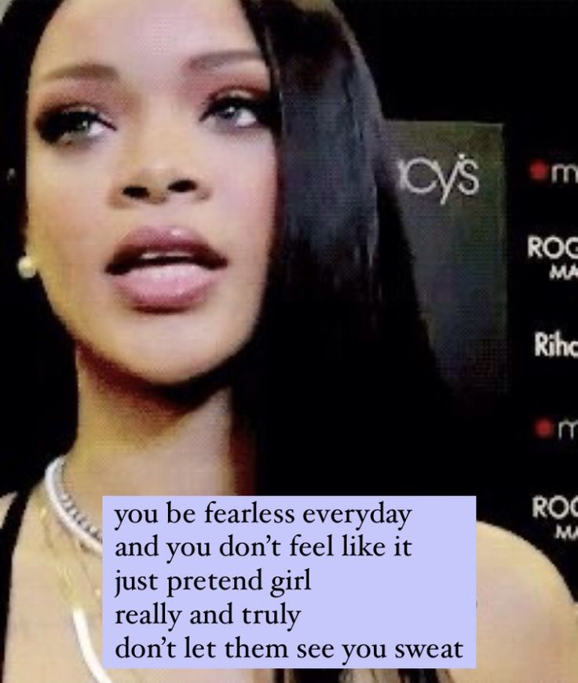
Thank you!
I hope you gain a bit more confidence starting today:)
Here is one famous quote from Rihanna. Even Rihanna pretends to be confident when she does not feel that way:)

Slide 7

Answers
Attitudes, behaviors associated with those attitudes
20
Who am I?, Who do I want to become? How does this person I want to become behave?
Literally sit at the table
All we’ve already done and already achieved

