Slide 1
TED Talks

Slide 2

TED Talk:
Strange answer to
the Psychopath Test
In this podcast, Jon Ronson reveals the gray area between insanity and sanity through his own terrifying experiences.
I've often wondered if psychopath test really accurate? That's why I chose this podcast.

Slide 3


Q1. Have you ever heard “Psychopaths”?
What kind of people are they?

Slide 4
Vocabulaly list
Vocabulary | Meaning
Aloof | Removed or distant either physically or emotionally
Leaf through | To turn a page of book or magazine quickly
Glibness | Smooth-talking or fluency in speaking
Carnage | The killing of many people

Slide 5
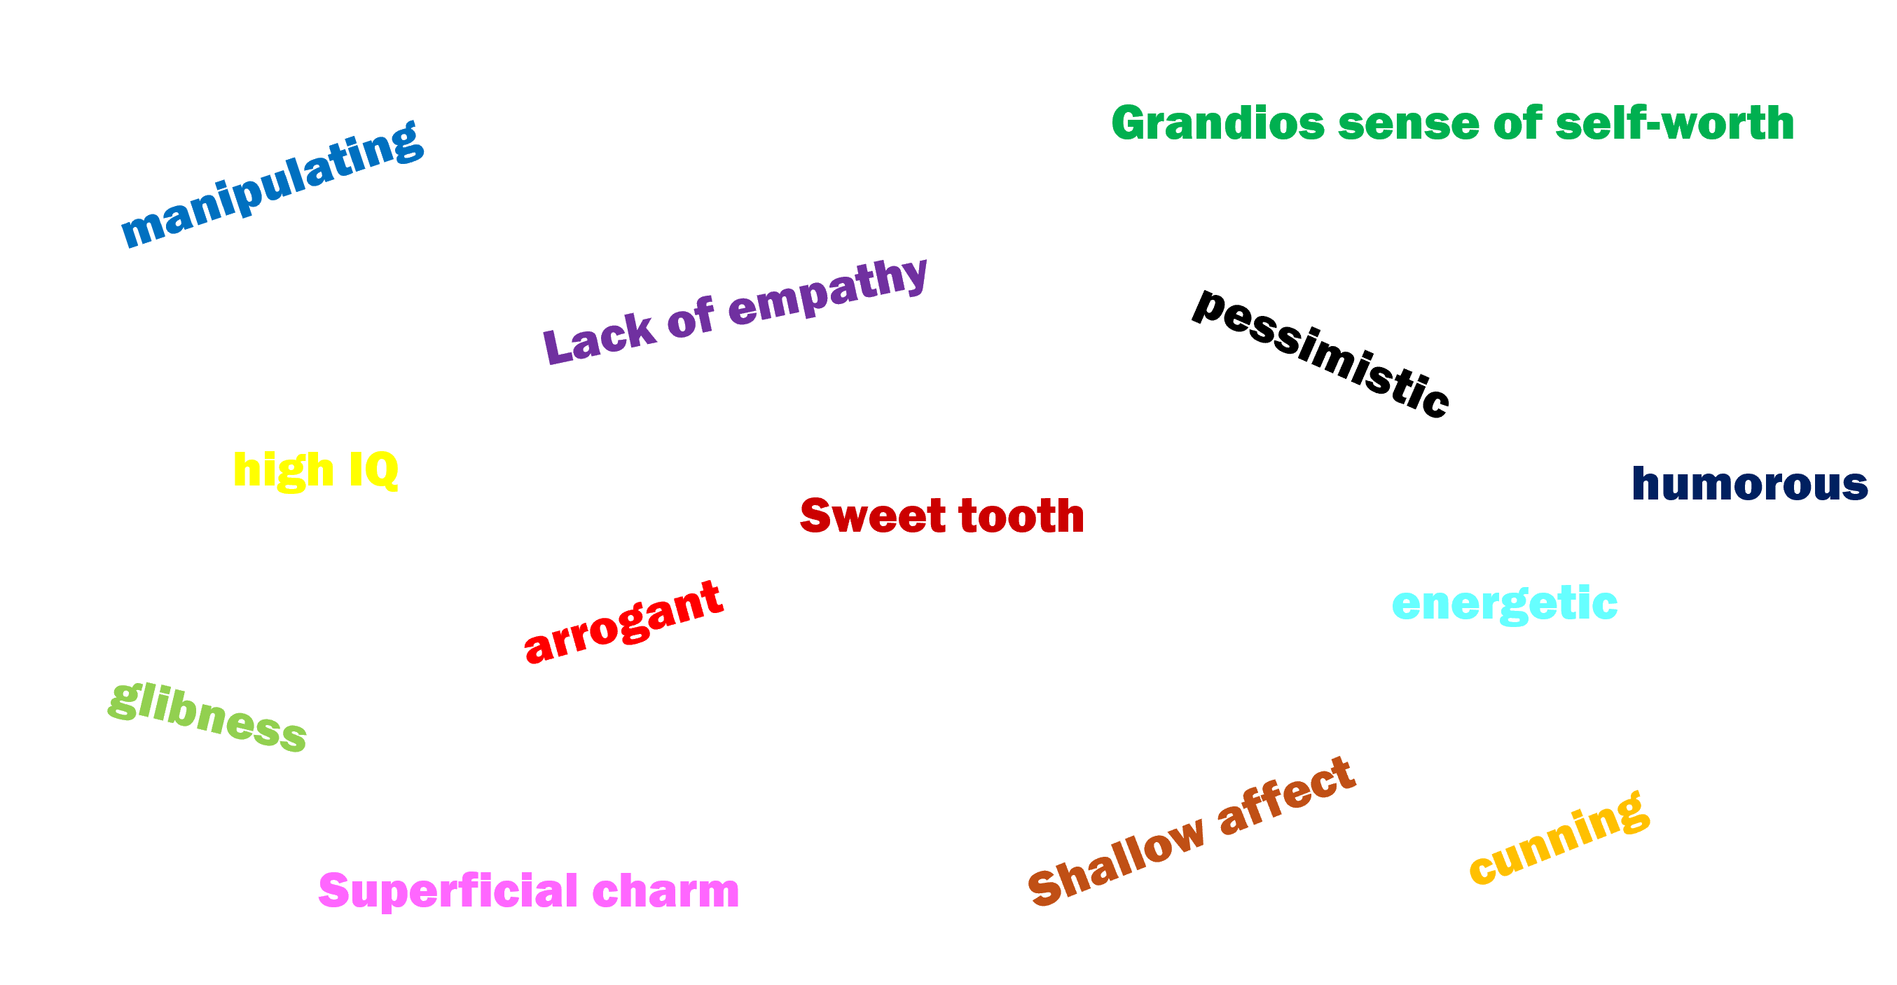
Q2. Circle the characteristics of psychopaths mentioned
in the TED talk

Slide 6
Q3. Why was Tom sent to the Broadmoor?
A.
Q4. What concern does Jon Ronson raise about psychiatric labeling?
A.
Q5. What conclusion does Jon Ronson come to about diagnosing psychopathy?
A.

Slide 7
Answers:
Q1: (possibly answer) A psychopath is a person with a personality disorder marked
by lack of empathy, no guilt, charming behavior, and manipulativeness. They often
act selfishly and can be dangerous, though not all are violent.
Q2: manipulating, glibness, grandiose sense of self-worth, lack of empathy,
cunning, arrogant, shallow affect, superficial charm
Q3:Because he pretended to be insane in order to avoid going to prison for
a violent crime.
Q4: He warns that labeling people with psychiatric diagnoses can be dangerous
when it’s misapplied. People may be distinguished into categories that may not
reflect the full complexity of their personalities.
Q5: He realizes that he was beginning to overanalyze people using the checklist,
seeing psychopathic traits everywhere. He concludes that mental health diagnosis
is nuanced and that it’s dangerous to judge people based on checklists.

Slide 8

Thank you for watching!

