Slide 1
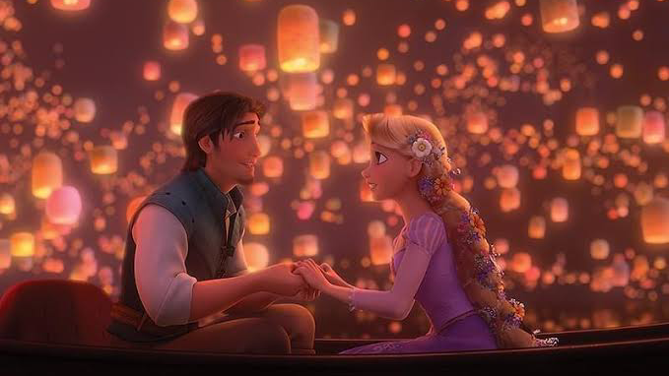
“I See the Light”
From Tangled
Tsubaki, Yuna, Mamiko

Slide 2
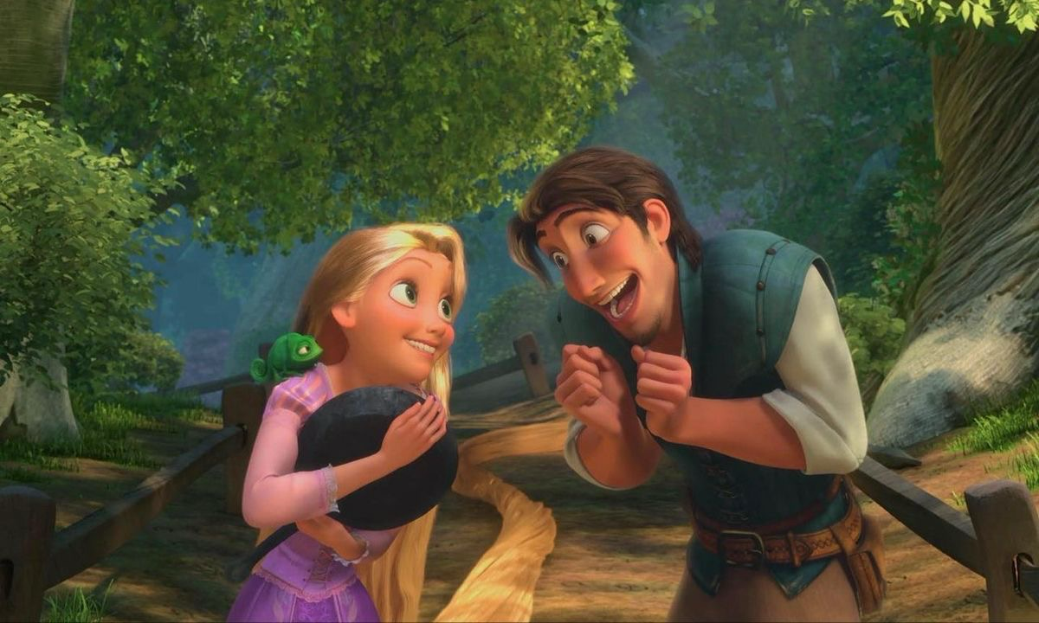

Slide 3
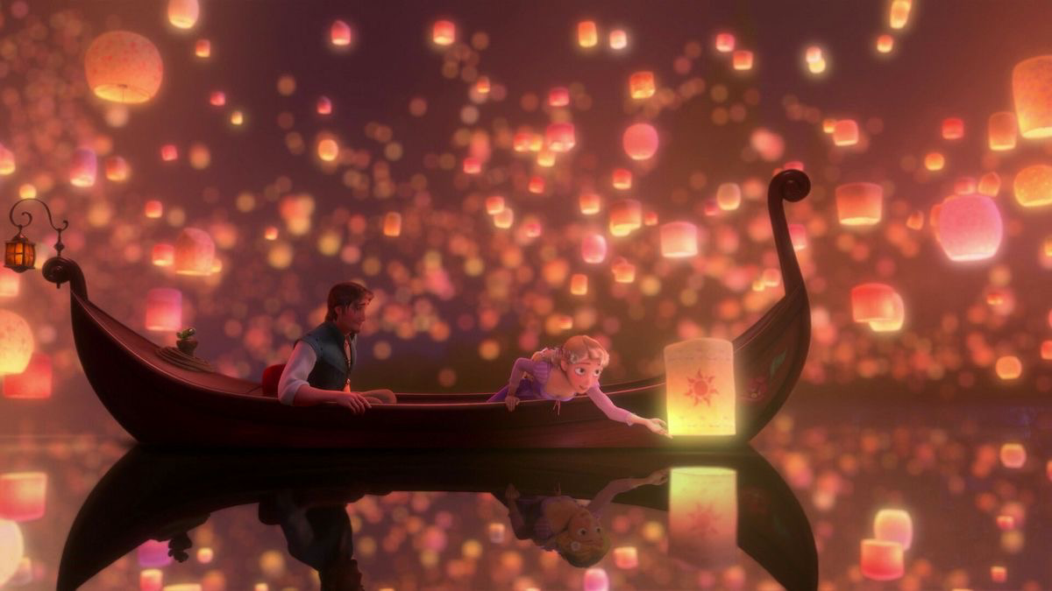

🌟Theme of this song
“Love changes the way we see the world and gives life a new meaning.”
For Rapunzel: finally seeing the lanterns she dreamed of and realizing her true feelings.
For Flynn: finding someone who changes his whole way of life.
Their love begins at this moment, symbolized through light.
✨ Summary
“I See the Light” expresses how love transforms life:
Light = love and truth
Clear vision = new meaning in life
Before/Now contrast = change of heart
Duet = harmony of two hearts

Slide 4


Charming lyrics🎶
“And at last I see the light
And it's like the fog has lifted”
“All at once everything looks different
Now that I see you”
▶︎It expresses the change in their feelings and the new view of the world that love brings.

Slide 5

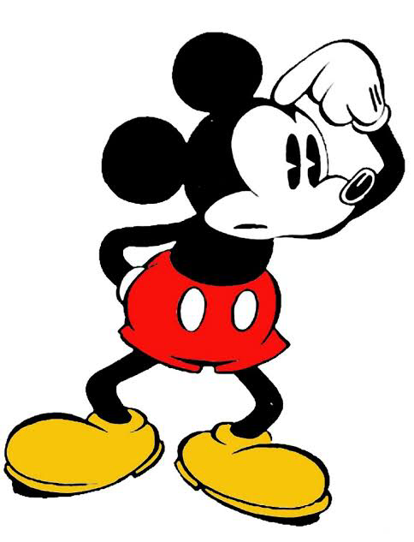
Do you know the movie “Tangled”❓

Slide 6
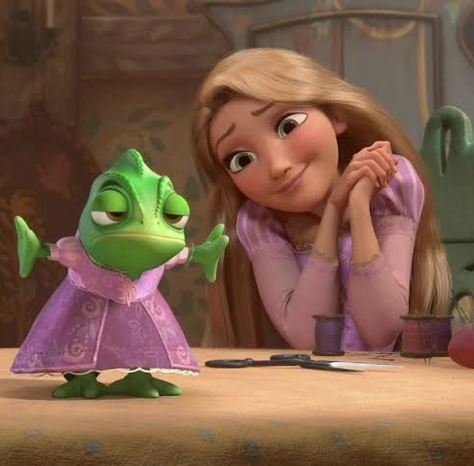
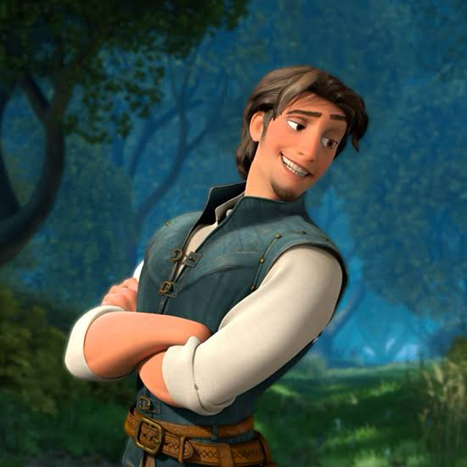
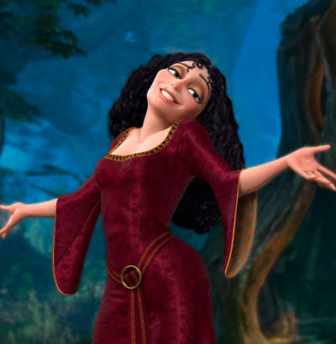
The 50th Disney feature animation
Rapunzel
thief Flynn Rider
witch Mother Gothel

Slide 7
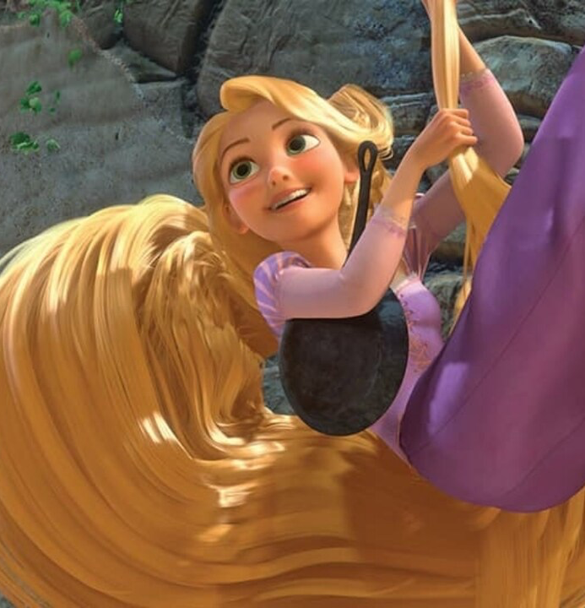
Rapunzel
Princess with long magical hair that glows when she sings a special song, and can rejuvenate people and heal wounds.
Kidnapped by a witch Gothel and imprisoned in a tall tower for a long time.
Her parents flew lanterns on her birthday, hoping for her safety.
From inside the tower, she always hoped to one day see the lantern up close.
This is the story of Rapunzel's adventure to go outside and make her dreams come true.

Slide 8

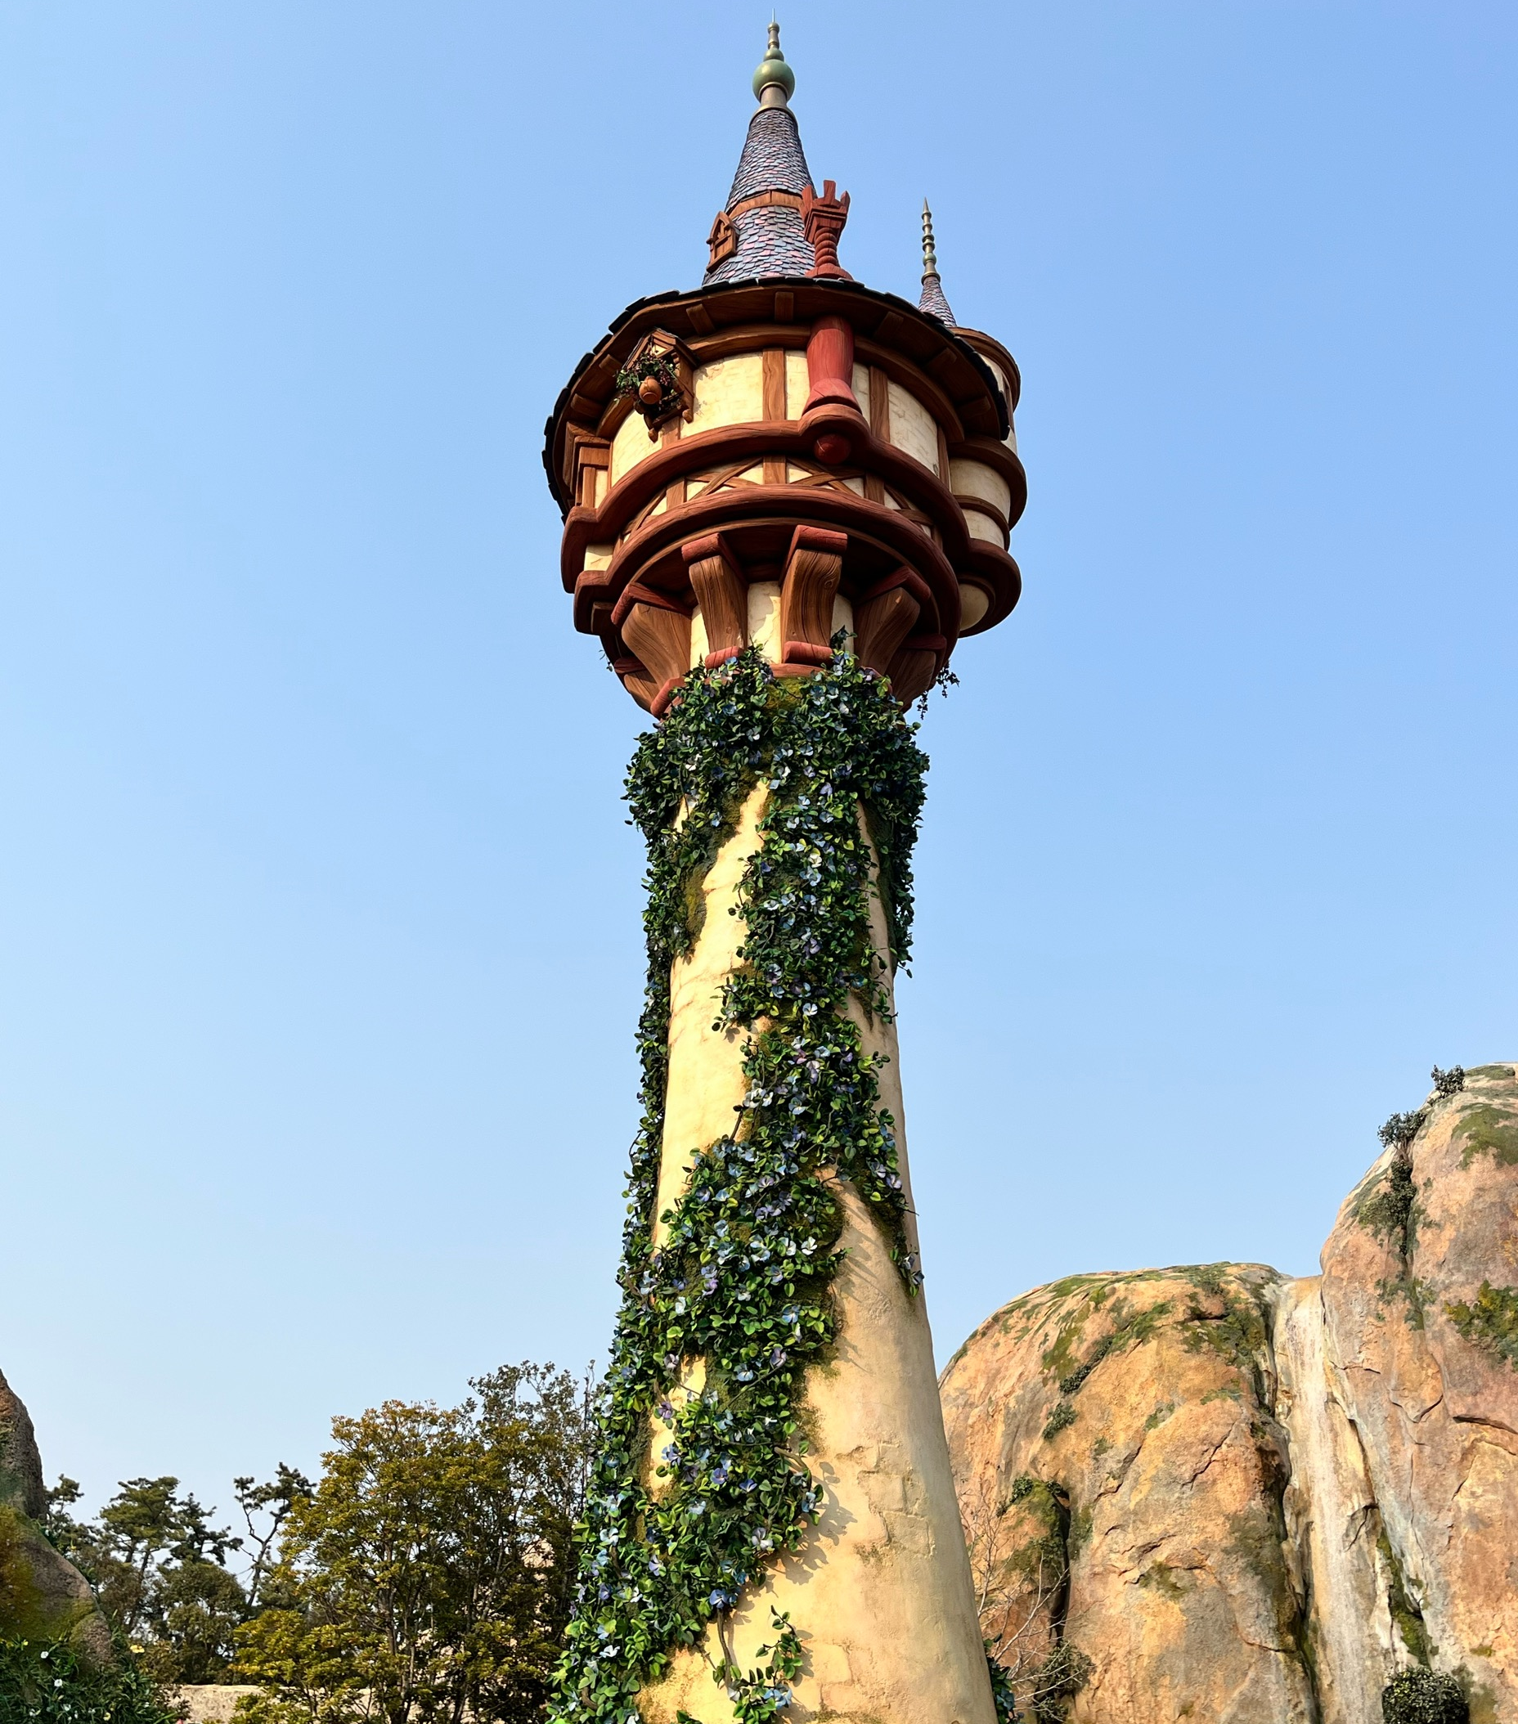
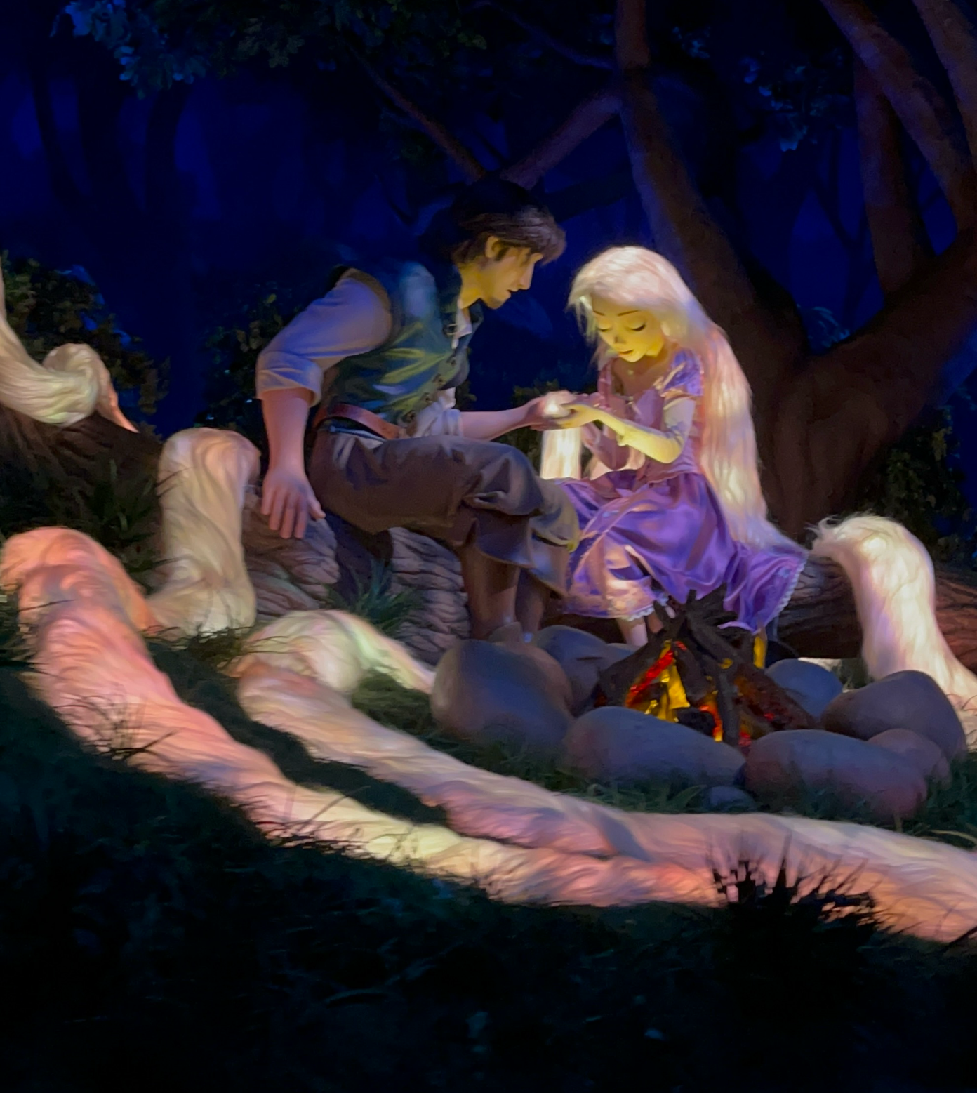
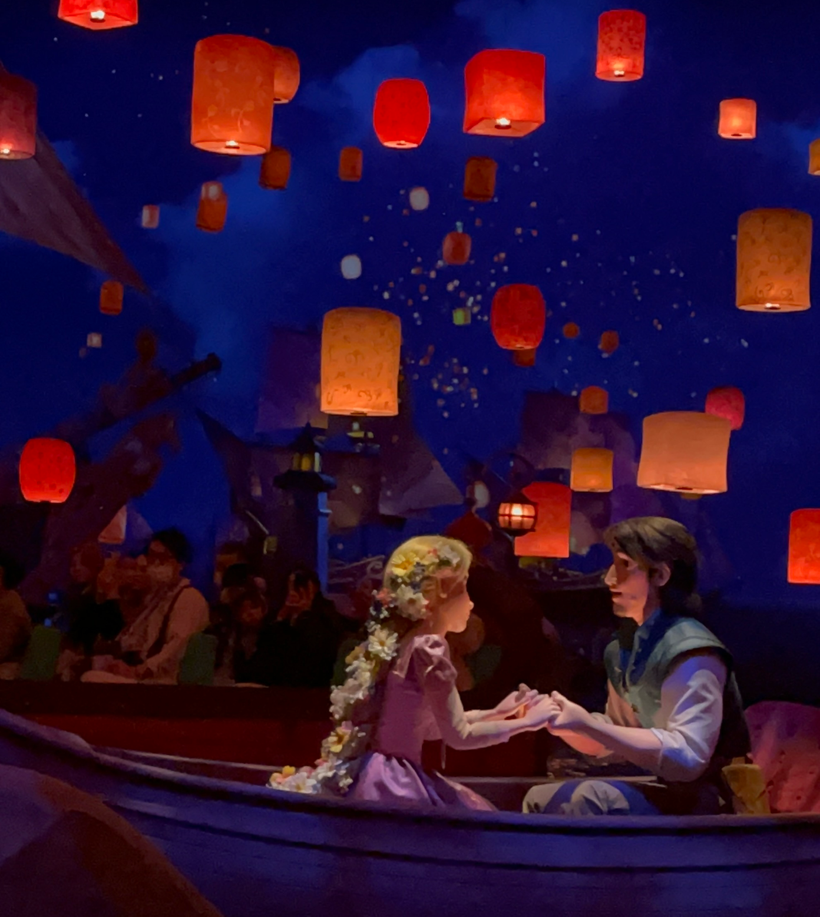
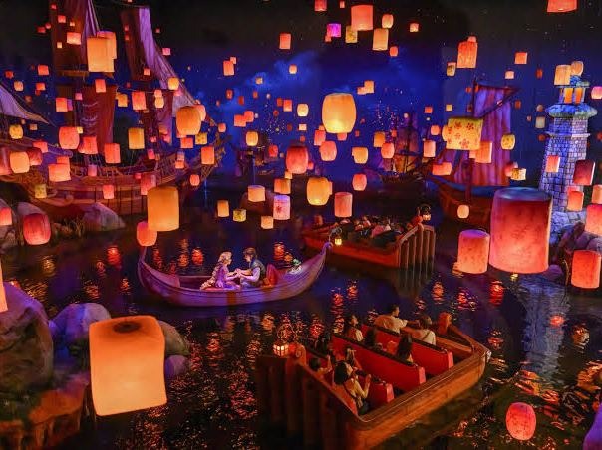

Rapunzel’s Lantern Festival in Fantasy Springs, Tokyo Disney Sea

Slide 9
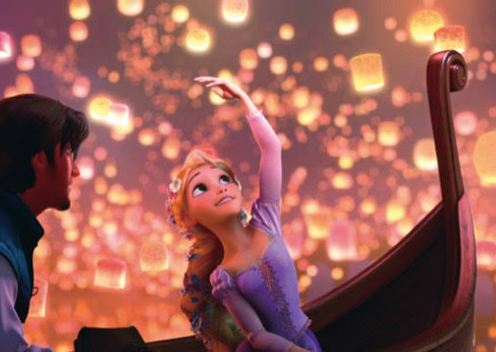
About this song
Music by Alan Menken
Lyrics by Glenn Slater
Sung by Mandy Moore and Zaccharine Levi
Emotional ballad plays during the scene where Rapunzel's dream comes true.

Slide 10
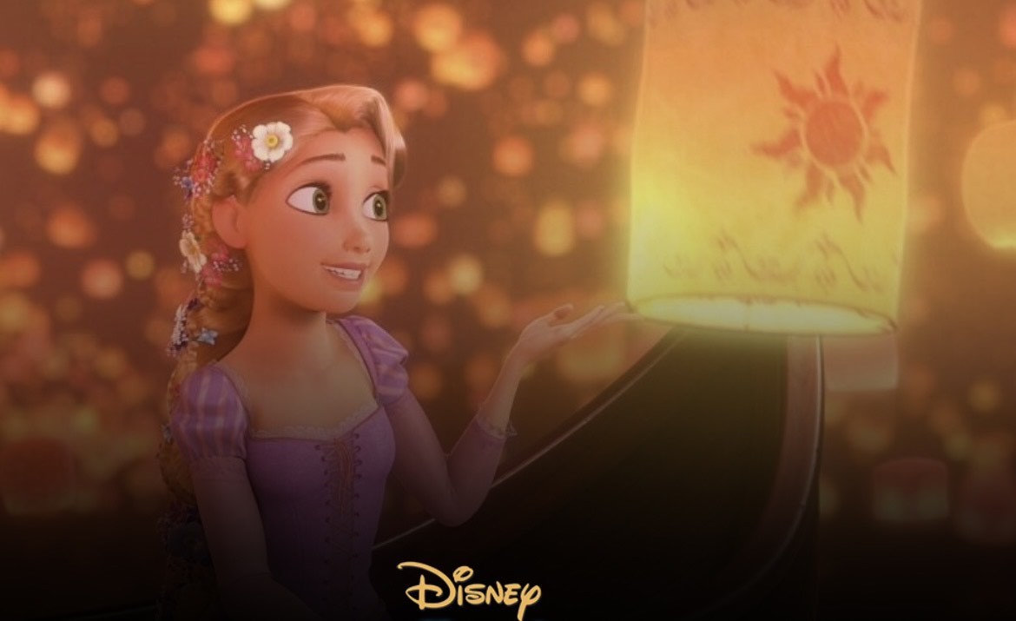
Let’s listening to
「I See the Light」！
Mandy Moore, Zachary Levi - I See the Light (From "Tangled"/Sing-Along)

Slide 11
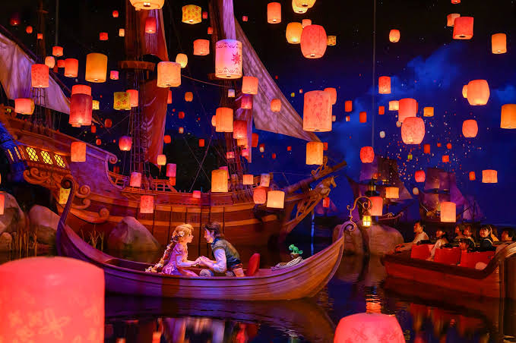
Check your answers！！
①the windows
②blind
③in the starlight
④clear
⑤at last
⑥in a blur
⑦crystal clear
⑧lifted
⑨warm
⑩real
⑪bright

Slide 12
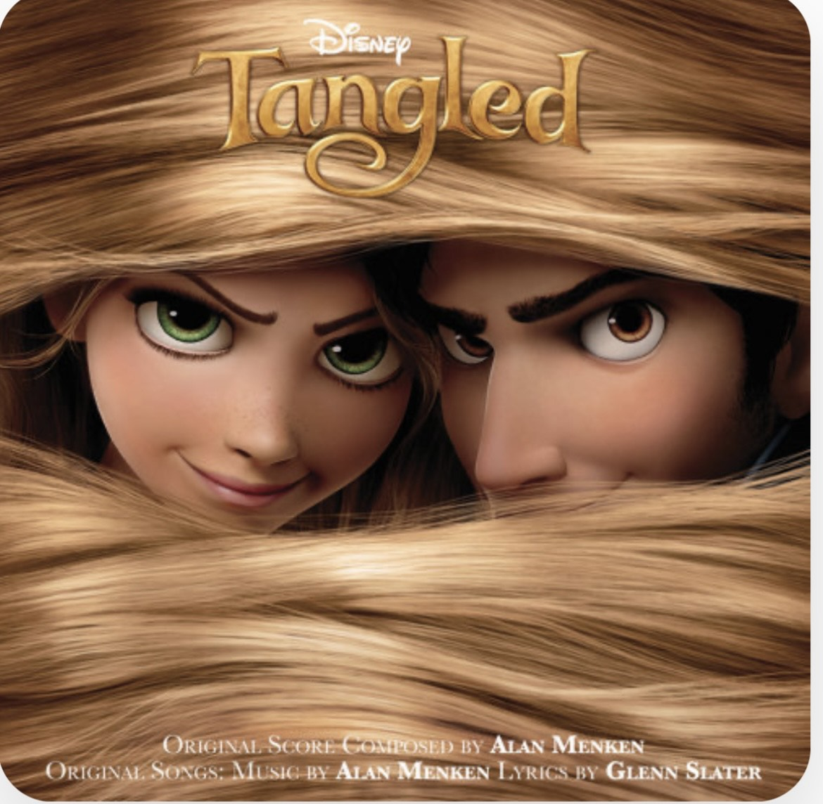
Quiz！！！！
①How long is Rapunzel’s hair?
②Flynn Rider is character in Rapunzel.
But Flynn Rider is not his real name.
What is his real name?
③What book is the original story of Rapunzel in?
https://share.google/a7YONBvh3m2NY26Rp
https://share.google/OJX9I5opkmyOFGeRj
https://share.google/0QcAXh2046iIKZXMp

Slide 13
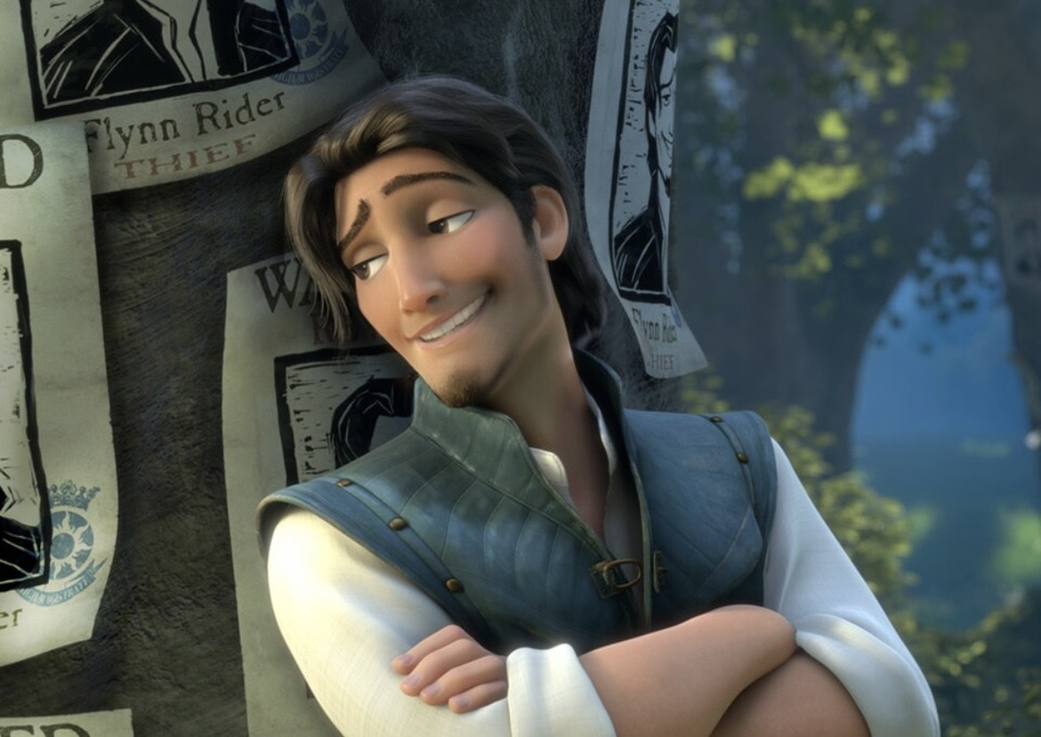
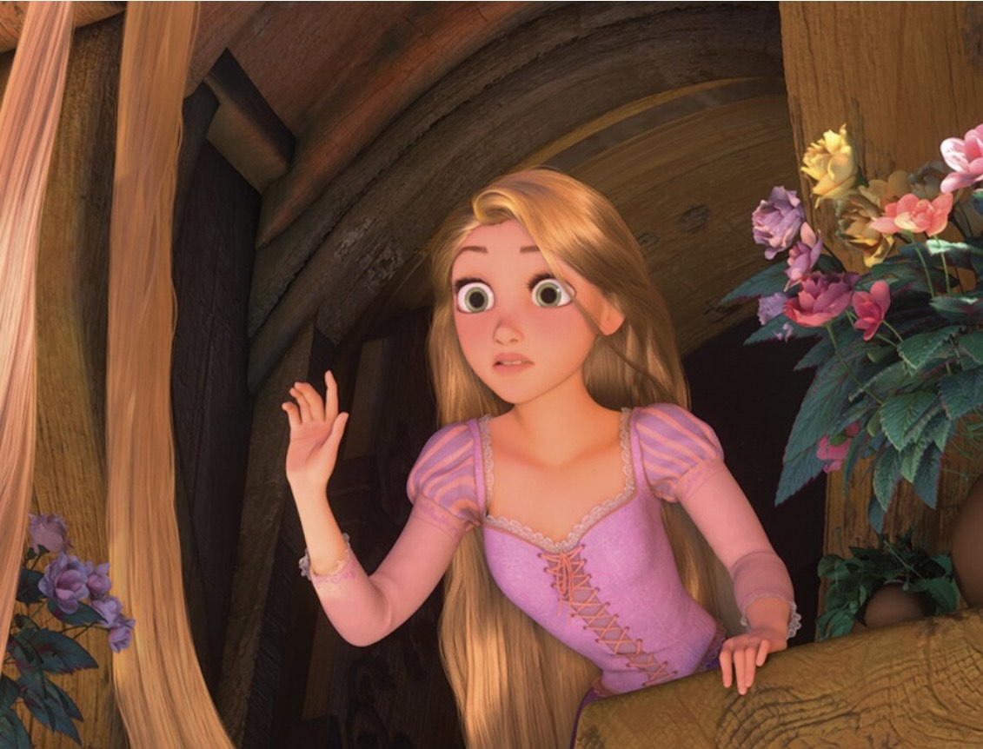
Check your answer!!
①Her hair is about 21 meters long.
②His real name is Eugene Fitzherbert.
③Rapunzel is included in the Grimm’s Fairy Tales.

Slide 14


Let’s practice the key phrase’s pronunciation!
①And a(t) last I see the light
②An(d) it’s warm and real an(d) bright.
③Now tha (t) I see you
https://share.google/a3KE1HK6HYiCja1bx

Slide 15
Thank you for your attention!

