Slide 1








Cruel Summer
by Taylor Alison Swift

Slide 2

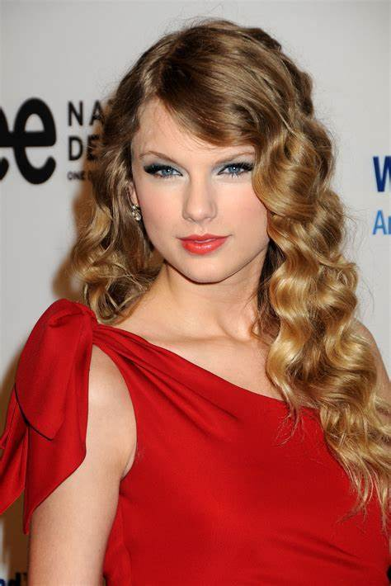

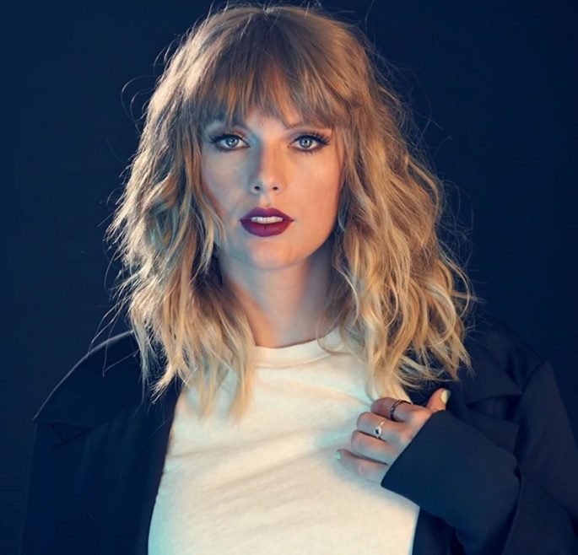
agenda
・Questions to discuss about 『cruel summer』
・Something that we can see in this video
・Useful information about a singer
・Useful information about this song
・Interpretation about this song
・Pronunciation Challenge
・Quiz Question

Slide 3







Question to disucuss about 『cruel summer』
・Have you experienced falling in love with someone?
・Are you falling in love now?
First, look at the movie of”ｃruel summer”
Youtube
Taylor Swift - Cruel Summer (Music Video) - YouTube

Slide 4

Something that we can see in this video
For example……
・A woman enjoys hanging with her friends.★
・A man and woman are hugging and kissing.★
・she is riding a motorcycle.★
・she is standing in the silent forest.★
・She is diving into ice lake.★
・she is pushing his partner with anger.★
★She emphasizes her feeling about love by
by alternating between bright scenes and emotional scenes.”

Slide 5


Useful information about a singer
Taylor Swift
A red lip
14 Grammy Awards and 46 nominations
Pennsylvania,U.S.A
1989, December 13
10 awards in 10 categories

Slide 6
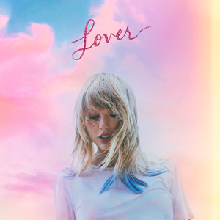



Useful information about this song
This song is a song from Taylor Swift's 2019 album "LOVER".
It was not a single song at the time of its release.
It has crossed the 4 year mark and reached No.1 in the United States.

Slide 7


Interpretation about this song
The theme of this song is by her real experience.
She can’t stop meeting with a man who hurts her.
⇒It’s because she falls deeply in love with him.
He is the most favorite man in the world for her.

Slide 8


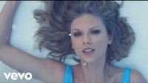
Pronunciation Challenge
Then, please prepare the vocabulary sheet.
Let’s listen to ‘Cruel summer’ again and try to fill in the brank !
https://youtu.be/GrKQvyXpNgc?si=YN1UL8aVMw12dxzt

Slide 9
Pronunciation Challenge
Next, work on one part and practice !
And it’s ne - w, the shape of your body It’s bl - ue, the feeling I’ve got and it’s
Ooh, who – a oh It’s a cru - el sum - mer
And it’s co - ol, that’s what I tell’em No ru - les unbreakable heaven
But ooh, who – a oh It’s a cru - el sum - mer

Slide 10









Quiz Question
①How many men have Taylor dated so far?
→At least , more than 12 men!!!
②This year, the live of Taylor swift was held in TOKYO DOME. How many people did you come for four days?
→ It’s about 220000 (two hundred twenty thousand people)
③ How many albums did Taylor release up to now?
→ She has a total of 46 albums.
④When did Taylor release her debut album?
→It’s 2006. The name of album is “Taylor Swift”

Slide 11

THANK YOU
+123-456-7890
Nami Sugawara
Yuna Aoki
Nanami Aramaki

