Slide 1

Wouldn't It Be Nice
The Beach Boys

Slide 2
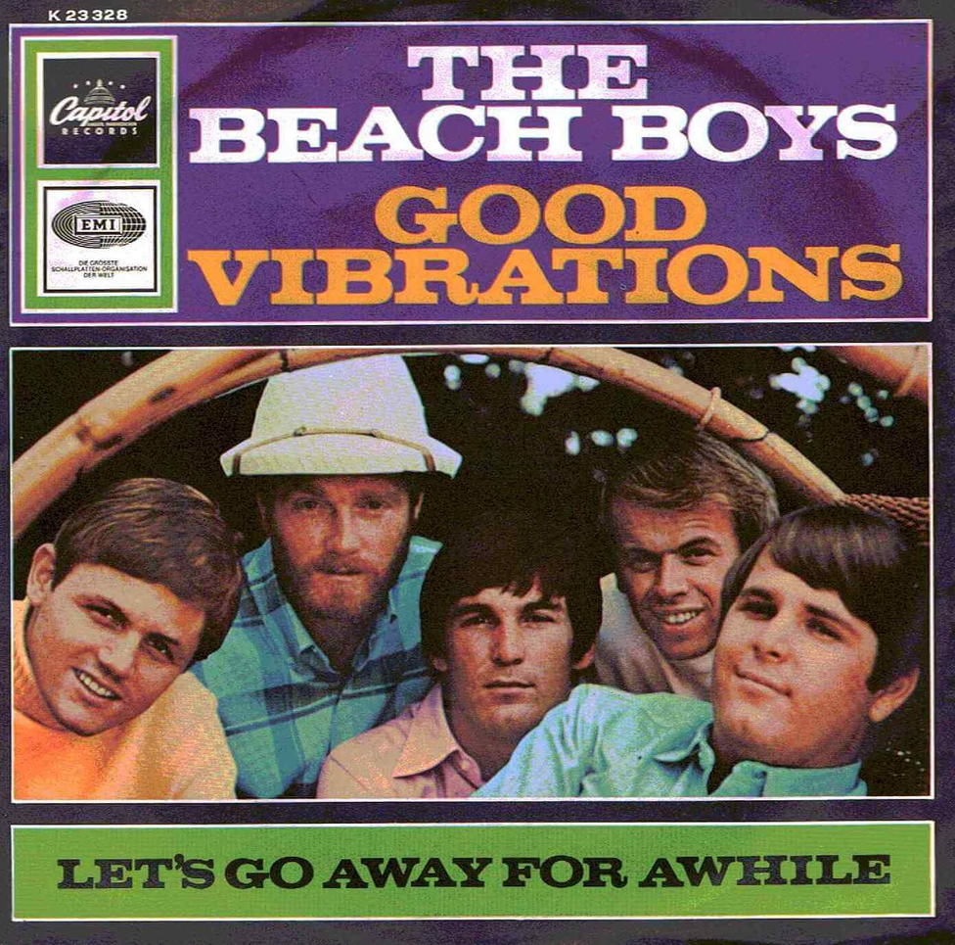

THE BEACH BOYS
Formed in 1961 in California
Symbol of 60s pop music
Original member is
Brian, Carl, Dennis, Mike and Al
Notes:
Hello, everyone. We will introduce `Wouldn’t it be nice`by the beach boys.
The beach boys formed in 1961 in california. They are symbol of 60s pop music. And the original member is…

Slide 3
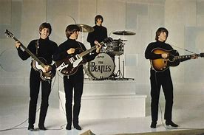
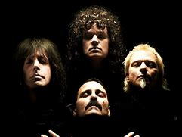
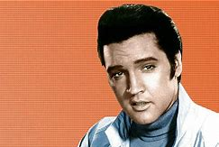
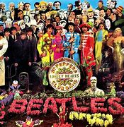
Influence on other musicians
The Beatles Queen Elvis Presley
`Sgt. Pepper's Lonely Hearts Club Band`.
Notes:
In sixties, many hit songs were made. For example, The Beatles, Queen and Elvis presley. They affected to each other. The beatles had inspiration from the beach boys, and they made their symbolic album, sergeant pepper’s lonely hearts club band.

Slide 4
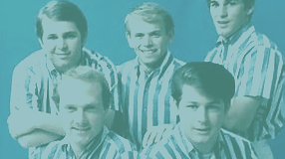
The road of the beach boys
In 1965, Brian suffered a mental breakdown due to the stress
Few years later, some member changed and Dennis and Carl were dead.
They got in trouble many times
but their music always give us power of youth.
Notes:
They have not only glorious achieviment.

Slide 5


“Wouldn’t it be nice if we were older?
Then we wouldn’t have to wait so long,”

Slide 6

Wouldn’t it be nice to stay with you?
=If we could stay with you, it would be nice.

Slide 7
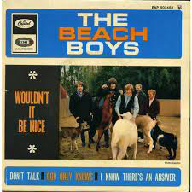
Late-’60s power-pop
Sing a pure romance between two lovers, who long for a little more time together
Appeal the innocence of the situation
–being too young to get married-

Slide 8
Late-’60s power-pop
Sing a pure romance between two lovers, who long for a little more time together
Appeal the innocence of the situation
–being too young to get married-

Slide 9
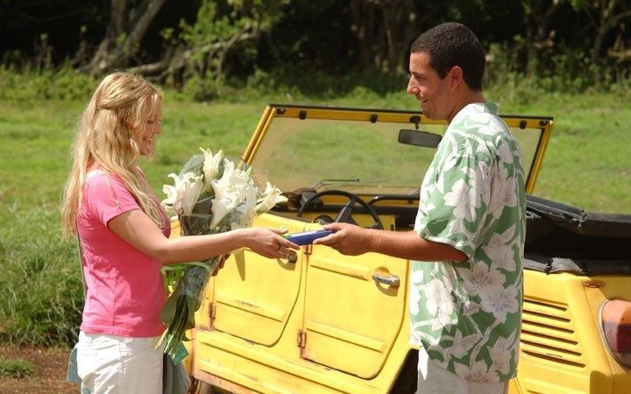
Exciting intro
This song started off with the impressive and cute intro guitar.
According to Brian “this guitar’s sound and the accordion express the excitement of the heart with sound”

Slide 10



