Slide 1
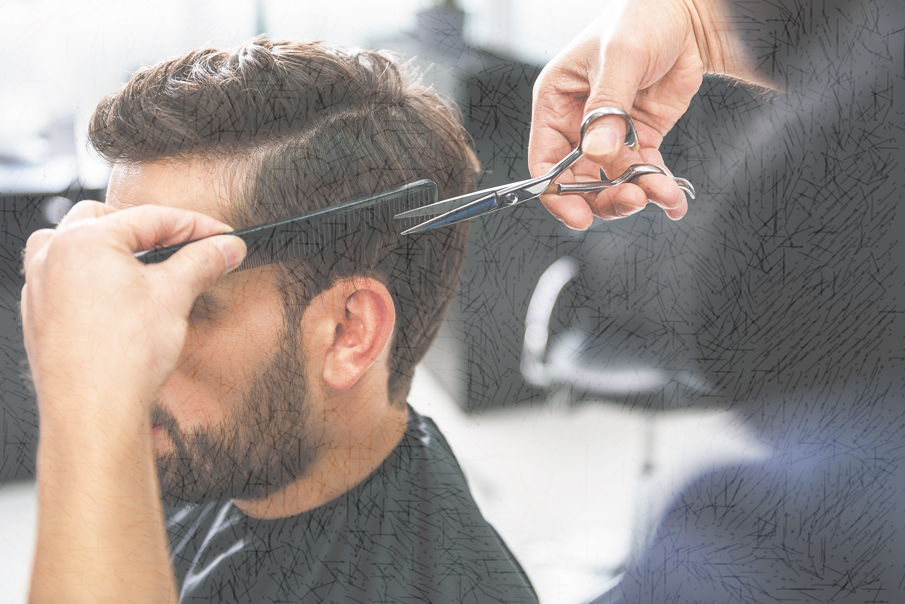
The brain science (and benefits) of ASMR https://www.ted.com/talks/craig_richard_the_brain_science_and_benefits_of_asmr

Slide 2

Why I chose the topic.
I sometimes listen to the nature sounds recorded with ASMR microphones, but I didn’t know why some ASMR contents are so popular. There are so many kinds of ASMR videos on YouTube, such as chewing sound, ear cleaning, sounds of life, whispering etc. What is the benefits of experiencing ASMR?

Slide 3

Before watching the video.
Have you ever watched ASMR videos?
  How was that experience?
If you don’t like it, why you don’t like it?

Slide 4
Vocabulary check.
-Match the words with synonyms.
Sparkling
Meridian
Blissful
Tingle
Insomnia
Meditation
Pros and cons
Soothing
Glittering
Sleeplessness
Strengths and weaknesses
Relaxing
Peak
Creepy
Contemplation
Euphoric

Slide 5
Now, let’s watch the TED Talk!

Slide 6
Let’s check your understandings １
:Fill in the blanks
・The speaker enjoyed the gentle sounds of (a ) right next to his ears.
・The moment of (b ) attention and the soft voice gives him light, (c ), pleasurable brain tingles.
・In the memory of the speaker, he fell asleep with relaxing sounds that Bob Ross makes with his (d ).

Slide 7

Let’s check your understanding 2
:Answer the questions below?
1. What is the full name of abbreviation “ASMR”?
2. When are the region on the brain that are active when watching ASMR videos active in the real world?
3. What is the hormone likely to be secreted(produced) when you experience ASMR?

Slide 8

Discussion topic 1 you can write down what you think about those topics.
Why does some people can’t experience ASMR the same way as others?
If you have experienced ASMR, why do you think you feel good with that? Has something similar to that ASMR videos happened to you in real life?
How did you feel listening to ASMR in the TED Talks video?

Slide 9
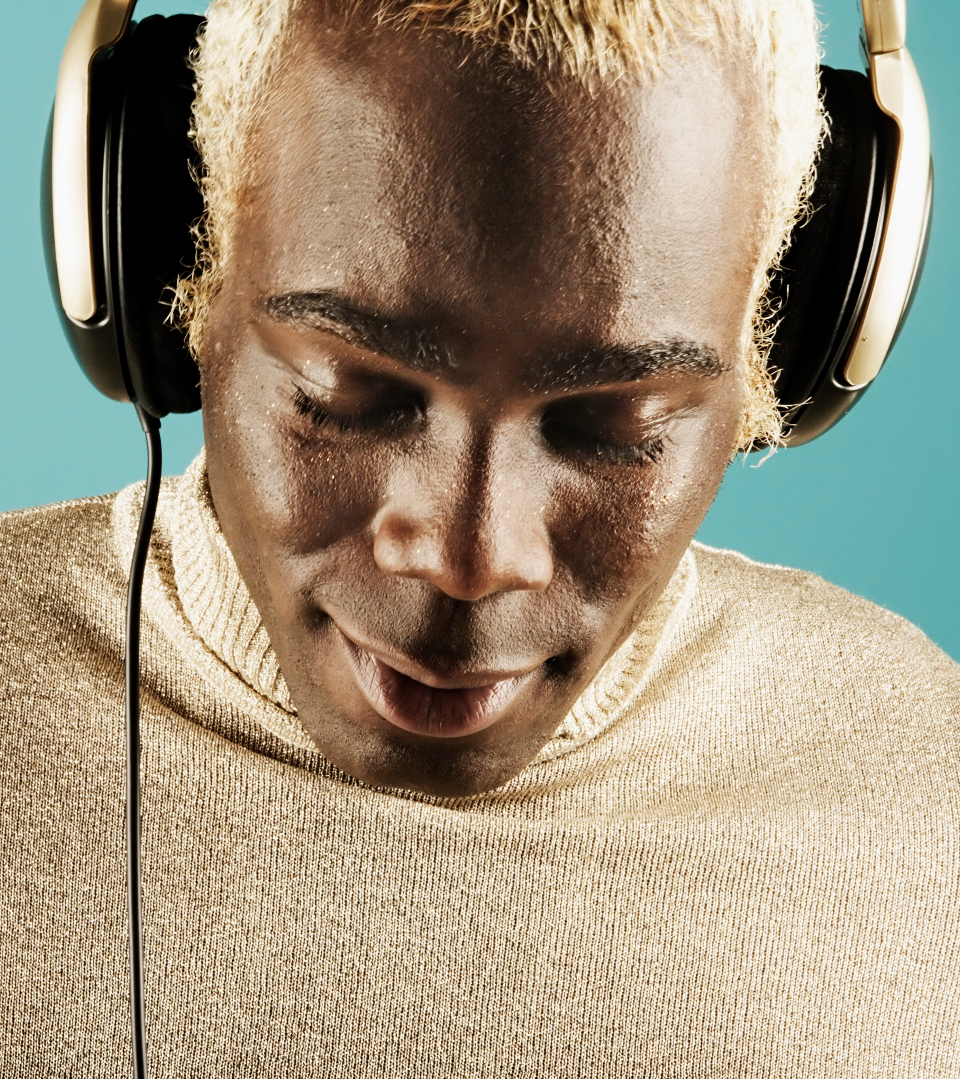
Discussion topic 2
:Further questions
Why do you think ASMR is so popular around the world now?
What might be the benefits of watching ASMR videos?

Slide 10
Answers
Vocabulary
sparkling-glittering, meridian-euphoric, blissful-euphoric, tingle-creepy, insomnia-sleeplessness, meditation-contemplation, pros and cons-strength and weakness, soothing-relaxing.
Check your understanding 1: Fill in the blanks
a-scissors, b-personal, c-sparkling, d-paintbrush
Check your understanding 2: Questions
Autonomous Sensory Meridian Response
When people are receiving positive personal attention from a kind and caring person.
The hormone is Oxytocin.

Slide 11
Thank you very much!

