Slide 1
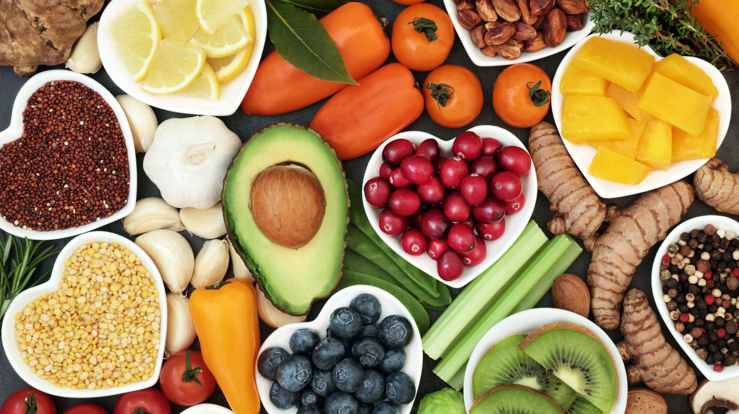
Bye volunteer, Hi new system
6124337 Hatsue Nozawa
https://www.ted.com/talks/jasmine_crowe_houston_the_delicious_potential_of_rescuing_wasted_food

Slide 2
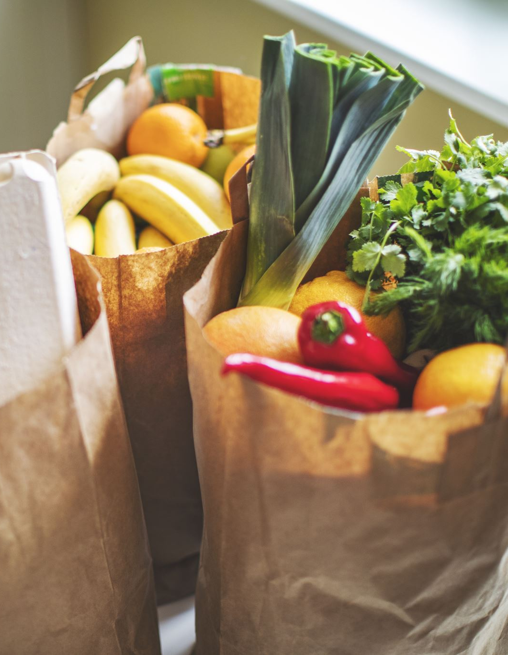
Why chose it?
😊I only knew about donations literally done by volunteer work
😊A lot of us are going to work in a company in the close future, so I thought it was interesting to know about wasted food made from companies. And the people trying to do something about it.
😊To think about the limit of volunteer works.

Slide 3
VOCABULARY
wee hours of the morning : between midnight and the sunrise
onus : a burden, duty, responsibility
compost : decomposed organic material used as fertilizer
anaerobic digester : a system which breaks down organic waste without using oxygen
greenwashing : when a company unintentionally promotes its products or practices as environmentally friendly to appear
linchpin : a key element or person
logistics : the detailed coordination and organization of complex operations
newfound spin : a new perspective, interpretation, or marketing twist given to something
A triple bottom line : the three key performance areas in business. People, Planet, Profit.

Slide 4
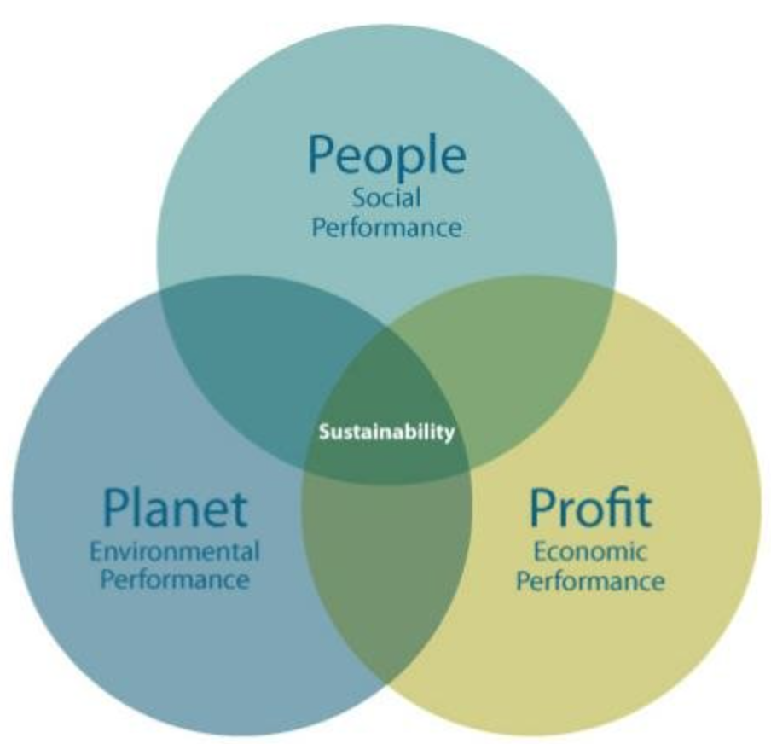
Triple Bottom Line
https://inchainge.com/knowledge/sustainability/what-do-we-know-about-the-triple-bottom-line/

Slide 5
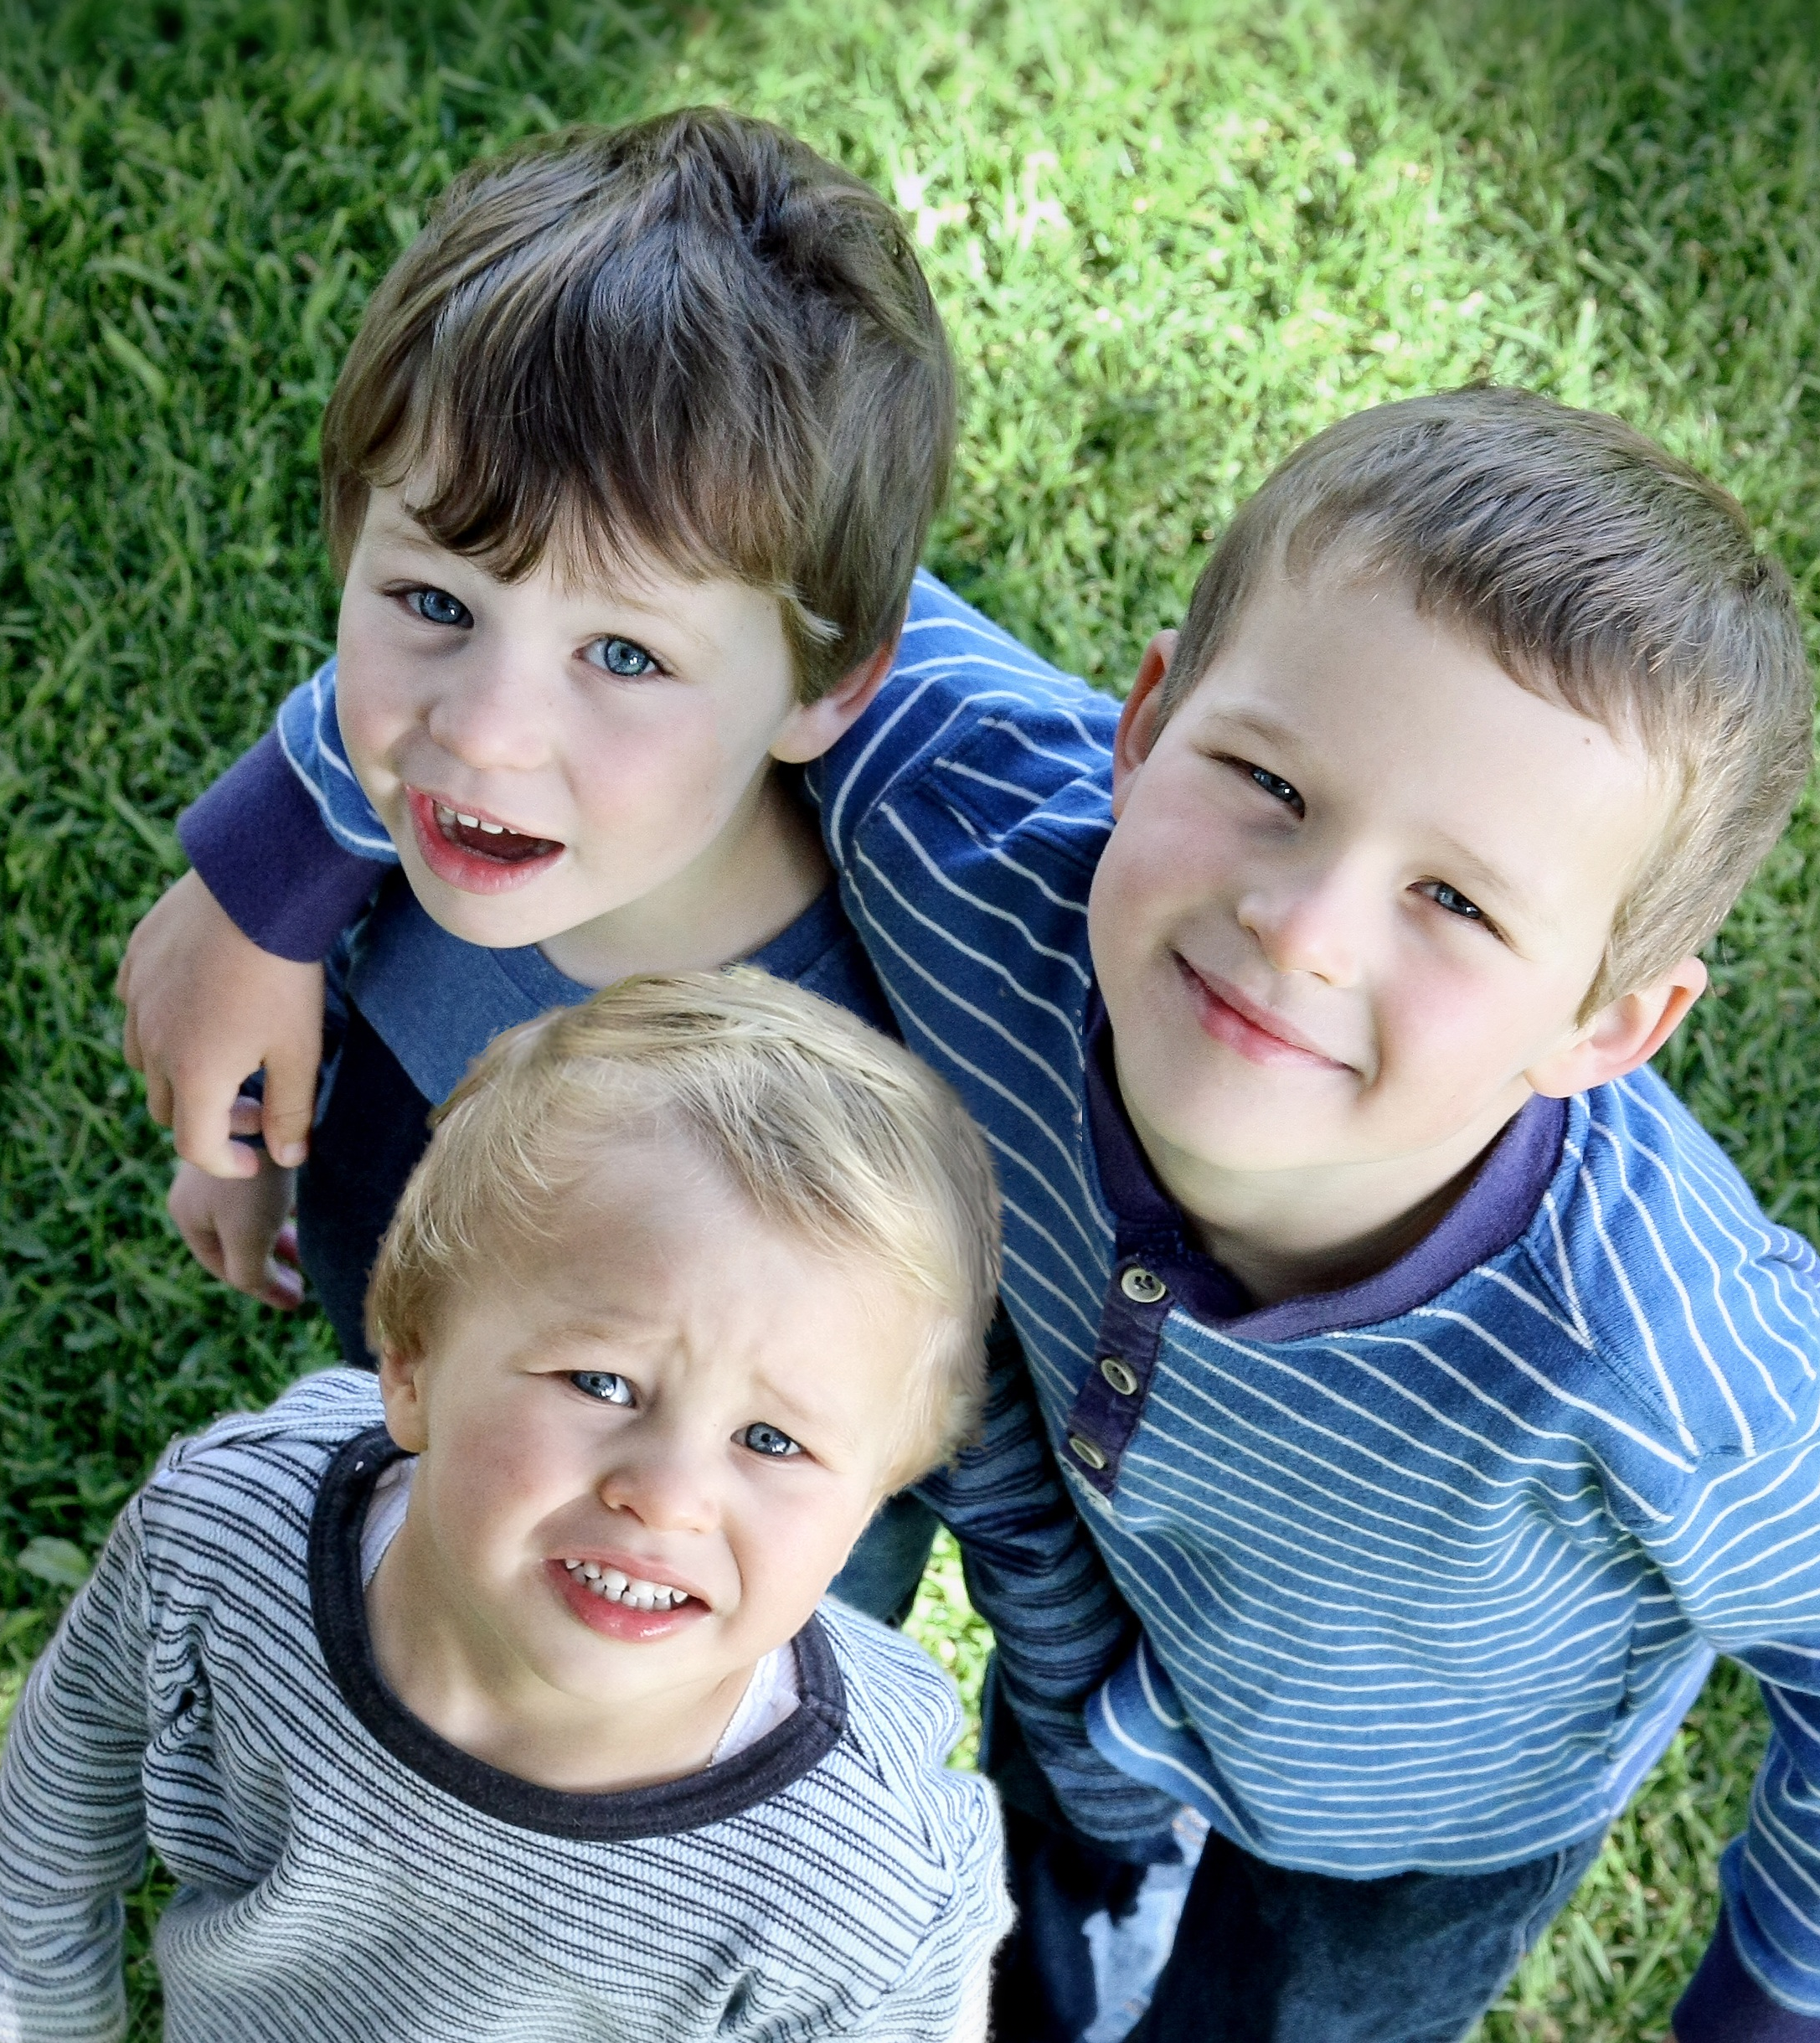
QUESTIONS
1. What are some volunteer works that are done without wage?
2. Should we make that a system that requires wage?
3. Do you think it’s okay to stop volunteer works and make everything paid?

Slide 6

ACTIVITY : Go to your fridge!
Look in your fridge and look for things you might throw away later.
https://insights-engine.refed.org/impact-calculator
↑
Jump to this site and see how much CO2 you’re providing to the earth.

Slide 7
By the way…
There are apps close to Goodr in Japan!
⇒クラダシ
https://kuradashi.jp/
⇒フリフル
https://sustainable.furifuru.com/

Slide 8

ANSWERS
Parents reading to elementary school students in the morning
Yes. All the parents who volunteered were women in my elementary school-days. I think this makes the women not being able to work on that day or arrive late to work. Maybe they were in a maternity leave but volunteered. We need to pay for these women since an opportunity cost is being incurred.
Yes. Food loss hasn’t been solved for years. Also, SDGs isn’t really working. It involves money to move things. We need to admit that nothing will change or can’t estimate how much time needed for us to help the environment and the poor.

