Slide 1

"Mamma Mia"
-Film Cast Feat. Meryl Streep
~From the musical movie "MAMMA MIA!"~
<Room 3>
Lucia Doi
Shiori Naito
Miyu Shibutani

Slide 2
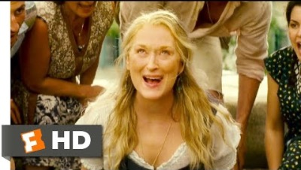
Mamma Mia - "Mamma Mia!" (2008)

Slide 3

Contents
1 - ABBA
2 - The Movie's Background
3 - The Meaning of the Lyrics

Slide 4
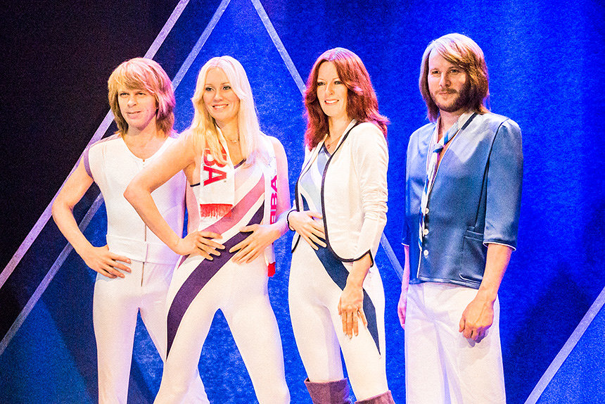
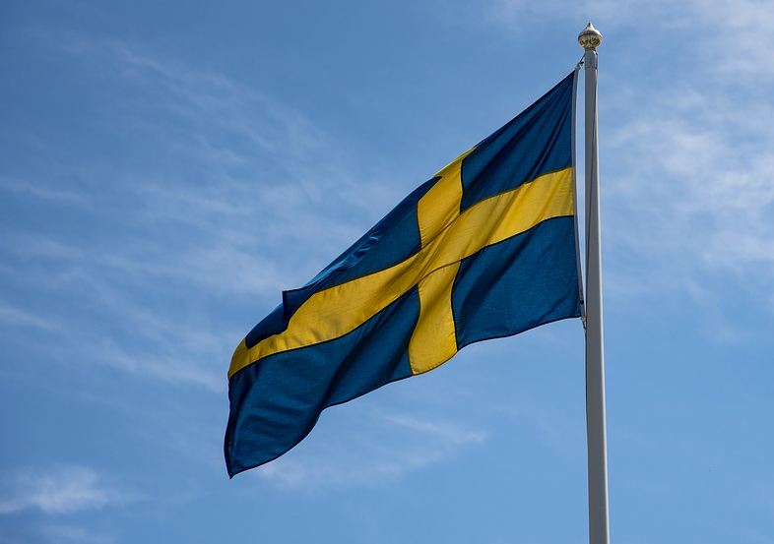

ABBA
・Swedish music group

Slide 5




a
A
B
B
A
Agnetha Fältskog
Benny Andersson
Anni-Frid Lyngstad
Björn Ulvaeus

Slide 6

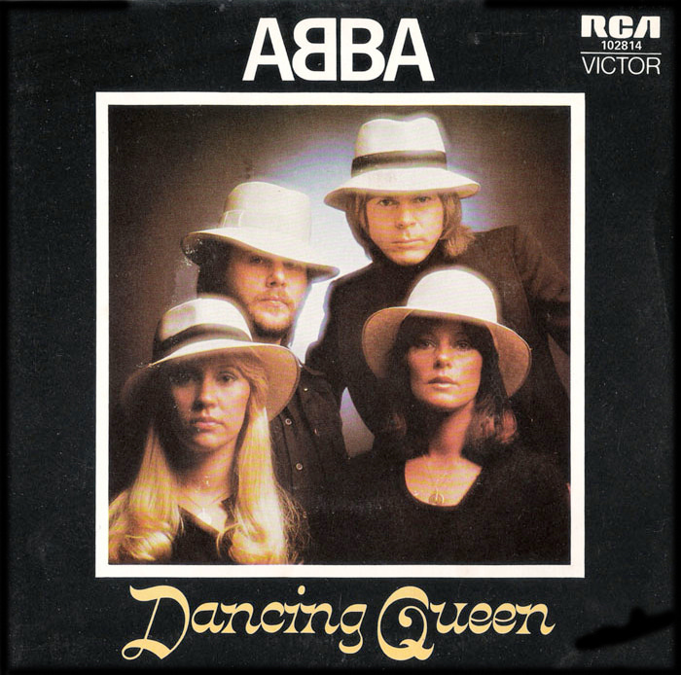
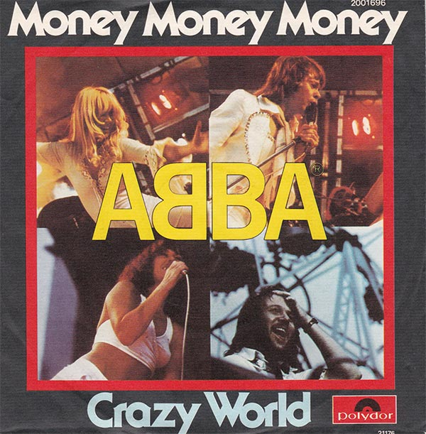
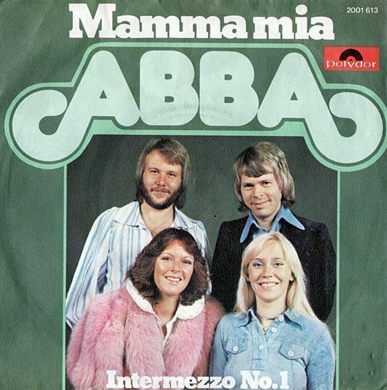
Famous songs
♪Mamma mia
♪Dancing Queen
♪Take a Chance on Me
♪Gimme! Gimme! Gimme!
♪Money Money Money
♪S.O.S.
♪Chiquitita

Slide 7


The ABBA story
1966 Björn Ulvaeus met Benny Andersson for the first time.
1969 Björn and Benny met the two women who were to become their fiancées .
1971 Agnetha Fältskog and Björn Ulvaeus were married.
1972 The group recorded a song called ‘People Need Love’. ABBA formed.
1975 Released the album ABBA. Includes blockbuster songs such as ‘SOS’,and ‘Mamma Mia’.
1978 Anni-Frid Lyngstad and Benny Andersson were married.Björn and Agnetha divorced.
1981 Anni-Frid and Benny divorced.
1982 ABBA decided to went on a hiatus.

Slide 8
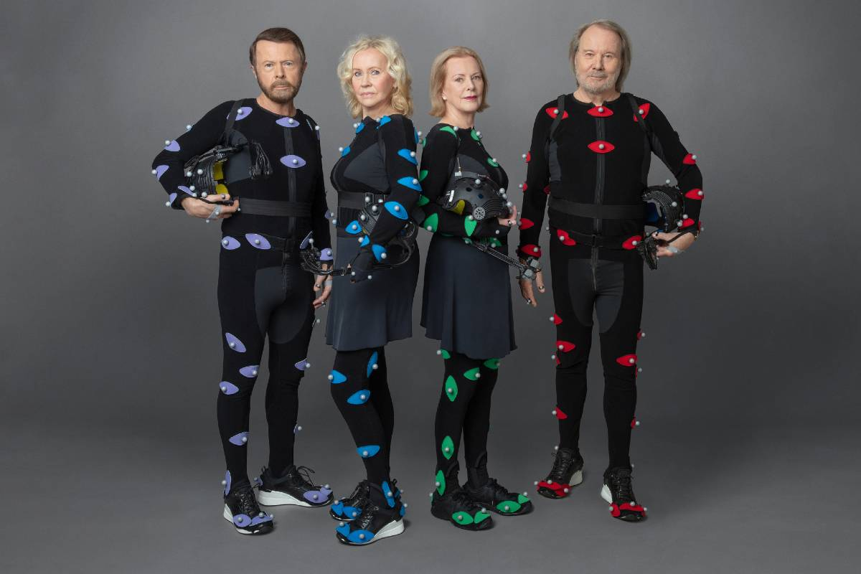
ABBA is back with 'Voyage', first new album in 40 years
ABBA has announced their first new album in four decades and said they would stage a series of virtual concerts using digital avatars of themselves in London next year.

Slide 9
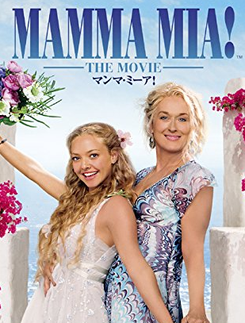
The movie’s background
About movie
・Adaptation of a musical “Mamma Mia”
・Based on ABBA’s music
・2008 jukebox musical romantic comedy
About Meryl Streep
・Meryl Streep nominated 81 times
・She has 12 awards
Meryl Streep

Slide 10

The movie’s background
Check! - jukebox musical-
jukebox: a machine that automatically
plays a selected music
when a coin is inserted.
jukebox musical: stage musical or
musical film which use
popular song,
rather than original song.
jukebox ↑

Slide 11
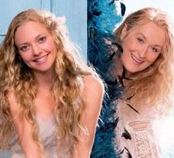
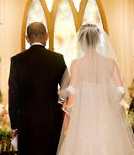
Story Scene 1
I want to walk down the aisle with my father in my upcoming wedding.
Check! - the (wedding) aisle-
aisle: a passage in a building such as a church.
daughter
（Sofy）
mother
(Donna)

Slide 12
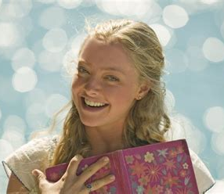
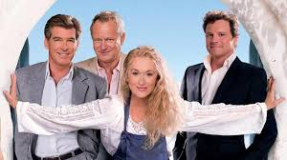
Story Scene ２
daughter
（Sofy）
←One of them is my father!
Who is my dad？
Let’s secretly invite
three man!
daughter
（Sofy）

Slide 13
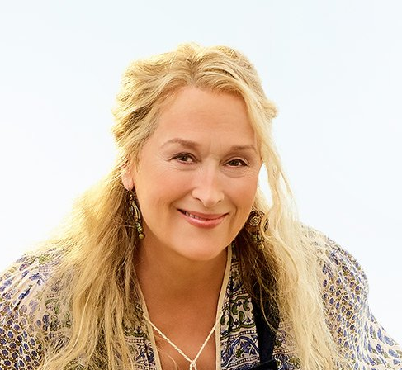
Story Scene ３
Meet!!!
mother
(Donna)
Donna sing "Mamma Mia"

Slide 14


The Meaning of the Lyrics
My boyfriend cheated on me, so I decided to leave him. [Verse]
↓
But I'm still love with him and cannot say good-bye to him [Bridge]
↓
So, what should I do? [Chorus]
She sings her feeling with upbeat, lilting music!

Slide 15
Key Expressions-1
So I made up my mind,
→ I decide to go our separate ways after much agonizing
it must come to an end
→ 'Come to an end' ; it slowly finishes
<Cf. 'End' ; it finishes suddenly>
In fact, she doesn't want to leave him, but she know it's over

Slide 16
Key Expressions-2
Just one look and I can hear a bell ring
→ My heart is throbbing violently
How can I resist you? / How much I've miss you?
→ I'm crazy about you as much as I don't care about your treachery
I cannot stop growing mad with love!

