Slide 1
My Favorite Things
- The Sound of Music -
<Room 3>
Lucia
Shiori
Miyu

Slide 2
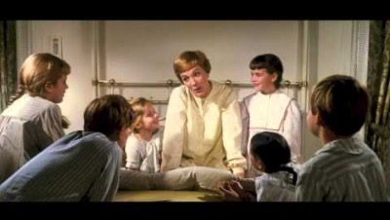
Song: My Favorite Things
[https://youtu.be/0IagRZBvLtw] “My Favorite Things” from The Sound of Music
Let’s watch!

Slide 3
Contents
1 - Story Background
2 – Gap Fill
3 – The Meaning of Lyrics
4 – Vocabulary
5 - Modern Version of "My Favorite Things"

Slide 4
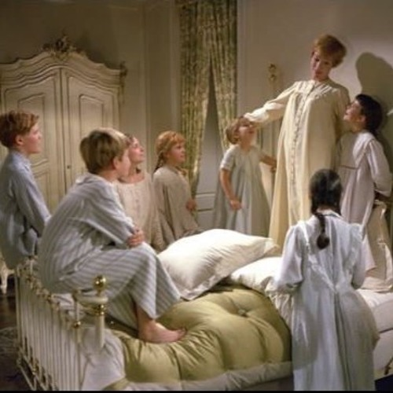
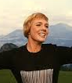
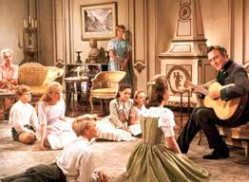
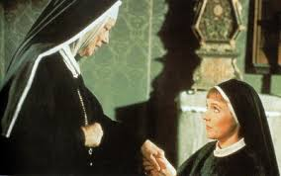

1. Story Background
4
1
・Sing “My Favorite
Things”
・Maria and the
children get to
know each other.
Maria :
・A sister
・loves singing
3
2
Colonel Trapp had lost his wife and had 7 children
Abbess told Maria to be a home tutor.

Slide 5
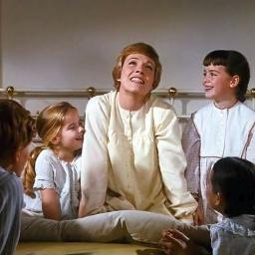
2 – Gap Fill
Raindrops on roses and ________ on kittens
Bright ________ kettles and warm woolen ________
Brown paper packages _______ ____ with strings
These are a few of my favorite things
____________ ponies and ________ apple strudels
Doorbells and sleigh bells and schnitzel with _______
Wild _______ that fly with the moon on their wings
These are a few of my favorite things

Slide 6

2 – Gap Fill
Girls in white dresses with blue satin sashes
__________ that stay on my nose and __________
Silver-white winters that ________ into springs
These are a few of my favorite things
When the dogs _______
When the bees ________
When I’m feeling sad
I simply __________ my favorite things
And then I don’t feel so bad
Let’s check the answer! ⇨⇨⇨

Slide 7
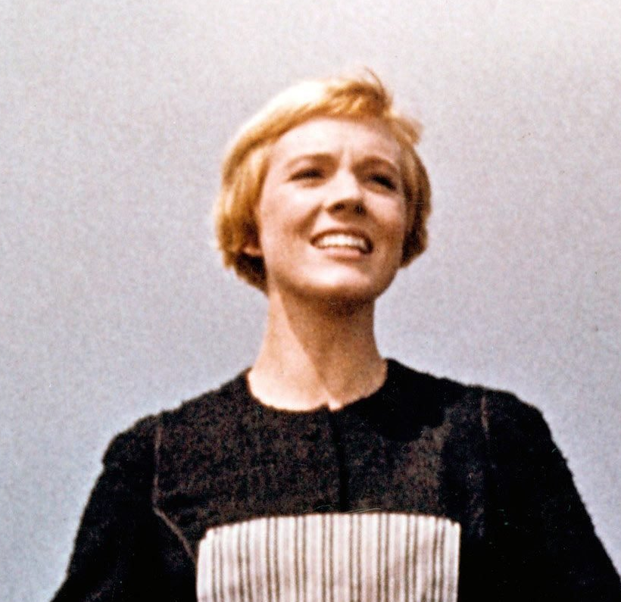
3- The Meaning of Lyrics
aa
Raindrops on roses
And whiskers on kittens
Bright copper kettles
And warm woolen mittens
Brown paper packages tied up with strings
These are a few of my favorite things
My favorite things sung in the lyrics are raindrops on roses, whiskers on kittens , warm woolen mittens,and other unique and usual things in everyday life. It doesn’t matter if it is good or bad for others. Thinking of your own favorite things will make you feel good when you are scared or sad.
👈Press this button and let’s sing together！

Slide 8
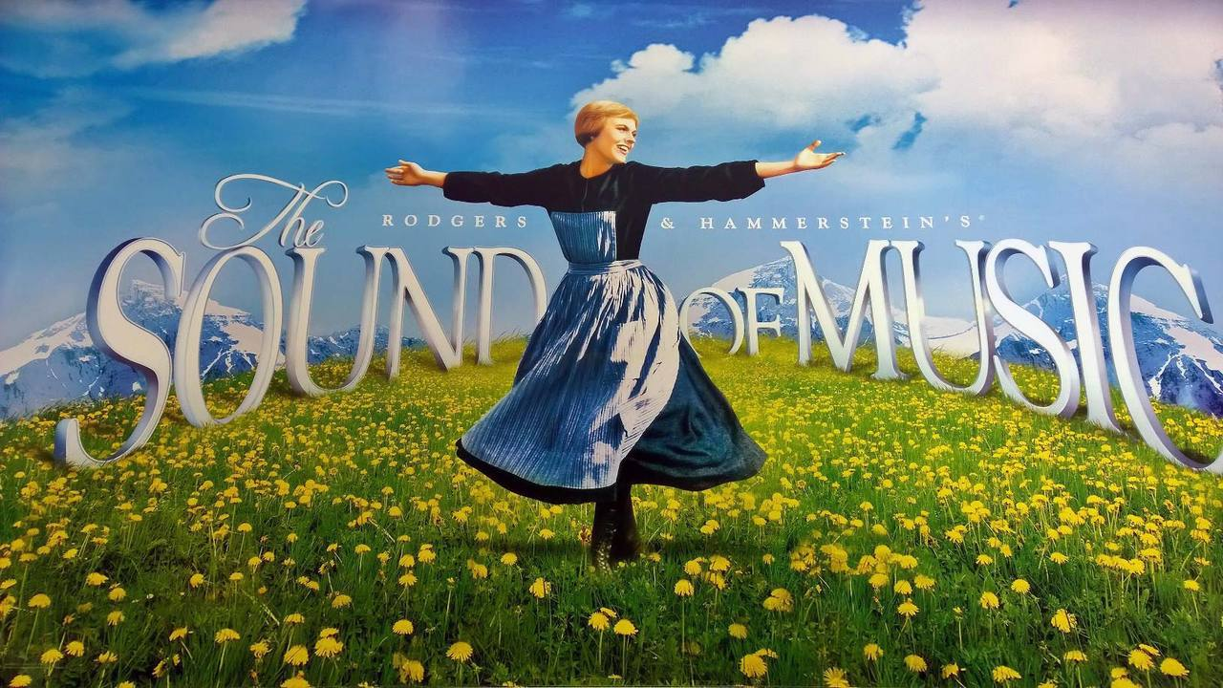
3- The Meaning of Lyrics
Cream-colored ponies
And crisp apple strudels
Doorbells and sleigh bells
And schnitzel with noodles
Wild geese that fly with the moon on their wings
These are a few of my favorite things
👆Press this button and let’s sing together！

Slide 9
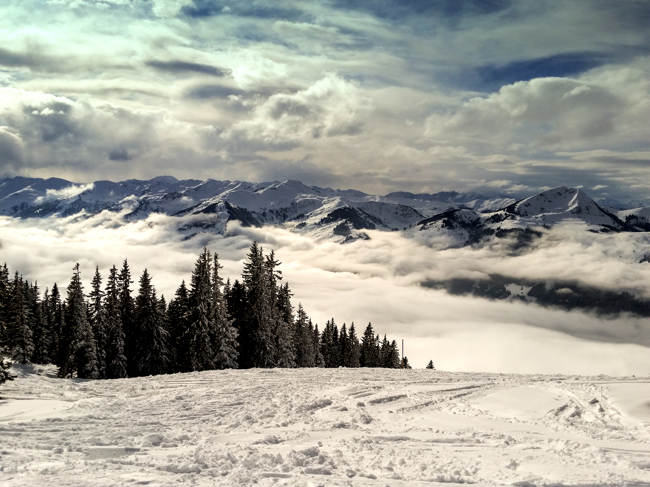
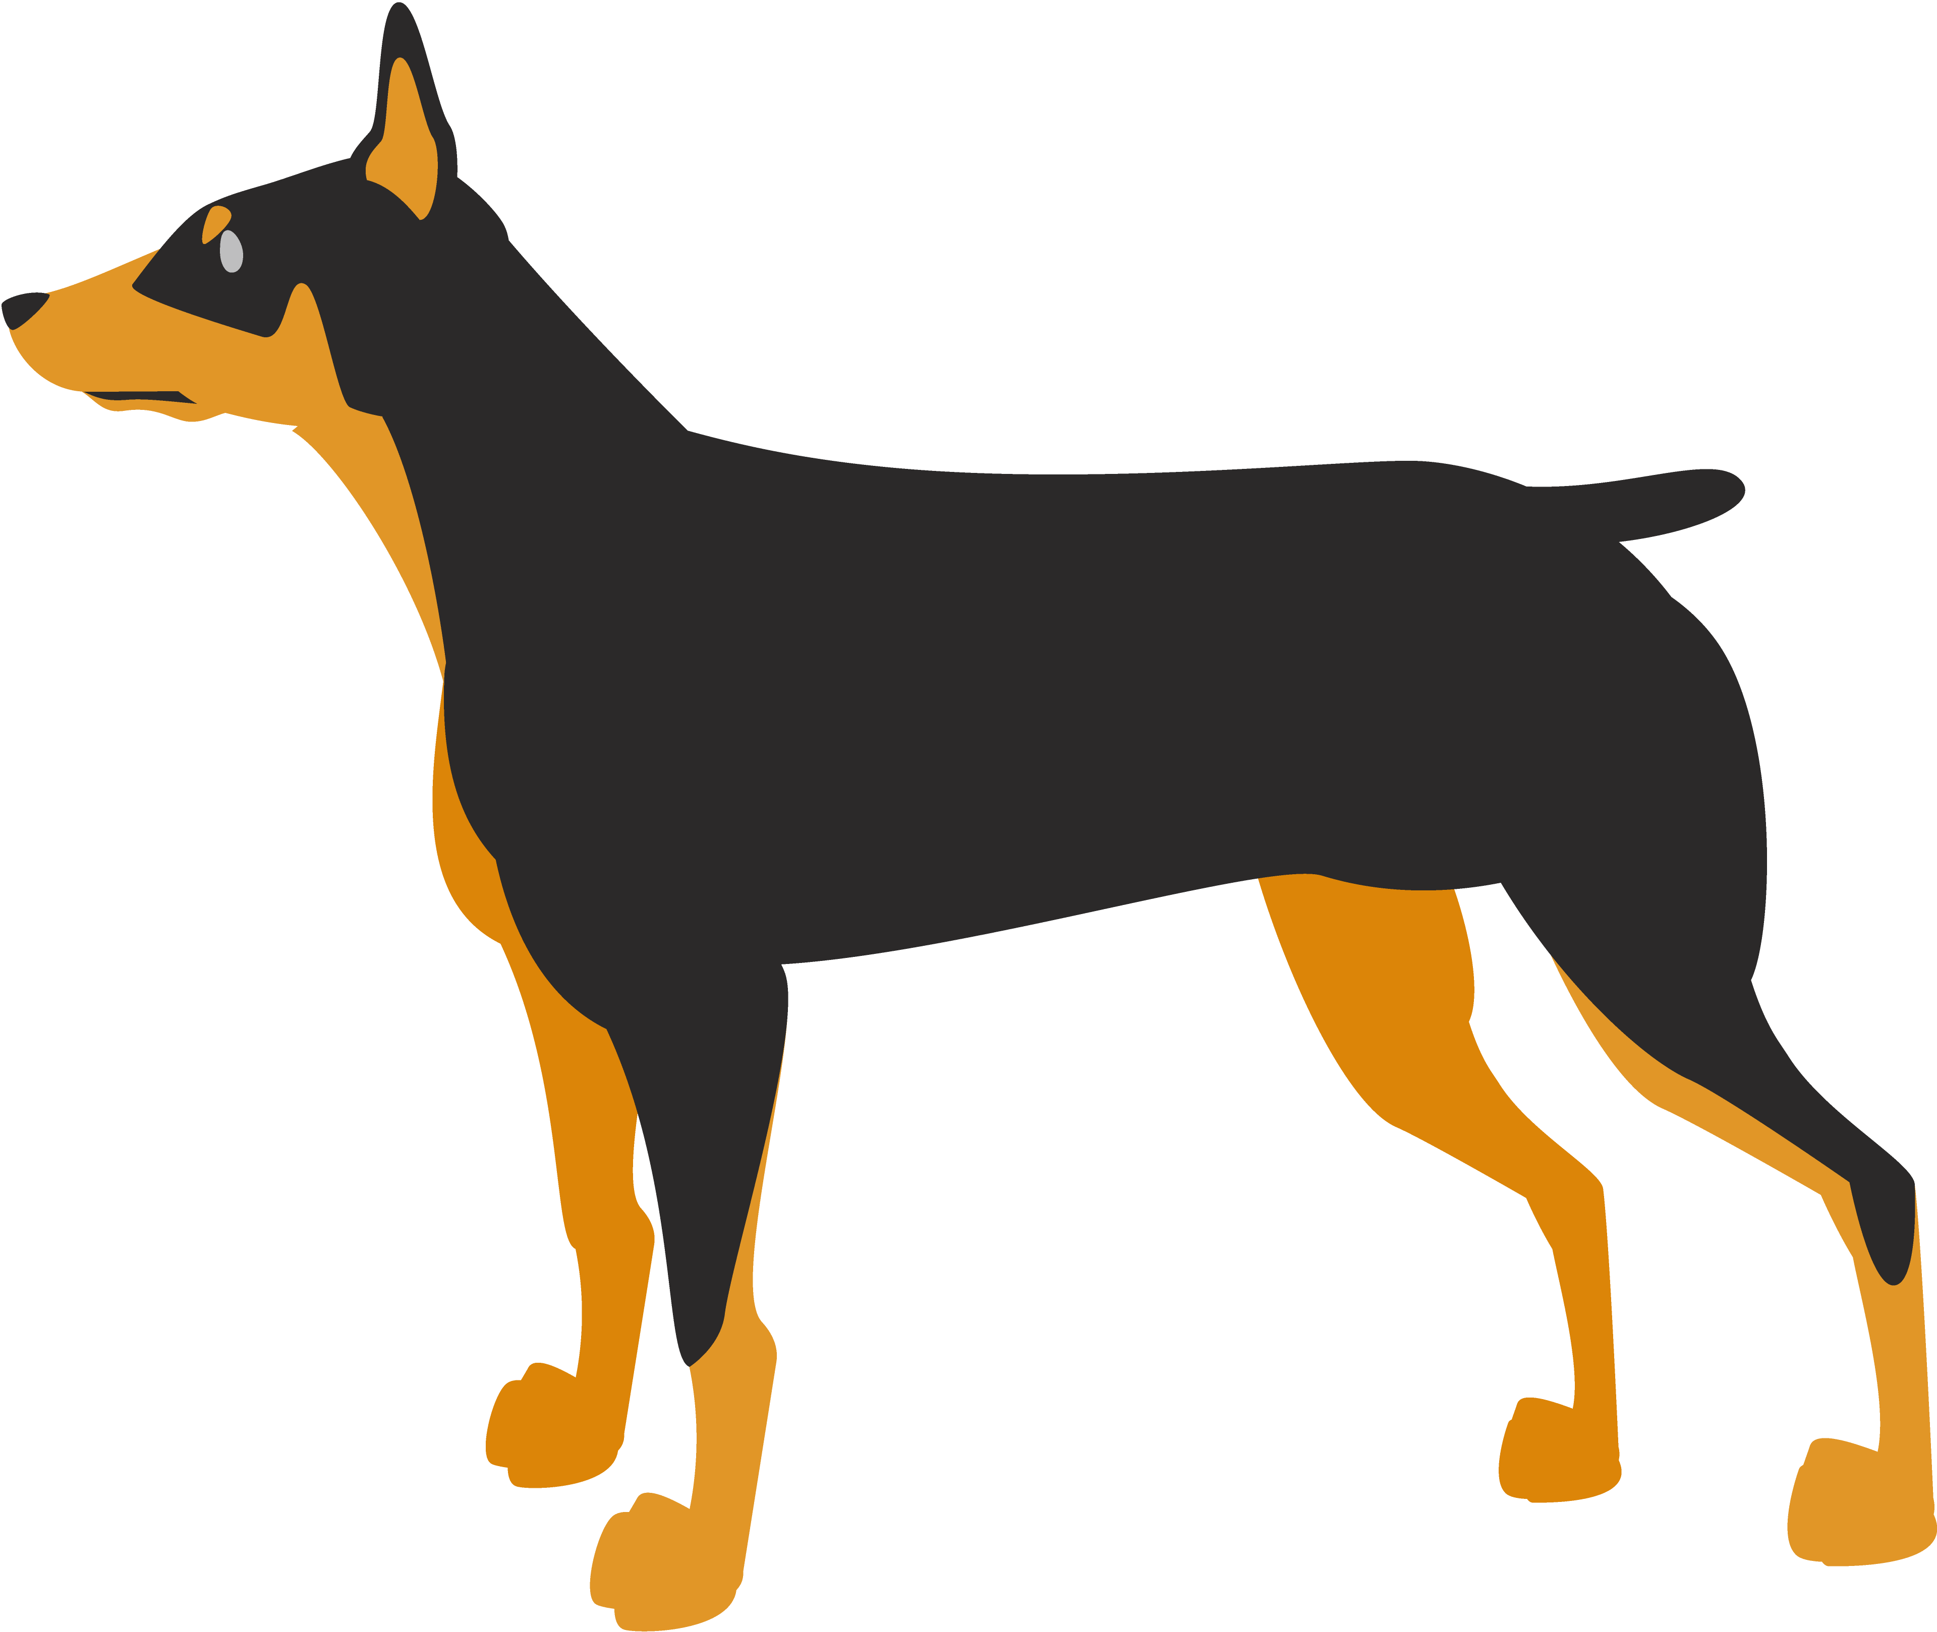
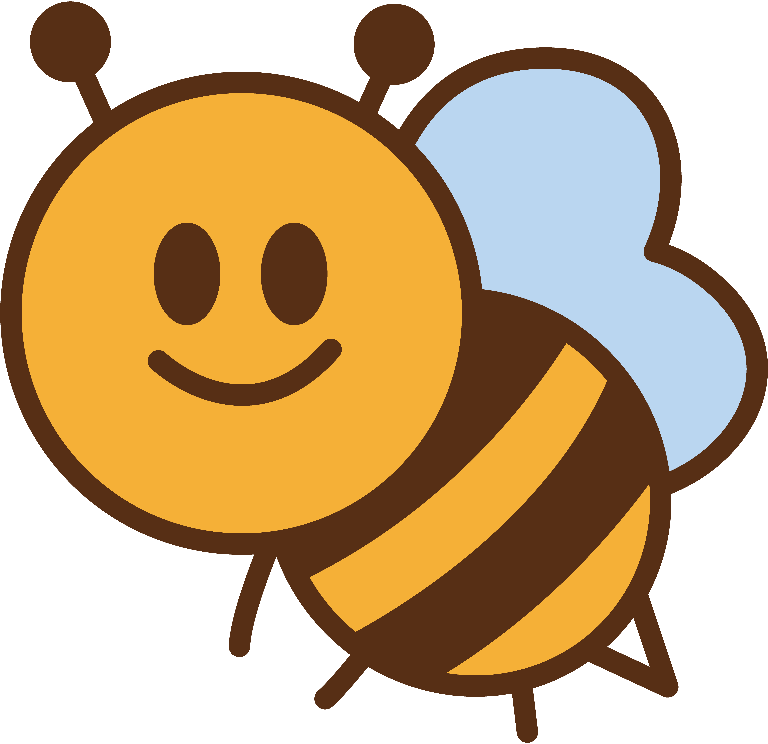
3- The Meaning of Lyrics
When the dog bites
When the bee stings
          When I’m feeling sad
I simply remember my favorite things
      And then I don’t feel so bad
Girls in white dresses with blue satin sashes
Snowflakes that stay on my nose and eyelashes
Silver-white winters that melt into springs
These are a few of my favorite things
👆Press this button and let’s sing together！

Slide 10
4 - Vocabulary
whisker
any of the long stiff hairs that grow near the mouth of a cat, mouse, etc.
copper
a soft reddish-brown metal
crisp
something that is crisp is hard, and makes a pleasant sound when you break it or crush it
geese
- the plural of goose
snowflake
- a small soft flat piece of frozen water that falls as snow

Slide 11
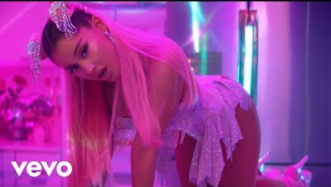
5 - Modern Version of "My Favorite Things"
7 rings / Ariana Grande (2019)

Slide 12
5 - Modern Version of "My Favorite Things"
<Comparison of original and modern version>
Original
Modern
Raindrops on roses and whiskers on kittens
Bright copper kettles and warm woolen mittens
Brown paper packages tied up with strings
These are a few of my favorite things
Breakfast at Tiffany’s and bottles of bubbles
Girls with tattoos who like getting in trouble
Lashes and diamonds, ATM machines
Buy myself all of my favorite things

