Slide 1
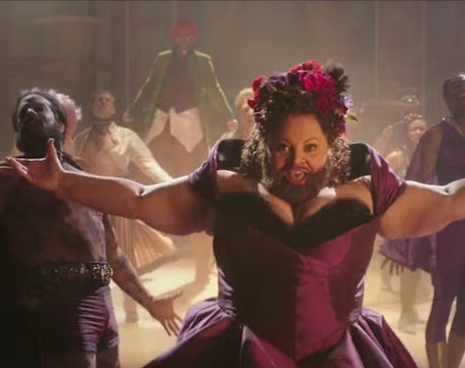

This Is Me

Slide 2

About movie
Genre… musical(1h45m)
Actors… Hugh Jackman, Zac Efron, Michelle Michaels, Zendaya

Slide 3
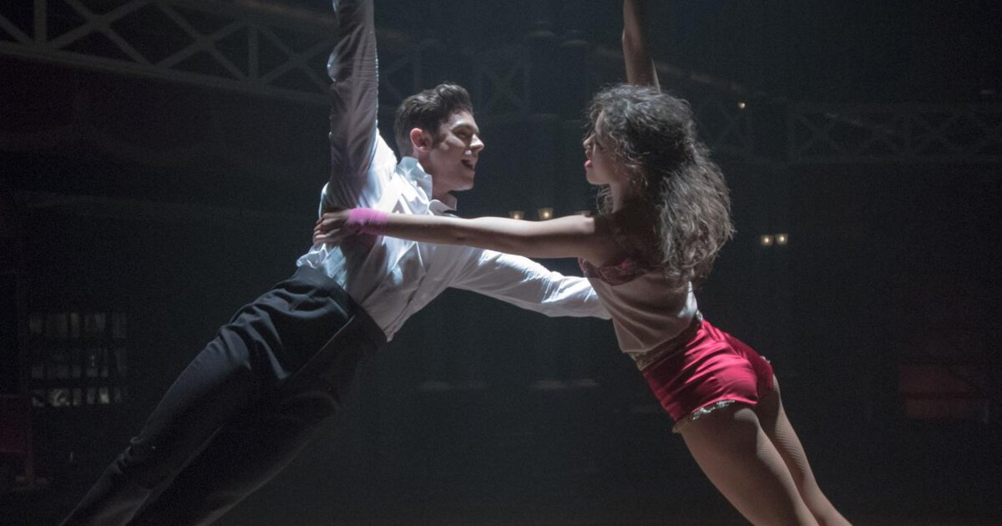
What songs in the movie?
The Greatest Show. ・From Now On
A Million Dreams
Come Alive
The Other Side
Never Enough
This Is Me
Rewrite The Stars
Tightrope

Slide 4
Songs in the movie
The Greatest Show. ・From Now On
A Million Dreams
Come Alive
The Other Side
Never Enough
This Is Me
Rewrite The Stars
Tightrope

Slide 5
This Is Me
The Greatest Showman - This Is Me Lyric Video - Bing video

Slide 6
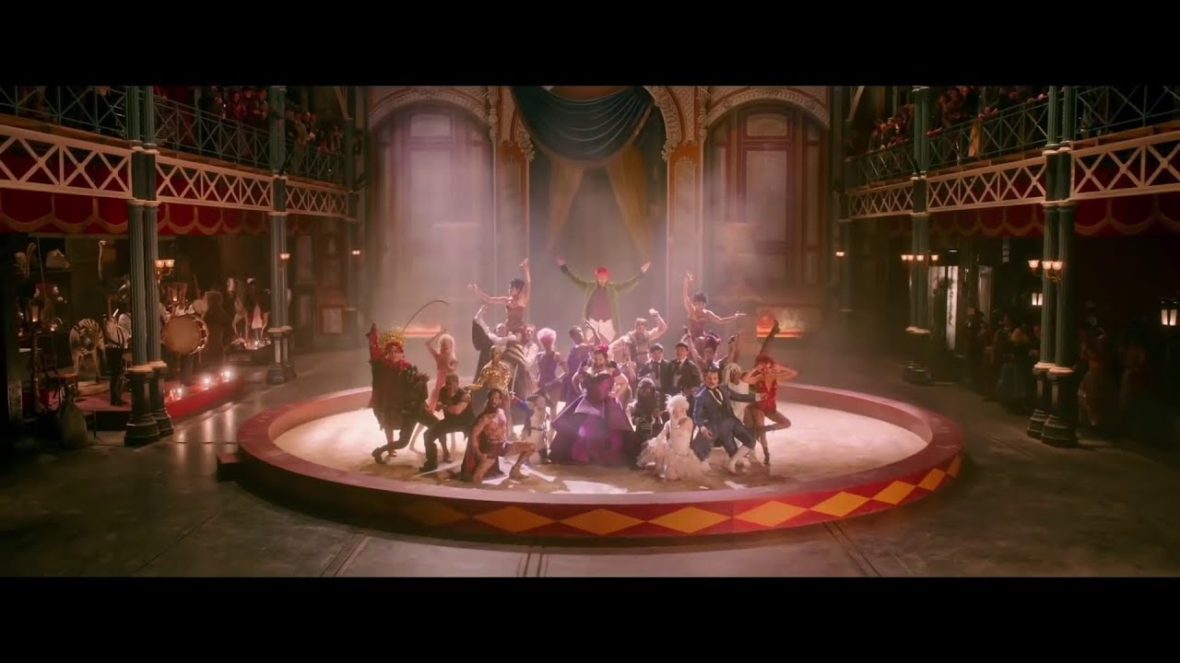
Gap feel
When the sharpest words wanna ______ me down
I‘ｍgonna send a _______, gonna drown them out
I am ______, I am bruised
I am who I‘m meant to be, This is me

Slide 7

Quiz
1. What was the woman (Letty) who sang the song being bullied for?
1. thick beard 2. obesity 3. face like a man 4. religion

Slide 8

Quiz
2. After being fired from his job and failing in the museum business, Burnham made a temporary success in show business on the advice of a certain person. Who's that?
1. daughter 2. wife 3. cousin 4. son

Slide 9

Quiz
3. the song has a strong meaning to change this appearance that has been bullied so far. ⭕️ or ❌?​
❌​
It has a strong meaning that I will be able to live my life with dignity and say, "This is me."​

Slide 10
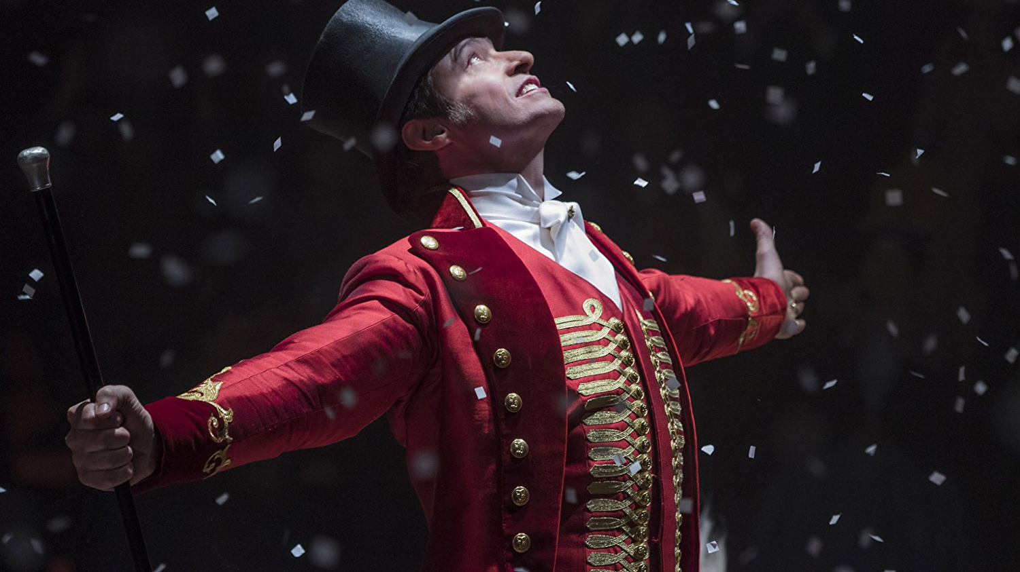
What message in this song ?
Main massage :
Have confidence in yourself!

